Slide 1
Crude Oil Production/Transportation/Processing/Refinement
AllegroDevelopment 6.0 Crude, NGL, Coal and Refined Product Training

Slide 2
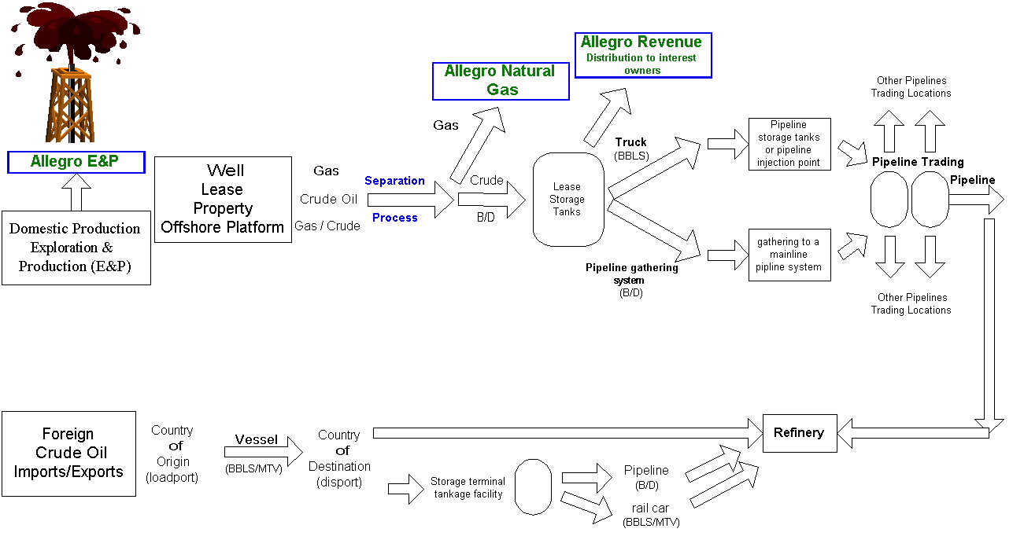

Slide 3
