Slide 1
Crestone Energy Ventures, LLC Bear Paw Energy, LLC
General Information Packet

Slide 2
Company Overview
Crestone and Bear Paw are wholly owned subsidiaries of Northern Border Partners, L.P. (“NBP”)
Crestone and Bear Paw are headquarted in Denver, CO
NBP is a publicly traded partnership, formed in 1993, with general partner interests owned by Enron Corp. and The Williams Companies, Inc.
NBP is headquartered inn Omaha, NE
NBP currently owns interests in the following assets:
70% of Northern Border Pipeline Company (“NBPL”)
100% of Crestone Energy Ventures, L.L.C.
100% of Bear Paw Energy, LLC
100% of Black Mesa Pipeline
100% of Midwestern Gas Transmission Company
100% of Border Midstream Services

Slide 3
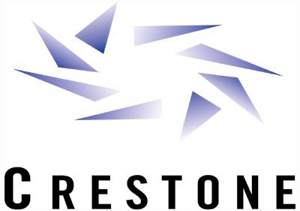
Crestone Energy Ventures, L.L.C.

Slide 4
Crestone Energy Ventures, LLC
Crestone currently owns
49% Bighorn Gas Gathering, LLC
Partnered with CMS Field Services
Gas gathering network in the northwest Powder River Basin of Wyoming
35% Lost Creek Gathering, LLC
Partnered with Burlington Resources
24” gas gathering header in the Wind River Basin of Wyoming
33% Fort Union Gas Gathering, LLC
Partnered with Western Gas Resources, CMS Field Services, Barrett Resources, Colorado Interstate Gas Co.
24” gas gathering header in the Powder River Basin of Wyoming

Slide 5
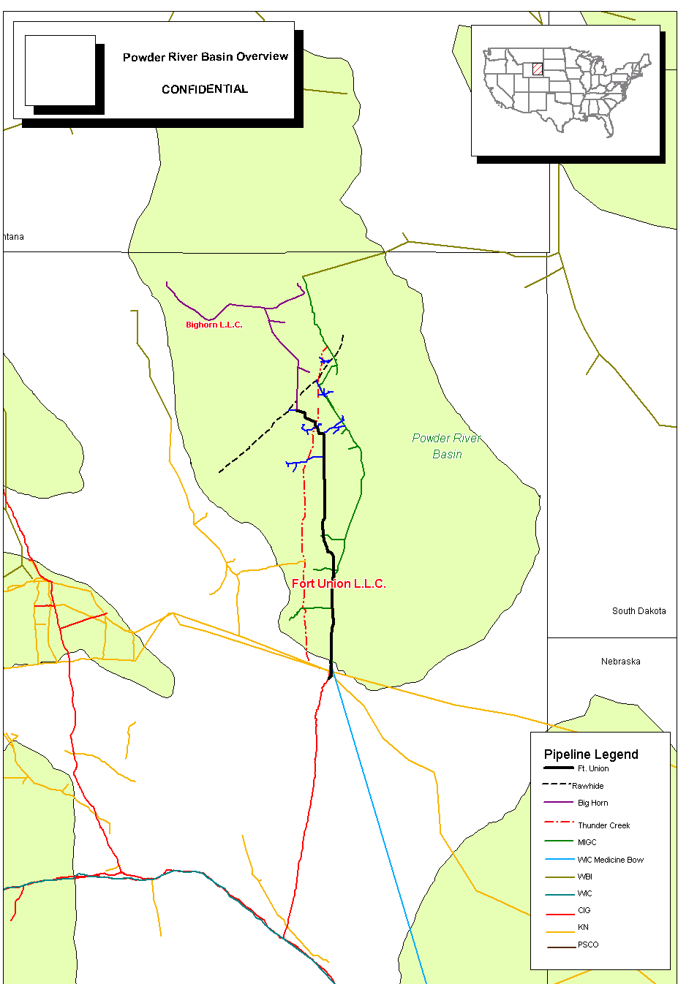
Bighorn Gas Gathering, L.L.C.
Location
Southwest of Gillette, Wyoming, to north of Spotted Horse, Wyoming, then west to Sheridan Wyoming.
Pipeline
Coal bed methane gas gathering
Pipe
24-inch, 20-inch, 16-inch, 10-inch and 8-inch
Length
90-miles
Compressor Stations
12
Compressor Station horsepower
1,200
Current Capacity
Capable of gathering 250 MMcf/d* of coal bed methane gas.
Bighorn Gas Gathering

Slide 6
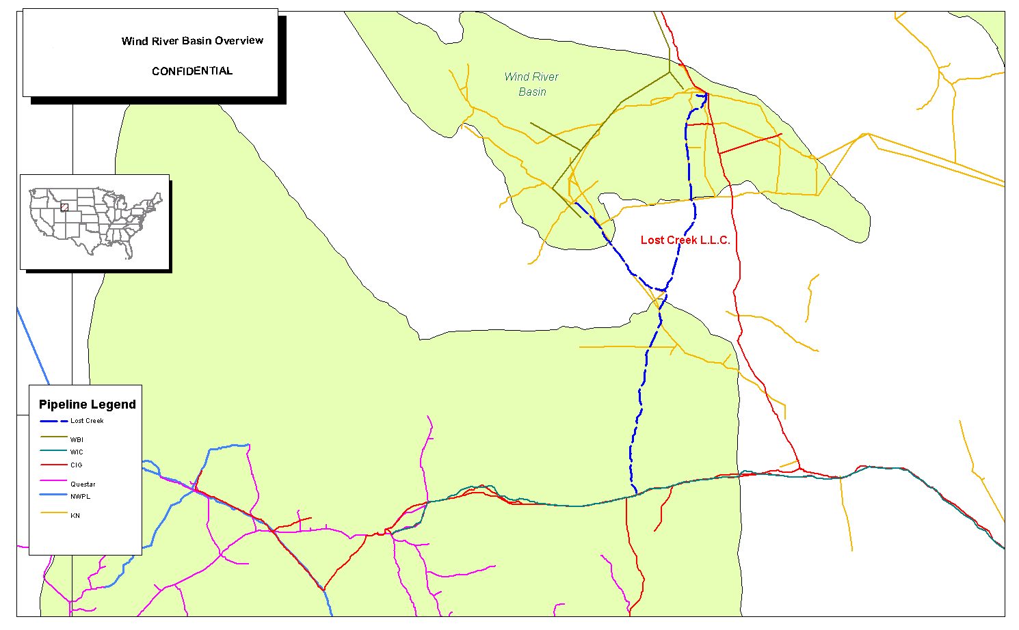
Lost Creek Gas Gathering, L.L.C.
Location
Extends south from the Madden Field in the north central Wind River Basin to a point near Wamsutter, Wyoming.
Pipeline
Conventional gas gathering
Pipe
24-inch main line gathering header
12-inch lateral
Length
120 miles of main line gathering
39 mile gathering lateral
Compressors/Processing Plant
2 / 275 MMcf/d
Compressor Station Horsepower
5,800 horsepower of
electric compression
Current Capacity
171 MMcf/d
Operating Pressure
Maximum allowable operating pressure (MAOP) is 1,310 psig
Currently operates between 800 & 1,000 psig

Slide 7
Fort Union Gas Gathering, L.L.C.
Location
Extends south from the Gillette, Wyoming area to a point near Glenrock, Wyoming.
Pipeline
Coal Bed methane gas gathering
Pipe
24-inch main line gathering header
Length
103 miles of main line gathering
Current Capacity
634 MMcf/d
Operating Pressure
Maximum allowable operating pressure (MAOP) is 1,440 psig
Currently operates between 1,200 & 1,350 psig

Slide 8
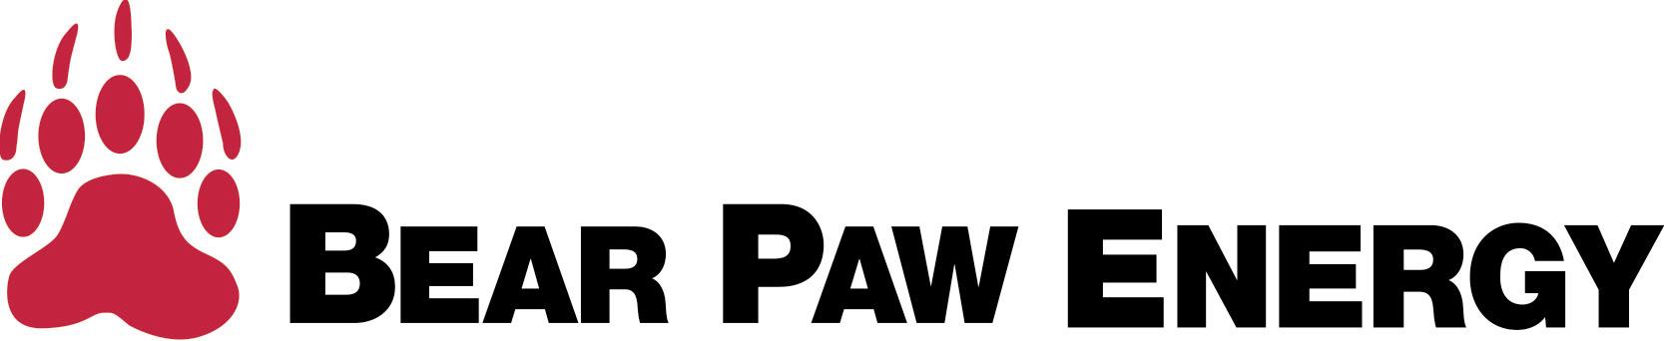

Slide 9
Bear Paw Energy, LLC
Bear Paw currently owns and operates
10 wellhead gathering systems in the Powder River Basin
Provides fee-based gathering services
4 gathering and processing facilities in the Williston Basin of Montana, North Dakota, and Saskatchewan
Provides gathering, processing, and treating services for a percent of the NGL and residual gas proceeds and/or a volumetric fee basis

Slide 10
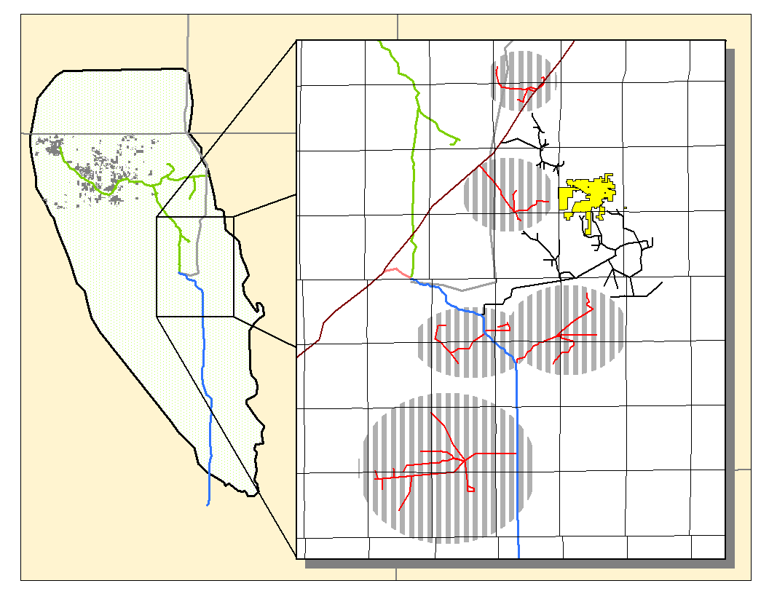
Powder River Basin Gathering
Facilities
Powder River Basin (PRB) in Wyoming
~300,000 acres under dedication
Currently Gathering 210 MMcf/d
Crestone Box Draw
Bear Paw Prairie Dog
Bear Paw North Gillette
Crestone South Kitty
City of Gillette
Bear Paw GAP
Bear Paw Bonepile
Crestone Hoe Creek
Crestone Caballo
Crestone House Creek
Crestone Clydesdale
Crestone Kudzu

Slide 11
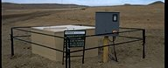
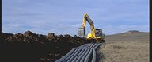
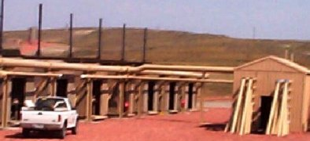
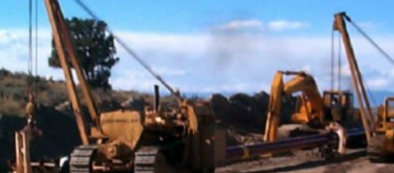
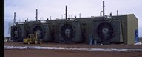
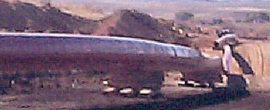
Powder River Basin Gathering
547 producing wells
535 mi. low pressure gathering
58,884 hp screw compressors (102 Units)
35 mi. intermediate gathering
57,737 hp recip compression (36 Units)
25 mi. high pressure pipeline

Slide 12
Williston Basin Midstream
Facilities
Williston Basin (WB) in Montana, North Dakota and Saskatchewan
2800 miles of gathering system in WB
4 Processing facilities with 90 MMcf/d capacity in in WB
Steelman
Canada
Montana
Tioga
Lignite
Grasslands
Montana
No. Dakota
Baker
North Dakota
Williston
Basin
Marmarth
So. Dakota
Wyoming
Nebraska

Slide 13
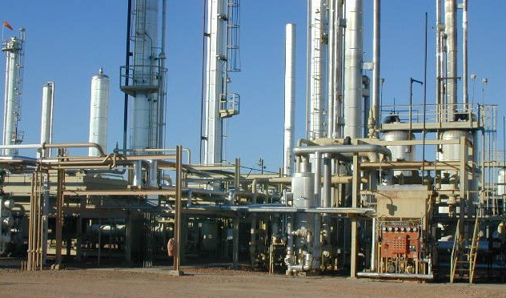
Williston Basin Midstream -- Grasslands
Plant Type Cryogenic/Frac/SRU-Clause
Compression 35,630 HP; 49 units
Miles of Pipe 2,582 miles gas; 18 miles liquid
Storage Capacity 23,162 Bbls
Capacity 75 MMSCFD
Residue Pipes WBI & Northern Border
Major Suppliers Aviara, Burlington, Conoco, Exxon, Duncan, Westport
Liquid Shipped Truck & Rail Car
Product Handled Natural Gas Residue, Propane, IsoButane, Normal Butane, Gasoline, Condensate, Sulfur

Slide 14
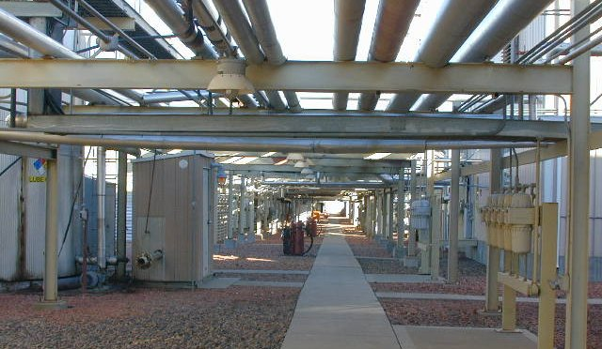
Williston Basin Midstream -- Lignite
Plant Type Cold Oil Absorption/SRU-Clause
Compression 3,475 HP; 4 units
Miles of Pipe 166 miles gas; 0 miles liquid
Storage Capacity 9,471 Bbls
Capacity 7.5 MMSCFD
Residue Pipes WBI
Major Suppliers Burlington, JN Operating, CamWest
Liquid Shipped Truck & Rail
Product Handled Natural Gas Residue, Propane, Butane, Gasoline, Condensate, Sulfur

Slide 15
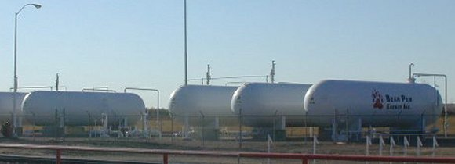
Williston Basin Midstream – Baker & Marmarth
Plant Type Refrigeration
Compression 3,930 HP; 7 units
Miles of Pipe 88 miles gas; 0 miles liquid
Storage Capacity 10,095 Bbls
Capacity 11 MMSCFD
Residue Pipes WBI, Colorado Interstate
Major Suppliers Burlington, Private Oil, Encore
Liquid Shipped Truck
Product Handled Natural Gas Residue, Propane, Butane, Gasoline, Condensate, NGL Mix

Slide 16
Summary
Northern Border Partners, L.P.
Experienced management team with sound operating and financial strategies and successful track record.
World-class general partners, Enron Corp. and The Williams Companies, Inc.
Modern, efficient and strategically located assets position NBP for continued strong performance and growth.
Conservative approach to commodity price risks.
Stable and consistent cash flows to service debt and support distributions.
Strong, consistent and sustainable performance provides flexibility to balance growth initiatives with conservative financial policy.
Excellent balance sheet, consistent earnings growth, and reliable cash flow coverage.

