Slide 1
Credit Trading
RAC - Risk Assessment & Controls
Update - September 2001

Slide 2
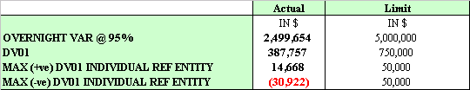
Credit Trading Book
The core product of the business unit is ‘creating synthetic credit’ and ‘credit derivatives’.
Instruments currently on the trading book include:
Credit default swaps
First-to-default basket trades
Bankruptcy Swaps
Synthetic CDO’s
Bonds
Total Return Swaps / Asset Swaps
Repos
Equities
High yield / Distressed debt
Gross trading revenue for the year (2001) as of 17th Aug = $19.56mm
Market Risk Limits
The book is currently in ‘Net Positive Carry’ = approx. +$29K/day.

Slide 3
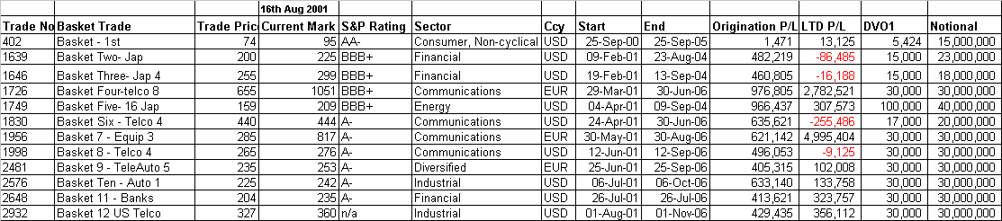
First-to-Default Basket Trades
12 trades on the book since the start of the business unit
In all instances, Enron Credit has gone Long First to Default protection
Notional Gross and Net exposure = approx. USD317mm
P/L as of 17th Aug. on these trades = USD8.7mm (not including hedge p/l)
Single names CDS’s have been sold against these to hedge the basket.
Names that are of concern: Marconi, KPN, Alcatel and Ericcson.

Slide 4
Portfolio Trades (Synthetic CDO’s)
Four portfolio trades on the book (one is a straight pass through, so no market risk - CNA/Citibank)
These trades account for most of the P/L reported to date
Notional exposure on the tranches is just over USD2.8bn (excluding the first loss piece retained by Enron)
Equity tranche (first loss) retained across all trades = USD112.50mm
YTD P&L as of 17th Aug = USD24.3mm
There has been one default. Comdisco Inc. in the ISIS Portfolio has recently been triggered. This is beneficial since EnronCredit did not sell the single name CDS, therefore, the credit event will help eat through the equity (first loss tranche). It should be noted that the USD17.5mm (A2) mezzanine piece that sits on top of the first-loss of $52.5mm, only contains 96 names - and Comdisco Inc. is not one of them.
Portfolio ‘THEBES’ - repackaging of the equity tranches (to be completed in Q3’01)

Slide 5
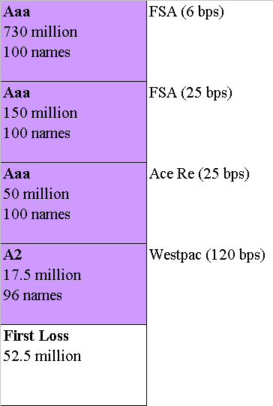
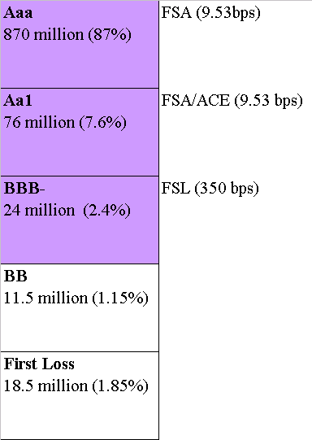
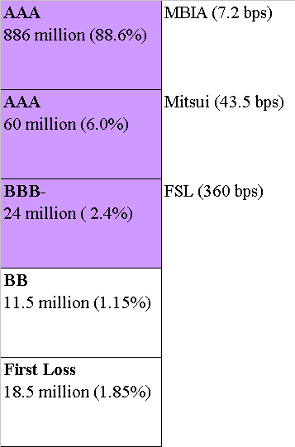
Portfolio Trades (Synthetic CDO’s)
ISIS
RA
OSIRIS

Slide 6
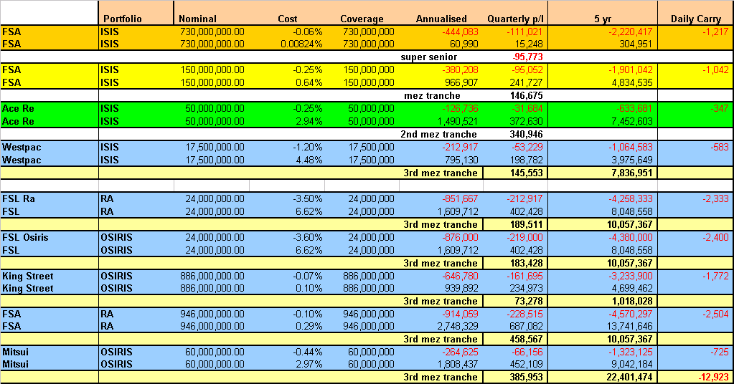
Summary of Tranches
as of 17th Aug. 2001

Slide 7
Analytical Risk Analysis
VaR
Historical prototype with basic total VaR completed end of month
Other more detailed analysis completed as year goes on
Research performing analysis on Monte Carlo methodology
Correlation Sensitivity
Perform revaluation of CBO’s and first to defaults using a range of correlations
Impact on P&L could be basis for ‘correlation reserve’
Equity ‘efficiency’
CBO valuation model can be adjusted to give information about the probability of ‘shorted’ CDS’s eating into equity tranche
Accuracy of results dependent upon ability to match CDS’s to CBO hedges
Overall project time 2 weeks once VaR model completed

Slide 8
Analytical Risk Analysis (Cont)
Create New Risk Metrics For Limits
Ideas include concentration limits
Market signals that provide early warning to senior management
Curve Construction Review
Liase with Research to examine the construction of the default curves from CDS prices
Currency/Interest Rate Effects
Consider the impact of FX in the credit portfolios: default creation, underlyings in basket trades with mixed FX exposures
Review Of New York Operations (Project Doorstep)
Visit operations in NY and define the processes by which they operate
Produce process documentation with help of Arthur Andersen / Accenture

Slide 9
Other things………..
Documentation Basis Risk
Risk Review
RiskTrac

