Slide 1

A Comprehensive Online Community for the Credit Markets
April 10, 2001

Slide 2
Introduction
Analytic Tools
Data
Web Site Page Views
Rollout Schedule

Slide 3
CreditDimensions is an ASP-based community that provides leading credit risk management solutions to financial institutions
CreditDimensions is a joint effort between PwC and leading credit risk vendors and institutions
CreditDimensions offers enabling infrastructure in four primary categories:
Counterparty Data
Credit Risk Analytics
Credit and Market Data
Credit Content
CreditDimensions integrates the services provided across the four categories
CreditDimensions provides the foundation for credit process reengineering
CreditDimensions will facilitate the comparison of model outputs

Slide 4
CreditDimensions - the Solution
CreditDimensions is an aggregator of leading credit risk solutions and enables development of advanced credit risk infrastructures
Current Problem
Core Products
Maintaining counterparty data costs up to $5 million per year, and $10 million for a one-time cleanup
Counterparty
Data
Analytic models require considerable implementation costs and resources, often limiting users to a single model
Analytics
CreditDimensions Enabling Infrastructure
Credit
Data
Credit data is not readily available, slowing analysis
Credit news and information is available from a myriad of sources and is not effectively delivered to end users
Content

Slide 5
CreditDimensions offers immediate value to subscribers in a number of ways
Provide one-stop shopping for risk management professionals
Facilitates transparency within the credit markets via clean and consistent hierarchical counterparty data
Facilitates aggregation of counterparty exposure
Provides a variety of analytical tools to subscribers
Provides the option to rent or lease rather than buying and implementing software
Enables consistent and efficient credit analysis, reducing credit costs
Reduces initial IT investment and maintenance by sharing costs across the community

Slide 6









Core Contributors
Credit Suisse First Boston
Bureau van Dijk
creditex
KMV
RiskMetrics Group
Algorithmics
Gifford Fong Associates
Moody’s
Standard and Poor’s
eCredit.com
Cygnifi
Product
Counterparty Data
Counterparty Data
Credit Default Swap prices
Analytic Risk Models
Analytic Risk Models, Credit Data
Analytic Risk Models
Analytic Risk Models
Credit Data, Ratings, Risk Models
Credit Data, Ratings, Risk Models
Credit Analysis Process Engine
Counterparty Risk Management Tools

Slide 7
Introduction
Analytic Tools
Data
Web Site Page Views
Rollout Schedule

Slide 8
Present and Future Core Contributors Will Offer Multiple Analytical Tools:
Credit Risk
Assessment
Portfolio Analysis
Pricing / Valuation
KMV Credit Monitor
KMV Private Firm Model
KMV CreditEdge
Algorithmics
Algo Credit eValuator
CSFB CreditRisk+
Gifford Fong
Credit Default Swap
Calculator
Moodys RiskCalc
(Public and Private Firm)
KMV Portfolio Manager
S&P’s CreditModel
RiskMetrics CreditManager
Cygnifi
Trading / ECN
Creditex

Slide 9
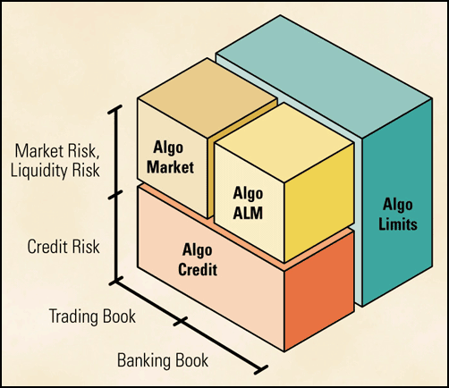
Algorithmics
Website: www.algorithmics.com/index.html
Algo Credit eValuator (ACV)
As the newest component of Algo Credit, ACV is a break-through decision-support application designed to substantially enhance risk-adjusted lending profitability. Developed by leading experts and financial engineers, ACV supports sophisticated pricing and valuation of loans, bonds and credit derivatives, including:
Front-office origination decision-support,
Middle-office credit trading,
Middle-office batch mode mark-to-market, and,
Integration with Algo Credit and Algo's portfolio credit risk solution -- PCRE
Notes:
Algorithmics was founded in 1989 in response to the complex issues surrounding financial risk management for the enterprise. Today, as the leading provider with the largest and most experienced team in the industry, Algorithmics continues to focus its efforts on creating and implementing enterprise-wide risk management software that meets the evolving needs of its customers. Continuing its tradition of leading the way in risk measurement and management tools and processes, Algorithmics recently introduced Mark-To-Future™ (MtF), an open and comprehensive framework for measuring risk and reward. Algorithmics’ product capabilities in Credit Risk are substantial, including, Algo Limits, Algo Collateral and the Algo Credit suite of solutions. Algo Credit eValuator (ACV), an advanced credit valuation application for pricing and valuing credit instruments is the newest capability to join this solution set. Headquartered in Toronto, with 15 offices around the world, Algorithmics serves more than 100 global financial institutions with 140 installations worldwide.

Slide 10


Website: www.creditex.com
creditex is a market-supported, Internet-based transactional and informational platform designed to meet the needs of the global over-the-counter (OTC) credit derivatives market. Founded and staffed by credit derivatives professionals, creditex has designed and developed its transactional and informational systems with significant feedback and involvement from market participants in North America and Europe.
Our mission at creditex is to provide liquidity, standardization and transparency to the credit derivatives markets. To accomplish our goals, we have used Internet technology to build a virtual marketplace for the credit derivatives community to promote the market's efficiency and growth. We continue to refine and improve our services with feedback from our clients.

Slide 11

Website: www.csfb.com/creditrisk/
CREDITRISK + is based on a portfolio approach to
modeling credit default risk that takes into account
information relating to size and maturity of an
exposure and the credit quality and systematic risk
of an obligor.
The CREDITRISK + Model is a statistical model of credit
default risk that makes no assumptions about the
causes of default. This approach is similar to that taken
in market risk management, where no attempt is made
to model the causes of market price movements. The CREDITRISK + Model considers default rates as
continuous random variables and incorporates the volatility of default rates in order to capture the uncertainty in the level
of default rates. Often, background factors, such as the state of the economy, may cause the incidence of defaults to be correlated, even though there is no causal link between them. The effects of these background factors are incorporated into the CREDITRISK + Model through the use of default rate volatilities and sector analysis rather than using default correlations as explicit inputs into the model.
CREDITRISK⁺
Notes:
Credit Suisse First Boston is a leading investment banking firm, providing comprehensive financial advisory, capital raising, sales and trading, and financial products for users and suppliers of capital around the world. It operates in more than 60 offices across more than 30 countries and has more than 25,000 employees.

Slide 12
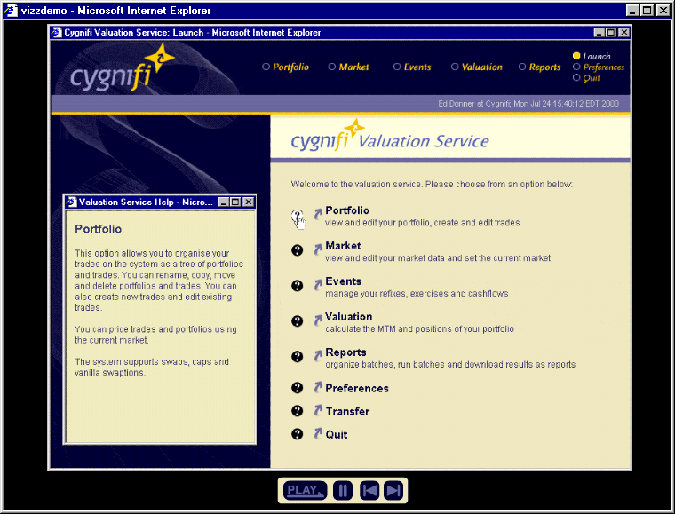
Website: www.cygnifi.com
In the past, only leading financial institutions had the sophisticated technology and skills to manage their derivatives businesses effectively.
Now Cygnifi unlocks this proprietary expertise.
Our capabilities were developed and proven at one of Wall Street's premier derivatives houses and our team includes the people who designed and implemented them. We offer financial institutions, asset managers and corporations a broad array of capabilities previously unavailable or unaffordable. We deliver pre-trade pricing, independent portfolio valuation, counterparty credit and collateral risk management services.
Notes:
Founded in February 2000, Cygnifi.com is an independent online derivatives services provider for the financial community and corporations. Cygnifi, a JP Morgan spin-off, offers easy access to sophisticated derivatives risk management capabilities as a state-of-the-art application service provider (ASP) to traders, asset managers, risk managers, corporate treasurers, and other professionals. Covering both market and credit risk, Cygnifi's on-line tools and services for pre-trade pricing, independent portfolio valuation, counterparty credit, and collateral risk management is offered to customers via subscription. Cygnifi also improves the control, transparency and understanding of the marketplace by offering access to trained professionals that can help subscribers analyze and value their portfolios Cygnifi is headquartered in New York City, with additional operations in London and Tokyo. For more information, please visit www.cygnifi.com.

Slide 13

Website: www.gfong.com
RISKVAL
RISKVAL is our newest generation of derivative product valuation and analysis software. A wide range of types is covered including interest rates, equity, currency and commodity deal structures. RISKVAL is a component based system using the latest design features and three dimensional graphics
Notes:
Gifford Fong Associates (GFA) provides consulting services and proprietary analytical tools to the financial and legal communities. Our services include the analyses of derivative products, fixed-income portfolios, asset allocation models and credit analysis modeling. Both domestic as well as international markets are covered. Whether to support risk management or investment operations of large institutions or in litigation support services, GFA specializes in high quality, timely and cost effective solutions.
A blend of cutting edge quantitative theory and user-friendly implementation is incorporated in our analytical platform called GENESIS. GENESIS is GFA's platform for fixed-income analytics. This system provides customized software applications that specifically match your needs. GENESIS includes calculation modules (i.e.,duration, fitted pricing, OAS, etc.), which can be easily linked to create your own customized software. Yet you don't need to have a significant programming background. Whether your interest is in portfolio manipulation or analysis, GENESIS offers a simple approach to both

Slide 14
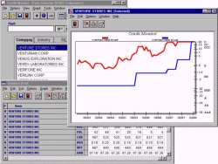
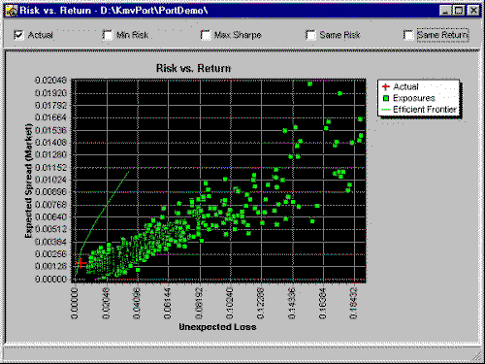
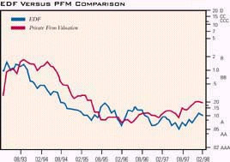
Website: www.kmv.com
Credit Monitor TM
Private Firm Model TM
Portfolio Manager TM
Notes:
San Francisco based KMV was founded in 1989 with a single focus: the measurement and management of credit risk. KMV has two main product areas: the default measure Expected Default Frequency™, or EDF™, and an array of portfolio management tools including “mark to model” technology, and diversification control. KMV offers software products that integrate data and analytics. KMV’s objective is to provide practical and robust methods to capture opportunities presented by credit risk. KMV supports clients intensively in the use of its products. These interactions shape the process leading to global debt capital markets.

Slide 15
Website: www.moodysrms.com
RiskCalc™
Moody's version of RiskCalc™ for public companies has been designed to act as an early warning system to monitor changes in the credit quality of corporate obligors. For each issuer, the model currently reports one-year and five-year default probabilities (DPs) using as inputs ratings (when available), market data and financial statement information. With the exception of financial institutions, whose capital structures tend to be quite unique, we are currently applying the model to all industries and U.S. firms.
RiskCalc™ for private companies is the next generation of Moody's RiskScore, and contains improvements in several dimensions: power, comprehensiveness, simplification of data requirements, and calibration to default probabilities.
The RiskCalc™ algorithm uses nine financial ratios and firm size, adjusts these inputs to linearize the modeling problem, and then estimates the final collection of transformed inputs within a probit model. The output is then mapped into a Default Probability (DP) at 1-year and 5-year horizons. A final mapping to an estimated Moody's rating is based on the 5-year DP.
Notes:
With more than 700 credit analysts operating in 16 offices around the world, Moody's Investors Service is the world's leading credit rating agency, servicing the capital markets with a wide range of credit and financial strength ratings, research products, and risk measurement systems. In 1999, Moody's had ratings on the issuers of 95% of the long-term cross-border debt issued worldwide....more
For further information on Moody's securities ratings or global credit research services, you may contact us via email or contact a Moody's representative at any of the offices listed below:

Slide 16
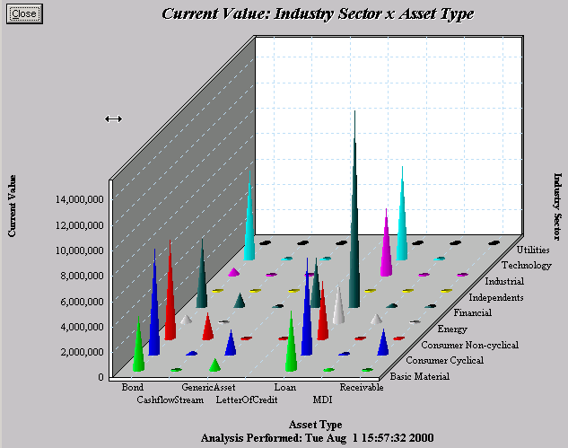
Website: www.riskmetrics.com
CreditManager (CM) is a stand-alone application for the measurement and analysis of portfolio Value-at-Risk (VaR) due to credit events including upgrades, downgrades and defaults. CM implements the industry standard CreditMetrics™ methodology and enables banks, fund managers and other financial institutions to consolidate credit risk across their entire organization. The application can help institutions evaluate the impact of specific exposures on their portfolio, measure risk adjusted capital requirements for a specific investment strategy and can be used as a powerful tool in making asset allocation decisions. CM's broad coverage of asset classes, advanced stress testing functionality and customizable reports, present risk managers with a complete Picture of Risk.
CreditManager
Notes:
RiskMetrics, the risk measurement experts, provides the financial community with innovative research, software, education and benchmark data. RiskMetrics is responsible for the creation and support of benchmark risk management products including RiskMetrics™, CreditMetrics™, DataMetrics, CorporateMetrics™ and RiskGrades™. These measurement tools work seamlessly to promote greater understanding in the financial markets. The company promotes transparency by distributing its risk management information publicly via the Internet and offers financial institutions and individuals measurement tools that enable a complete Picture of Risk.
Formerly the Risk Management Products Group of JP Morgan, RiskMetrics was spun-off in 1998. They are a core component of the risk management practice of more than 5,000 institutions around the world.

Slide 17
Website: www.standardandpoors.com
CreditModel
Scoring for Both Public and Private Firms Standard & Poor’s CreditModel is effective for both publicly traded and privately owned firms with revenues of at least $100 million. Currently available models cover corporates in North America, Japan, and western Europe
CreditPro®
CreditPro® offers credit professionals the ability to quickly create value-added tables extracted from Standard & Poor’s proprietary database of historical rating behavior. These tables, covering roughly 8,600 + obligors, are created with ready-to-use Windows® - based software, featuring a built-in graphics engine. Results are easily exported to Excel.
Notes:
Standard & Poor's offers a range of credit risk management products and services, including empirical data on default incidence, default correlations and rating transitions, credit scoring models, credit indices, and credit training. Consulting services help customers understand, evaluate, and manage their credit risk exposures. Standard & Poor's also conducts research in the area of fixed income trends, defaults and rating transitions, and publishes Standard & Poor's annual Long-Term Default and Ratings Transition Study.

Slide 18
Introduction
Analytic Tools
Data
Web Site Page Views
Rollout Schedule

Slide 19
CreditDimensions’s standardized hierarchical counterparty data has several applications
Multiple sources of counterparty data...
…normalized and cleansed in the ASP...
…allows subscribers to apply clean and consistent counterparty static and hierarchy data for analytical and data management uses
CP Data Donor 1
CP A
Sub. A1
Sub. A1a
CP Data Donor 2
Sub. A2
Sub. A2a
CP Data Donor 3
Exposure reporting
Credit data management
Account opening

Slide 20
Counterparty Distribution
Results as of March 2001

Slide 21
Counterparty Distribution
Results as of March 2001

Slide 22
Counterparty Static Data

Slide 23
Value Proposition
Reduce costs and increase quality of static data by using a collaborative industry source for credit data.
Increase efficiency by automating the data mapping and cleansing process.
Maximize the corporate asset by using a standard platform for cross-enterprise information management. Leverage client data into customer profitability and relationship management systems
Open tools will facilitate outsourcing / process management solutions from third party providers.

Slide 24
Summary of Effort
Install CreditDimensions as the central source for credit entity data maintenance
Generate entity-specific cross-reference tables.
Merge, match, eliminate duplications and cleanse existing databases through automatic and manual means.
Enrich the cross-reference table with specific internal and third-party data elements (SIC, CUSIP, etc.)
Review the adequacy of CreditDimensions Legal Hierarchy - ultimate parent and immediate parent methodology.
Develop ongoing process / services
Maintain the cleansing and enriching process for the databases and systems.
Exception handling and data remediation procedures, map maintenance

Slide 25
Subscriber Download - Initial Data Cleansing and Matching
Process and Roles - Approximately 10-12 working days to perform
Subscriber
CreditDimensions
Create Counterparty Feed and Delivery to Credit Dimension
Receive and Validate Counterparty Data
Cleansing and Matching
Subscriber Resolve Exceptions
Credit Dimension Resolve Exceptions
Validate Cleansed Counterparty Data
Create Cross-reference
Receive Matched Counterparty Data and Cross-Reference
Deliver Matched Counterparty Data and Cross-Reference

Slide 26
Subscriber Download - Initial Data Cleansing and Matching
Creation and Delivery of Initial Subscriber Counterparty File to CreditDimensions
Subscriber
CreditDimensions
Create Counterparty Feed and Delivery to Credit Dimension
Receive and Validate Counterparty Data
Counterparty Files will be created by the Subscriber in a Common Format.
Files may be delivered via CD, File Transport Transmission(FTP).
Custom File and delivery processing is an additional service.
A trailer record or spreadsheet column needs to be added to hash total of counterparties
The Subscriber Counterparty File will be placed in a secure Staging Area for each subscriber
The File will be Validated to insure that it is not a duplicate, and that is in the correct format.
Format Counterparty Records into the Data Management Facility Internal Data Bus Format.
Time Approximately 2 hours

Slide 27
Subscriber Download - Initial Data Cleansing and Matching
Cleansing and Matching
CreditDimensions
Subscriber
Cleansing and Matching
Data Cleansing is the process of standardizing the data attributes used for matching and categorizing Counterparties.
SIC Codes, Ratings, and Country Names and Code are used to classify counterparties. These attributes will be converted into common names and domains or code lists through table lookup routines. Unrecognized names or codes will be flagged as exceptions to be manually resolved.
Exceptions will be used to update conversion tables to facilitate automated conversion of future occurrences.
Name, Address, and SIC Code will be used to match counterparties by employing sophisticated matching software.
The names will be standardized to improve matching.
The address information will be validated with postal software and a high percentage corrected automatically to improve match effectiveness.
Address errors, name standardization errors, and close matches that need to be reviewed will be flagged as exceptions
Time approximately 2 days for 100,000 counterparties with standard codes

Slide 28
Subscriber Download - Initial Data Cleansing and Matching
Exception Resolution
Subscriber
CreditDimensions
Subscriber Resolve Exceptions
Credit Dimension Resolve Exceptions
Exceptions in the Data Cleansing and Mapping Process will be handled by CreditDimensions Staff with support from the subscriber staff.
Exceptions will be sorted into queues for the staff that is dedicated to the initial cleansing to insure that knowledge of the subscribers unique issues is leveraged to provide high quality speedy results.
The CreditDimensions Staff will resolve most (80% to 90%) of the exceptions without Subscriber Staff assistance.
The CreditDimensions Staff will work with Subscriber staff to resolve the remaining exceptions.
All exception resolution will be documented and reviewed with the Subscriber staff assigned.
The cost of research sources will be a component of the initial cleansing cost.
Time approximately 5 days for 100,000 Counterparties with high quality data and timely Subscriber research and review

Slide 29
Subscriber Download - Initial Data Cleansing and Matching
Validation
Subscriber
CreditDimensions
Validate Cleansed Counterparty Data
Validation will be initiated by the data cleansing staff once all exceptions are resolved.
Automated rules will be applied to the complete set of cleansed counterparties to identify unreasonable results (i.e. Name formats, address elements missing, Sic Codes, etc.)
CreditDimension Data Cleansing Staff will perform audits of selected sample counterparties.
Time approximately - 2 Days

Slide 30
Subscriber Download - Initial Data Cleansing and Matching
Cross Reference
Subscriber
CreditDimensions
Create Cross-reference
The Cross Reference is the link between the Subscriber Counterparty Information and the enriched CreditDimension Counterparty Information.
An automated process will create a cross reference between CreditDimension and Subscriber Counterparties.
The Cross Reference will allow CreditDimensions to identify changes that require re-cleansing in an automated fashion reducing the cost of maintaining clean counterparty maps.
The Cross Reference will be the link that will enable the enrichment of Subscriber Counterparty Data with CreditDimension Data in queries and downloads.
Using this cross reference the subscriber can implement a consolidated view of customer information in their own systems.
Time approximately - 1/2 day

Slide 31
Subscriber Download - Initial Data Cleansing and Matching
Data Cleansing Output Delivery
Subscriber
CreditDimensions
Receive Matched Counterparty Data and Cross-Reference
Deliver Matched Counterparty Data and Cross-Reference
As the final step in the initial cleansing and matching process a download of CreditDimensions Counterparty Data for all matched Counterparties will be delivered to the Subscriber.
The Download file will contain the cross reference data as an integral set of attributes.
The Download file will be delivered by FTP or on CDROM.
The Download file will be accompanied by a Data Cleansing report listing exceptions and cleansing / match statistics and issues.
Time required - 1 day

Slide 32
Subscriber Download - Ongoing Data Cleansing and Matching
Process and Roles - Approximately 9 hours to process
Subscriber
CreditDimensions
Create Counterparty Feed and Delivery to Credit Dimension
Receive and Validate Counterparty Data
and Identify Changes Requiring cleansing
Cleansing and Matching
Subscriber Resolve Exceptions
Credit Dimension Resolve Exceptions
Validate Cleansed Counterparty Data
Includes
Changes and additions from Data Providers
Create Counterparty and Cross-Reference update file
Receive Matched Counterparty Data and Cross-Reference
Deliver Updated Matched Counterparty Data and Cross-Reference

Slide 33
Subscriber Download - Ongoing Data Cleansing and Matching
Creation and Delivery of Initial Subscriber Counterparty File to CreditDimensions
Subscriber
CreditDimensions
Create Counterparty Feed and Delivery to Credit Dimension
Receive and Validate Counterparty Data
and Identify Changes Requiring cleansing
Counterparty Files will be created by the Subscriber in a Common Format.
Files may be delivered via CD, File Transport Transmission(FTP).
Custom File and delivery processing is an additional service.
A trailer record or spreadsheet column needs to be added to hash total of counterparties
The Subscriber Counterparty File will be placed in a secure Staging Area for each subscriber
The File will be Validated to insure that it is not a duplicate, and that is in the correct format.
Format Counterparty Records into the Data Management Facility Internal Data Bus Format.
The file will be processed against the Cross Reference to identify changed records that require cleansing
Time Approximately 2 hours

Slide 34
Subscriber Download - Ongoing Data Cleansing and Matching
Cleansing and Matching
Subscriber
CreditDimensions
Cleansing and Matching
Data Cleansing is the process of standardizing the data attributes used for matching and categorizing Counterparties.
SIC Codes, Ratings, and Country Names and Code are used to classify counterparties. These attributes will be converted into common names and domains or code lists through table lookup routines. Unrecognized names or codes will be flagged as exceptions to be manually resolved.
Exceptions will be used to update conversion tables to facilitate automated conversion of future occurrences.
Name, Address, and SIC Code will be used to match counterparties by employing sophisticated matching software.
The names will be standardized to improve matching.
The address information will be validated with postal software and a high percentage corrected automatically to improve match effectiveness.
Address errors, name standardization errors, and close matches that need to be reviewed will be flagged as exceptions
Time approximately 2 hours for 20,000 counterparties with standard codes

Slide 35
Subscriber Download - Ongoing Data Cleansing and Matching
Exception Resolution
Subscriber
CreditDimensions
Subscriber Resolve Exceptions
Credit Dimension Resolve Exceptions
Exceptions in the Data Cleansing and Mapping Process will be handled by CreditDimensions Staff with support from the subscriber staff.
Exceptions will be sorted into queues for the staff that is dedicated to the initial cleansing to insure that knowledge of the subscribers unique issues is leveraged to provide high quality speedy results.
The CreditDimensions Staff will resolve most (80% to 90%) of the exceptions without Subscriber Staff assistance.
The CreditDimensions Staff will work with Subscriber staff to resolve the remaining exceptions.
All exception resolution will be documented and reviewed with the Subscriber staff assigned.
The cost of research sources will be a component of the initial cleansing cost.
Time approximately 3 hours for 200 Counterparties with high quality data and timely Subscriber research and review

Slide 36
Subscriber Download - Ongoing Data Cleansing and Matching
Validation
Subscriber
CreditDimensions
Validate Cleansed Counterparty Data
Validation will be initiated by the data cleansing staff once all exceptions are resolved.
Automated rules will be applied to the complete set of cleansed counterparties to identify unreasonable results (i.e. Name formats, address elements missing, Sic Codes, etc.)
CreditDimension Data Cleansing Staff will perform audits of selected sample counterparties.
Time approximately - 1 Hour

Slide 37
Subscriber Download - Ongoing Data Cleansing and Matching
Cross Reference
Subscriber
CreditDimensions
Create Cross-reference
The Cross Reference is the link between the Subscriber Counterparty Information and the enriched CreditDimension Counterparty Information.
An automated process will create a cross reference between CreditDimension and Subscriber Counterparties.
The Cross Reference will allow CreditDimensions to identify changes that require re-cleansing in an automated fashion reducing the cost of maintaining clean counterparty maps.
The Cross Reference will be the link that will enable the enrichment of Subscriber Counterparty Data with CreditDimension Data in queries and downloads.
Using this cross reference the subscriber can implement a consolidated view of customer information in their own systems.
Time approximately - 1 Hour

Slide 38
Subscriber Download - Ongoing Data Cleansing and Matching
Data Cleansing Output Delivery
Subscriber
CreditDimensions
Receive Matched Counterparty Data and Cross-Reference
Deliver Matched Counterparty Data and Cross-Reference
As the final step in the initial cleansing and matching process a download of CreditDimensions Counterparty Data for all matched Counterparties will be delivered to the Subscriber.
The Download file will contain the cross reference data as an integral set of attributes.
The Download file will be delivered by FTP or on CDROM.
The Download file will be accompanied by a Data Cleansing report listing exceptions and cleansing / match statistics and issues.
Time required - 1 day

Slide 39
Introduction
Analytic Tools
Data
Web Site Page Views
Rollout Schedule

Slide 40
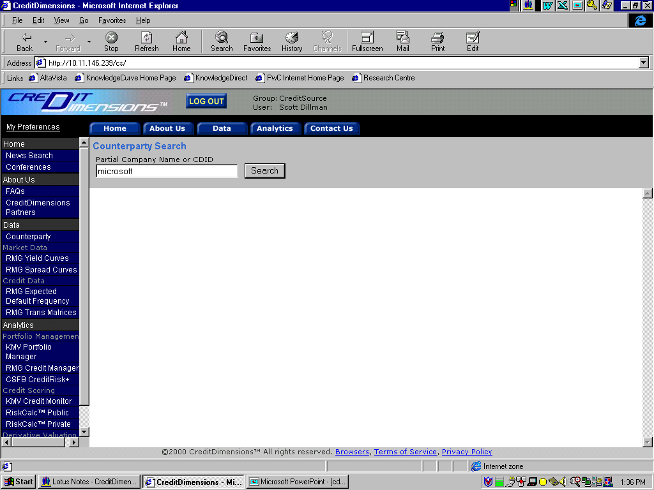
Enter the counterparty of interest

Slide 41
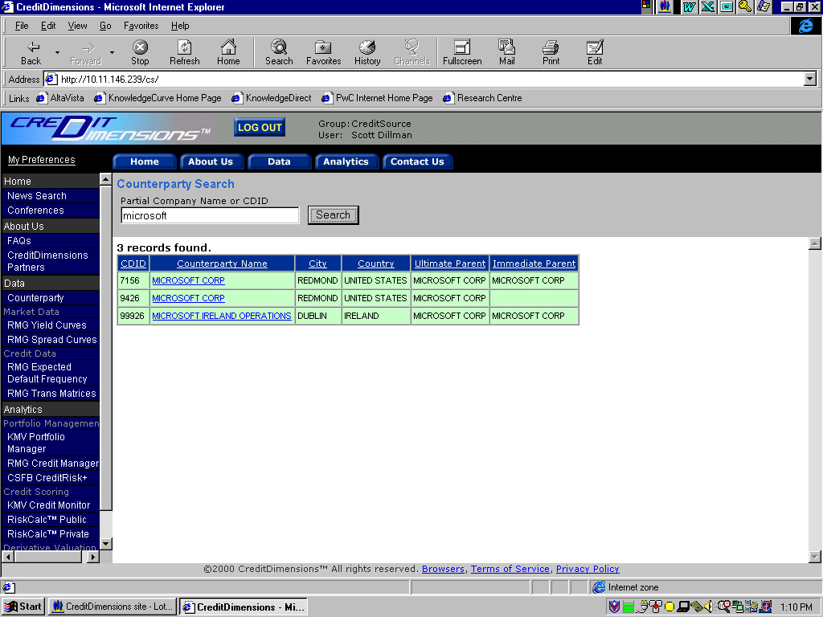
Potential matches are returned onscreen

Slide 42
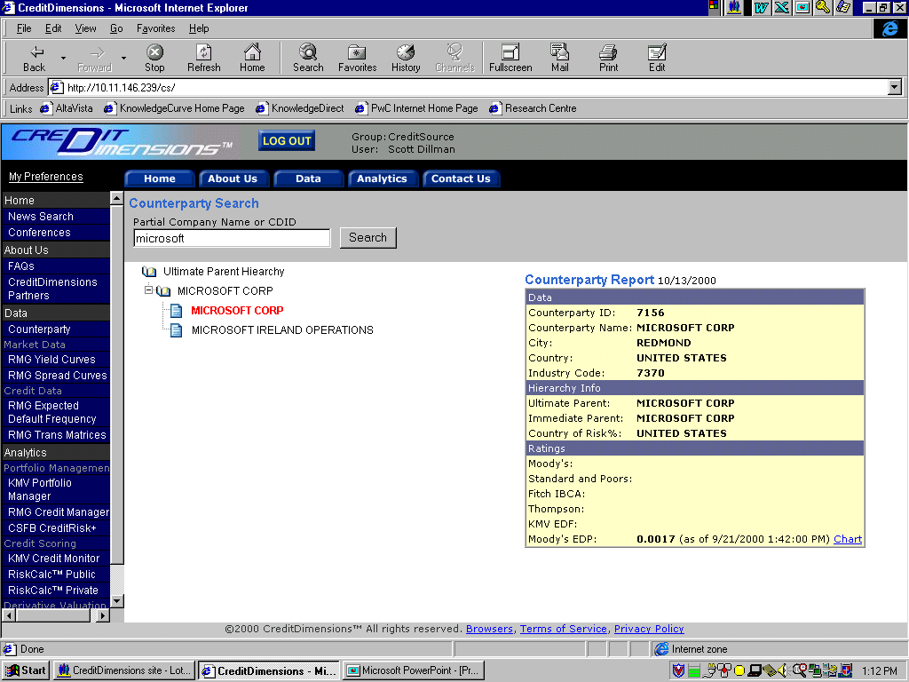
Obtain counterparty hierarchy data and static information

Slide 43
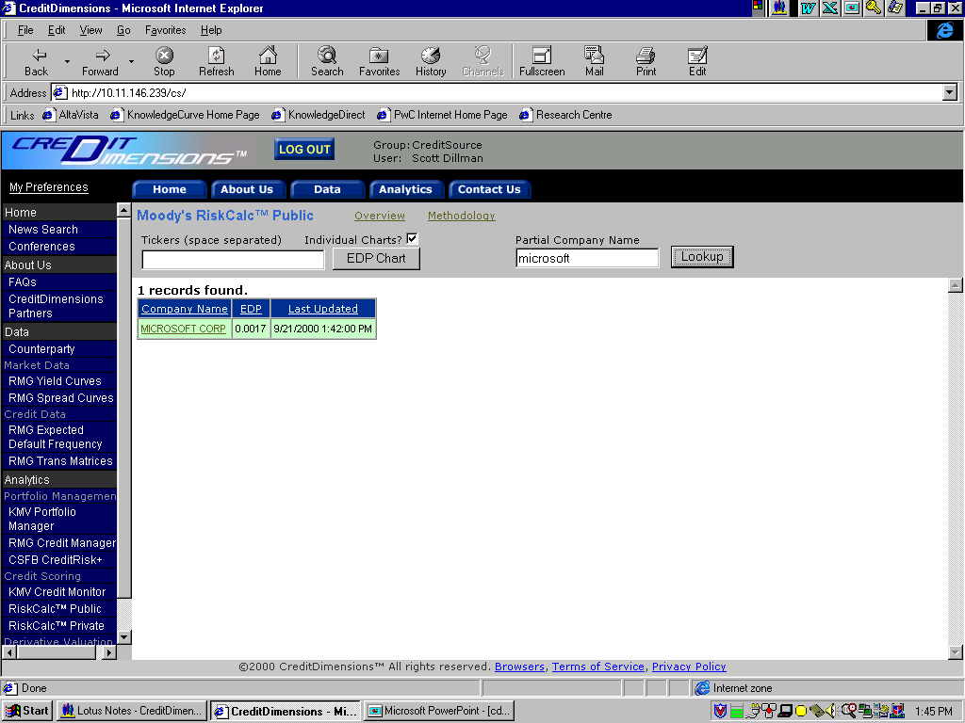
Click on the company name to get an EDP chart.

Slide 44
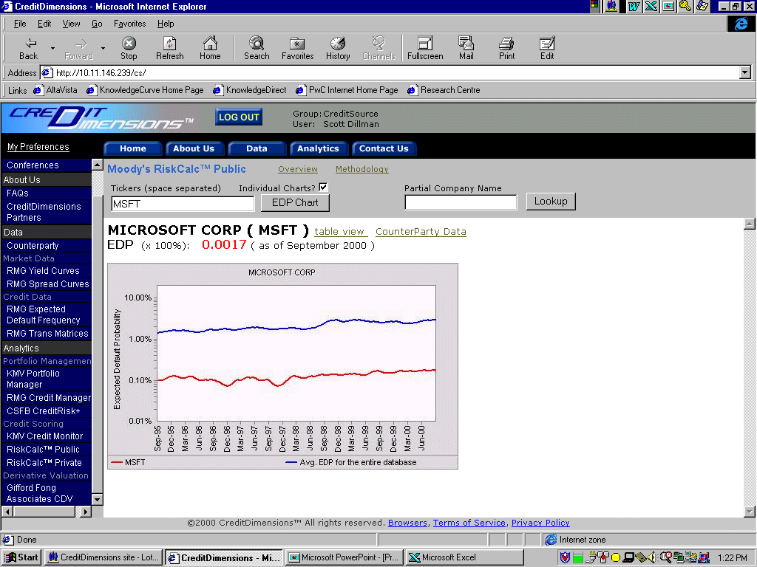
CreditDimensions will host applications for credit quality assessment

Slide 45
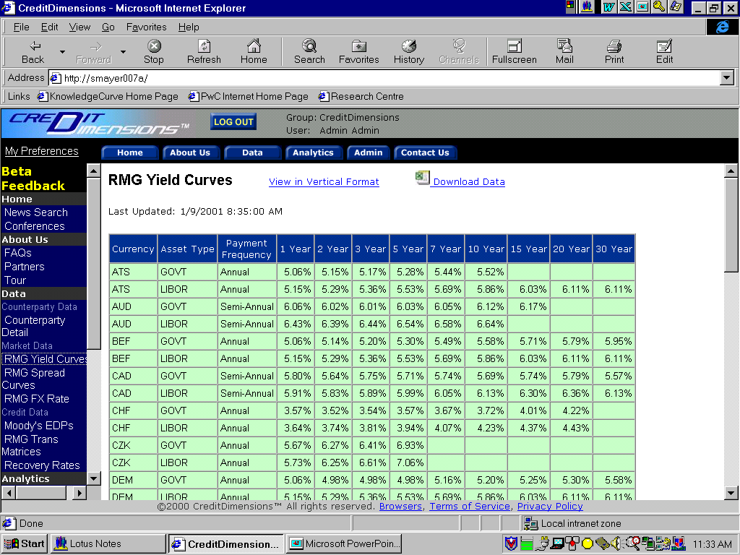
Various types of Market Data will be available, such as Yield Curves

Slide 46
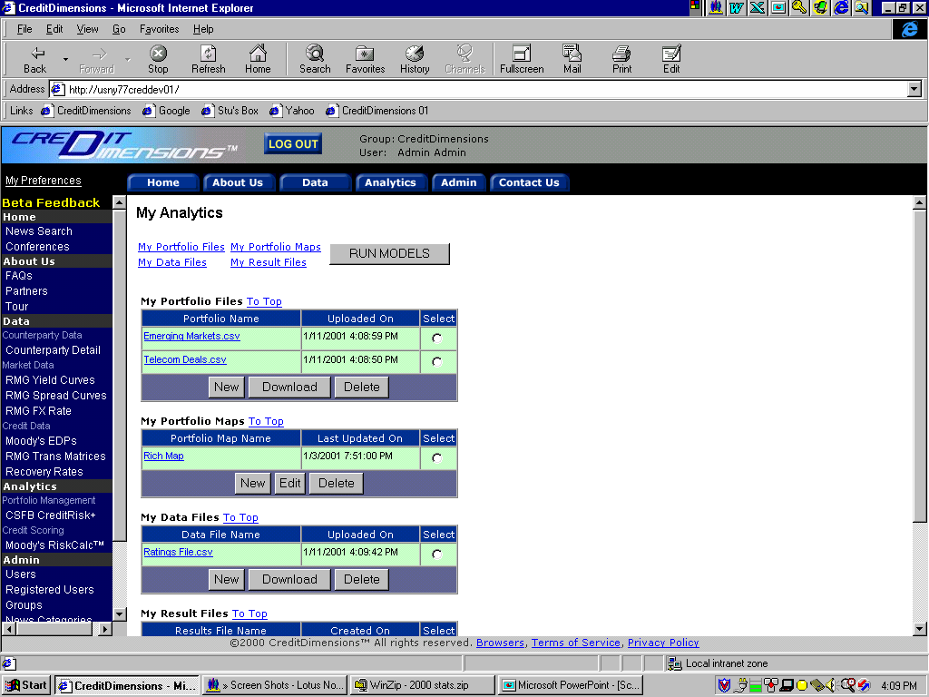
Users will be able to maintain their own data for portfolio modeling

Slide 47
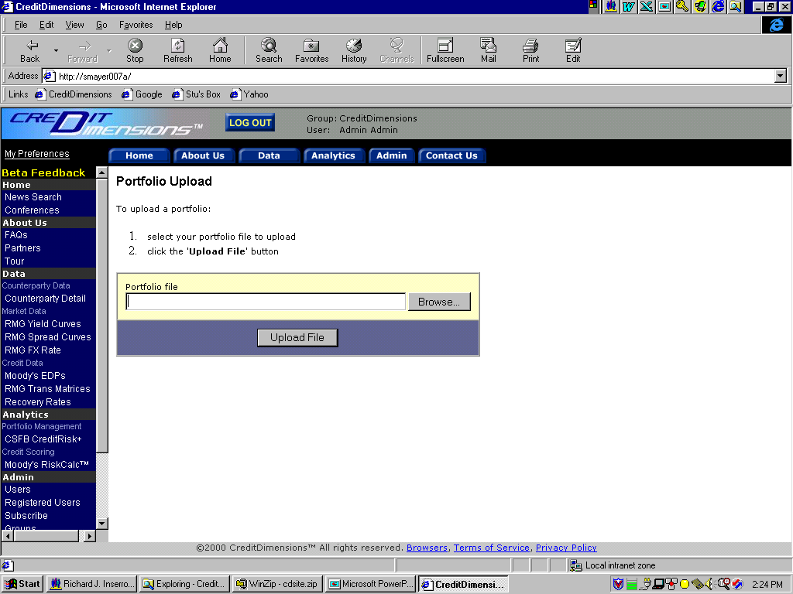
Portfolio data may be uploaded for analysis

Slide 48
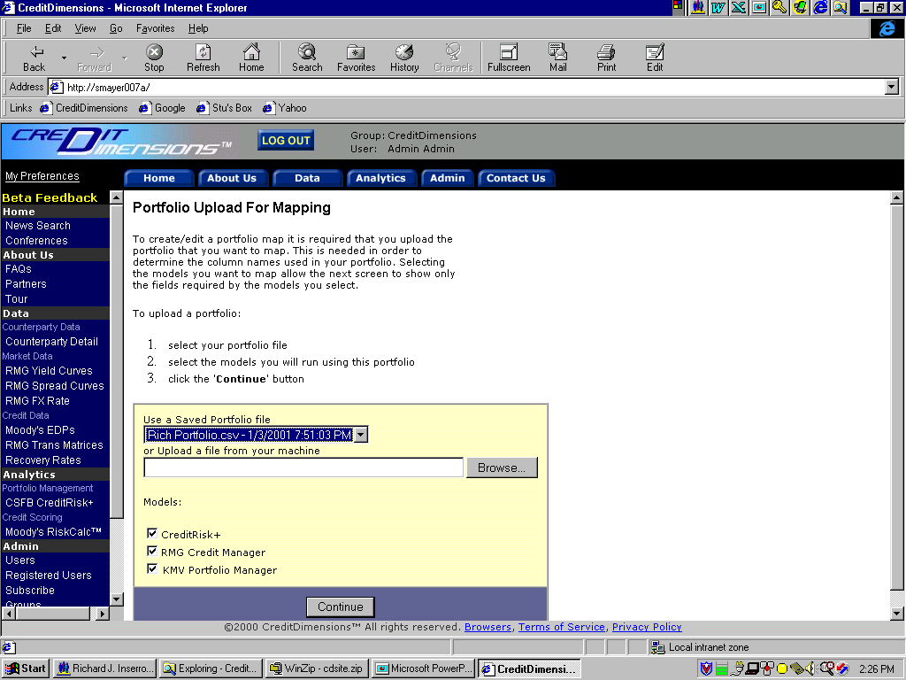
A unique portfolio format can easily mapped to multiple models

Slide 49
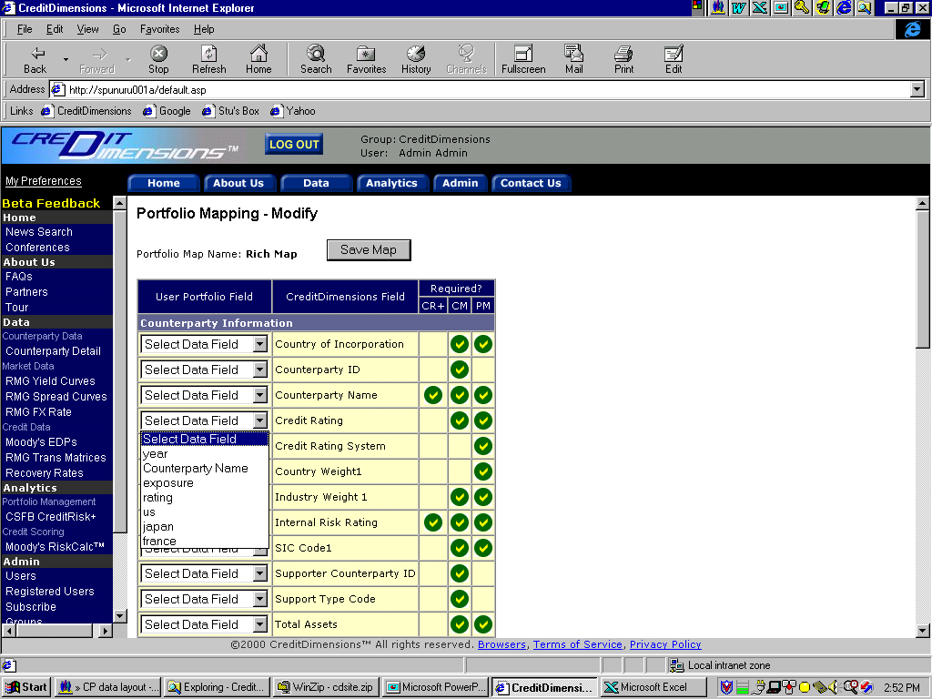
Users will be able to map their portfolio data...
…to the fields required by the models they selected

Slide 50
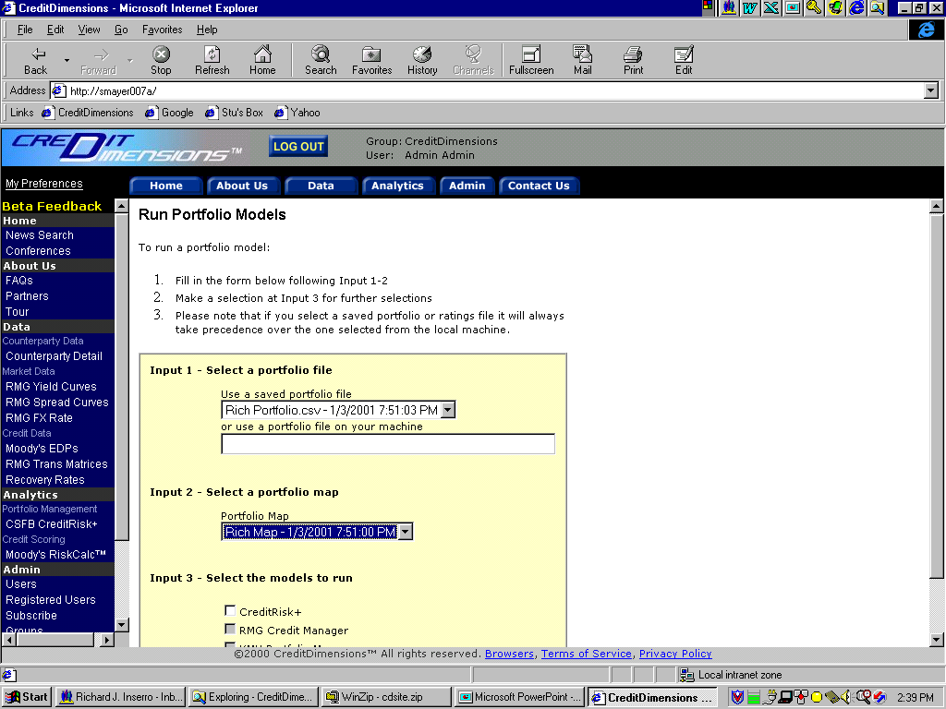
Users will be able to run portfolio models to their own specifications
X

Slide 51
Introduction
Analytic Tools
Data
Web Site Page Views
Rollout Schedule

Slide 52
ECN: Electronic Communications Networks, or ECNs, are computerized systems that automatically match orders between buyers and sellers. While there are many private networks that automatically match orders, the term ECN only applies to those private networks that have been recognized as such under the SEC’s ECN Display Alternative Rule.

Slide 53
For further information please contact:
James Vinci C. Craig Palmore
(212) 520-2660 (212) 520-2615

