Slide 1


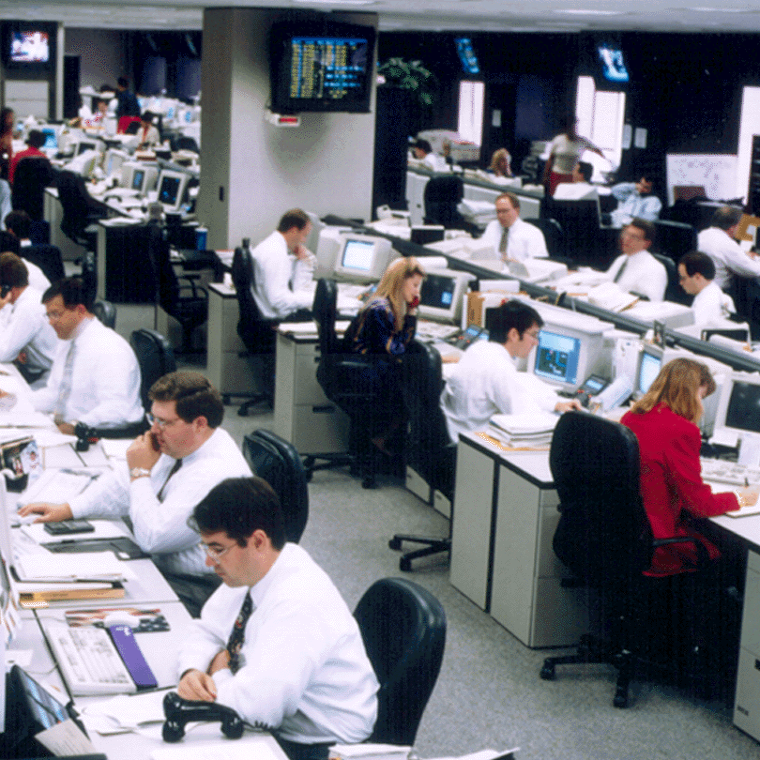

Risk Management Marketing Craig Breslau Vice President
®

Slide 2

Risk Management Marketing
Where do we fit in
Objective
What do we do?
What do we sell?
How do we make money?
Who are our customers
Hedging
Case Studies
1. Gas & Propane
2. Gas & Paper
3. Refining Margin
Advanced Structures
Questions

Slide 3
Enron North America
Dave Delainey
CEO
ENA
Jeff Shankman
COO
EGM
John Lavorato
COO
ENA
Fred Lagrasta
Vice President
Middle Marketing
Origination
Trading
Hedge Funds
Craig Breslau
Vice President
Industrial Mid Marketing
Producers
Natural Gas
Power

Slide 4
Objective
Risk Management Solutions (External)
Market Enron & our Capabilities to New Customers
Origination
Client Visits
Introducing Risk Management
Market Analysis and Data Resource
Risk Management Solutions (Internal)
Provide Liquidity to Enron Trading Desks
ENA
EIM
EGM
Information: We bring unique information to Trading Desks
Coverage: Find opportunities for all parts of Enron
Origination Dollars: No position taking, no capital at risk

Slide 5
Middle Marketing
Middle
Marketing
Producers
Endusers
Hedge
Funds
Fred
Lagrasta
Charlie
Otto
George
Gilbert
Nelson
Ferries
Ross
Prevatt
Per
Sekse
Caroline
Abramo
Craig
Breslau
Jennifer
Shipos
Troy
Black
Jennifer
Fraser
Vikas
Dwivedi
Lucy
Ortiz
Russell
Dyk
Sheetal
Patel
Bill
Berkeland
Mark
Smith
Sabina
Rank
Mog
Heu

Slide 6
Middle Market Opportunities
ENA
Natural Gas
Power
Coal
Weather
EIM
EES
FX
Pulp & Paper
Insurance
Crude & Products
EGM
Profit Opportunities Exist Within and Between Markets
Broad Scale and Unique Information Base Enable Identification of Highest-Value Opportunities
Low Incremental Entrance Cost to New Markets as Extension of Core Skills and Systems
Diversified Product Portfolio Contributes to Steady Business Growth

Slide 7
Summary of Products Traded
Natural Gas
Physically and Financially
All Pipes and Locations in North America
Internationally
Electricity
Physically and Financially
All locations in U.S.
Internationally
Crude Oil
WTI
WTS
Brent
Dubai
Bow River
Light Louisiana Sweet
Heavy Louisiana Sweet
Various California Crudes
Petrochemicals
Benzene
Tolulene
Xylene
Mixed Xylene
Paraxylene
Orthoxylene
Styrene
Methanol
Mono-Ethylene Glycol (MEG)
Cyclo Hexane
Pure Theraphtalic Acid (PTA)
Propylene
MTBE
Plastics
Ethylene
Propylene
Polypropylene-various grades
Polyethylene-various grades

Slide 8
Products Traded (Continued)
Fuel Oil
NYH/GC 1%
NYH/GC 3%
Europe 1%
Natural Gas Liquids
Ethane
Propane
Normal Butane
Iso-Butane
Natural Gasoline
Coal
Domestic and International
All Grades All Locations
Weather Derivatives
Degree Days
Rainfall
Snowfall
Storm Activity
Distillates and Others
Jet Fuel-#54, #55, DERD
Low Sulphur Diesel
High Sulphur #2
Gasoline-All Grades
Alkylate
Naptha
Condensate
Emissions Credits
SO2, NO2
Pulp and Paper Products
LWC No. 5, 34lb- 240lb
Newsprint
Linerboard
OCC, ONP Recycled Materials
Metals
Aluminum, Copper, Zinc
All Base Metals

Slide 9
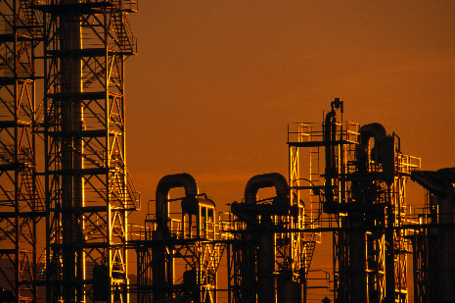
Industries Covered
Transportation
Airlines, Railroads, Transit Authorities, Trucking, Shipping
Chemicals & Petrochemicals
Fertilizer
Glass
Metals & Mining
Pulp & Paper
Refining
Propane & Heating Oil Distributors
Automotive Manufacturing

Slide 10













Customers

Slide 11
NYMEX Natural Gas
?

Slide 12
Hedging Minimizes the Unknown
Hedging:
Price Risk
Management
Predictable Prices
Lock in Margins
Meet Budgets and Earnings Expectations
Increase Financial Flexibility/ Lower Cost of Capital
Develop Growth Strategy with Price Certainty
Improve Equity Market Capitalization

Slide 13

Financial Instruments
Derivatives
Forwards
Swaps- basis, fixed price, spreads
Options- calls, puts, collars
Exotics
Swaptions
Double-Ups / Double Downs
Extendables
Digitals
Three-Way Structure

Slide 14
Customer Analysis
Risk Exposure
Quantify Dollar Exposure
What risks are unique to their commodity markets
Risk Tolerance
Level of volatility customer is willing to absorb
What is the Customer trying to achieve
Below market prices
Above market prices
Budgeting stability
Earnings volatility reduction
Margin Protection

Slide 15
Case Study 1: Gas & Propane
Gas
Propane
Gas
Supplier
Processor
Propane
Market
IF Gas Index
Opis Propane Index
Conversion = 1MMBtu = 10.94 gals propane
Assume = $1/MMBtu fixed operating costs
Risk: The spread between propane and gas is less than $1/MMBtu
ENRON: We sell gas to Processor @ Opis Propane Index - $1.50/MMBtu
EVERYONE WINS
Customer: Spread that covers Fixed Costs + Profit
Trading Desk: NGL made a mid/bid spread
Nymex made a mid/offer spread
Basis Trader made a mid/offer spread
Mid Market: .01 of Orig*30,000 *365 = $109,500

Slide 16

Case Study 2: Gas & Paper
Scenario: Paper Mill buys a large quantity of gas to produce paper
Problem: The volatility of paper prices is very high
Risk: Natural gas prices go up at the same time that paper prices are going down
Solution: Enron links the price of their input (NG) to the price of their output (paper). Thus when paper prices go down, so does the gas price, regardless of what happens in the gas market.

Slide 17

Case Study 3: Custom Crack
Gasoline (45%)
CRUDE
Low Sulfur
Diesel (36%)
Jet Fuel (19%)
Refiner buys Crude and “Cracks” it into Refined Products
(Jet, Gasoline, Heating Oil, etc…)
Each Refinery has its own “Crack”
(Difference between the value of the Products produced and the Crude Cost)
Understand Product Mix for Refinery A
(i.e.45% USGC Gasoline, 36% USGC LS Diesel, 19% USGC Jet 54 vs. WTI)
Obtain Generic Cracks from the Gasoline and Diesel Traders
Calculate Custom Crack using the % developed above
Trade Custom Crack number with Refinery A

Slide 18
Three-Way Structure
Provides price protection from rising prices while offering flexibility to benefit from decreasing prices within a defined range
No upfront or limited upfront cost
Buy cap / Sell call / Sell floor
Customer receives additional
premium for selling the call,
which allows greater
downside participation vs a
no cost collar
If market price is above $6.05 customer’s price is market price minus $0.20.
If market price is between $6.05 and $6.25 customer pays $6.05.
Customer pays market price between $5.75 and $6.05 and pays $5.75 if market price falls below $5.75
Index Price
Sell Call
$6.25
$6.05
Buy Call
$5.75
Sell Put
Effective Price
Time

Slide 19
Call Spread
Provides partial price protection
from rising prices while offering
flexibility to benefit from
decreasing prices.
Customer reduces the
premium by selling call
at a higher strike price.
Buy call / Sell call
Customer buys $6.00 call and
sells $6.30 call.
Customer pays market price below $6.00, between $6.00 and $6.30 Customer pays $6.00 and above $6.30 customer pays market price minus 30 cents.
Market Price
Effective Price
30 Cents
$6.30
Sell Call
$6.00
Buy Call
$5.75
Time

Slide 20
Extendable and Double Up
Customer receives protection
from upward price movement
while lowering the fixed price
on the swap.
Lowers the fixed price by giving
Enron the right but not the
obligation to extend the swap.
For example, a 12 month swap price is $4.56, but a 12-month by 12-month price on the extendible would be lower at $3.84.
A double up would give the customer an even lower fixed price by giving Enron the right to double the volume during the extended period of the swap.
Regular Swap is
$4.56
Enron has right but not the obligation to extend swap at $3.84
Extendable Swap
1st 12 mths
2nd 12 mths

Slide 21
Questions?

