Slide 1

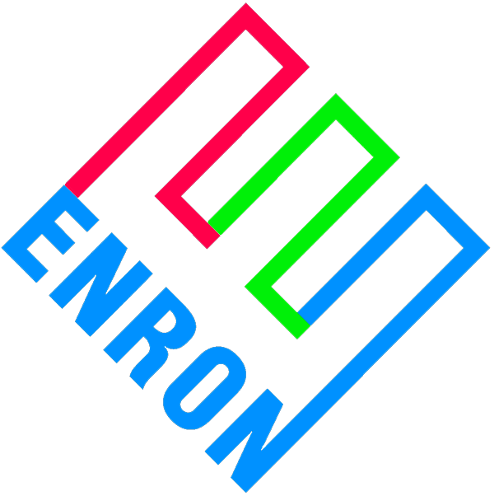
Corporate Responsibility
®
Presentation to the Board of Directors
December 12, 2000
Kelly Kimberly
Sr.. Vice President, Corporate Responsibility

Slide 2
What is Corporate Responsibility?
Corporate responsibility integrates social and environmental considerations into business strategy, market development and decision-making
Sustainable Development - “Meeting the needs of the present, without compromising the ability of future generations to meet their own needs… ” (World Commission on Environment and Development, 1987)
Notes:
Bullet 1: developing market-based solutions to sustainability challenges,
- defining how key issues (human rights, economic development, environmental issues) affect the business and responding appropriately,
- understanding the social, environmental and economic impacts of the business
- stakeholder engagement
WHAT IT IS NOT: philanthropy, volunteerism, a few ‘good deeds’
Sustainable Development (often called “sustainability”) was defined by a high level UN Commission, chaired by Gro Harlem Brundtland in 1987.
In 1992, a non-binding multilateral agreement further defining sustainable development and committing to its principles -known as “Agenda 21” - was signed by 150 nations at the UN Conference on Environment and Development (“Rio Earth Summit”) in 1992.
Following this conference, a variety of efforts have been undertaken to understand and respond to SD by governments, NGOs and businesses (e.g. US President’s Council on Sustainable Development (Ken Lay/Enron a member) in 1993, World Business Council for Sustainable Development formed in 1995.)

Slide 3
Emerging Trends
The Emergence of Business Standards - Critical developments in Corporate Governance and standards for global operations
C21st
Social Concerns
90’s
Corruption
80’s
Supply Chain
Community impact, labour standards, human rights, stakeholder relations, etc.
70’s
Environment
Widening Scope of Reporting Requirements
Quality & Consumers
60’s
Labour, Health & Safety
Codes & Compliance:
Voluntary standards -
Voluntary Codes / regulation - internal business principles - audit - compliance - public reporting ………
C20th
Financial Management
Emerging pressures for Standards & Transparency
Source: Prince of Wales Business Leaders Forum
Notes:
Proliferation of internationally recognized standards on reporting, corporate governance, management systems and behavior that include social and environmental aspects.
Standards based upon existing standards and practices from financial management and accounting to ISO and Total Quality Management (GE and Motorola’s “six sigma”)
Developed as a more effective and inexpensive alternative to legislation/regulation-
Developed around issues that affect business - privacy, labor rights, ethics, procurement, supply chain management; human rights; reporting.
Industries, companies and multi-sector initiatives have developed voluntary codes of conduct that cover environmental and social considerations (e.g. Responsible Care - chemical industry)
HOW IT APPLIES TO ENRON: Business partners acquisitions, Peers, Customers, buyers/sellers in trading, competitors, and the industry is participating include Pulp/Paper/Lumber; energy, chemicals, Mining sectors.

Slide 4
Emerging Trends and Practices
Shareholder, market, customer and employee interest in non-financial performance and services
Salomon Smith Barney
Polaroid, Starwood
University of Chicago
Friends of the Earth
Market-based solutions
demand for environmentally/socially superior products
provision of goods and services to address sustainability concerns
Notes:
1) Important constituencies want information about our non-financial performance to make purchasing, investment, and other decisions:
this year 150 companies received shareholder proposals on environmental, social and governance issues (FOE proposed that Enron report on our Biodiversity strategy)
EES Customers U of Chicago, Archdiocese of Chicago, Eli Lilly have all asked about Enron’s social and environmental governance and performance.
1600 hits to date (Labor day to now) on the Internet (Intranet hits on EHS report = 2700)
Stock Exchanges: All London Stock Exchange listed companies must report in their annual report and accounts on their adherence to the Principles of Good Governance and Code of Best Practice. Brazilian Stock Exchange held a conference on sustainability issue
2) Market-based solution: Large companies and institutions are are turning to market based solutions and voluntary principles to address social/environmental issues. Not only is this more effective and less expensive than regulation but it creates market opportunities:
GM all suppliers must be ISO 14000 compliant by 2002, procure goods with recycled content
British Telecom procures £5 billion in goods and services and asks all suppliers about impacts, management of impacts
Quadrum, an e-metals marketplace, is providing social and environmental information about the products they offer (Rio Tinto, MSDW, Phelps Dodge).
3) Companies are examining sustainability issues as opportunities to develop new products and services (BT - digital divide, Dupont- new products for global underserved populations)

Slide 5
Why is this important for Enron?
Social and Environmental Issues Present Risks and Opportunities
Equity positions in assets in traded commodities
Market need
Trading
Content
Access
Security /privacy
Broadband
Emissions
Demand for clean power
Existing Assets
Energy
Notes:
- CR issues create risks and opportunities for all Enron businesses
- Need to identify and manage to capitalize opportunities and Develop systematic approach to mitigate risk b/c whether 100% owned by Enron, LLC, joint venture, or minority interest – may be able to limit legal risk but not reputation risk. What partners do affects our reputation.
TRADING: Because Enron is now taking equity positions to facilitate trading of certain commodities, we are entering industries unfamiliar to us in terms of social and environmental issues. Many of these present risks that cannot be mitigated purely through legal arrangements - such as risks to our reputation.
Concern with environmental and social issues has created a demand in the B2B market for products that are socially or environmentally superior (e.g. Many companies’ (GM, BT) procurement policies reflect preferences for “certified” goods or suppliers.)
BROADBAND: Enron’s involvement in content presents both risks (degree of responsibility for what is distributed over our networks - hatespeak, pornography) and opportunities (telemedicine, distance learning). The “digital divide” or access for underserved populations is an issue of concern that we need to address.
ENERGY: Air emissions present risks (increased regulation) and opportunities (profitable emission reductions such as through energy efficiency). Increasing global demand for cleaner power sources also positions Enron well for the future. Existing assets present both opportunities and risks in modernization efforts and greenfield projects.

Slide 6
Benefits of a Strategic Approach
Improve ability to recruit and retain employees
Create new markets
Develop new products and services
Mitigate product, service, operations risk
Strengthen brand/reputation
Maintain and improve competitive position
Notes:
Data to support bullet 1 attracting employees:
A 1997 study of 2,100 MBA students conducted by Net Impact found that slightly more than half said they would accept a lower salary to work for a socially responsible company. Studies also have shown that companies appearing on one of the many published "best places to work" lists have higher profit margins, rates of growth, and job-creation.
Last bullet -Maintain and improve competitive position:
A recent longitudinal Harvard University study found that "stakeholder-balanced" companies showed four times the growth rate and eight times the employment growth when compared to companies that are shareholder-only focused.

Slide 7
Progress to Date
Defined Mission: To establish Enron as a leading 21st century company- “best in class”
Benchmarked leaders
Established Corporate Responsibility task force
Published First Annual EHS Report
Developed Human Rights policy
Risk Management
Stakeholder Engagement
Product and Service Strategies
Performance Assessment and Review
Policy Development and Review
Notes:
Benchmark leaders (customers and competitors). Some examples:
Swiss Re: incorporate environmental criteria in investment policy and have an Environmental New Markets group to develop new products to manage environmental risk
British Telecom: emphasis on teleservices (tele-medicine, tele-shopping, etc.) which enable provision of services regardless of geography, mobility, etc. This market opportunity creates jobs and opportunities for disabled persons to have access to the services they need.
Stakeholder Engagement: ongoing dialogue with critics and friends
In response to last year’s shareholder resolution on biodiversity, we have engaged in dialogue with the authors (Friends of the Earth). Their concerns included Enron’s history in India and the Bolivia-Brazil pipeline.
We are participating in a discussion on strategic approaches to biodiversity and measurement of impacts with Conservation International and four other multinational companies.
Project & Service Strategies: EES is working on integrating energy-related environmental issues into products and services
Risk Management: Working with Transredes to ensure good social and environmental performance.
Policy Development/Review: Security, Indigenous rights, etc.

Slide 8
Goals for 2001
Work with business units to identify new products, services, markets, and opportunities
Integrate social and environmental considerations into existing business unit strategies and management systems (due diligence, risk management, stakeholder engagement, training, performance incentives, auditing)
Benchmark, measure, and continuously improve Enron’s social and environmental performance (previous performance, customer and investor expectations, competitors)
Confirm and communicate “lessons learned”
Identify opportunities to improve efficiency, reduce environmental impacts and procure ‘green products’ -- while saving money
Publish second annual report on social and environmental performance

Slide 9
Proposed Next Steps
Expand Board Committee Responsibilities
structure
scope
Establish External Advisory Committee
high level internationally recognized experts
provide insight and information on issues and trends
comment on corporate goals, plans, strategies
Notes:
These next steps are necessary for Enron to be a leadership company in the area of Corporate Responsibility. They demonstrate our commitment to integrating this corporate decision-making and an ongoing commitment to learn about and address social and environmental issues.
BOARD COMMITTEE (alter this to reflect decisions made after discussion with KL)
Benchmarking information:
1999 Korn/Ferry Board of Directors study found that 19% of those surveyed had corporate responsibility committees
STRUCTURE:
Expand mandate of audit committee to include CR oversight. CR function will report semi-annually on progress toward goals. OR
Create subcommittee of Audit committee to review CR. Will membership expand?
SCOPE (first two are strongly suggested, latter is an option to add):
Review internal policies, external standards and guidelines, management systems and structure, and performance;
Consult with Advisory Committee on emerging issues
Provide guidance to management on emerging issues relating to: Environment, Ethics Social Responsibility, Health and Safety, Human Rights
EXTERNAL COMMITTEE: (fill in details once decided/approved)

