Slide 1
Energy and Air Quality Subcommittee Overview
Congressman Joe Barton of Texas, Chairman
U.S. House Energy & Commerce Subcommittee on
Energy & Air Quality
Texas Conservative Forum
September 27, 2001

Slide 2
Fuel Sources for Electricity Generation in 2000

Slide 3
New Power Plants Needed To Meet Electricity Demand
800
500
Assume Each
Plant is 300 Mw

Slide 4
Cleaner Air: Energy Use Has Risen While Emissions Decline
GDP+147%
Coal
+100%
Energy +42%
Key Emissions-31%
(SO2, NO2, Hg, CO)

Slide 5
H.R. 4 Securing America’s Future Energy Act
CONSERVATION AND RENEWABLE ENERGY
Tax credits for home energy efficiency improvements
Renewable energy assessment and Solar tax credit
Saves 5 billion gallons over 6 years for light trucks
TECHNOLOGY IMPROVEMENTS
Clean Coal Initiative, Double funding for Biomass
Nuclear energy research, Ultra deep-water oil and gas
INCREASE SUPPLY
Federal land inventory for energy production
Tax credits for domestic oil and gas production
Limited development of Federal lands including ANWR

Slide 6
Electric Supply and Transmission Act
INCREASE ELECTRIC SUPPLY
Uniform interconnection standards for new plants
Net metering for residential renewable generation
Repeal Public Utility Holding Company Act (PUHCA)
INCREASE TRANSMISSION CAPACITY
Require State siting action in a year or Fed can grant
Fed review of incentive rates to boost transmission investment
IMPROVE TRANSMISSION OPERATION
Open access by all transmission line owners
Increase participation in Regional Transmission Orgs (RTOs)
Create Electric Reliability Organizations to enforce standards

Slide 7
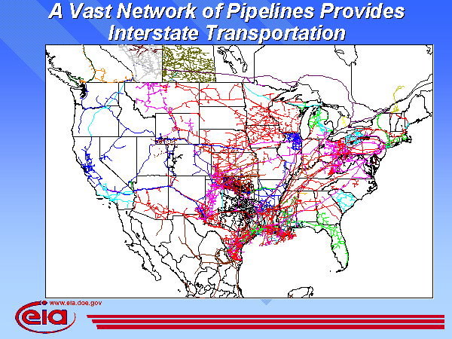
Slide 11 of 33

Slide 8
Energy Infrastructure Vulnerability
103 Nuclear Power Plants
70 Locations where Spent Fuel is Stored
2700 Hydroelectric Dams
1300 Fossil Power Plants
157,000 Miles High Voltage Transmission
2.2 million Miles Natural Gas/Oil Pipelines
155 Refineries

