Slide 1
^{Enron Broadband Services}

Slide 2
Today’s Message
The Broadband Explosion Is Real, It Is Here Now and It Will Fundamentally Change the Existing Internet Delivery Platform
The Enron Business Model, Which Emphasizes Open, Robust Networks and Markets, Will Enable Enron to Develop the Most Efficient Broadband Delivery Network in the World
Enron Broadband Has Already Established the Superior Broadband Delivery Network

Slide 3
Key Metrics
Total Headcount
Fiber Route Miles
1,100
18,000
15,000
775
12,325
490
5,538
89
1,755
25
1997
1998
1999
2000E
2001E
1997
1998
1999
2000E
2001E
Servers
Pooling Points
3,000
40
1,500
13
0
0
222
0
0
3
1997
1998
1999
2000E
2001E
1997
1998
1999
2000E
2001E

Slide 4
Bandwidth Market
Illustrative
Volume
High Bandwidth Applications
  Video
  Large File Transfer
Low Bandwidth Applications
  Voice
  Text
1999
2001
2002
2003
2004
2005
2006
2007
2008
Today
Enron’s Target Market

Slide 5

The Internet
A
B
Advantages
Disadvantages
Open
Ubiquitous
Flexible
Designed for Text World
  Slow Speed
  Limited Data Interchange

Slide 6
Proposed Solution
A
B
Add Intelligence
to the System
Bypass Internet With Point-to- Point Connection
A
B
A
B

Slide 7
Add Intelligence to the System
Players
Caching
  Inktomi
Route Selection
  Akamai
Router Upgrade
  RSVP Protocol
A
B
Issues
Big Improvement for Lower Bandwidth Applications
Does Not Solve Problem for High Bandwidth Applications

Slide 8
Bypass Internet with Point-to-Point Connection
Players
MCI Worldcom
Qwest
AT&T
Williams
Level 3
A
B
Issues
Lack of Ubiquity, Flexibility
High Capital Intensity

Slide 9

Enron’s Approach
MCI WorldCom
Qwest
Williams
AT&T
A
B

Slide 10
Enron’s Approach
Advantages
Extremely High Quality of Service (QoS)
Extremely High Capacity; Ability to Handle the Highest Bandwidth Applications
Ubiquitous
Flexible - Ability to Provision Bandwidth Real-Time
Absolutely Lowest Cost
Other Features
Ability to Differentiate QoS
Ability to Forward Reserve Bandwidth
Ability to Provide Full Range of Financial Products and Services Along-Side Physical Capacity
  Forward Price Contracts
  Derivatives and Hedges
  Financing

Slide 11
Enron Broadband Services
Enron
Intelligent
Network
Deploy the Most Open, Efficient Network with Broad Connectivity
Fiber
Servers
Pooling Points
Software

Slide 12
Enron Broadband Services
Enron
Intelligent
Network
Bandwidth
Intermediation
Deploy the Most Open, Efficient Network with Broad Connectivity
Be the World’s
Largest Buyer and
Seller of Bandwidth
Fiber
Servers
Pooling Points
Software
Bandwidth Management
Trading
Finance

Slide 13
Enron Broadband Services
Enron
Intelligent
Network
Bandwidth
Intermediation
Deploy the Most Open, Efficient Network with Broad Connectivity
Content
Services
Be the World’s
Largest Buyer and
Seller of Bandwidth
Be the World’s Largest Provider of Premium Broadband Delivery Services
Fiber
Servers
Pooling Points
Software
Bandwidth Management
Trading
Finance
Streaming Broadband Services
Data Asset Management Services

Slide 14
Today’s Discussion
Enron Intelligent Network
Business Centers
Intermediation
Content Services
Financials
BOS

Slide 15
Enron Intelligent Network
(EIN)
Enron
Intelligent
Network
Bandwidth
Intermediation
Deploy the Most Open, Efficient Network with Broad Connectivity
Content
Services
Be the World’s Largest Provider of Premium Broadband Delivery Services
Be the World’s
Largest Buyer and
Seller of Bandwidth
Fiber
Servers
Pooling Points
Software
Bandwidth Management
Trading
Finance
Streaming Broadband Services
Data Asset Management Services
Notes:
What do you need to win in the emerging mission critical communications market
- Reach
- Cost
- Reliability
Enron has a strategy to achieve superior levels of capability in each of these areas
- ECI’s network build combined with the establishment of open pooling point interconnections will

Slide 16
Fiber
Owned and Contracted
_{Seattle}
_{Portland}
_{Minneapolis}
_{Albany}
_{Boston}
_{London}
_{Boise}
_{Toronto}
_{Paris}
_{Detroit}
_{Salt Lake City}
_{Omaha}
_{New York}
_{Copenhagen}
_{Chicago}
_{Cleveland}
_{Munich}
_{Sacramento}
_{Denver}
_{Philadelphia}
_{Amsterdam}
_{San Francisco}
_{St. Louis}
_{Washington D.C.}
_{Rome}
_{Kansas City}
_{San Jose}
_{Las Vegas}
_{Albuquerque}
_{Charlotte}
_{Tokyo}
_{Phoenix}
_{Atlanta}
_{Los Angeles}
_{Dallas}
_{Jackson}
_{San Diego}
EIN Route Miles
_{New Orleans}
_{Orlando}
18,000
_{San Antonio}
_{Houston}
15,000
_{Miami}
12,325
5,538
1,755
1997
1998
1999
2000E
2001E

Slide 17
Fiber
State of the Art Fiber Optic Network
  Pure Internet Protocol (IP)
  12 Fibers, Each Upgradable to OC-192
  Low Capital and Operating Costs
Low Cost Scalability
Provides Guaranteed Backstop for Enron’s Firm Delivery Commitments

Slide 18
Servers
_{Seattle}
_{Portland}
_{Minneapolis}
_{Toronto}
_{Albany}
_{Boston}
_{London}
_{Boise}
_{Detroit}
_{Paris}
_{Omaha}
_{New York}
_{Copenhagen}
_{Salt Lake City}
_{Munich}
_{Denver}
_{Chicago}
_{Cleveland}
_{Sacramento}
_{Philadelphia}
_{Amsterdam}
_{San Francisco}
_{St. Louis}
_{Washington D.C.}
_{Rome}
_{Kansas City}
_{San Jose}
_{Las Vegas}
_{Albuquerque}
_{Charlotte}
_{Tokyo}
_{Phoenix}
_{Atlanta}
_{Los Angeles}
_{Dallas}
_{Jackson}
_{San Diego}
3,000
_{Orlando}
_{New Orleans}
_{San Antonio}
_{Houston}
_{Miami}
1,500
222
0
1998
1999
2000E
2001E

Slide 19
Servers
High-Capacity Broadband Servers “One Hop” From End Users
18 GB Storage and 500-1,000 Broadband Stream Capacity
Automated, Flexible Market Interconnects
Co-Located With Distribution Partners
Enron’s Distributed Server Architecture Capable of Serving 2-3 Million Broadband Streams Simultaneously by 2001

Slide 20
Pooling Points
_{London}
_{New York}
_{Los Angeles}
Public Pooling Point
Server

Slide 21
Pooling Points
Large-Scale Electronic Bandwidth “Switches” that Enable Real-Time Circuit Provisioning
Off the Shelf, Proven Lucent Equipment
Proprietary Enron Software
Highly Scalable
Connects Multiple Carriers and Multiple Circuits
Enron’s Pooling Points Provide Real-Time
Access to Bandwidth and Ability to
Dynamically Scale Network

Slide 22
Network Connectivity
_{Seattle}
_{Portland}
_{Minneapolis}
_{Toronto}
_{Albany}
_{Boston}
_{London}
_{Boise}
_{Detroit}
_{Paris}
_{Salt Lake City}
_{Omaha}
_{Copenhagen}
_{New York}
_{Munich}
_{Denver}
_{Chicago}
_{Cleveland}
_{Sacramento}
_{Philadelphia}
_{Amsterdam}
_{San Francisco}
_{St. Louis}
_{Rome}
_{Kansas City}
_{Washington D.C.}
_{San Jose}
_{Las Vegas}
_{Albuquerque}
_{Charlotte}
_{Tokyo}
_{Phoenix}
_{Dallas}
_{Atlanta}
_{Los Angeles}
_{Jackson}
_{San Diego}
_{New Orleans}
_{Orlando}
_{San Antonio}
_{Houston}
Servers
_{Miami}
Public Pooling Points
Fiber Network

Slide 23
Network Control Software
Routing – Network Element Control
Bandwidth Reservation
Quality of Service
Metering
Applications Management

Slide 24


The EIN: Unparalleled
Content Delivery, Quality and Reliability
ISP
Seattle
Portland
Minneapolis
Toronto
Albany
Boston
London
Boise
Detroit
Paris
Salt Lake City
Omaha
New York
Copenhagen
Sacramento
Denver
Chicago
Cleveland
Munich
San Francisco
St. Louis
Philadelphia
Amsterdam
San Jose
Las Vegas
Kansas City
Washington D.C.
Rome
Tokyo
Los Angeles
Phoenix
Albuquerque
Dallas
Atlanta
Charlotte
San Diego
Jackson
San Antonio
Houston
New Orleans
Orlando
Miami
Content
Provider
ISP
Poor Quality Video Stream

Slide 25








The EIN
Major Industry Participants
Supplier
Functionality
DWDM Equipment Maximizes Broadband Transmission Capacity Over the EIN Network
Servers Interconnect Network and Physically Store Data “One Hop” From End Users
Software Provides Data Storage and Retrieval
Routers Control Physical Flow of Data
Caching Software Distributes Data Among Servers Closest to End Users
Lucent
Bandwidth Manager Enables Real Time Switching of Circuits
DWDM and Optical Switching

Slide 26
The EIN
Comments by Leading Industry Participants
Business Model
Technology
Jonathan Schwartz
Vice President, Venture and
Strategic Investments
Graeme Fraser
V.P. of Engineering, Optical
Networking
David Peterschmidt Dr. Adam Beguelin
Chief Executive Officer Senior Scientist

Slide 27
Today’s Discussion
Enron Intelligent Network
Business Centers
Intermediation
Content Services
Financials
BOS

Slide 28
Intermediation
Bandwidth Management
Outsourcing of Bandwidth
Customized Bandwidth Solutions
Bandwidth Optimization
Trading
Finance
Pricing and Structuring
Risk Management
Physical Services
Structured Financial
Solutions
Investments

Slide 29
Ease of Creating a Commodity
Intermediation Business
Attitude of Participants
Sellers
Interconnection
Sellers
Buyers
Natural Gas
1980’s
Motivated
Monopoly
Massive
Take or Pay
Electricity
1990’s
Mostly
Tied to Monopoly
Monopoly
Motivated
Bandwidth
2000’s
Favorable
Unfavorable
Motivated
Motivated
Motivated

Slide 30
Ease of Creating a Commodity
Intermediation Business
Number of Players
Sellers
Interconnection
Sellers
Buyers
Natural Gas
1980’s
Many
Few
Many
Electricity
1990’s
Many
Few
Many
Bandwidth
2000’s
Many
Many
Many
Favorable
Unfavorable

Slide 31
Bandwidth Management
Aggregate
Discrete
Bandwidth
Obligations
Build Large Market & Supply Portfolios
Reconfigure
& Optimize
Portfolios
Deliver New Products & Contract Structures

Slide 32
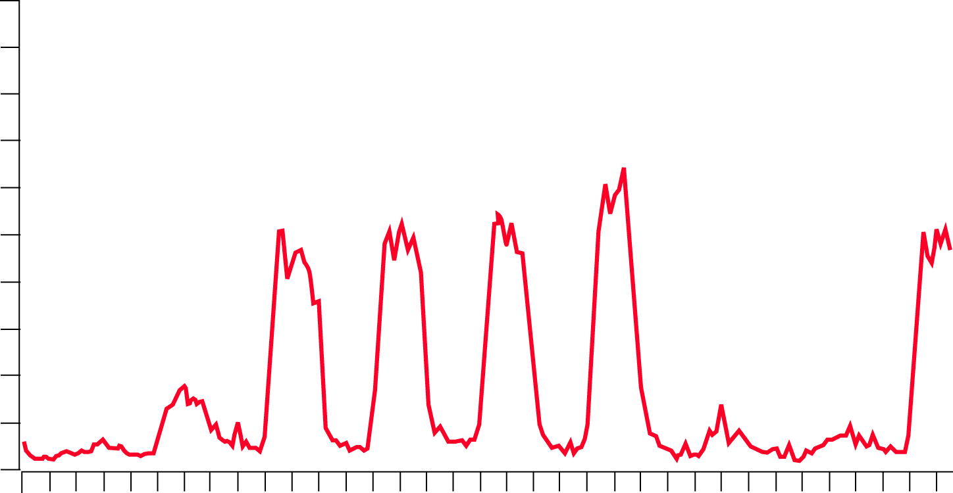
Bandwidth Management –
Typical Capacity Utilization Profile
100%
90%
Peak Utilization
Average
80%
70%
60%
50%
40%
30%
25%
20%
10%
0%
1/2/2000
1/3/2000
1/4/2000
1/5/2000
1/6/2000
1/7/2000
1/8/2000
1/9/2000
1/10/2000

Slide 33
Aggregate Discrete Bundles of Bandwidth
Into Diversified Portfolios
%
Enron
Composite
100
One Week
80
%
Media
60
40
One Week
20
%
Financial
0
One Week
Allows More Efficient Allocation of Bandwidth
Creates Incremental Bandwidth “Headroom”
Provides Framework for Tiered QoS Bandwidth
Allocation
One Week
%
Retail
One Week

Slide 34
Reconfigure and Optimize Portfolios
QoS Sensitive
Applications
QoS Insensitive
Applications
100
Incremental Firm
Capacity
80
60
40
20
Avg.
0

Slide 35
New Product and Contract Structures
QoS Sensitive
Applications
QoS Insensitive
Applications
100
3rd Party QoS
Insensitive Applications
80
Capacity Available for Resale
60
40
20
0
By Identifying Non-QoS or Time Sensitive Applications and Routing Them Over Alternate Routes or in “Time Troughs”, Enron Can Create More Firm “Headroom”

Slide 36
Outsourcing of Bandwidth Management
Enables Enron to Accelerate Creation of Portfolios
Businesses, ISP’s, Media Companies and Telecom Resellers Will Increasingly Outsource Bandwidth Requirements as Broadband Becomes More Predominant
Outsourcing is a Direct Application of Enron Energy Services Outsourcing Skill Set

Slide 37
Outsourcing of Bandwidth Management
Today
Enron Solution
Enron
Global Corporate Customer
  20 Offices Globally
  35 Circuits
  $10 Million per Year
Replace With One Term Enron Broadband Contract
  Flexible and Reliable
  Price Certainty
  Expandable

Slide 38
Trading
Trading of Bandwidth Enables Reconfiguration of Portfolios
Establishment of Benchmark and Market Pricing for Outsourcing and Portfolio Management
Foundation for Risk Management Services and New Product Development
Enron Has Been the Primary Architect of Market Structures in Most Major Markets in Which
It Participates

Slide 39
Trading
Creating Cash and Forward Markets for Bandwidth
Standardized Benchmark and Emerging Liquidity Become Foundation
for Reliable Market
- Segment City Pair: NY to LA
- Bandwidth Unit TDM DS-3 (44.7 Mbps)
- Term 1 Month Increments
- QoS
Errored Seconds: Not More Than 400 Errored Seconds Per Day
Severely Errored Seconds: Not More Than 4 Severely Errored
Seconds Per Day
Unavailable Seconds: Not More Than 26 Unavailable Seconds
Per Month
With Emergence of Liquidity, Price Discovery and Standardization, Risk
Management Products Evolve
Alternative Routes and QoS Will Trade At a Discount or Premium
to Benchmark

Slide 40
Finance
Apply Enron Finance Expertise as Tool to Aggregate Portfolios
Lever Structured Finance, Investments and Risk Management Skills into Opportunities that Enhance the Performance and Content of the Network
Enron Has Been the Leader in Creating New Finance Alternatives in Markets in Which
It Participates

Slide 41
Finance
Structured Finance
Investments
Providing Capital Access Solutions for Customers and Suppliers
Leading Edge Network Technologies and Enron’s Broadband Content
Equipment Funding Pools
Bandwidth Monetization Structures
DSL Implementation Fund
Network
Technology
Equinix
Avici
Sycamore Networks
Broadband
Content
DEN
Salus Media
M.Show.com

Slide 42
Intermediation Services Organization
Bandwidth Management
Ted Seitz (10)
Global Trading & Risk Management Tom Gros (20)
Global Finance
Kevin Howard
(12)
Ventures
Kevin Garland
(9)
Business Development Rich DiMichele (6)
Bandwidth Origination
Bandwidth Outsourcing
Bandwidth Restructures
Trading
Risk Management
Pooling Point
Research
Logistics
Structuring
Finance
Risk Assessment Interface
Technology
Content
Portfolio Management
Joint Ventures
M & A

Slide 43
Content Services
Enron
Intelligent
Network
Bandwidth
Intermediation
Deploy the Most Open, Efficient Network with Broad Connectivity
Content
Services
Be the World’s Largest Provider of Premium Broadband Delivery Services
Be the World’s
Largest Buyer and
Seller of Bandwidth
Fiber
Servers
Pooling Points
Software
Bandwidth Management
Trading
Finance
Streaming Broadband Services
Data Asset Management Services

Slide 44
Content Services
Streaming
Broadband
Services
Digital Asset
Management Services
High Quality Streaming Video
Usage-Based Business Model
Other Broadband Applications
Video File Transfer
Engineered CAD/CAM Data Management
Storing/Archiving Data

Slide 45
Demand for Streaming Video
In 1998, 9% of U.S. Organizations Were Using Streaming Video on Their Web Sites….This Percentage is Expected to Grow to 25-35% in the Next Two Years
- Gartner/Dataquest
Today, Rich Media Ads Account For 1% of Internet Ads….by 2002, 60% of All Internet Banner Ads Will Be Rich Media
- Jupiter Communications
An Estimated 45 Million Users Actually Stream Media Each Month
- Vision Consultancy
The Internet is Inadequate for Premium Broadband Content Delivery
Red Herring December 1999

Slide 46
Enron’s Solution
Provide EIN Solutions to Enable Enron’s Customers to Effortlessly Utilize Streaming Media to Access Their Customers
- Access Large, Diverse Customer Base
- Encoding Content
- Scheduling and Reserving Bandwidth
- Distribute Content to Servers at the Edge of Network
- High Quality and Reliable Serving of Streams
- Accurate, Quality of Service and Appropriate Billing
Enable Customers to Tailor the Quality of Service That Is Appropriate for the Content
Initial Target Market: Early Adopters
- Financial Services
- Media and Entertainment
- Technology

Slide 47


Content Services
Customer Base
Financial Services
  Major Financial Institutions
  Major Consulting Firms
  Financial News Services
Media and Entertainment
  Traditional Broadcast Networks
  Emerging Internet-Based Production Companies
  Professional Sports
  Movie Production Companies
Technology
Sample of
DEN
Content

Slide 48
Content Services Organization
Strategic Alliances
Jim Crowder
(4)
Sales
David Cox
(90)
Project Development
John Bloomer (39)
Marketing
Claudia Johnson (6)
Business Development
Media Services
Financial Services
Sales Engineering
North American Distribution
European Distribution
Media Transport
Media Cast
Video Conferencing
QA & Testing
Marketing Communication
Corporate Communication

Slide 49
Content Services
Customer Comments
Digital Entertainment Network
Jim Ritts
Chief Executive Officer
Greg Carpenter
Chief Technology Officer

Slide 50
Today’s Discussion
Enron Intelligent Network
Business Centers
Intermediation
Content Services
Financials
BOS

Slide 51
U.S. Network Industry Growing Rapidly
(Billions)
Telecommunications Services¹
Internet Services²
CAGR = 8%
CAGR = 35%
$345
$255
$117
$35
2000
2004
2000
2004
1 Includes Long Distance Voice and Data, Wireless, Local Voice, Access Charges, and Managed Data Services (Source: Dataquest; Enron Analysis)
2 Includes Basic Internet Access, Premium Broadband Delivery Services, and Web/Application Hosting (Source: Morgan Stanley Dean Witter; IDC; JP Morgan; Forrester; Enron Analysis)

Slide 52
Enron Is Targeting Two Segments Of The Network Industry
Telecommunications Services
Internet Services
Premium
Broadband
Delivery Services
Content Services - Be the World’s Largest Provider of Premium Broadband Delivery Services
Bandwidth Intermediation - Be the World’s Largest Buyer and Seller of Bandwidth
Long-Haul Bandwidth Transport

Slide 53
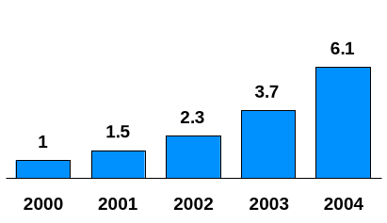
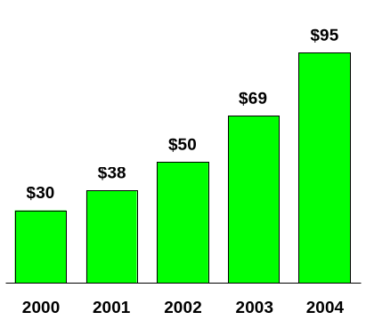
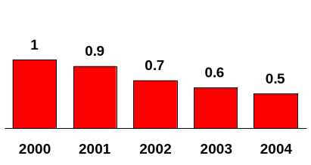
Long-Haul Bandwidth Transport –
Rapid Growth Despite Price Declines
Bandwidth Capacity in Use (Voice and Data)*
Index (2000 = 1.0)
Long-Haul Bandwidth Transport Market
(Billions)
CAGR = 57%
CAGR = 34%
Price
Index (2000 = 1.0)
CAGR = -15%
* Includes Bandwidth Transport for Internet Infrastructure Services and Traditional Carrier Revenues; Midpoint of Lehman Brothers Bandwidth Capacity Forecast; Excludes Dark Fiber
Source: FCC; Lehman Brothers; Enron Analysis

Slide 54
Growth Of Bandwidth Capacity In Use
Index¹
Service
Source
1998
2002
2004
CAGR
Voice
Lehman
0.3
0.4
0.5⁴
10%
Data
2,3
Lehman
0.2
2.0
5.7⁴
70%
Pioneer
0.2
2.2
6.8
76%
Mutooni
0.2
6.4
34.1
130%
Total
Lehman
0.5
2.4
6.1
57%
1 Indexed Against Year 2000 Total Estimate of 16,347 E15 Bits
2 Lehman Brothers October 1998 Forecast; Alternative Estimates: Pioneer Projects Internet Backbone Use to Grow at 76% From 1998-2003; Mutooni Projects Data Traffic to Grow at 130% From 1998-2004
3 Data Includes Private Line; Residential and Business Internet; Traditional Data Services Such As Frame Relay, ATM, SMDS, and X.25
4 Lehman 2004 Value Estimated by Extrapolating 1998-2002 Expected Growth Rates to 2004
Notes:
<number>
<footer>
<header>
<date/time>

Slide 55
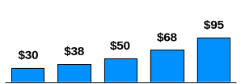
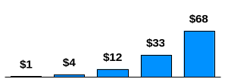
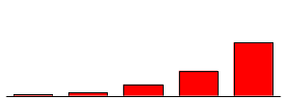




Bandwidth Intermediation Opportunity
(U.S. Only)
Bandwidth Transport Market
(Billions)
Bandwidth Intermediation Market
(Billions)
Enron Intermediation
Operating Income
(Millions)
$545
2000
2001
2002
2003
2004
2000
2001
2002
2003
2004
Share Intermediated
(Percent)
Enron Market Share
(Percent)
$260
$115
$9
$40
2000
2001
2002
2003
2004
2000
2001
2002
2003
2004
2000
2001
2002
2003
2004
Transaction Velocity
(Ratio)
Enron Operating Income Margin
(Percent)
2000
2001
2002
2003
2004
2000
2001
2002
2003
2004
Source: Dataquest; Lehman Brothers; Enron Analysis

Slide 56
Bandwidth Intermediation Value
(Millions)
2000
2001
2002
2003
2004
U.S Operating Income
$9
$40
$115
$260
$545
International Operating Income
**
$2
$15
$70
$210
$ 545
Global Operating Income
$11
$55
$185
$470
$1,090
2004 Operating Income $1,090 million
2004 Value at 20X Multiple $22 billion
Value as of January 2000*
$14 billion
* Assumes Discount Rate of 11%
** Global Telecom Long Distance Market Approximately 3x U.S. Market in 2000; Assumes Worldwide Opportunity Reaches 2x U.S. Opportunity for Bandwidth Intermediation in 2004
Source: Enron Analysis
Notes:
<number>
<footer>
<header>
<date/time>

Slide 57
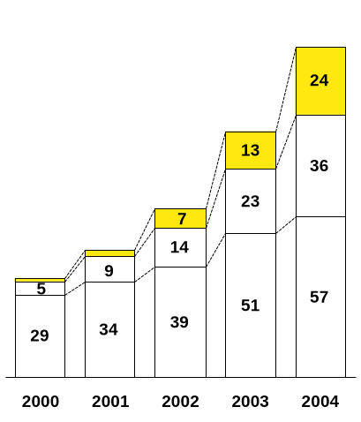
U.S. Internet Services Market
(Billions)
$117
Premium Broadband Delivery Services*
Enron
Focus
CAGR
35%
CAGR
151%
$87
Hosting**
$60
CAGR
64%
$45
2
1
$35
Basic Access***
CAGR
18%
* Defined As Delivery of Primarily High Bandwidth Content and Applications Requiring Guaranteed/Tiered QoS; J. P. Morgan Forecasts U.S. Market Size for “Intelligent Delivery Network Service” of $24.7 Billion in 2004; Morgan Stanley Dean Witter Projects a $44 Billion U.S. Market for “Intelligent Content and Application Distribution” in 2004
** Defined As Colocated and Shared/Dedicated Web Hosting and Application Hosting (Source: IDC; J.P. Morgan; Forrester; Morgan Stanley Dean Witter)
*** Defined As Business and Consumer Narrowband (Dial-up) and Broadband (Cable, DSL, T1/OC3/DS3, Internet Access, (Source: Morgan Stanley Dean Witter)

Slide 58
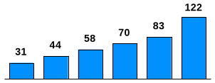
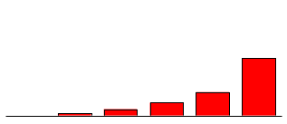


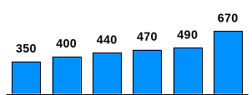
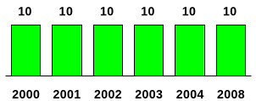
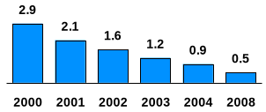
Content Services Opportunity
(U.S. Only)
U.S. Broadband Internet Users*
(Millions)
X
Premium Broadband Delivery Services Revenues
(Billions)
Premium Delivery (Primarily Streaming)**
(Minutes/day)
Enron Content Services Revenues
(Millions)
$5,870
X
X
Average Access Speed*
(Kbps)
Enron Market Share
(Percent)
$2,400
$690
$1,280
$45
$240
2000
2001
2002
2003
2004
2008
X
Premium Delivery Service Charge**
(¢/MB)
* Estimated by Morgan Stanley Dean Witter, Broadband Users Defined As Those With Greater Than 100 Kbps Access;
Business Users 250 Days/Year, Consumer 365 Days/Year
** Enron Analysis
Source: Enron Estimates; Morgan Stanley Dean Witter; Enron Analysis

Slide 59
Content Services Value
(Millions)
2000
2001
2002
2003
2004
2008
U.S Revenues
$45
$240
$690
$1,280
$2,400
$5,870
International Revenues**
$9
$70
$280
$580
$1,200
$5,870
Global Revenues
$54
$310
$970
$1,860
$3,600
$11,740
2008 Revenues $11,740 Million
2008 Operating Income @ 30% Margin $3,520 Million
2008 Value at 20X Multiple $70 Billion
Value As of January 2000*
$18 Billion
* Assumes Discount Rate of 17%
** Global Broadband Internet Users 3x U.S. in 2000 and 5x U.S. In 2004; Assumes Worldwide Opportunity for Premium Delivery Services Reaches 2x U.S. Opportunity in 2008
Source: Enron Analysis
Notes:
<number>
<footer>
<header>
<date/time>

Slide 60
Enron Broadband Services
Potential Value
(Billions)
$3
$18
$29
$14
Bandwidth Intermediation
Content Services
G & A*
Total
* Excluding Depreciation; $125 Million in 2000 Escalated at 12% until 2008 and 5% thereafter; Discount Rate @ 11%
Source: Enron Analysis

Slide 61
Enron’s Intermediation Metric
Volumes
(DS-3* Months Delivered)
1,740,000
640,000
170,000
5,000
41,000
2000
2001
2002
2003
2004
* DS-3 Equals Approximately 45 Mbps

Slide 62
Enron’s Content Services Metric
Total Contract Value
(Millions)
Terabytes Delivered
$5,390
$3,720
$1,940
$920
$160
2000
2001
2002
2003
2004
Source: Morgan Stanley Dean Witter; Enron Analysis

Slide 63
Financial Targets - 2000
Financials
Capital Expenditures $650 Million
IBIT ($60) Million
Metrics
Bandwidth Intermediation 5,000 DS-3 Months
Content Services $160 Million TCV

Slide 64
Today’s Discussion
Enron Intelligent Network
Business Centers
Intermediation
Content Services
Financials
BOS

Slide 65
Broadband Operating System (BOS)
Proposed Standard Protocol for Accessing Real-Time Bandwidth
  Routing - Network Element Control
  Bandwidth Reservation
  Metering
  Verification of User Authorization
  Data Transmission Encryption
  Quality of Service Definition; Confirmation
Single OS Paradigm for All Network Resources: Switches, Routers, Servers and Applications
Direct Software Link Between Applications and the Network Resources
Protocol Consistent With EIN and Enron’s Bandwidth Provisioning Architecture
To Be Made Available to All Software Developers Through Published Application Programming Interface (API)

Slide 66
Central Role of BOS
Seattle
Portland
Minneapolis
Toronto
Albany
Boston
London
Boise
Detroit
Paris
Salt Lake City
Omaha
New York
Copenhagen
Sacramento
Denver
Chicago
Cleveland
Munich
San Francisco
St. Louis
Philadelphia
Amsterdam
San Jose
Kansas City
Washington D.C.
Rome
Tokyo
Las Vegas
Albuquerque
Charlotte
Los Angeles
Phoenix
Dallas
Jackson
Atlanta
San Diego
San Antonio
New Orleans
Orlando
Houston
Miami

Slide 67
Our Goal: Be the Broadband Platform
Enron
Intelligent
Network
Bandwidth
Intermediation
Deploy the Most Open, Efficient Network with Broad Connectivity
Content
Services
Be the World’s Largest Provider of Premium Broadband Delivery Services
Be the World’s
Largest Buyer and
Seller of Bandwidth
Fiber
Servers
Pooling Points
Software
Bandwidth Management
Trading
Finance
Streaming Broadband Services
Data Asset Management Services

Slide 68
Market Opportunity - U.S.
(Revenues in Billions)
Long Haul Bandwidth Transport
Premium Broadband Delivery Services
$95
$54
34% CAGR
84% CAGR
$68
$50
$38
$24
$30
$13
$7
$1
$2
2000E
2001E
2002E
2003E
2004E
2000E
2001E
2002E
2003E
2004E
2008E
Source: Dataquest; J.P. Morgan; Lehman Brothers; Morgan Stanley Dean Witter; Enron Analysis

