Slide 1

Coal, Emissions, and Vessel Trading Group
2000 - Year in Review 2001 - Where We’re Going
February, 2001

Slide 2
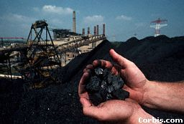
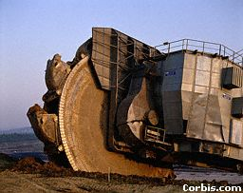
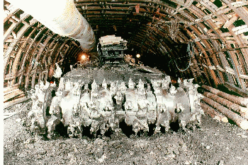
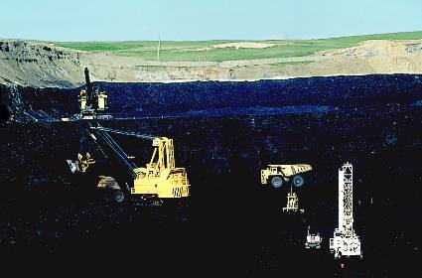
Coal Group MTM Income
*Budget

Slide 3
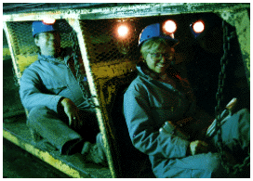
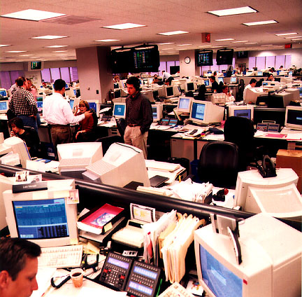
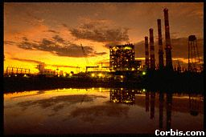
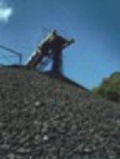
Coal Group Domestic Tons Traded
*Projected

Slide 4
International Coal Tons Traded
*Projected

Slide 5
International Vessel Tons Traded
*Projected

Slide 6
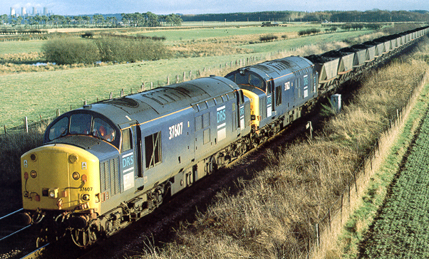
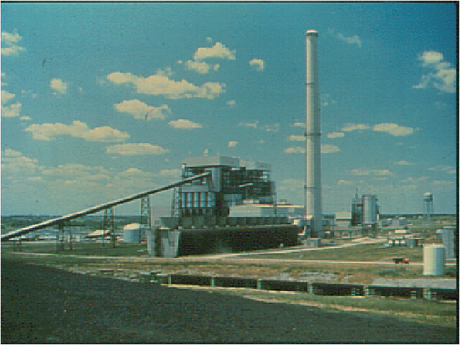
Coal Group Tons Shipped
*Projected

Slide 7
Major Areas of Activity
Coal, Emissions, and Vessel Trading
EOL and OTC
Mid-Market
Origination

Slide 8
2001 Goals - Origination
Mike Beyer
Gain control of physical production in US-PRB, Australia, and RSA (equity, debt, distressed debt, and pre-pays)
Utilize capital to expand short position with buyers (contract buyouts & infrastructure upgrades)
Continue to expand synfuel - AIG, Pace, and others (2-3 deals)
Restructure existing portfolio - American Coal, Cline, BMR, and Jupiter
PRB origination
Emission Technology - NoxTech & Mitsui Babcock
USA “Stockpile” Deals

Slide 9
2001 Goals - Domestic Trading
Kevin McGowan
Trade to make money - not just sell equity coal
Individual books push responsibility to individual traders - add more traders to the desk
Mid-marketers concentrate on smaller number of customers
Counterparties - constant pitches of “book inspired” deals
Logistics as a profit center - rail/barge “day ahead” decisions
Trade synfuel spread vs. NYMEX
Continue to dominate volumes - EOL / OTC / Mid-market
Long term purchase/supply contracts
Big PRB deal through debt or marketing agreement
Sempra synfuel restructuring

Slide 10
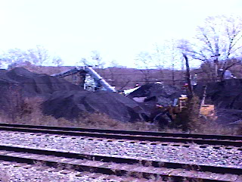
2001 Goals - International
Stuart Staley
Trade more tons than any other player in the international market (OTC / EOL / Mid-market)
Extend network of “stockpile” deals into Europe
-Spain
-ARA
-Mediterranean
Expand Pacific business out of Sydney office
-focus on sales into Japan, Korea, Taiwan
-leverage CLP position with mines in China and Indonesia
-originate long position out of Newcastle, Australia
Leverage Project Springbok to obtain long position out of South Africa
Continue to identify and control constraint points - Rail, Port, Barge
Establish SECA as the most liquid OTC contract

Slide 11
2001 Goals - Emissions
Kevin McGowan and John Massey
Develop mid-market liquidity in SO₂ / NO_{X}
Trade more products - NO_{X}, ERC, mercury, and carbon (when available)
Integrate emission technology with trading group
Global integration - UK NO_{X} program, carbon, etc.

Slide 12
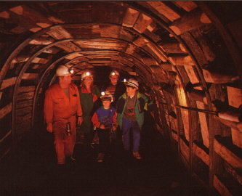
2001 Goals - Vessel Freight
Pierre Aury
Build EOL and OTC liquidity - banks, funds, owners, operators, end users, and producers
Dominate long dated market - build origination capabilities, focus on options
Leverage shipping requirements of other Enron groups: coal, grain, liquids, paper, and steel
Leverage Enron’s credit advantage
Move LNG Shipping P&L responsibility under coal

Slide 13
The Dream Team
Synfuel
Stockpile Deals
Credit
Sites
O&M
Coal Feedstock
Synfuel Off-take
Monetizers
Market
Transportation - Barge/Rail
Credit
Station stockpile - optionality
Rail - trade capacity
Port - stockpile optionality
Vessels / Barges (US flag & international flag)
Coal - (domestic & offshore)
Currency - USD book in London
Emission Credits

Slide 14
Summary
Become acknowledged market leaders - global coal, vessel trading, and emissions
Trade to make money
Big origination deals
The Dream Season - $75 MM
.

