Slide 1

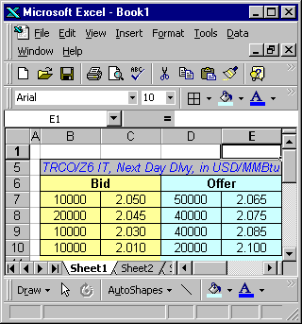
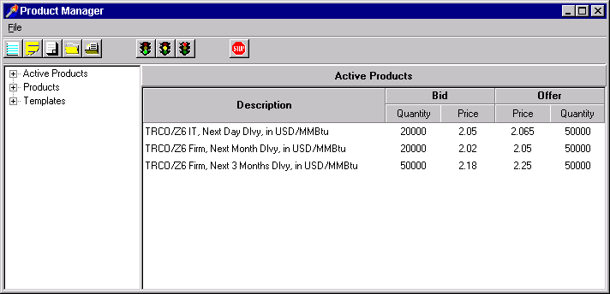
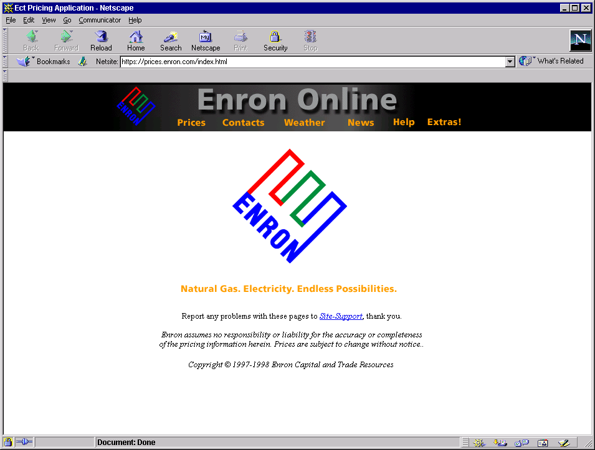

System Architecture
Product Management
Web Delivery
abcdefgadfjlkjdfuaojfldkjfoiejlkajdfpqoadfafadfaefaefefasdfasdfafdafdasfdasfdasdfasDfsadfasdfasfdadfadfasdfasdfasdfasdfasdfasdfasaskldfjalkfdjaifj;oiwejqflkajdfoiwef;akjdfoiwjfe;lkjfoiwefjalskjfdoqpwiefja;sdkfjeifja;sokfjdqopwefjia;dfkjqpoiefja;ldkfjqpwoeifja;sdkfjqpwoefjia;sodfjkpqwoefijasdkfjpqweoifjas;dkfjqpwekfojasdofkjqpwoekjfaskodjfasdklfjalskfjalsdkfjalsdkjf;lk
Server
Server
Database

Slide 2
Development
Product Management
Web Delivery
abcdefgadfjlkjdfuaojfldkjfoiejlkajdfpqoadfafadfaefaefefasdfasdfafdafdasfdasfdasdfasDfsadfasdfasfdadfadfasdfasdfasdfasdfasdfasdfasaskldfjalkfdjaifj;oiwejqflkajdfoiwef;akjdfoiwjfe;lkjfoiwefjalskjfdoqpwiefja;sdkfjeifja;sokfjdqopwefjia;dfkjqpoiefja;ldkfjqpwoeifja;sdkfjqpwoefjia;sodfjkpqwoefijasdkfjpqweoifjas;dkfjqpwekfojasdofkjqpwoekjfaskodjfasdklfjalskfjalsdkfjalsdkjf;lk
Server
Server
Internal
Database
Outsource

Slide 3
Web Delivery

Slide 4
Home
Contacts
News
Links
Login
Quotes
Custom Quotes
Transactions
Administration
HOME PAGE
MARKETING DATA
MARKET HOURS
Language Selection

Slide 5
Home
Contacts
News
Links
Login
Quotes
Custom Quotes
Transactions
Administration
CONTACTS PAGE
ROLE CONTACT PHONE EMAIL
List of contacts
Can click a contact to email

Slide 6
Home
Contacts
News
Links
Login
Quotes
Custom Quotes
Transactions
Administration
NEWS PAGE: , Static, Polled every 10 minutes
Shows all headlines in last 72 hours.
DATETIME HEADLINE BY-LINE
DateTime in User Profile TimeZone
List of headlines
Can click on a headline and takes user to URL with the news item.
Supporting tools: 1. User ability to create news item (should update news headline page). 2. Process which ages the page.

Slide 7
Home
Contacts
News
Links
Login
Quotes
Custom Quotes
Transactions
Administration
LINKS PAGE
Shows list of links to other interesting energy sites
LINK DESCRIPTION
List of links
Can click on a link to go to that URL

Slide 8
Home
Contacts
News
Links
Login
Quotes
Custom Quotes
Transactions
Administration
LOGIN PAGE
User can go here to login to the protected areas of the site. Clicking on any of the protected areas will also force a login.

Slide 9
Home
Contacts
News
Links
Login
Quotes
Custom Quotes
Transactions
Administration
Quotes
Search
Description
Min Qty
Tick Size
Trading Hours
Country
Bid
Offer
5000/day
1000/day
2.05
2.065
TRCO/Z6 IT, Next Day Dlvy, in USD/MMBtu
7AM CST to 11AM CST
20000/day
50000/day
Region
TRCO/Z6 IT, Next Month Dlvy, in USD/MMBtu
5000/day
1000/day
7AM CST to 11AM CST
20000/day
2.02
2.05
50000/day
Commodity
TRCO/Z6 Firm, Next 3 months Dlvy, in USD/MMBtu
5000/day
1000/day
7AM CST to 11AM CST
50000/day
2.18
2.25
50000/day
Phys/Fin/Capacity
Deal Type
Current session transactions shown with timestamp given by user profile.
Transactions this Session
DateTime
Buy/Sell
Description
Quantity
Price
5/2/99 7:15 AM CST
Buy
TRCO/Z6 IT, Next Day Dlvy, in USD/MMBtu
8000/day
2.045
5/2/99 7:15 AM CST
Sell
TRCO/Z6 IT, Next Day Dlvy, in USD/MMBtu
5000/day
2.035

Slide 10
Home
Contacts
News
Links
Login
Quotes
Custom Quotes
Transactions
Administration
Quotes
Search
Description
Min Qty
Tick Size
Trading Hours
Country
Bid
Offer
5000/day
1000/day
2.05
2.065
TRCO/Z6 IT, Next Day Dlvy, in USD/MMBtu
7AM CST to 11AM CST
20000/day
50000/day
Region
TRCO/Z6 IT, Next Month Dlvy, in USD/MMBtu
5000/day
1000/day
7AM CST to 11AM CST
20000/day
2.02
2.05
50000/day
Commodity
TRCO/Z6 Firm, Next 3 months Dlvy, in USD/MMBtu
5000/day
1000/day
7AM CST to 11AM CST
50000/day
2.18
2.25
50000/day
Phys/Fin/Capacity
This is the long description of the product just clicked. Click cancel to exit or GTC to view the General Terms and Conditions for this product. Click custom to add this product to your custom quotes page.
Deal Type
Transactions this Session
DateTime
Buy/Sell
Description
Quantity
Price
5/2/99 7:15 AM CST
Buy
TRCO/Z6 IT, Next Day Dlvy, in USD/MMBtu
8000/day
2.045
5/2/99 7:15 AM CST
Sell
TRCO/Z6 IT, Next Day Dlvy, in USD/MMBtu
5000/day
2.035

Slide 11
URL for the GTC
General Terms and Conditions
TEXT OF THE GTC

Slide 12
Home
Contacts
News
Links
Login
Quotes
Custom Quotes
Transactions
Administration
Quotes
Search
Description
Min Qty
Tick Size
Trading Hours
Country
Bid
Offer
5000/day
1000/day
2.05
2.065
TRCO/Z6 IT, Next Day Dlvy, in USD/MMBtu
7AM CST to 11AM CST
20000/day
50000/day
Region
TRCO/Z6 IT, Next Month Dlvy, in USD/MMBtu
5000/day
1000/day
7AM CST to 11AM CST
20000/day
2.02
2.05
50000/day
Commodity
TRCO/Z6 Firm, Next 3 months Dlvy, in USD/MMBtu
5000/day
1000/day
7AM CST to 11AM CST
50000/day
2.18
2.25
50000/day
Phys/Fin/Capacity
Deal Type
Transactions this Session
DateTime
Buy/Sell
Description
Quantity
Price
5/2/99 7:15 AM CST
Buy
TRCO/Z6 IT, Next Day Dlvy, in USD/MMBtu
8000/day
2.045
5/2/99 7:15 AM CST
Sell
TRCO/Z6 IT, Next Day Dlvy, in USD/MMBtu
5000/day
2.035

Slide 13
Home
Contacts
News
Links
Login
Quotes
Custom Quotes
Transactions
Administration
Please Confirm
Quotes
You are selling
Search
20000/day
Description
Min Qty
Tick Size
Trading Hours
Bid
Offer
Country
TRCO/Z6 IT, Next Day Dlvy, in USD/MMBtu
5000/day
1000/day
2.05
2.065
TRCO/Z6 IT, Next Day Dlvy, in USD/MMBtu
7AM CST to 11AM CST
20000/day
50000/day
Region
2.02
2.05
TRCO/Z6 IT, Next Month Dlvy, in USD/MMBtu
1000/day
for 2.05
5000/day
7AM CST to 11AM CST
20000/day
50000/day
Commodity
TRCO/Z6 Firm, Next 3 months Dlvy, in USD/MMBtu
5000/day
1000/day
7AM CST to 11AM CST
50000/day
2.18
2.25
50000/day
Phys/Fin/Capacity
Fill Or Kill
Deal Type
Accept Partial Volume
I accept
I decline
Transaction Failed
Reason Transaction Failed will show here.
The reason could be that our database has not yet registered that this client has seen the GTC governing this transaction. If this is the case, this box will include a link to the page containing the GTC. If the user clicks this link, we will then register that it has been read by this client.
OR
Transaction data returned, Highlight recent changes.
Transactions this Session
DateTime
Buy/Sell
Description
Quantity
Price
5/2/99 7:15 AM CST
Buy
TRCO/Z6 IT, Next Day Dlvy, in USD/MMBtu
8000/day
2.045
5/2/99 7:15 AM CST
Sell
TRCO/Z6 IT, Next Day Dlvy, in USD/MMBtu
5000/day
2.035
5/2/99 8:15 AM CST
Sell
TRCO/Z6 IT, Next Day Dlvy, in USD/MMBtu
10000/day
2.05

Slide 14
Please Confirm
You are selling
20000/day
TRCO/Z6 IT, Next Day Dlvy, in USD/MMBtu
for 2.05
Accurate Price?
No trade
No
Fill Or Kill
Accept Partial Volume
I accept
I decline
Yes
Lock Price
Acknowledge and update transactions
Server
Add Transaction
Database Transaction
Update volume or Push Price Stack
Commit Transaction
Database

Slide 15
Home
Contacts
News
Links
Login
Quotes
Custom Quotes
Transactions
Administration
Custom Quotes
Description
Min Qty
Tick Size
Trading Hours
Bid
Offer
TRCO/Z6 IT, Next Day Dlvy, in USD/MMBtu
5000/day
1000/day
7AM CST to 11AM CST
20000/day
2.05
2.065
50000/day
TRCO/Z6 IT, Next Month Dlvy, in USD/MMBtu
5000/day
1000/day
7AM CST to 11AM CST
20000/day
2.02
2.05
50000/day
Transactions this Session
DateTime
Buy/Sell
Description
Quantity
Price
5/2/99 7:15 AM CST
Buy
TRCO/Z6 IT, Next Day Dlvy, in USD/MMBtu
8000/day
2.045
5/2/99 7:15 AM CST
Sell
TRCO/Z6 IT, Next Day Dlvy, in USD/MMBtu
5000/day
2.035

Slide 16
Home
Contacts
News
Links
Login
Quotes
Custom Quotes
Transactions
Administration
Transactions
Search
DateTime
Buy/Sell
Description
Quantity
Price
Country
5/2/99 7:15 AM CST
Buy
TRCO/Z6 IT, Next Day Dlvy, in USD/MMBtu
8000/day
2.045
Region
5/2/99 7:15 AM CST
Sell
TRCO/Z6 IT, Next Day Dlvy, in USD/MMBtu
5000/day
2.035
Commodity
Phys/Fin/Capacity
Deal Type
Last
20
Transactions shown with timestamp given by user profile.

Slide 17
Home
Contacts
News
Links
Login
Quotes
Custom Quotes
Transactions
Administration
Administration
Company Profile
Contacts
CPT English
Product Type
Buy
Sell
Term Limits
Admin
CPT English
US IT Natural Gas Forwards
Trade
Trade
1 month
Joe Smith
Add
CPT English
US Firm Natural Gas Forwards
Trade
Trade
3 months
Mike Davis
Tom Johnson
US Firm Electricity Forwards
Trade
Trade
3 months
CPT English
US Natural Gas Financial Swaps
Read
Read
6 months
US Natural Gas Financial Options
Read
6 months
Time Zone: CPT
Language Preference: English

Slide 18
Home
Contacts
News
Links
Login
Quotes
Custom Quotes
Transactions
Administration
Administration
Company Profile
Contacts
Product Type
Buy
Sell
Term Limits
Admin
CPT English
US IT Natural Gas Forwards
Trade
Trade
1 month
Joe Smith
CPT English
Add
US Firm Natural Gas Forwards
Trade
Trade
3 months
Mike Davis
CPT English
US Firm Electricity Forwards
Trade
Trade
3 months
Tom Johnson
CPT English
US Natural Gas Financial Swaps
Read
Read
6 months
Click update to change this users name or password or change this users preferred language or time zone, or click delete to remove this user (cannot delete the admin user).
US Natural Gas Financial Options
Read
6 months
Time Zone: CPT
Language Preference: English

