Slide 1

Many things happened at the Christmas Party…………………………..

Slide 2
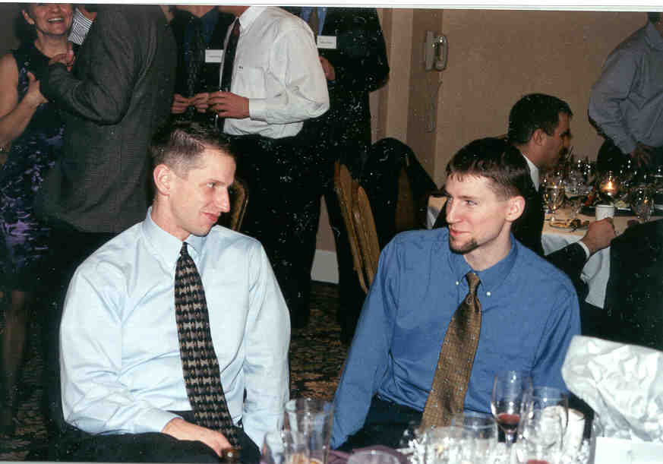
I hope he doesn’t
mind about the
bonus
I hope my bonus
is good
Work relationships were improved….

Slide 3
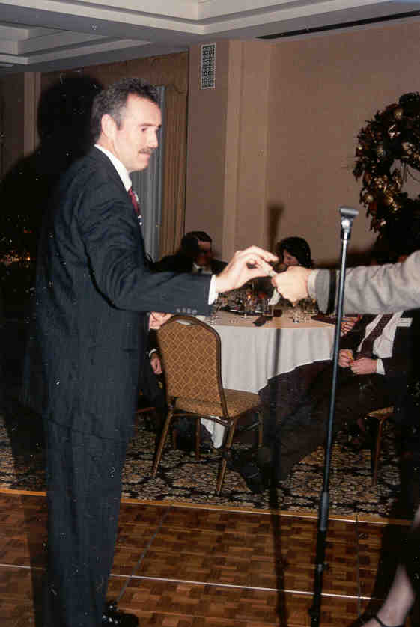
The Cold and Flu Prevention Award went to......
Wayne shows
that he will
take your money...
But he won’t
touch
your hand!

Slide 4
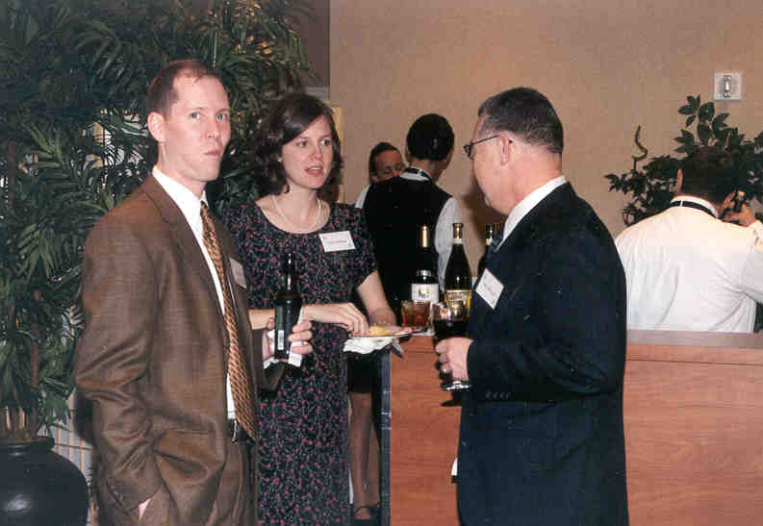
Mmm..
Shrimp!
Tim enjoyed the h’ors devres…………..twice

Slide 5
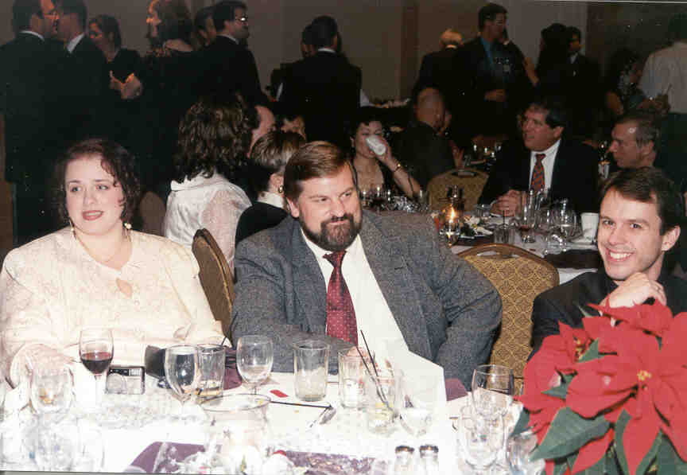
If I get blamed
for this, you
are dead
Smile, nobody
thinks it’s me...
What’s that
SMELL??
People enjoyed socializing and relaxing…………...

Slide 6
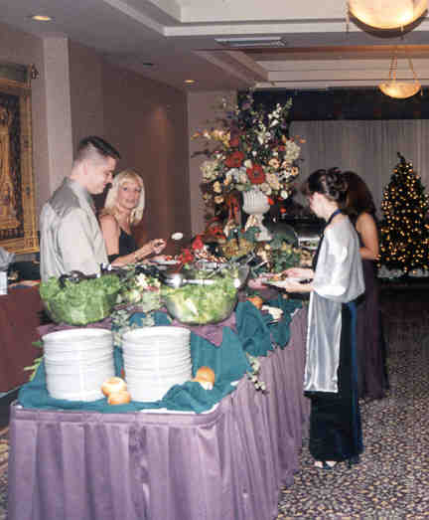
Kathy got overtime pay
because she was busy
evaluating the caterer……..
Do you think
they would
deliver by 6?
What the
*!@%$# is
this?
Erin wonders if
Stewart has heard that
dinner is ready………….

Slide 7
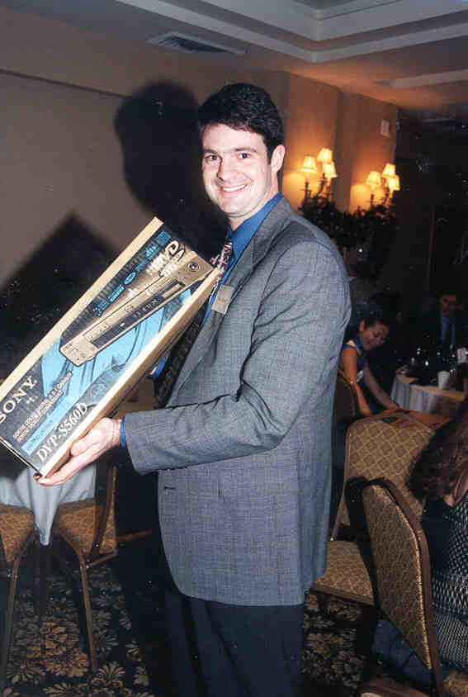
I think Mom
will go $150!
Stan was very happy
to have won a new
DVD player……..

Slide 8
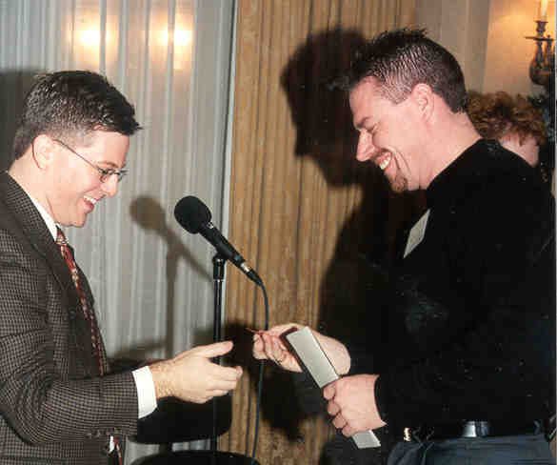

I didn’t really
think he would
pay the whole $100!
I sure hope he
doesn’t notice its
fake until tomorrow
Finally, Mike and Murray enjoyed a new business relationship.

Slide 9
Merry Christmas Everyone!!!

