Slide 1






Natural Gas Outlook & Hedging Strategies
Chicago, June 14, 2001

Slide 2
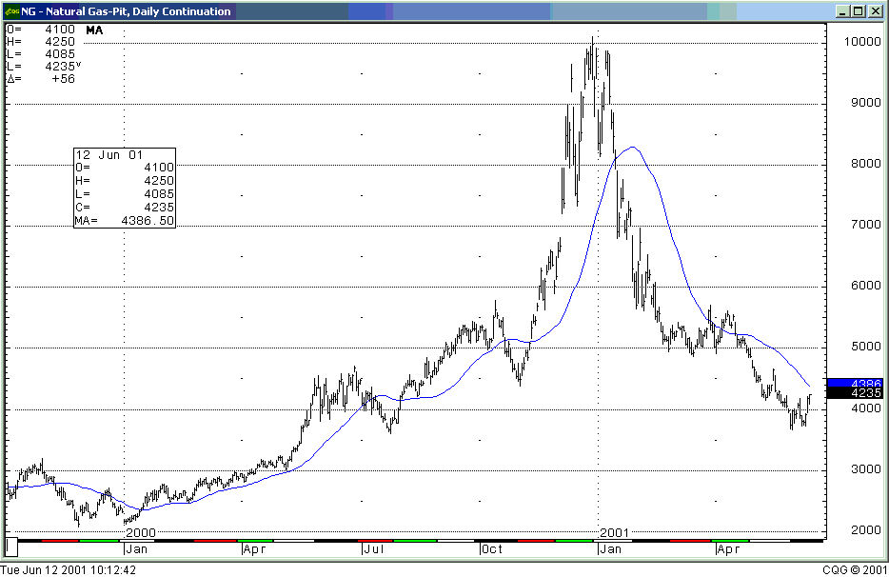
NG Price History
Coldest Nov-Dec in History
Industry Reacts
End of 2000 injection season – Storage 2794
Beginning of injection season

Slide 3
US Gas Demand vs. Domestic Supply
Deliverability Gap
Source: PIRA

Slide 4
Current and Projected Components U.S. Natural Gas Demand:
Electric Generation Experiences the Greatest Growth
(Year 1985 - 2020)
Bcf per day
Projected Annual Growth Rate (1999 - 2020)
Residential: 1.3% Total: 2.3%
Commercial: 1.3%
Industrial: * 1.2%
Generation: 5.4%
* Includes Cogenerators
19% Growth
35 Tcf
Source: EIA, Annual Energy Outlook 2001

Slide 5
Historical & Projected Gas Fired Capacity Additions
Source: EIA, EEI, and EVA
**1 Megawatt/hr of Electricity generated requires 9 MCF of natural gas assuming a 9000 Btu/kWh heat rate

Slide 6
Production
Source: EIA & Baker Hughes, Updated as of May 01

Slide 7
Higher Rig Counts not a Short–term Solution
Lag time between production and drilling
Higher levels of first year depletion rates
Lower initial production rates
Excessive reliance on development drilling
Producers focusing on smaller prospects
Estimated that 1,500-2,000 rigs may be necessary to meet growing U.S. demand

Slide 8
U.S. Natural Gas Production
Source: In House Analysis
30,243
29,433
29,735
29,168
29,419
28,860
29,000
28,793
28,811
29,050
28,632

Slide 9
U.S Production History- Offshore

Slide 10
US Gas Supply Components

Slide 11
Flow of Gas: US-México-Canada: 2000
BCF’s 2000
LNG
75
Algeria 44.08
Trinidad 100.28
Qatar 46.9
Australia 5.9
Nigeria 12.98
UAE 12.74
Indonesia 2.76
66
Japan
3543
103
11
Imports to US
105
225
Exports from US
122

Slide 12
Western Canadian Field Receipts
Rate of Production is Increasing
Alberta + British Columbia + Saskatchewan
Source: In House Analysis

Slide 13
Chicago Basis Scenario
Alliance brings 1.5bcf in the beginning of 2001
Chicago basis was expected to plummet
Trigger the construction of additional pipelines
Taking gas out of the region

Slide 14
Chicago Basis (what really happened)
Most of the volume coming from Alliance was already committed
  Wisconsin (Guardian)
  Other (Vector, ANR)
Actual volume actually coming into Chicago(Nicor/Peoples Gas) – 350,000
Basis went down from $.39 last winter to a forecast of $.16 for next winter

Slide 15
Weather and the Storm Season
April & May were mild in the major population areas
Summer Forecast: Warm along the U.S. coast, cooler in the midwest
Extremely weak El Niño to none at all
Atlantic hurricane season predicted to be 20% more active than the norm of the last 50 years.
Number of storms predicted for the Atlantic Ocean increased from 10 to 12.
39% chance of landfall along the gulf coast.
Increased possibility of supply and / or production interruptions.
Weather continues to be the wild card

Slide 16
Storage Levels
Source: AGA, Week Ending June 8, 2001
2001
2000
7 Year Range
Injection Season
January 1st
December 31

Slide 17
Eliminating the Deficit
Milder weather and decreasing demand

Slide 18
Current Inventories by Region
Source: In House Analysis, AGA,, Week Ending June 8, 2001

Slide 19
Where Could Storage Go
Bcf
3225
2803
MAX
5 YR AVE
2715
LAST YEAR
2355
MIN
1503

Slide 20
Elasticity of Demand
Source: In House Analysis

Slide 21
Economics of Demand
US Economic Growth is slowing
Fuel Switching
Mild weather
Conservation
  Residential / Commercial
Industrial Demand
  Aluminum smelters
  Ammonia / Methanol
  Steel

Slide 22
Resid and Distillate as a Ceiling and Floor

Slide 23
LNG
Currently, Lake Charles, LA, and Everett, MA are the only two active LNG receiving terminals in the U.S. with combined vaporization and trucking capacity of 1.3 Bcf/D, or 2% of U.S. daily gas consumption
Elba Island, Georgia, and Cove Point, Maryland, are expected to be operational by 2002, adding 1.25 Bcf/d to capacity
Sonat announced last winter they had signed a 22-year deal with the Atlantic Project in Trinidad and Tobago to import 82 Bcf of natural gas per year at the Elba Island Facility
El Paso to Build Six LNG Facilities: 3 in US, 2 in Mexico, 1 in Bahamas
Enron is actively exploring the possibility of building an LNG terminal in the Bahamas as well as building a pipeline from the Bahamas to Florida
Source: Society of Petroleum Engineers, Morgan Stanley Dean Witter, EEA

Slide 24
Hedging Strategies

Slide 25
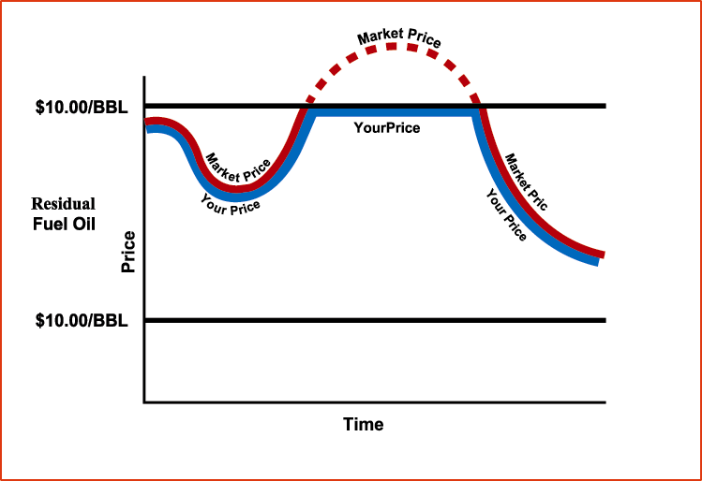
Caps/ Call
1. Objective:
  A maximum price is established
  Customer participates in all the downward movement below the established ceiling (maximum price)
2. Cap Mechanics:
  For example, $4.85/ MMBtu for Natural Gas - this is the maximum you will pay and you benefit from all downside price movement
  The protection has a cost, for July ‘01 - Jun ‘02 the cost would be $0.48/MMBtu for this insurance
$4.80/MMBtu
Natural Gas
Prices are illustrative only

Slide 26
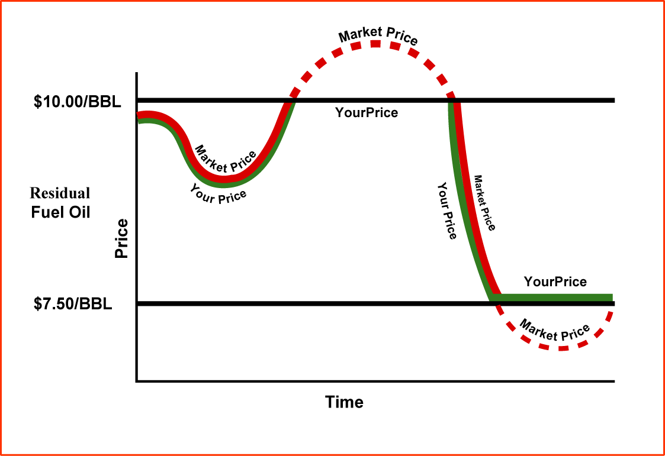
Costless Collars
1. Objective:
  For endusers looking to limit their upside price exposure, but who do not wish to pay for this insurance
2. Collar Mechanics:
  In this case, the enduser chooses a range: opportunity given up on the downside is used to fund the cost of upside price protection
$5.50/MMBtu
Natural Gas
$3.85/MMBtu
Prices are illustrative only

Slide 27
Three-Way Structure
Provides price protection from rising prices while offering flexibility to benefit from decreasing prices within a defined range
No upfront or limited upfront cost
Buy cap / Sell call / Sell floor
Client receives additional
premium for selling the call,
which allows greater
downside participation vs a
no cost collar
If market price is above $4.90, customer’s price is market price minus $0.50.
If market price is between $4.40 and $4.90 customer pays $4.40.
Client pays market price between $3.50 and $4.40 and pays $3.50 if market price falls below $3.50
Index Price
Sell Call
$4.90
$4.40
Buy Call
$3.50
Sell Put
Effective Price
Time
Prices are illustrative only

Slide 28
Accelerated downside Participation
Provides price protection from rising prices while offering flexibility to benefit from decreasing prices within a defined range
No upfront or limited upfront cost
Sell Put Buy Call $3.80
Flexible Pricing Points
Allows for broader range of
downside participation
If market is above $5.25 customer pays $5.25. If market price is between $4.35 and $5.25 customer pays Market. Between $3.81-$4.35 client pays $4.35, between $2.81-$3.80 pay $4.00. If market reaches $2.80 or below customer pays $3.65
Mkt. Price
$7.00
$5.25
Buy Call
$4.35
Sell Put
$3.80
$2.80
$3.65
$4.00
Effective Price
Prices are illustrative only

Slide 29
Extendable and Double Up
Customer receives protection
from upward price movement
while lowering the fixed price
on the swap.
Lowers the fixed price by giving
Enron the one-time right but not the
obligation to extend the swap.
For example, a 12 month swap price is $4.40, but a 12-month by 12-month price on the extendable would be lower at $3.95.(based on Nymex)
A double up would give the end user an even lower fixed price by giving Enron the right to double the volume during the extended period of the swap.
Regular Swap is
$4.40
Enron has right but not the obligation to extend swap at $3.95
Extendable Swap
1st 12 mths
Jul 01- Jun 02
2nd 12 mths
Jul 02- Jun 03
Prices are illustrative only

Slide 30

Gas Linked to Paper
Scenario: Paper Mill buys a large quantity of gas to produce paper
Problem: The volatility of paper prices is very high
Risk: Natural gas prices go up at the same time that paper prices are going down
Solution: Enron links the price of their input (NG) to the price of their output (paper). Thus when paper prices go down, so does the gas price, regardless of what happens in the gas market.

Slide 31
Contact:
Craig Breslau
Jennifer Shipos
Troy Black
Mark Smith
Matt Titus
Lucy Ortiz
Eric Feitler
Chris Figueroa
Sheetal Patel
Questions?

