Slide 1
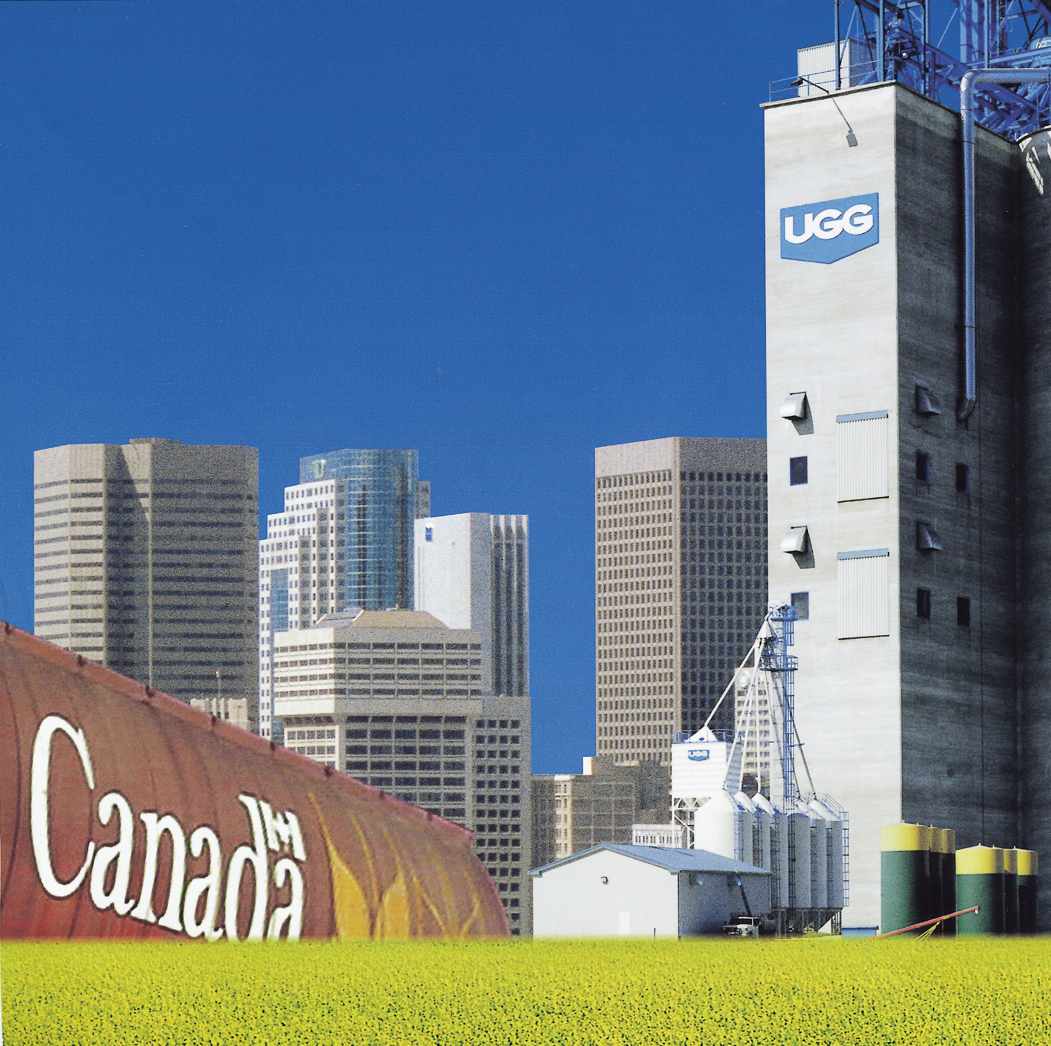

Enterprise - Wide Risk Management
and
United Grain Growers

Slide 2

Who We Are
Formed As Canada’s First Co-op (1906)
A Strong Tradition of Providing Products & Services To Western Canadian Farmers
Transformed Into A Publicly Traded Company in 1993 (Common Shares Traded on the Toronto Stock Exchange)

Slide 3
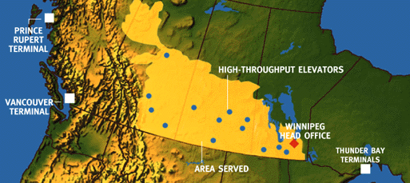

UGG’s Current Turf
●
●
●
●
●

Slide 4
Gross Profit 1983 - 1998

Slide 5
Diversification Within The “Core Business”(Gross profit in million dollars)
Grain Handling
Crop Inputs
Feed Manufacture
Publications & Other

Slide 6

Outline
Why we started
How we proceeded
What we did
The Outcome
Parting thoughts

Slide 7
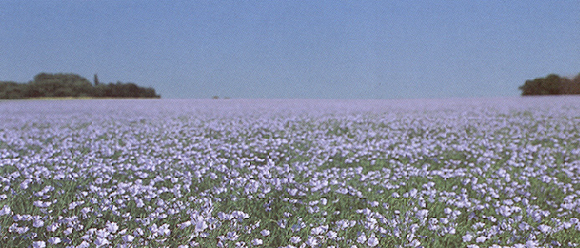
Why
we started

Slide 8
1. Corporate Governance
Regulators concerned about risk management after Barings and Orange County problems
Prompted various initiatives
  U.K. “Cadbury” report
  USA Treadway report
  Canada: Toronto Stock Exchange “Dey” report issued corporate governance guidelines

Slide 9
1. Corporate Governance
“The Board of Directors of every corporation should assume responsibility for ... the identification of the principal risks of the corporation’s business and ensuring the implementation of appropriate systems to manage these risks”.

Slide 10
2. Trends in the financial “community”
Stock analysts and investors
  increasingly sensitive to unfavorable deviations from earnings targets
Accounting rules
  evolving toward increased disclosure of risks
Credit rating agencies
  using more sophisticated models to evaluate a firm’s risks

Slide 11
Evolution--not Revolution
We had...
We sought...
Good policies
Defined responsibilities
Well-defined position limits
Good risk control practices
Formal monitoring & reporting
Improved accountability
Better structure of responsibilities
Improved internal communication
Focus & understanding of costs of principal risks
A risk management system for keying in on highest risks

Slide 12
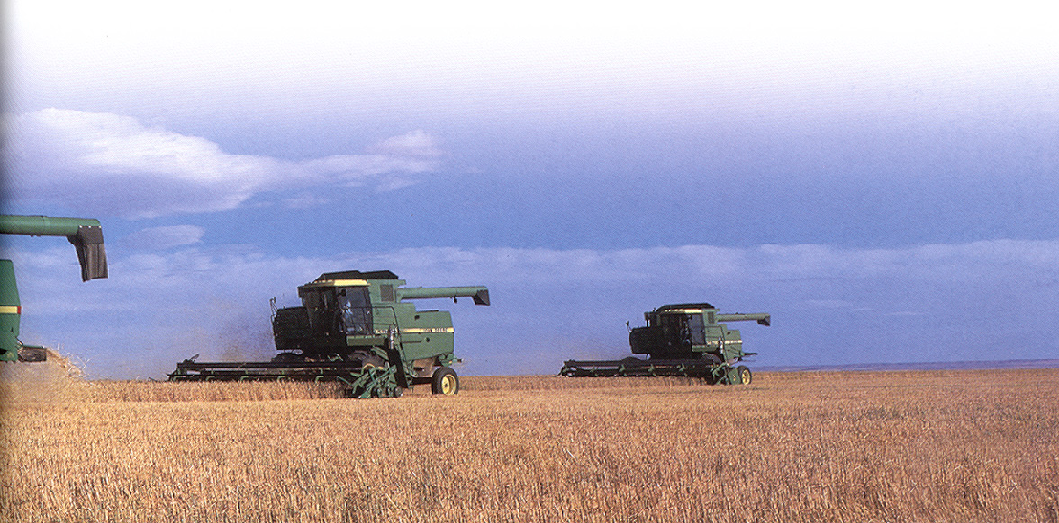
How
we
proceeded

Slide 13
How we proceeded: Who is involved and what are our tools?
Board of Directors
Risk Management Committee
Committee Mandate
Risk Management Policy
Risk Management Process
Application of Process
Consistency in Risk language
Exposure Analysis
Reporting
Internalizing
Process Audit

Slide 14
The Team: Risk Management Committee
CEO
CFO
Risk Manager
Treasurer
Manager Corporate Audit Services
Divisional Managing Directors (as required)

Slide 15
Language and Process
distinction between risk process and application of R.M. technique
ensure that process is general enough to apply to everyone
identify
analyze
evaluate
control, prevent, reduce
finance
select
implement
monitor and audit

Slide 16
How
risk management “brainstorm”
identify principal business risks
rank risks
choose those to analyze/quantify
data collection
risk mapping
Seek options for non-traditional risks and begin pricing process
explore integration of risk financing model
price risk financing on stand alone and integrated basis

Slide 17
How
Identified 47 exposure areas
force ranked them
grouped these into 25 areas
picked top six
intensively evaluated these
picked top one that had catastrophic potential and set out to find a way to transfer this risk

Slide 18
Decision Matrix - “Map”
High/Low
(transfer & control)
High/High
(avoid)
Severity ($)
Low/Low
(retain & passive control)
Low/High
(retain & active control)
Frequency (n)

Slide 19
Then the light went on
Top risk - weather
Couldn’t control weather itself but could soften financial impact it had on company’s earnings
volume related solution

Slide 20
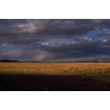
What?

Slide 21
What we did
Decided that integration with current traditional program was a good idea to gain greatest cost efficiency by placing all risk areas into one portfolio thus utilizing a favorable long term integrated loss history
Test, measure, and model risk financing scenarios and their impact on long term cost of risk*

Slide 22
*Cost of Risk
Cost of Risk =
Risk Transfer costs
Risk Retention costs
Loss Control costs
Administrative expense
$

Slide 23
Rationale for an Integrated Program
Integrating grain volume coverage with traditional insurance risks combined “leverage” from UGG’s favourable loss history with the “portfolio effect”
Reducing average long-term cost of risk
Reducing earnings volatility
Reducing the need for “precautionary capital”
Making it possible to increase financial (balance sheet) leverage
All of which has the potential to increase the stock price and shareholder value

Slide 24
Tactical Objective
Negotiate a positive outcome

Slide 25
Tactical Mission
Translate Portfolio Theory (data and statistics) to Market Reality (structure and price).

Slide 26
Reaching the Objective
See the target - Focus is essential
Tools - People and technology
Time - To think differently
Communication - More not less
Prove it - Measure results

Slide 27
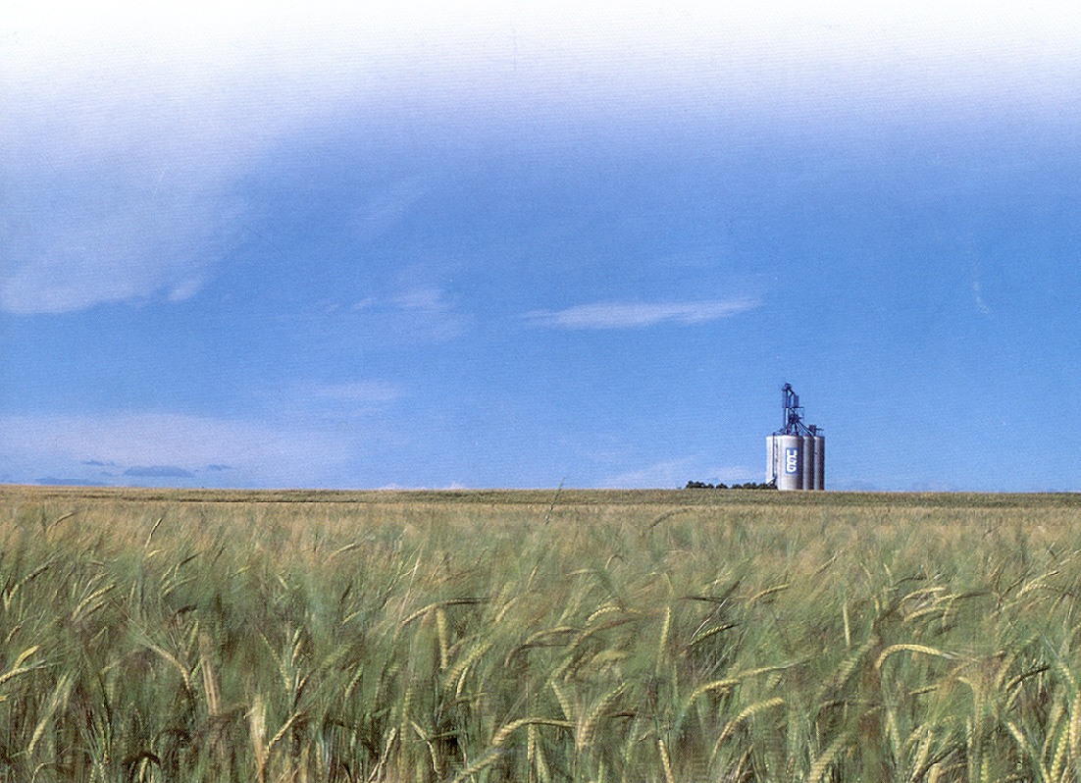
The Outcome

Slide 28
The Outcome- Integrated Risk Financing Mechanism
Traditional P&C plus grain volume coverage (weather and macro-economic events)
Traditional P&C coverages plus coverage for grain volumes
Property
Casualty
Operational
Employee
Financial

Slide 29
UGG Integrated v. Traditional
Program - Conceptual
Property Tower
Integrated Layer
Grain Handling
Volume Sub-limit
Integrated P&C/Volume Retention
Traditional
Integrated

Slide 30
Grain Handling Volume & Gross Profit and Corporate Gross Profit

Slide 32
Average Annual Cost of Risk

Slide 33
Effect of Integrated Risk Program on Operating Income

Slide 34
Operating Income Trends

Slide 35
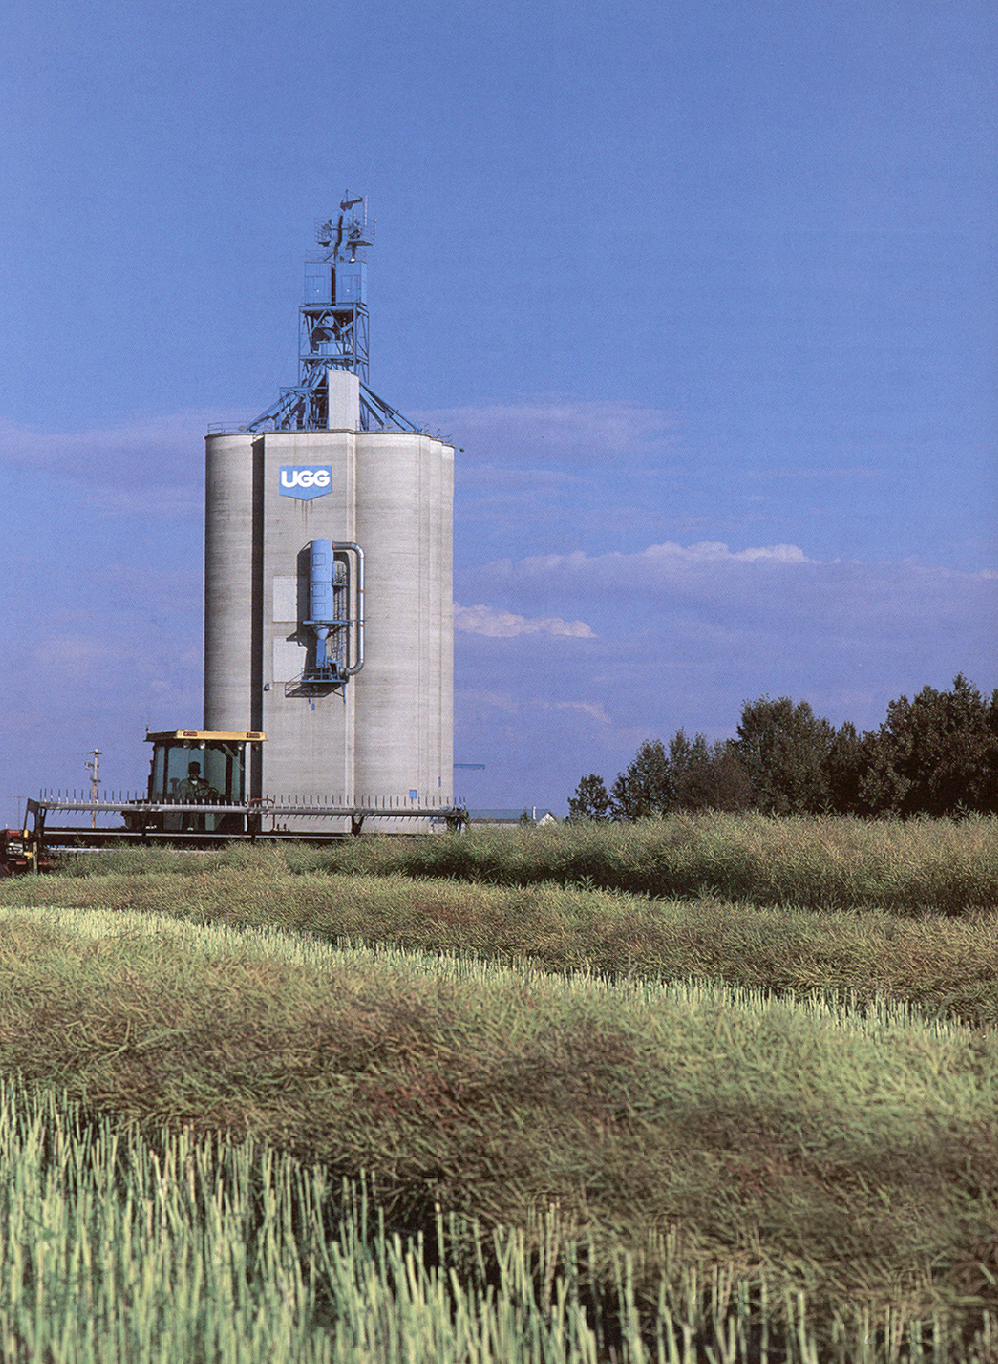
Parting
Thoughts

Slide 36
A Changed Mindset
“Traditional” Risk Management is tactical and defensive
  avoidance, reduction or transfer of risk
“Enterprise” (Integrated) Risk Management is strategic and more “offensive” activity
  earnings / shareholder value management
Ensures the same rigour and consistency is brought to managing “business” risks as is practiced towards (traditionally) insurable risk

Slide 37
“Political” Considerations
Senior Management and the Board of Directors must be “on side”
Ultimate acceptance requires that they understand the “concept” and are in touch with progress so that they support the expenditure of Resources (time and money)
This is a perfect opportunity to help build (up) a multi-discipline, multi-divisional team to deal with a high level, strategic activity

Slide 38
“Cultural” pre-requisites
A pragmatic environment
  Where people feel comfortable seeking innovative solutions to practical problems
A consultative/collective approach to issues
  “tapping into” available ideas
An ability to recognize in-house capabilities (and limitations) when it’s time to “go outside” for external expertise
Tolerance for “step-by-step” risk-taking in the inquiry / research process

Slide 39
Ongoing Management Issues
Responsibility and authority for risk management are not disconnected
Risk Management is not quantification only … or process only
The approach is not a “panacea”
  Not all risks should (or can) be intensively quantified … or transferred
  some risks are better handled through internal management controls - or even complete avoidance

Slide 40
Questions, Comments and Observations

