Slide 1


REPOWERING AMERICA Presentation to Texas Conservative Forum
CALPINE
Sept. 2001

Slide 2
A NATIONWIDE POWER PORTFOLIO
Net Megawatts
In Operation 4,700
Under Construction 6,700
Announced Development 14,350
Advanced Development 14,250
40,000
Peaking Capacity 6,000
46,000

Slide 3
Vertically Integrated Organization
Development
Financing
Construction
Operations
Fuels
Marketing
Trading
Asset Optimization
Risk Management

Slide 4
U.S. POWER MARKET
A $250 Billion Industry
800,000 mw Base
History of Regulation
Aging Fleet of Power Plants
Oil & Gas
20%
Nuclear
13%
Hydro & Other
17%
Coal
50%

Slide 5

DRIVERS OF CHANGE
Growing Demand
Environmental Concerns
New Technologies
Deregulation

Slide 6
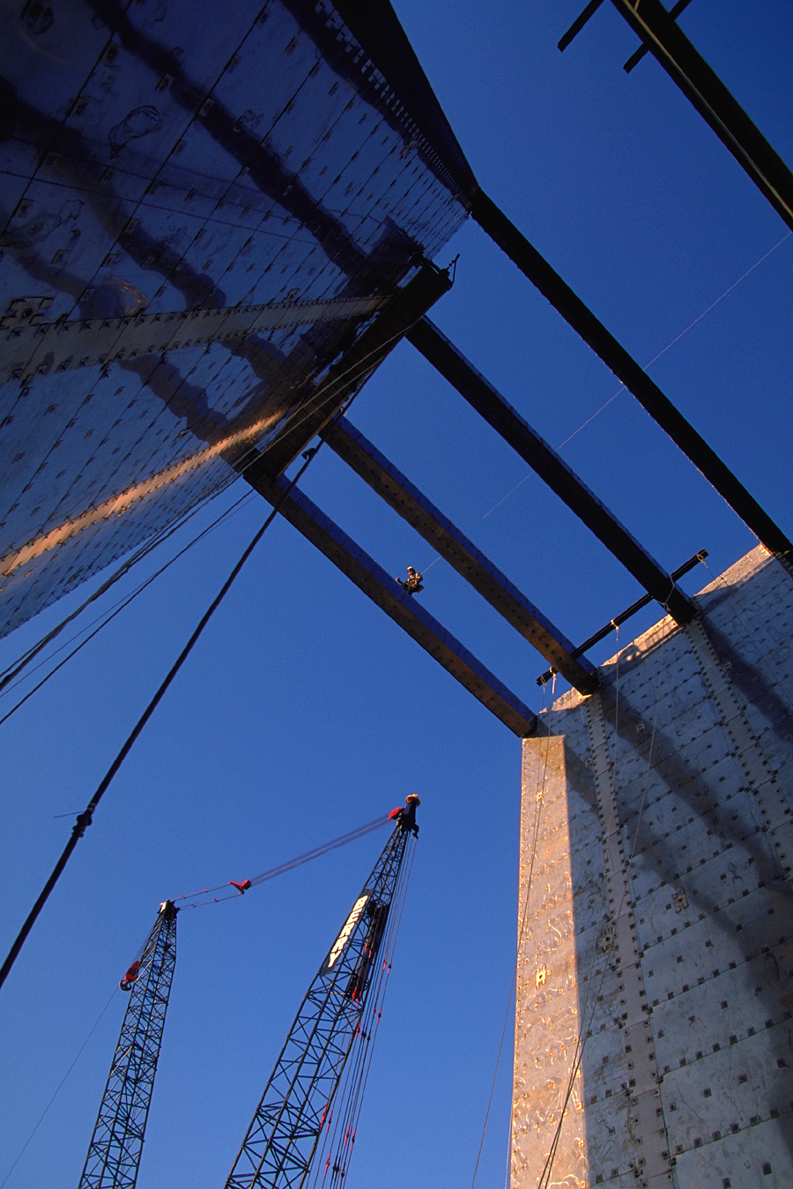
ERCOT –Doing the Right Thing
Created Robust Wholesale Market
Date Certain for Implementation
Stakeholder Representation
Standardized Interconnection Agreements
Permitting Certainty
Independent System Operator
Standard Products
Promoting Clean Air
TPUC clarified co-gens ability to sell steam to multiple counter-parties

Slide 7

ERCOT-Good, but not Perfect or is Retail DOA?
TXU & Reliant retain too much market share
Muni’s and Co-ops not opted in
Limited choices for alternative REP’s
Capacity auctions
Not soon enough
Limited participation
Incumbents retain market information

Slide 8
CALPINE’S RECOMMENDATIONS
Open Markets
Support Independent RTO’s
Standardize Interconnection Procedures
Implement Date Certain
Streamline Permitting Process
Promote efficiency
Improve Transmission through Technology
Encourage Cogeneration
Change fuel incentives for I.O.U.’s now
Promote Clean Air Initiatives
Promote conservation

