Slide 1
Structured Capital Markets Financings
October 2001

Slide 2
Table of Contents
Marlin
Osprey
Yosemite & CLN

Slide 3
Opening Comment
Recent press reports have suggested that Enron would be required to issue equity in order to fulfill certain obligations of Marlin and Osprey.
Prior to the occurance of a Note Trigger Event, outlined later in this presentation, the obligations of Marlin and Osprey are expected to be repaid through proceeds from the sale of assets from the Trusts. It is expected that proceeds from such sales will be sufficient to retire in full, the obligations of Marlin and Osprey upon their respective maturities. To the extent that these proceeds are insufficient, Enron may supplement these proceeds with cash available from its asset sales.
Following a Note Trigger Event, the investors have the ability to pursue the sale of both equity and assets.

Slide 4
Marlin Water Trust

Slide 5
Terms
Issuer:
Marlin Water Trust
Together “Marlin”
Co-Issuer:
Marlin Water Capital Corp.
Securities:
€
515 million
US$475 million
Term:
2 years
€
Coupon:
6.19% paid annually in arrears
US$ Coupon:
6.31% paid semi-annually in arrears
Optional Redemption:
Callable at Make-Whole Price
Distribution:
144A/Reg S (no registration rights)
Ranking:
Senior secured obligations of Marlin
Ratings:
Moody’s
S&P
Fitch
Baa1
BBB
BBB
Rationale:
Refinance $830mm of existing Marlin Water Trust
Notes and pre-fund interest through maturity

Slide 6
Transaction Overview
Enron acquired 100% of Wessex Water Plc (“Wessex”) in October 1998 for $2.4 billion
In December 1998, Enron executed the original Marlin transaction to:
  - Fund the Wessex acquisition on a non-dilutive off-credit basis to Enron
  - Deconsolidate a non-core business
  - Allow Azurix flexibility to operate and grow its business
Allows Enron to continue to achieve deconsolidation of Azurix

Slide 7
Marlin Structure
Voting
Remarketing
Marlin Notes
Enron Preferred Stock
Trust
Agreement
$915
ENRON
Marlin
50% Vote
Preferred Return
Water Trust
Enron Debt
Overfund
50% Vote
Obligations
Amount
Atlantic
Marlin Certificates
Bristol
Water Trust
$125
Water Trust
67% Common
Azurix
Azurix
Europe
Overfund
100%
Note
Azurix
Europe Ltd.
33% Common
100%
Wessex

Slide 8
Support for Senior Notes
Principal Repayment
Sale of Assets, principally Wessex
Enron Mandatorily Convertible Preferred Stock (“EMCPS”)
    Issued and held in the Voting Trust and designed to be remarketed at a conversion and dividend rate to generate sufficient proceeds to repay the Marlin Senior Notes
    EMCPS is convertible into shares of common stock which have been reserved by the Board in an amount equal at pricing to 2x the Marlin Senior Notes
Enron Remarketing Agreement
    Enron has an obligation to issue additional equity to repay the Notes in full should the proceeds of the EMCPS not be sufficient
Interest Payment
Overfund Amount
    A portion of the proceeds were invested in Enron debt securities (Baa1/BBB+) in an amount sufficient to pay interest on the Senior Notes and yield on the Marlin Trust Certificates

Slide 9
Support for Senior Notes
Trigger Events
    “Note Trigger Events” are designed to provide timely access to collateral for repayment
    Amount sufficient to redeem Senior Notes not deposited within 120 days prior to maturity (3/17/03)
    Event of Default under the Senior Note Indenture, including a cross-default to Enron senior obligations greater than US$100 million
    Enron is rated below investment grade by Moody’s, S&P or Fitch concurrent with a decline in Enron’s common stock price below $34.13
Dollar/Euro Conversion
Forward Currency Agreement
    Atlantic Water Trust will make all distributions to Marlin to pay interest and principal in US dollars
    Through a forward currency agreement executed at closing, Enron is obligated to provide Euros in exchange for US dollars to pay interest and principal on the Euro Senior Notes
    Investors in the Euro Senior Notes are fully hedged through the term of the transaction

Slide 10
Osprey Trust
October 2000

Slide 11
Terms

Slide 12
Transaction Rationale
Investments in projects and debt and equity interests are an integral component of Enron’s business development strategy
The partnership provides a vehicle to efficiently monetize these investments and raise capital for continuing growth
Access value in previously o/s and issued Enron convertible preferred stock (“EMCPS”)
Allow for the financing of continued investment in merchant assets in an off-balance sheet manner

Slide 13
Whitewing Structure
Senior Notes
Senior Notes
$2.43B
$2.4B
Enron
Enron
Osprey
Osprey
Trust
Trust
50% Vote
50% Vote/
Preferred Return
Certificates
Certificates
$0.22B
$0.22B
Condor Share
Condor Share
Whitewing
Trust
Whitewing
Trust
Assets
EMCPS
MCPS
Share Settlement
Agrmt
Share Settlement
Agrmt
ENE Notes
ENE Notes
Overfund Amount
Overfund Amount

Slide 14
Support for Senior Notes
Principal Repayment
Enron Mandatorily Convertible Preferred Stock
  Held in Condor Share Trust in support of the Senior Notes
  Issued, outstanding and included in Enron’s EPS
  Convertible into 50 million shares of Enron common stock
Enron Share Settlement Agreement
  Obligation to deliver proceeds from the issuance of additional equity to insure at least US$2.35 billion to repay the Senior Notes
Whitewing Assets or Permitted Investments
  Valued at approximately US$2.1 billion

Slide 15
Support for Senior Notes
Interest Payment
Overfund Amount
  A portion of the proceeds are invested in Enron debt securities to pay interest on the Senior Notes and yield on the Osprey Trust Certificates
Enron Mandatorily Convertible Preferred Stock
  Provides approximately US$63 million annually for interest and yield payments
Enron Notes
  Interest on direct Enron obligations supports the payment of interest on the Senior Notes and yield on the Osprey Trust Certificates

Slide 16
Support for Senior Notes
Trigger Events
    “Osprey Note Trigger Events” are designed to provide timely access to collateral for repayment
    Amount sufficient to redeem Senior Notes not deposited within 120 days prior to maturity (9/17/02)
    Event of Default under the Senior Note Indenture, including a cross-default to Enron senior obligations greater than US$50 million
    Enron is rated below investment grade by Moody’s, S&P or Fitch concurrent with a decline in Enron’s common stock price below $59.78
Dollar/Euro Conversion
Forward Currency Agreement
    Whitewing makes all distributions to Osprey to pay interest and principal in US dollars
    Through a forward currency agreement executed at closing, Enron is obligated to provide Euros in exchange for US dollars to pay interest and principal on the Euro Senior Notes
    Investors in the Euro Senior Notes are fully hedged through the term of the transaction

Slide 17
Summary of Major Assets

Slide 18
Yosemite Securities Trust I & II
Credit Linked Notes Trust I & II

Slide 19
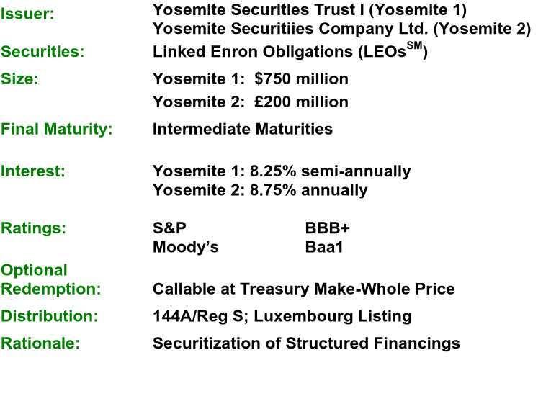
Yosemite - The Offerings
Notes:
<number>
<footer>
<header>
<date/time>

Slide 20
CLN I & II - The Offerings
Issuers:
Enron Credit Linked Notes Trust I & II (“ECLN I & II”)
Enron Euro Credit Linked Notes Trust (“ECLN Euro”)
Enron Sterling Credit Linked Notes Trust (“ECLN Sterling”)
Securities:
Enron Credit Linked Notes I & II $ 1,000 Million
Enron Euro Credit Linked Notes € 200 Million
Enron Sterling Credit Linked Notes £ 125 Million
Term:
Intermediate Maturity
Interest:
ECLN I : 8.00%, fixed rate payable semi-annually
ECLN II: 7.375%, fixed rate payable semi-annually
ECLN Euro: 6.50%, fixed rate payable annually
ECLN Sterling: 7.25%, fixed rate payable annually
Ratings:
S&P Moody’s
BBB+ Baa1
Early
Redemption:
Par plus Make-Whole
Distribution:
144A/Reg S (No Reg. Rights); Luxembourg Listing
Rationale:
Simple credit hedge for Enron senior, unsecured obligations

Slide 21
Transaction Rationale
Securitization of Structured Financings in the Capital Markets
Reduce existing exposure in the bank market or eliminate the need to syndicate a new financing
Principally used to support long term crude pre-pay transactions

Slide 22
Transaction Structure
Notes
Certificates
Note Interest & Certificate Yield
Trust
Credit Swap
Citibank
Interest on Trust Investments
Trust Investments

Slide 23
The Trust Investments
  Trust Investments:
  Yosemite Structures:
    Enron Investments: Payment obligations supported, in whole or in part, directly or indirectly, by Enron
    Highly Rated Investments:
      Governments (including the United Kingdom for Yosemite 2)
      AAA Insurance Companies
      Securities of Issuers with short term ratings of A1+/P1 and long term ratings of Aa3/AA-
      Securities of Issuers with long term debt ratings of Aaa/AAA
  CLN Structures:
    Highly Rated Investments
      Governments
      AAA Insurance Companies
      AA-/Aa3 long term and A-1/P-1 short term rated Money Center Banks
      A+/A1, A-1/P-1 Euro Commercial Banks
  Trust Investments may be substituted at Citibank’s direction

Slide 24
The Citibank Swap
    In the absence of a Credit Event:
      Citibank will receive periodic distributions on Trust Investments
      Citibank will make interest payments and yield payments
      Principal payments on Trust Investments or Deliverable Obligations under the Citibank Swap are the investors’ expected source of principal repayment
Notes:
<number>
<footer>
<header>
<date/time>

Slide 25
Enron Bankruptcy
  In the event of an Enron Bankruptcy
    Yosemite: At the completion of the bankruptcy proceedings Citbank is required to make up the differential between the Enron Investments and recovery on Enron bonds.
    CLN: Citibank is required to settle the Swap with Enron Deliverable Obligations (senior, unsecured obligation) within 60 days following an Enron Credit Event.

Slide 26
Investment Highlights
  Enron
    Senior unsecured rating BBB+/Baa1
  Citibank
    Senior unsecured rating AA-/Aa2
  Investors are fundamentally in the same position as a holder of Enron senior, unsecured obligations

