Slide 1

Canada
2001 Plan
Enron North America
February 1, 2001

Slide 2
Income Statement - ($000s) - Total
2000 Forecast
2001 Plan
Variance
Originations
$ 23,500
$
162,500
$
139,000
Trading
7,500
102,500
95,000
FV- Investments
14,000
20,000
6,000
Accrual
Other
Total Margin
$
45,000
$
285,000
$
240,000
Capital Charge
636
6,154
(5,518)
Margin Net of Capital Charge
$
44,364
$
278,846
$
234,482
People
7,882
13,346
5,463
Travel and entertainment
116
225
109
Consulting
172
52
(120)
Office
417
633
217
Controllable infrastructure
669
1,472
803
Insurance
15
20
5
System development
-
1,257
1,257
Other Expenses
39
-
(39)
Outside Legal
600
675
75
Outside Tax
-
50
50
Depreciation and Amortization
-
1,000
1,000
Total Direct Expenses
$
9,909
$
18,730
$
8,821
Pre-Tax Income
$
34,455
$
260,116
$
225,661
Headcount
Executive
2
5
3
Director
8
7
(1)
Manager
9
15
6
Analyst and Associates
15
34
19
Support Departments
6
9
3
Total Headcount
40
70
30
2001 Plan (in thousands)
Team
ENA Total
Variance
Direct Expense (People & Office)/Headcount Ratio
$
200
$
135
$
(65)
ROCE
8228%
60%
8168%

Slide 3
Income Statement - ($000s) - Gas
2000 Forecast
2001 Plan
Variance
Originations
$ 23,500
$
25,000
$
1,500
Trading
7,500
25,000
17,500
FV- Investments
Accrual
Other
Total Margin
$
31,000
$
50,000
$
19,000
Capital Charge
Margin Net of Capital Charge
$
31,000
$
50,000
$
19,000
People
3,982
4,377
395
Travel and entertainment
50
81
31
Consulting
42
16
(26)
Office
188
203
15
Controllable infrastructure
Insurance
7
7
(0)
System development
Other Expenses
Outside Legal
150
169
19
Outside Tax
13
13
Depreciation and Amortization
-
-
Total Direct Expenses
$
4,419
$
4,866
$
447
Pre-Tax Income
$
26,581
$
45,134
$
18,553
Headcount
Executive
-
0
-
Director
4
6
2
Manager
4
5
1
Analyst and Associates
9
10
1
Support Departments
1
2
1
Total Headcount
18
23
5
2001 Plan (in thousands)
Team
ENA Total
Variance
Direct Expense (People & Office)/Headcount Ratio
$
199
$
135
$
(64)
Productivity Ratio
$
1,962
$
1,541
$
421

Slide 4
Gas - Goals & Objectives
Financial
  Meet EBIT target and revenue mix between Origination and Trading
Cost
  15% reduction in travel and entertainment, consulting, controllable infrastructure and Other Expenses versus budget.
Market Deliverables
  Minimum number of EOL trades: 48,500 (2000 levels 48,500)
  Total number of Mid-Market/Origination and Trading: 720
  Mid-Market trades: 605
  Structured product trades: 115
  Customers transacted with: 105
  New customers added: 25
  New Management Services Agreements: 6

Slide 5
Gas - Goals & Objectives
Strategy
  The key product & market strategies necessary to grow our existing business are:
    Increase customer coverage as measured by increased deal flow year over year
    Target a much larger end-user customer base – this group has been hurt by the high prices and is dissatisfied with current suppliers (blaming them for unhedged positions)
    Increase gas focus in eastern Canada – hire two senior originators
    Significantly increase coordination amongst originators on coverage, products, knowledge base, and more frequent reporting – clarity on expectations of each individual have been set already (see attached)
    New product roll-out – Applied TerraVision linked MSA
    Customers have been split by marketer (see attached) – daily customer contact records are now maintained as a means of focusing on coverage.

Slide 6
Gas - Gas Origination Marketer Metrics

Slide 7
Gas - Gas Origination Customer Accounts
- Means multiple coverage

Slide 8
Gas - Gas Origination Customer Accounts

Slide 9
Gas - Gas Origination Customer Accounts

Slide 10
Income Statement - ($000s) - Finance
2000 Forecast
2001 Plan
Variance
Originations
$
-
$
-
$
-
Trading
FV- Investments
14,000
20,000
6,000
Accrual
Other
Total Margin
$
14,000
$
20,000
$
6,000
Capital Charge
636
4,366
(3,730)
Margin Net of Capital Charge
$
13,364
$
15,634
$
2,270
People
1,301
1,411
110
Travel and entertainment
20
24
4
Consulting
5
8
3
Office
51
67
16
Controllable infrastructure
Insurance
3
2
(1)
System development
Other Expenses
Outside Legal
150
169
19
Outside Tax
-
13
13
Depreciation and Amortization
-
-
-
Total Direct Expenses
$
1,530
$
1,694
$
164
Pre-Tax Income
$
11,834
$
13,940
$
2,106
Headcount
Executive
1
1
-
Director
-
0
-
Manager
2
2
-
Analyst and Associates
2
3
1
Support Departments
2
1
(1)
Total Headcount
7
7
-
2001 Plan (in thousands)
Team
ENA Total
Variance
Direct Expense (People & Office)/Headcount Ratio
$
211
$
135
$
(76)
Productivity Ratio
$
2,615
$
1,541
$
1,074

Slide 11
Finance Goals & Objectives
Financial
  Meet EIBIT target of $15MM origination
  ROCE > 25%
Cost
  15% reduction in travel and entertainment, consulting, controllable infrastructure and Other Expenses versus budget.
Strategy
  Monetize Startech position
  Monetize the ABB 11 NI Turbines
  Manage Invasion Energy position
    Monetize senior debt
    Maximize origination on equity and royalty interest via sale or produce out
  Manage Alberta PPA capital position
    Secure “Change in Law” insurance
    Explore non-recourse financing as risk mitigation tool
  Focus capital capability on private ventures
    Coalbed methane
    Emission and combustion technologies
    Wind power.

Slide 12
Finance Goals & Objectives
Strategy (con’t)
  Manage AMPS position
    Monetize prototype unit
    Secure outside sale orders
    Secure financing for commercial production
    Expand product offering
    Initiate commercial production
  Monetize Impact Energy position
  Complete Moore Project permitting.

Slide 13
Balance Sheet - ($000s) - Finance

Slide 14
Income Statement - ($000s) - Alberta Power
2000 Forecast
2001 Plan
Variance
Originations
$
-
$
77,500
$
77,500
Trading
-
77,500
72,500
FV- Investments
Accrual
Other
Total Margin
$
-
$
155,000
$
155,000
Capital Charge
Margin Net of Capital Charge
$
-
$
155,000
$
155,000
People
150
2,035
1,885
Travel and entertainment
1
16
15
Consulting
1
4
3
Office
2
55
53
Controllable infrastructure
Insurance
2
3
1
System development
Other Expenses
Outside Legal
150
169
19
Outside Tax
-
13
13
Depreciation and Amortization
-
-
-
Total Direct Expenses
$
306
$
2,295
$
1,989
Pre-Tax Income
$ (306)
$
152,705
$
153,011
Headcount
Executive
-
2
2
Director
2
0
(2)
Manager
1
2
1
Analyst and Associates
2
6
4
Support Departments
-
1
1
Total Headcount
5
11
6
2001 Plan (in thousands)
Team
ENA Total
Variance
Direct Expense (People & Office)/Headcount Ratio
$
190
$
135
$
(55)
Productivity Ratio
$
13,882
$
1,541
$
12,341

Slide 15
Alberta Power Goals & Objectives
Financial
  Meet EBIT target and revenue mix between Origination and Trading
Market Deliverables
  Minimum number of EOL trades: 2000 (2000 levels 0)
  New EOL customers: 30
  Minimum number of Mid-Market /Originated trades: 80 (2000 levels 7)
  Execution of 20 Master contracts/Enabling agreements
  Minimum number of B.C. transactions: 10 (2000 levels 0)
Strategy
  Introduce EOL intra-day market
  Establish real time 24 hour desk in Calgary to facilitate:
    PPA dispatch
    hourly arbitrage between Alberta and Mid C markets
    procurement of outsourcing services to industrials/other PPA buyers
  Solution for physical power deliveries at the Disco level (IT or Buy/Sell mechanism)
Regulatory Strategy
  Resolve Clover Bar dispatch strategy
  Formulate a solution for the unsold PPAs on a go forward basis
  Ensure Pool Price Deficiency Price Regulation does not exist beyond 2001
  Promote Alberta export wheel auction
  Resolve PPA related issues: STS and SAS

Slide 16
Alberta Power - Target Customer List - Generators
Utilities
EPCOR
Enmax
ATCO
Utilicorp
IPPs
Transalta
AES
Calpine
Shell
AEC
CNRL
Vision Quest
Petro-Canada
Canadian Gas and Electric
Canadian Hydro Developers
Columbia Power Systems
Fording
Valeo Power
Penn West Petroleum
Columbia Power Systems

Slide 17
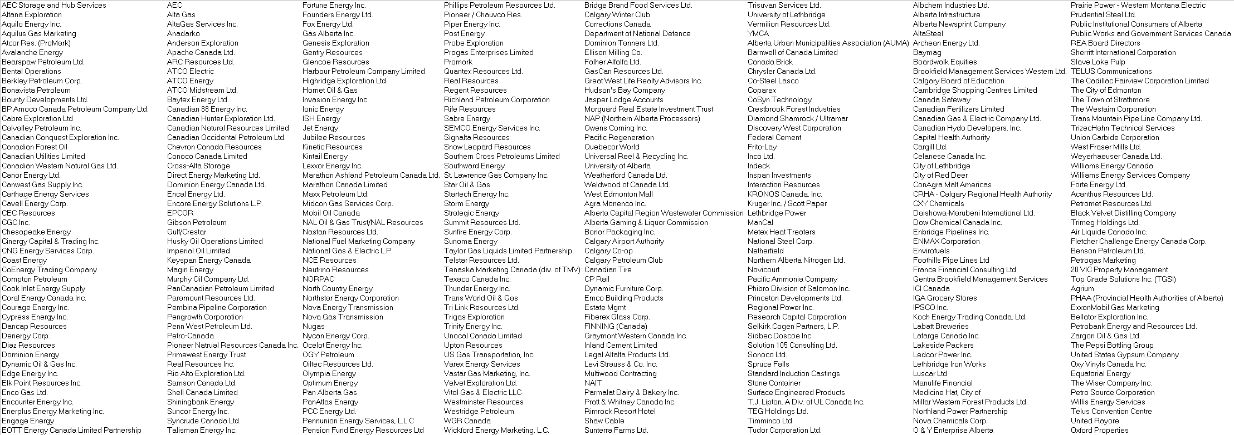
Alberta Power - Target Customer List - All Customers

Slide 18
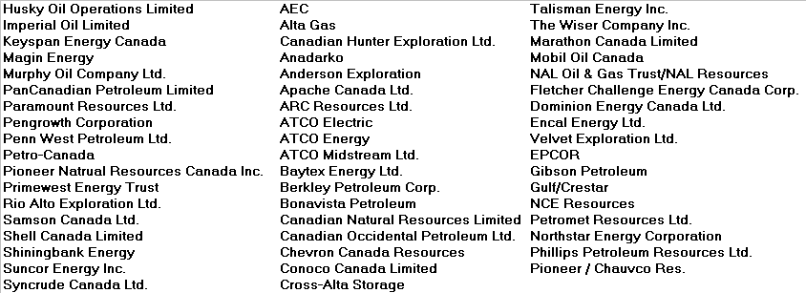
Alberta Power - Target Customer List - E & P Companies
53 Customers

Slide 19
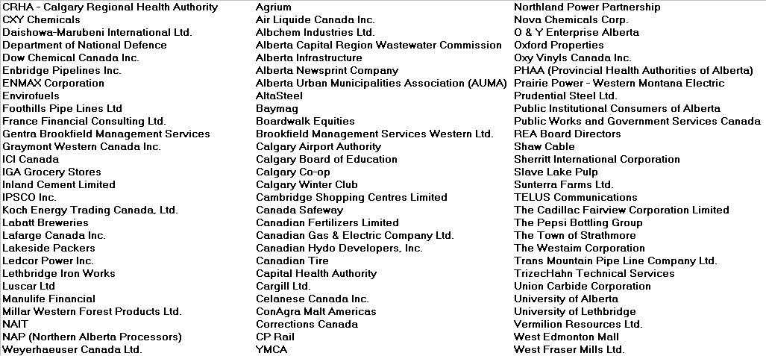
Alberta Power - Target Customer List - Industrials
84 Customers

Slide 20
Income Statement - ($000s) - Eastern Canada Power
2000 Forecast
2001 Plan
Variance
Originations
$
-
$
50,000
$
50,000
Trading
-
-
-
FV- Investments
Accrual
Other
Total Margin
$
-
$
50,000
$
50,000
Capital Charge
-
1,788
1,788
Margin Net of Capital Charge
$
-
$
48,212
$
48,212
People
771
4,070
3,299
Travel and entertainment
25
80
55
Consulting
121
16
(105)
Office
53
267
214
Controllable infrastructure
Insurance
3
6
4
System development
Other Expenses
Outside Legal
150
169
19
Outside Tax
-
13
13
Depreciation and Amortization
-
-
-
Total Direct Expenses
$
1,122
$
4,621
$
3,499
Pre-Tax Income
$
(1,122)
$
43,591
$
44,713
Headcount
Executive
-
1
1
Director
2
1
(1)
Manager
2
6
4
Analyst and Associates
2
12
10
Support Departments
1
2
1
Total Headcount
7
22
15
2001 Plan (in thousands)
Team
ENA Total
Variance
Direct Expense (People & Office)/Headcount Ratio
$
197
$
135
$
(62)
Productivity Ratio
$
2,063
$
1,541
$
522

Slide 21
Eastern Canada Power Goals & Objectives
Financial
  Meet EBIT target and revenue mix between Origination and Trading
  ROCE > 25%
Cost
  15% reduction in travel and entertainment, consulting, controllable infrastructure and Other Expenses versus budget.
Market Deliverables
  Continue to apply pressure at all levels for market opening.
  Continue to directly cover all Ontario industrials larger than 25MW load.
  Direct and manage G6 initiative to transact at least 250 MW of load from commercial small industrial class in calendar 2001.
  Target discontinuities and arbitrage opportunities within the short term trading environment.
  Create a seamless trading/marketing environment for our customers between Ontario, Northeast US, and across Canada.
  Leverage Power relationships to capture natural gas loads.
Strategy
  (See following slide for summary of strategies for Eastern Canada Power business.)

Slide 22
Eastern Canada Power - Strategy Summary
Sector
INDUSTRIALS
(725 MW)
NUGS
TRADING
G6
SERVICES
GENERATION
Strategy Summary
Consistent, ongoing coverage
Free expertise and support
Lock in initial transaction and keep for life
Leverage power to win gas
Use services as swing (fee or free depending on customer’s load and
commodity price point)
Manage for maximum value
Gather trading intelligence within conflict of interest boundaries
Leverage position into restructuring principal role
Know more than anyone else
Identify and execute on discontinuities and arbitrage opportunities
Stay ahead of pack
Blend trading and service provision to maximize value
Educate marketers
Massive initial marketing program to target market
Exercise option to gain control or sell within 3 years
Leverage existing infrastructure to create relationships with industrials
Continue to identify new service areas
Gain control of undervalued industrial generation capabilities
Participate (equity or marketing control) in any generation divestments
or projects in Ontario

Slide 23
Eastern Canada Power - 2001 - Opportunities
Sector
INDUSTRIALS
(>25 MW/h)
NUGS
TRADING
G6 RETAIL INITIATIVE
(< 25 MW/h)
SERVICES
GENERATION
Opportunities
Sunoco Manulife
Abitibi Atlantic Packaging
Bowater Cadillac Fairview
Domtar Magna
Nitrochem Olympia & York
Ford Lafarge
Incentive fees
Service Fees
Fee Structuring
OP-Reserve
Dispatchability / Flexibility
Short-Term Trading
NUGS
Industrial / Commercial
Residential
Enerconnect
Industrials
Importers
Industrial
Power by the hour
Backup generators
OPGI Divestiture
Terra
Ivaco
Casco
Slater
Tembec
Falconbridge

Slide 24
Eastern Canada Power - ($000s) - Balance Sheet

Slide 25
Income Statement - ($000s) - Retail
2000 Forecast
2001 Plan
Variance
Originations
$
-
$
10,000
$
10,000
Trading
FV- Investments
Accrual
Other
Total Margin
$
-
$
10,000
$
10,000
Capital Charge
Margin Net of Capital Charge
$
-
$
10,000
$
10,000
People
-
828
828
Travel and entertainment
Consulting
Office
-
19
19
Controllable infrastructure
-
-
-
Insurance
-
1
1
System development
Other Expenses
Outside Legal
Outside Tax
Depreciation and Amortization
-
-
-
Total Direct Expenses
$
-
$
847
$
847
Pre-Tax Income
$
-
$
9,153
$
9,153
Headcount
Executive
-
-
-
Director
-
-
-
Manager
-
-
-
Analyst and Associates
-
2
2
Support Departments
-
1
1
Total Headcount
-
3
3
2001 Plan (in thousands)
Team
ENA Total
Variance
Direct Expense (People & Office)/Headcount Ratio
$
282
$
135
$
(147)
Productivity Ratio
$
3,051
$
1,541
$
1,510

Slide 26
Retail Goals & Objectives
Financial
  Meet EBIT target
Cost
  Achieve budget by actively managing customer service and back office expenses during start-up
Market Deliverables
  Achieve average margins of $0.35/GJ
  15% share of Alberta’s commercial segment (8,420,000 GJs)
  20% of portfolio (volume) composed of customers with annual loads > 8,000 GJs
  70% of sales consultants scoring in the top quartile on sales audits
  65% of A/R collected in 45 days or less
Strategy
  Build critical mass by exploiting backwardated gas curve
  Focus on the commercial segment to minimize service costs
  Develop systems to manage critical mass including a database for enrollment, tracking, relationship management, and invoicing
  Proactively utilize regulatory personnel to inact favorable changes (power & gas)

Slide 27
Income Statement - ($000s) - Executive
2000 Forecast
2001 Plan
Variance
Originations
$
-
$
-
$
-
Trading
FV- Investments
Accrual
Other
Total Margin
$
-
$
-
$
-
Capital Charge
-
-
-
Margin Net of Capital Charge
$
-
$
-
$
-
People
1,678
624
(1,054)
Travel and entertainment
20
24
4
Consulting
3
8
5
Office
123
22
(101)
Controllable infrastructure
669
1,472
803
Insurance
1
1
0
System development
-
1,257
1,257
Other Expenses
39
-
(39)
Outside Legal
Outside Tax
Depreciation and Amortization
-
1,000
1,000
Total Direct Expenses
$
2,533
$
4,408
$
1,875
Pre-Tax Income
$
(2,533)
$
(4,408)
$
(1,875)
Headcount
Executive
1
1
-
Director
-
-
-
Manager
-
-
-
Analyst and Associates
-
1
1
Support Departments
2
2
-
Total Headcount
3
4
1
2001 Plan (in thousands)
Team
ENA Total
Variance
Direct Expense (People & Office)/Headcount Ratio
$
161
$
135
$
(26)
ROCE
-27%
60%
-87%

