Slide 1


Slide 2
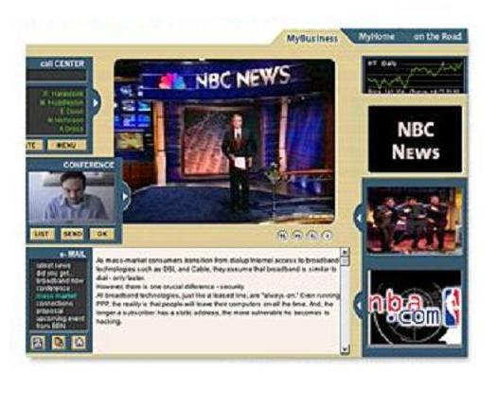
First the Web, Now “Broadband”
Live Broadcast
Pay-per-use
applications
Personalized
News Summary
Real-time
Collaboration
Pay-per-view
e-Learning
On-Demand
Services
Notes:
Cambira was formed to enhance the Quality of Experience in broadband content delivery by…

Slide 3

Broadband Anytime, Anywhere, Any Device
NOT JUST “PC’s”

Slide 4
Today’s Broadband Killers “Best-Effort IP”
Unreliable and unpredictable content delivery
Even normal web-page downloads exceed 15 seconds
Increase in abandon rates and lost revenues
Denial-of-Service attacks and Flash-crowds
Best effort Internet Infrastructure is not suited for
Scaling content delivery & distribution (Audio/Video streaming)
Broadband applications (Live broadcast, High Resolution)
Real-time collaborative applications
Caching solutions
Not suited for dynamic content
Limits the ability to measure promotions & customer usage
Limits content providers ability to target personalized services
Lack of customer, content, & transaction prioritization
Unable to offer personalized premium services

Slide 5
Problems we solve… “Make IP predictable to support broadband applications”
Optimize broadband content delivery
Streaming – Audio, Video, Desktop & Enterprise Applications
New media distribution & delivery
Broadband applications - Live broadcast, high resolution
Optimized for various user access devices
Premium personalized services – reviews, on-demand services
Support evolving content distribution models
Broadband access, interactive TV, wireless appliances
Enable real-time collaborative applications
Conferencing, Interactive Call-Center, etc.
Important customers, content, & transactions are prioritized
Content networking redundancy ensures 100% availability
Minimize “Flash-crowds”, “Denial-of-Service”, “Brown-outs”

Slide 6
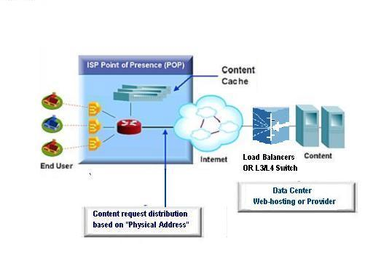
Traditional Solution “Best-effort IP + Load-balancer + Caching”
Optimized for:
Narrowband Applications ONLY
Plain HTML & Graphics delivery
Limited streaming support

Slide 7
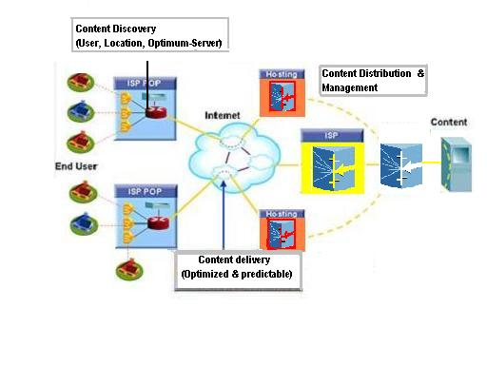

Cambira Solution “MPLS Enabled Content Networking Switch + Caching [non-realtime]”
Optimized For:
Broadband applications
Rich Media & Streaming
Real-time collaboration
Premium Personalized services
Cambira’s Broadband Content Switch

Slide 8
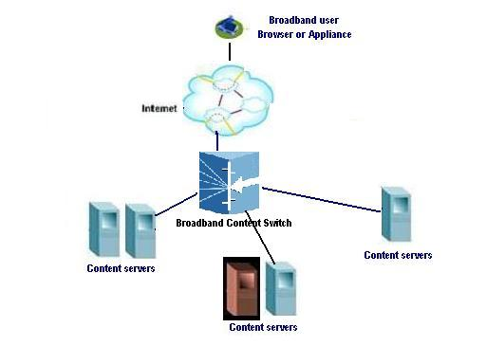
How Broadband Content Switching Works
Broadband user clicks: www.etrade.com/live-events
Browser/Appliance sends TCP SYN (“connect”)
Switch sends “TCP SYN ACK” to Appliance/Browser
Browser/Appliance send requested URL
Switch uses content discovery to determine best server
If content is not available locally, request is
sent to best site based on user, location,
network congestion & server-load
Switch connects to optimum server
Switch establishes an end to end “logical tunnel” between
origin-server and user in the network based on “Content QoS”
for optimized broadband content delivery
[Optional] Switch does content management & distillation functions for review, caching, billing, etc.
All subsequent packets are forwarded at optimized rates [with redundancy]

Slide 9
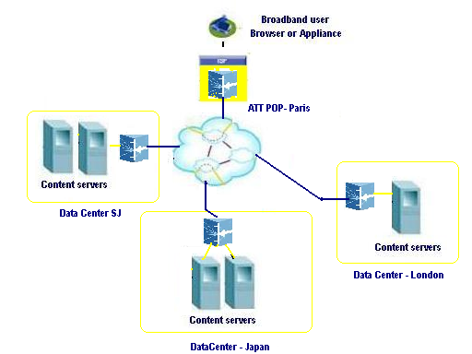
Content Discovery
Content based discovery (not physical address)
for optimal origin-server selection
Discovery model is based on
Content requested
User, Appliance
Language
Location
Network & Server-aware
Interconnect congestion
Multi-site
User-proximity & Location aware
Discover media server & multimedia content
Enables personalized and premium service selection & delivery

Slide 10
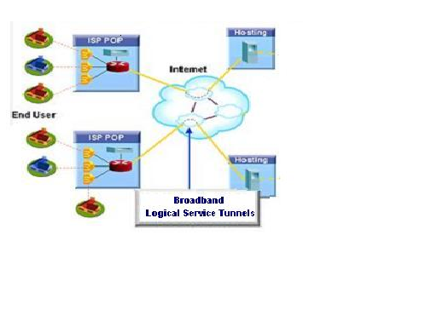
Content Delivery
MPLS Enabled Edge to Edge Quality of Content Delivery
Support for multiple broadband applications
Streaming – Audio, Video, Broadcast, High Resolution
Split-stream rich-media content delivery support
Support for per-flow and aggregate flow QoS & Negotiation
Synchronized content delivery to any appliance or user

Slide 11
Content Management Services
Content distribution
Push rich media content & applications closer to user at internet edge
Reduces traffic congestion to origin-servers
Intelligent distribution of rich media traffic to distributed servers globally
Content Policy & QOS management
Supports - Per-flow and Aggregate Flows
SLA Measurement & Enforcement
Billing interface to Portal billing system
Content Distillation
Content Summary
Content Peering support
Usage reporting for targeting promotions
Delivering personalized services
Billing
Enables personalized and premium service selection & delivery

Slide 12
Industry’s First BroadBand Content Switch
Switching Performance
160 Gigabit switching capacity
High Speed Line cards
Support 8x1 1 Gigabit Ethernet Ports
Support 1x1 10 Gigabit Ethernet Port
Support 1:1 OC-48 SONET/SDH Port
Active Network Services
Content Discovery/Delivery/Distribution
Content Management
Service Features
Content QoS and SLA Management
MPLS enabled Content switching
RSVP, DiffServ, COPS Support
Bandwidth Management with Billing
Carrier class/robustness
Fully redundant
NEBS/ETSI compliant
Scalable to a Terabit system
SONET Card
Gigabit Ethernet
Ethernet Card
S/W Fabric
Management Card
Management Card
S/W Fabric Stand by
RJ-45
Redundant Card Slot
Redundant Card Slot
Serial
Serial
Optical
Best in Class
Highest scalability (50Million content streams)
Maximum port density (64 variable ports)
Most sophisticated content switch
High security & access control

Slide 13
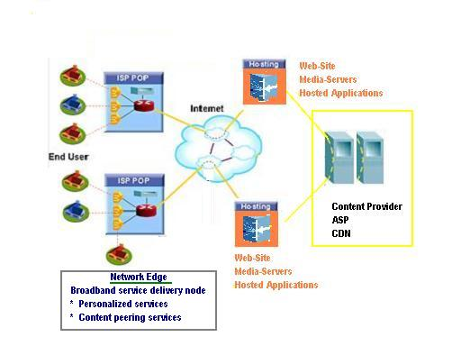
Cambira Web-hosting Solution
Five times price/performance & scalability
Support 32 POP’s
50 Million streaming/flows per second
Target applications
Web-site (e-commerce)
Application-hosting
CDN
New revenue stream
Differentiated services
(User, content, transaction prioritization)
Broadband application service
(Real-time collaboration)
Audio/Video streaming
Enterprise Desktop/Application streaming
Digital media delivery & distribution
Managed Network Services Benefits
SLA Measurement & Enforcement
Billing
Pay-per-view/use business models

Slide 14
Cambira CDN Solution
Five times price/performance & scalability
Support 32 delivery nodes
50 Million streaming/flows per second
Target applications
CDN
Content peering
Multi-content/service integration
New revenue stream
Personalized premium services
High Definition broadcast
Broadband application service
(Real-time collaboration)
Audio/Video streaming
Enterprise Desktop/Application streaming
Digital media delivery & distribution
Managed Services Benefits
SLA Measurement & Enforcement
Guaranteed roundtrip transactions
pay-per-view/use business models

Slide 15
Cambira Content Provider Solution
Five times price/performance & scalability
Support 32 delivery nodes
50 Million streaming/flows per second
Target applications
CDN
Content peering
New revenue streams
Personalized premium services
Content reviews/summary
High Definition broadcast
New Interactive programming services
Interactive Television
Video-on-demand
Managed Services Benefits
Better advertisement & promotions targeting
pay-per-view/use business models
QOS/SLA for broadcast scale networks

Slide 16

Summary
Cambira provides the industry’s first Broadband Content Switch
Enhances Customer experience by delivering “Personalized content & application services”
Makes IP predictable and reliable to offer broadband content & application services
Enables “Broadcast Scale Networks” for high definition and interactive programming services
Provides highly scalable solution for large service providers
Generates new revenue streams

