Slide 1
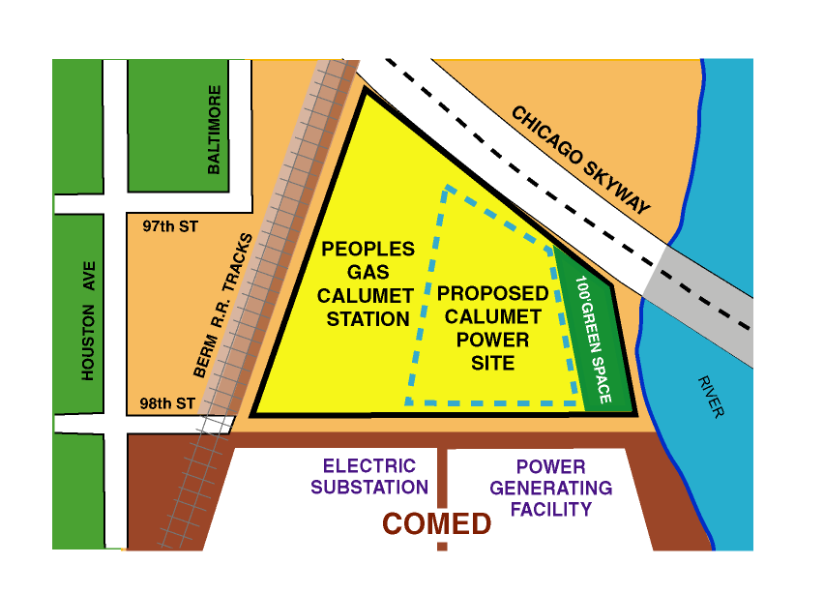
Exhibit I
Calumet Power Project Site
Chicago, Illinois
Page 1 of 1
Calumet Power Project Site consists of all power generating facilities located within the area designated above as Proposed Calumet Power Site

