Slide 1
2. Market Fundamentals
What happened in 2000/early 2001?
What is going on today?

Slide 2
Market Fundamentals
2000 and early 2001: The market looked short gas, short power generation and short hydro
    AGA’s were low starting in the winter of 2000 and by Jan 2001, gas levels were 350 Bcf behind the previous year and 310 Bcf behind the 7 year average
    Hydro conditions among one of the lowest since modern records began in 1929
    There were no signs of immediate relief!
The markets were supportive of new generation solutions

Slide 3
Power Prices: Historical and Forward
The forward market at that time was pointing to development/transportation as solution and ability to secure a rate of return

Slide 4
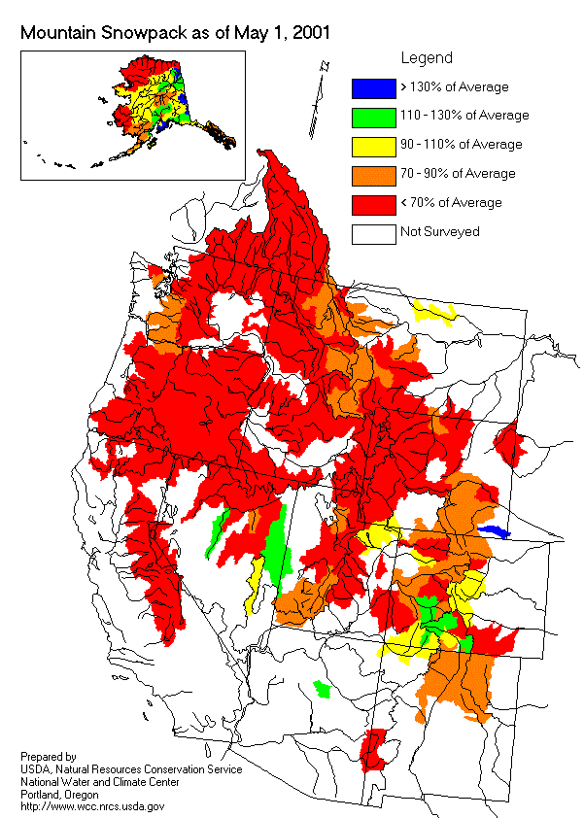
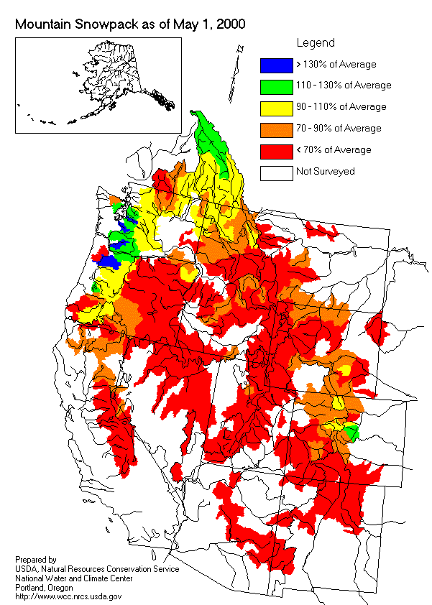
Western Snowpack Levels

Slide 5
WSCC Proposed Generation (in MW)

Slide 6
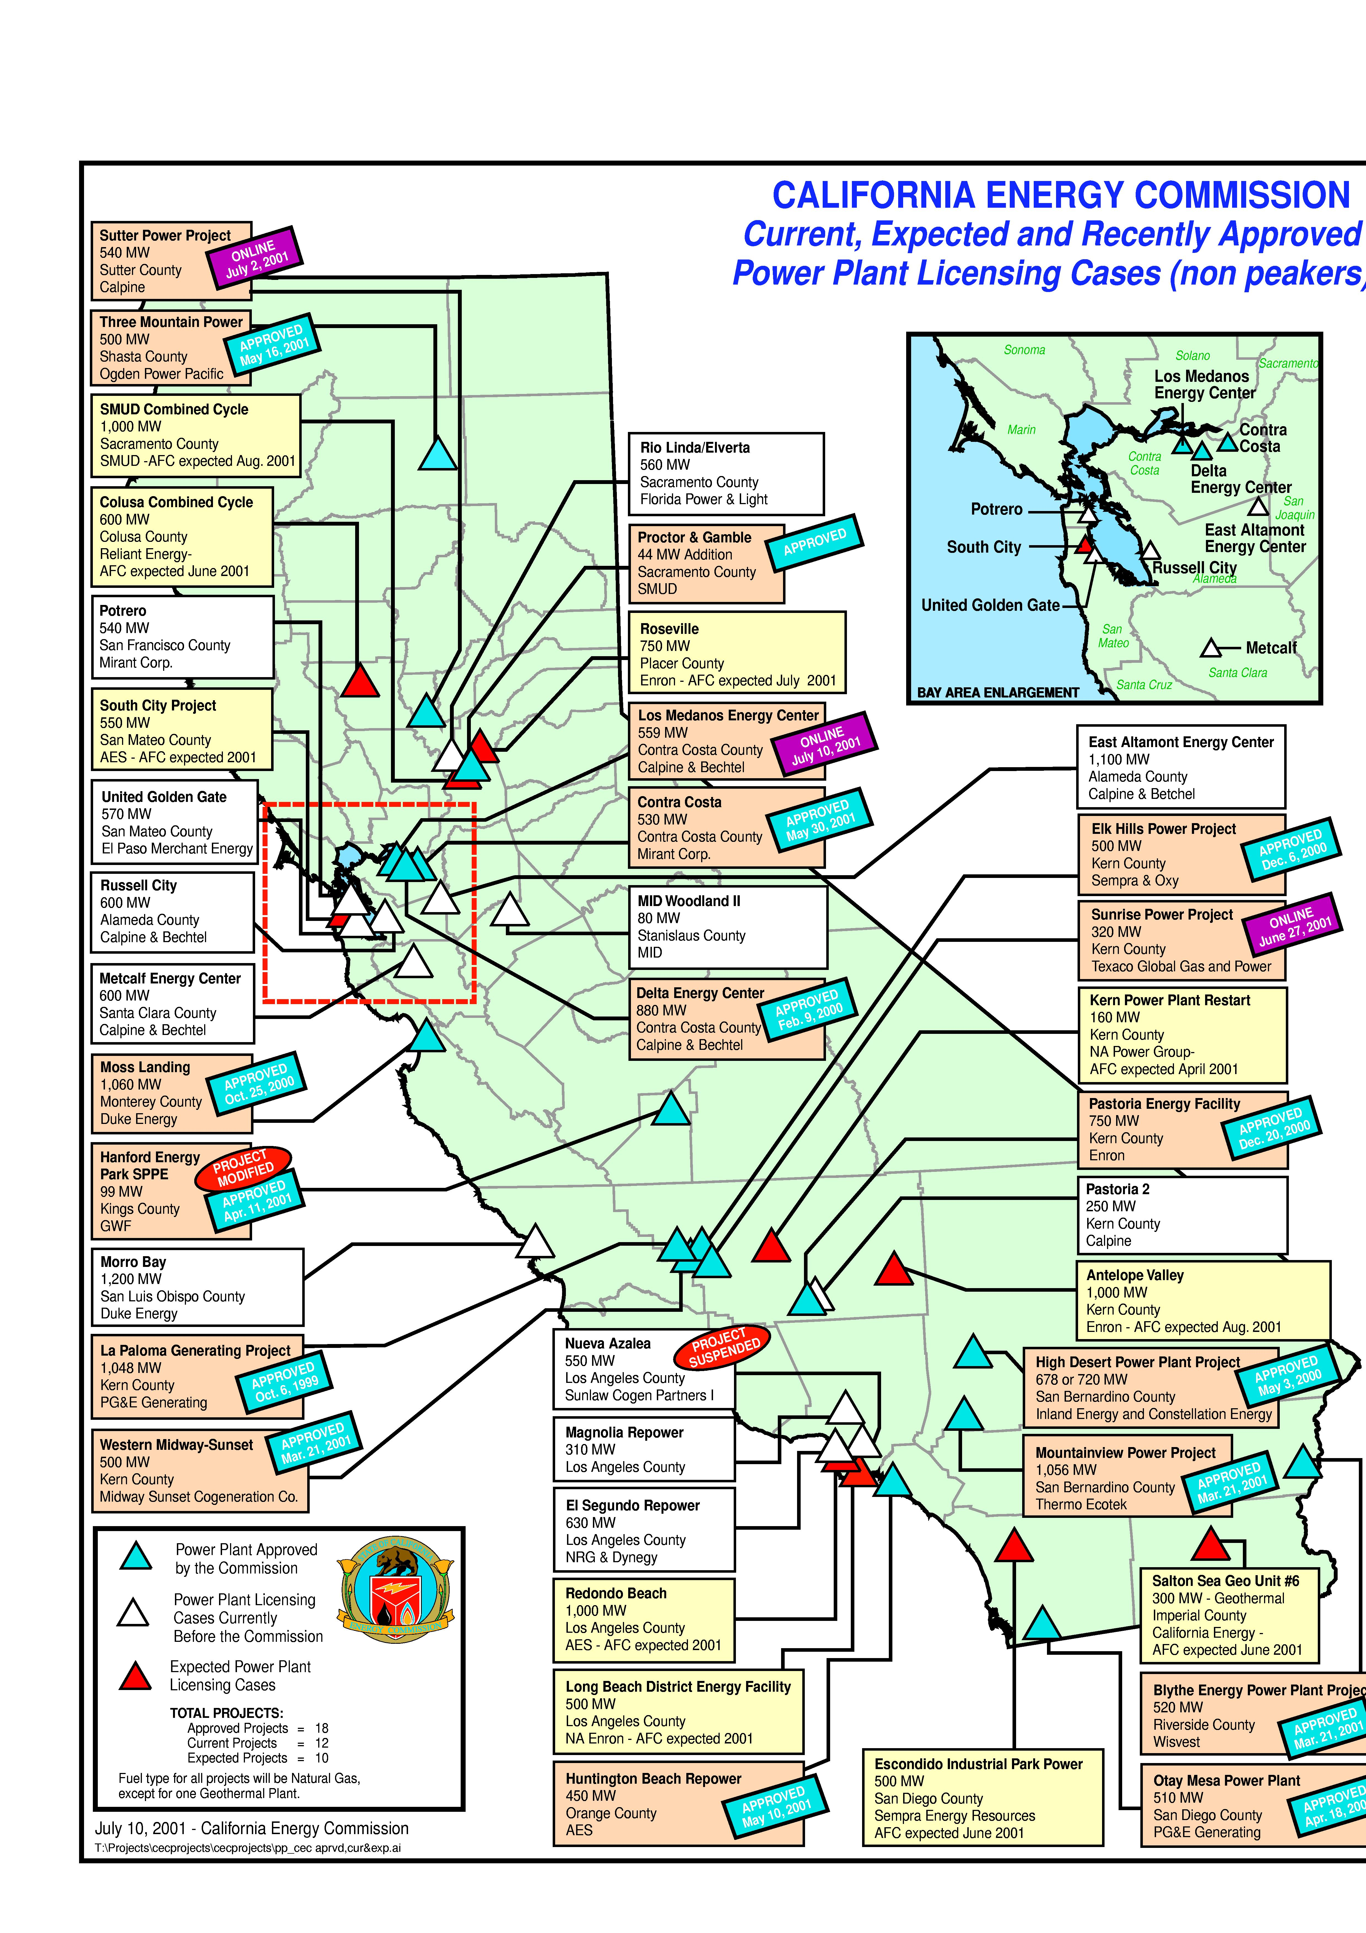
CEC Generation Report

Slide 7
Gas Supply and Transportation
Natural gas had to respond! Fuel plans for natural gas were also caught up in market sentiment
Pipeline expansions appeared everywhere in the west to support development projects
Most of the contracted expansions were underpinned by generators with 2003 start dates
Open Season | Term/Obligation | Estimated Tariff | Probability | Estimated Start Date
Southern Trails | 15 years | $0.52 | < 30% | May 2002
Ruby | 15 years | $0.87 | 50/50 | Late 2004
PGT | 30/52 years | $0.42 | 90% | Nov. 2002/2003
TW – Red Rock | 5/15 years | $0.68/$0.38 | 90% | June 2002
TW – Sun Devil | 15 years | $0.34 | 50/50 | June 2005
Sonoran | 20 years | $0.39 | 50/50 | May 2004
Kern River | 10/15 years | $0.70/$0.57 | 90% | May 2003
North Baja | 7/25 years | $0.29/$0.35 | 100% | June/Sept 2002
El Paso (ENA) | 2.5 years | $0.33 | 100% | Jan 2003

Slide 8
Slowing Growth in U.S. Gas Supply
U.S. Dry Gas Production
(Tcf)
Domestic production flat with increasing levels of gas drilling

Slide 9
More Difficult to Increase U.S. Production
U.S. Gas Rigs
Onshore Offshore
High
Low
Current
Gas Drilling Has Peaked -
942 (7/13/01)
134 (3/23/00)
318 (4/23/99)
38 (5/14/99)
824
112
As rig count increases, rig efficiency and initial production rates decrease
Decline Rates Up -
increasing by double in the major areas over the past decade
Numerous Major Plays
Working -
big plays becoming more remote and capital intensive

Slide 10
Market Fundamentals: What Happened?
Demand Side Management: Everybody backed off!
Pricing Pressure
Industrial load: shut down/bankrupt!
Hydro: peak pressure but made their way through regionally—Weather was normal!
California price caps: downward pressure
Conservation: everybody pitched in
Storage response: 10 week record injection of 100 Bcf/week
Market started to believe the shortage was over! Prices fell for term and daily markets… aggressively!

Slide 11
U.S. Storage Overview
The Rapid Pace Continues
Strong storage levels reflective of weak fundamentals
Unprecedented level of injections have been a critical factor in market declines
As of October 14, the year-over-year storage surplus was 471 Bcf
3,042 Bcf in inventory with 2 weeks left in injection season
High probability of reaching 11/5/98 storage high of 3,094 Bcf

Slide 12
U.S. Electric Power Use
1999
2000
2001

Slide 13
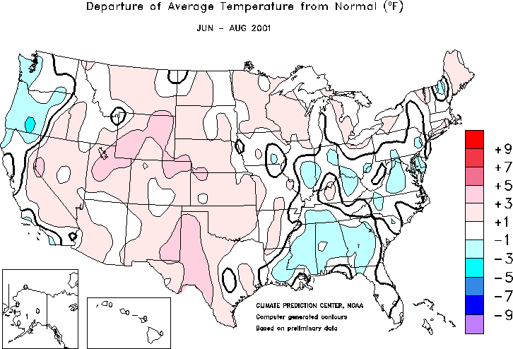

Moderate Summer Weather
Notes:
http://www.cpc.ncep.noaa.gov/products/analysis_monitoring/regional_monitoring/usa.html#seasonal

Slide 14
Power Prices: Historical and Forward
From the time in Jan ’01 that all the decisions were made, to today, the market developed a different theory

Slide 15
Fundamentals Conclusions
Despite expectations of a continued bullish price environment, fundamentals have actually pushed prices down
Gas supply, though on the upswing, is not the primary driver of this bearish environment
Similarly, unremarkable weather has not sparked a demand rally
The weak economy combined with successful conservation efforts are key drivers in pushing down demand and prices
The resulting rapid pace of injections has set the stage for record inventories going into the withdrawal season

