Slide 1
November 2000
Confidential & Proprietary
Management Presentation
Caledonia Overview

Slide 2
Overview
Caledonia Overview
Plant Description: 504 MW (nominal) natural gas-fired, simple-cycle facility
Location: 60-acre tract in Lowndes County, Mississippi, in TVA subregion of SERC
Power Interconnect: TVA 500 kV line
Gas Interconnect: Tennessee Gas Pipeline Company
Start of Construction: September 1998
Commercial Operation Date: June 1999
Heat Rate (ISO): 12,000 Btu/kWh (HHV)
Approx. Max. Annual MWh: 550,000 @ 59ºF
Approx. Run Hours: 1,088 including approximately 200 hours of peak-firing
NOx (per unit): <15 ppm
CO (per unit): <25 ppm

Slide 3
Facility Strengths
Caledonia Overview
“First-mover advantage” inside TVA
TVA and surrounding areas have historically experienced extreme power price volatility
Request for dual interconnection submitted to Southern Company and TVA
Southern Company is anticipated to complete an interconnection study by the end of November 2000
TVA is projected to complete its interconnection study by January 2001
Ideally suited to capitalize on gas/power arbitrage opportunities
Expansion/conversion potential
Site has room for additional gas turbines
Turbine technology and layout allow for easy conversion to combined cycle
30-minute normal unit ramp-up from cold to full load
Permits allow for approximately 200 hours of peak-firing, which adds approximately 30 MW of plant-wide output

Slide 4
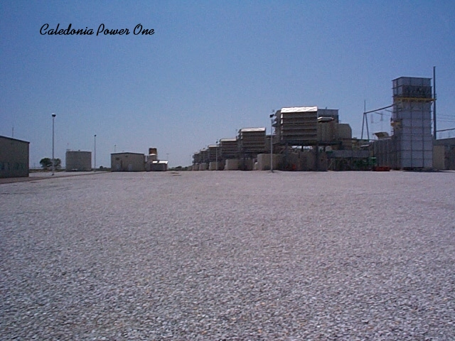
Plant Picture
Caledonia Overview

Slide 5
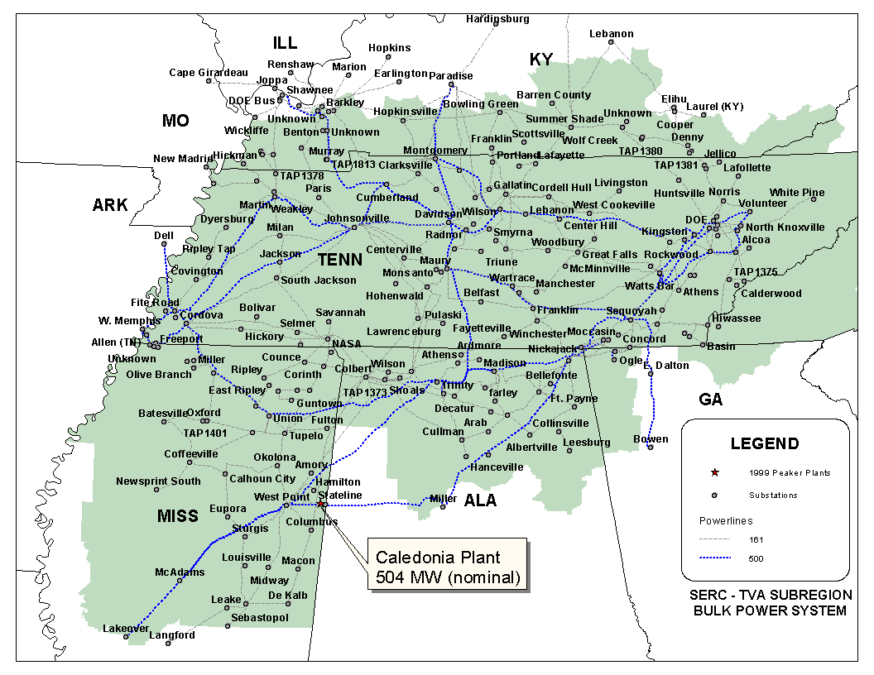
Regional Overview
Caledonia Overview

Slide 6
Power Market Opportunities
Caledonia Overview
Caledonia Power I, L.L.C. is qualified as an Exempt Wholesale Generator and has authority to sell energy and capacity at market-based rates
TVA’s extensive 500 kV system provides system users excellent transmission reliability and reach
Caledonia’s location in TVA and access to eastern U.S. electricity market provide sales opportunities into the wholesale power markets
Caledonia provides access to TVA system with direct connections to 12 surrounding control area markets
Caledonia is within two utility wheels away from over 70 control area markets
Planned interconnection to Southern transmission line would provide valuable power marketing opportunities;
No TVA transmission costs into Southern
No TVA transmission losses into Southern
Added flexibility

Slide 7
Equipment Overview
Caledonia Overview
Turbines: 6 General Electric 7EA gas turbines using fogging for inlet air cooling
Switchyard Equipment: ABB, 500 kV interconnect breakers
Switchyard Configuration: radial
Transformers: (3) ABB 208 MVA, 3 winding, 3 phase, 13.8 kV/500 kV
Control System: General Electric Mark V
Generator Circuit Breakers: (6) ABB HGC (7,500A)
Generator Voltages: 13.8 kV
Plant Distribution Voltages: 4160 V and 480 V
CALEDONIA
ENCA
500 kV line to:
TVA
B
G1
Lowndes
B
Substation
GSU 1
B
G2
500 kV Bus
B
G3
B
GSU 2
B
G4
B
G5
B
GSU 3
B
G6
Unit MW Rating:
Summer
Nominal
Winter
78
84
90
B = Breaker
GSU = Generator Step-up Unit

Slide 8
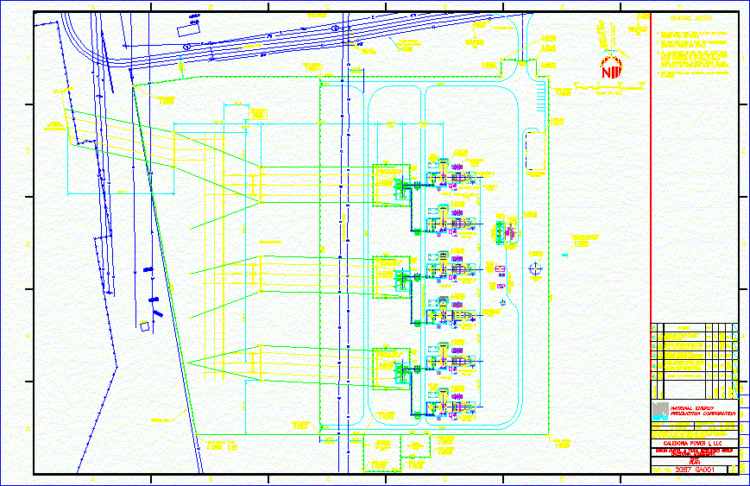
Plant Layout
Caledonia Overview

Slide 9
Performance Results
Caledonia Overview

Slide 10
Power Interconnection
Caledonia Overview
Interconnected directly to TVA’s Lowndes substation with access to TVA’s Lowndes-to-Miller 500 kV line, TVA’s Lowndes-to-Westpoint 500 kV line, and TVA’s 161 kV system
Request for dual interconnection submitted to Southern Company and TVA
Southern Company is anticipated to complete an interconnection study by the end of November 2000
TVA is projected to complete its interconnection study by January 2001

Slide 11
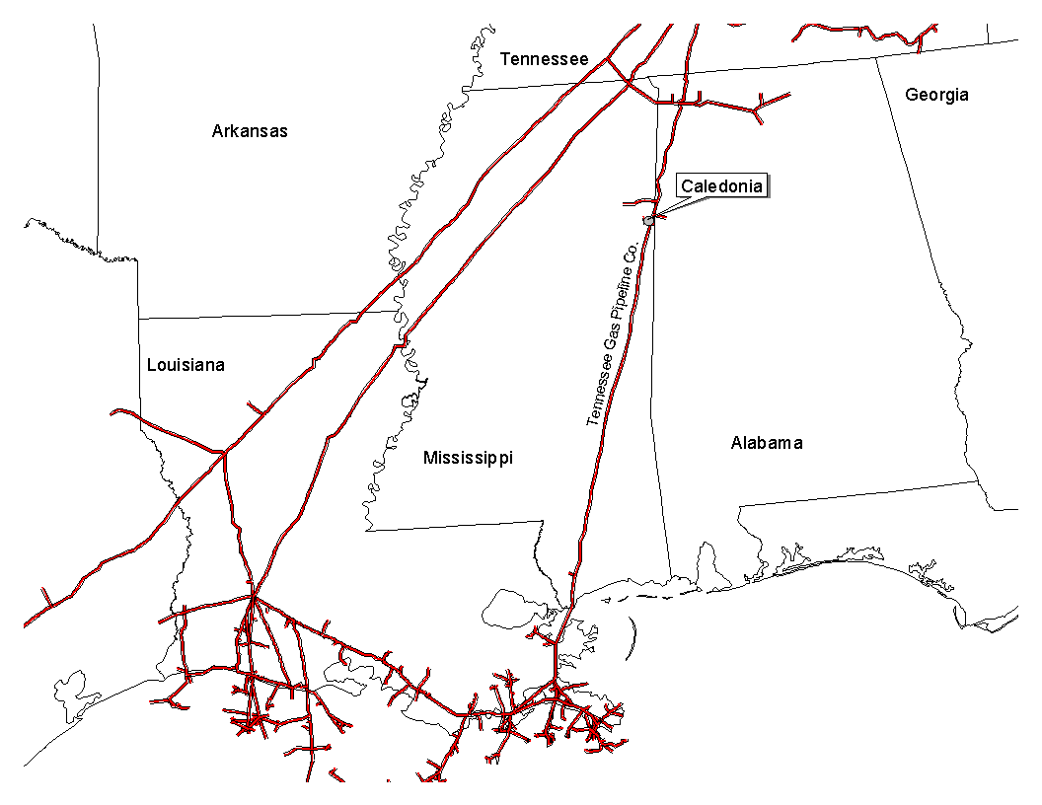
Gas Transportation
Caledonia Overview
Pipeline: Tennessee Gas Pipeline Company
Delivery Point: Plant-Gate and Midwestern Gas Transmission Portland Interconnect
Two Gas Transport Options Exist
1. Option A (Combination of FT, AO and Backhaul Service)
BASE CONTRACT
Term: 10 years (May - Sept) beginning June 1, 1999
Volume: 85,200 MMBtu/d
FT-A with AO CONTRACT
Rate: $.01 year round Demand on 12,500/d
$.1085 plus fuel Commodity on first 12,500/d, May through Sep
$.1125 plus fuel Commodity on excess (up to 72,700 Dth/day), May through Sep
$.50 plus fuel Commodity rate, Oct through Apr
Vol. Commit: - 4.5 Bcf per year, Excess Volumes credited years 1,2,3,4 against years 5,4, etc...
- Transport nominated under Option A is credited against volume commitment
Fuel: 0.5% on Backhaul; 1.70% on forward haul (summer) and 1.91% (winter)
Receipt Points: Zone 1 & Zone L
BACK-UP CONTRACT
FT-BH CONTRACT (Years 1-5)
Rate: $.05 plus fuel (volumetric), May through Sep
Maximum rate, Oct through Apr
Receipt Points: Downstream point in Zone 1, 2, 4, 5 & 6

Slide 12
Gas Transportation (Continued)
Caledonia Overview
2. Option B: Enron North America has a one time right to convert to Option B at any time during the life of the agreement
FT-A CONTRACT (Plant sole provider)
Rate: $.01 year round Demand on 85,200/d
$.12 plus fuel Commodity on first 5.0 Bcf/yr, May through Sep
$.05 plus fuel Commodity on next 1.3 Bcf/yr, May through Sep
$.12 plus fuel Commodity on dth greater than 6.3 Bcf/yr, May through Sep
$.50 plus fuel Commodity rate, Oct through Apr
Receipt Points: 500 Leg Zone 1 Secondary
Midwestern Primary (Years 1-5); Midwestern Like Primary (Years 6-10)
BALANCING:
OBA at plant interconnect
Cash-out monthly
Allows for uneven hourly flow at plant delivery point with even 24 hour supply flow
OTHER
Cancellation Option beginning at year 6. Payoff as follows: YRS 6-10 ($1,100,000), YRS 7-10 ($1,000,000), YRS 8-10 ($950,000), YRS 9-10 ($900,000), YR 10 ($800,000)
1 Bcf storage contract at Bear Creek for one year beginning 11/1/00. Capacity charge is $.05 on the avg monthly balance, $.0053 for injections / withdrawals plus 1.49% fuel. Transport from Zn L pools to storage is $.05 (winter) and $.015 (summer) plus fuel and ACA.
Winter 2000 (Nov '00 through March '01) transportation from Zn L pools to plant gate is $.18 plus fuel and ACA

Slide 13
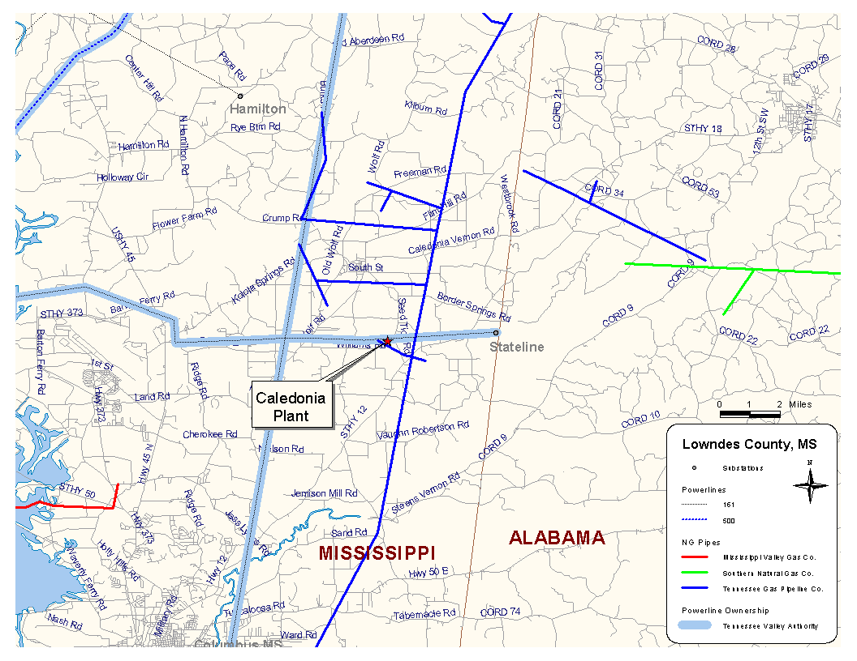
Plant Location
Caledonia Overview

Slide 14
Control Area Status
Caledonia Overview
Caledonia control area, ENCA, has been designated a control area in accordance with NERC policy
Control area designation is valuable for point to point power sales and scheduling of power
Control area options for Caledonia purchaser include:
control area services provided by TVA
control area re-established by purchaser in accordance with NERC procedures
control area and scheduling services provided by Enron affiliate, under separate contract

Slide 15
Expansion/Conversion Opportunity
Caledonia Overview
Caledonia designed to facilitate future plant expansion and/or conversion to combined cycle
Net heat rate could go from 12,000 Btu/kWh (HHV) currently to 8,300 (HHV), depending on equipment
Net output could go from 504 MW (nominal) currently to 804 MW (nominal), depending on equipment
Caledonia conversion should take approximately 18 to 24 months
Installation of an SCR should facilitate getting a PSD permit for combined cycle operation
An interconnect study agreement has been initiated with TVA for the addition of approximately 510 MW at the Caledonia Plant.

Slide 16
Environmental Specifications
Caledonia Overview
Discharge Permit: Not Required
Air Permit: Non-PSD
NOx Control Method: DLN
Compliance Method: CEMS
Limits: 248 T NO_{x} per year
248 T CO per year
Actual Commission NO_{x}: <15 ppm
Actual Commission CO: <25 ppm
Estimated Run Hours: 1,088

Slide 17
Estimated Operating Costs
Caledonia Overview
Cost Type
Est. Cost
Comments
Variable O&M
$1.00 / MWh
- includes estimates on water costs, electricity, and
variable maintenance expenditures
Fixed O&M
?/ Year
- includes estimates of payroll expenses and other fixed
O&M
Major Maintenance
$1,000 / Start / Turbine
- includes estimated accrual for future major maintenance
on a per turbine basis, assuming 100 starts/year, using
OEM recommended maintenance schedule
Owner's Expense
?/ Year
- includes estimates of insurance, utilities, interconnection
fees, gas pipeline metering costs and miscellaneous
expenses

Slide 18
Organizational Chart
Caledonia Overview
Caledonia is currently operated by Operational Energy Corp (“OEC”), an Enron Corp. subsidiary
It is anticipated that at closing, O&M contract with OEC will be terminated
Caledonia personnel are currently employees of OEC

Slide 19
Legal Structure
Caledonia Overview
Caledonia Power I, L.L.C. (“Caledonia Power”) is a Delaware limited liability company and is 100% owned by Enron North America Corp.
Purchaser will acquire 100% of member interests in Caledonia Power

