Slide 1
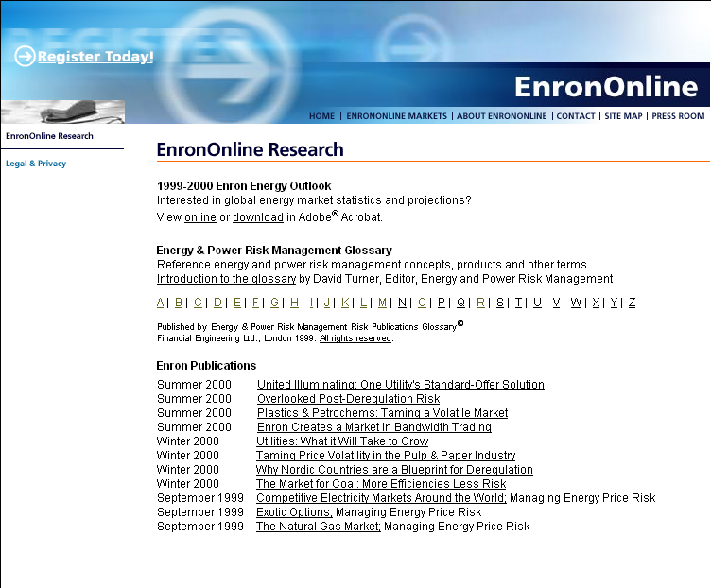
1999-2000 Enron Energy Outlook
Interested in global energy market statistics and projections?
View online or download in Adobe® Acrobat.
Energy & Power Risk Management Glossary
Reference energy and power risk management concepts, products and other terms.
Introduction to the glossary by David Turner, Editor, Energy and Power Risk Management
A | B | C | D | E | F | G | H | I | J | K | L | M | N | O | P | Q | R | S | T | U | V | W | X | Y | Z
Published by Energy & Power Risk Management Risk Publications Glossary©
Financial Engineering Ltd., London 1999. All rights reserved.
Options Calculator
This basic options calculator provides easy computations for European, American and Asian options. It also includes instructional information about options.
Enron Publications
Summer 2000 United Illuminating: One Utility's Standard-Offer Solution
Summer 2000 Overlooked Post-Deregulation Risk
Summer 2000 Plastics & Petrochems: Taming a Volatile Market
Summer 2000 Enron Creates a Market in Bandwidth Trading
Winter 2000 Utilities: What it Will Take to Grow
Winter 2000 Taming Price Volatility in the Pulp & Paper Industry
Winter 2000 Why Nordic Countries are a Blueprint for Deregulation
Winter 2000 The Market for Coal: More Efficiencies Less Risk
September 1999 Competitive Electricity Markets Around the World; Managing Energy Price Risk
September 1999 Exotic Options; Managing Energy Price Risk
September 1999 The Natural Gas Market; Managing Energy Price Risk
New section on the research page to navigate to options calculator

Slide 2
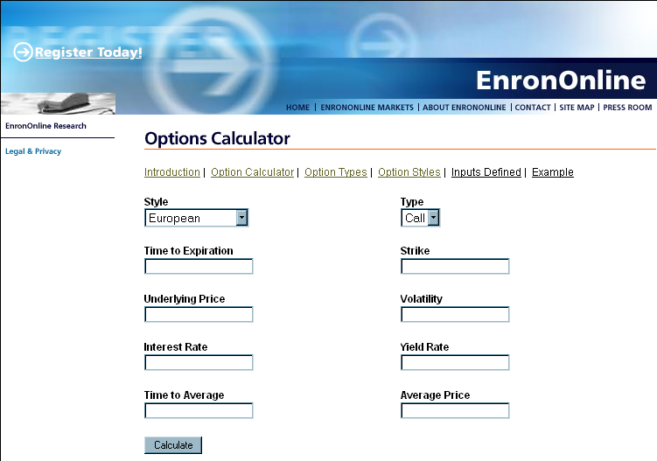
>> Options Calculator
Calculator
Introduction
Types
Styles
Example
___________________
Legal & Privacy
This basic options calculator is based on common formulas used for pricing options. Premium values are based on your inputs and the applicable formula. Any premium values calculated with this tool do not represent Enron’s assessment of the value of the option.
Style
Type
Strike
Volatility
Expiry
Underlier
Rate
Yield
Premium
Option style
Type of option
Strike price of option
Annualized volatility (%)
Trading days to expiration
Price of underlying instrument
Annualized risk-free rate (%)
Yield of the underlying instrument
Calculated price of the option
Float calculator
Looks like this when user selects European option.
EnronOnline
Options Calculator
Style
Type
Strike
Volatility
Expiry
Underlier
Rate
Yield
Premium
Close

Slide 3
>> Options Calculator
Calculator
Introduction
Types
Styles
Example
___________________
Legal & Privacy
This basic options calculator is based on common formulas used for pricing options. Premium values are based on your inputs and the applicable formula. Any premium values calculated with this tool do not represent Enron’s assessment of the value of the option.
Style
Type
Strike
Volatility
Expiry
Underlier
Rate
Yield
Premium
Option style
Type of option
Strike price of option
Annualized volatility (%)
Trading days to expiration
Price of underlying instrument
Annualized risk-free rate (%)
Yield of the underlying instrument
Calculated price of the option
Float calculator
Looks like this when user selects American option.

Slide 4
>> Options Calculator
Calculator
Introduction
Types
Styles
Example
___________________
Legal & Privacy
This basic options calculator is based on common formulas used for pricing options. Premium values are based on your inputs and the applicable formula. Any premium values calculated with this tool do not represent Enron’s assessment of the value of the option.
Style
Type
Strike
Volatility
Expiry
Ave price
Average #
Underlier
Rate
Yield
Premium
Execution convention
Type of option
Strike price of option
annualized volatility (%)
Trading days to expiration
Average price to date
Days of averaging
Price of underlying instrument
Annualized risk-free rate (%)
Yield of underlying instrument
Calculated price of the option
Float calculator
Looks like this when user selects Asian option.

Slide 5
>> Options Calculator
Calculator
Introduction
Types
Styles
Example
___________________
Legal & Privacy
An option is a contract giving its owner the right but not the obligation to buy or sell a specified quantity of a specified commodity at a fixed price for a specific period of time.
The seller receives a price (the premium) for the sale of this right and is obligated to deliver, if the buyer exercises his right. The buyer receives either the specified commodity (physical options), or the difference between the strike price and the specified index (financial options).
The specified commodity is referred to as the underlying price, the fixed price is termed as the strike and the maturity date is termed as the expiration date.
Example
XYZ Co purchases the right to buy 5000 MMBtu /day of September 00 NYMEX Henry Hub natural gas at $ 4.30/MMBtu expiring on 8/27/00 for $0.30/MMBtu. This option can be summarized as shown below:
  Commodity Natural Gas
  Index: NYMEX Henry Hub.
  Strike $4.30
  Term September 00
  Expiration date 8/27/00
  Premium $0.30/MMBtu

Slide 6
>> Options Calculator
Calculator
Introduction
Types
Styles
Example
___________________
Legal & Privacy
Call Option
A call option is a contract giving its owner the right but not the obligation to buy a specified quantity of a specified commodity at a fixed price for a specific period of time.
Call Example
AAA Co. sells the right to buy 500 MWh (onpeak) of power in the month of October in NEPOOL at $50/MW expiring on 9/30/00 for $1.40/MW.
Put Option
A put option is a contract giving its owner the right but not the obligation to sell a specified quantity of a specified commodity at a fixed price for a specific period of time.
Put Example
ABC Co purchases the right to sell 1000 bbls/day of September 00 NYMEX WTI crude oil at $30.00 expiring on 8/31/00 for $1.20/bbl.

Slide 7
>> Options Calculator
Calculator
Introduction
Types
Styles
Example
___________________
Legal & Privacy
European Option
European options are those that can be exercised only on the options expiration date. This options calculator uses the Black-Scholes model to value European options.( Reference: Black,F., and M. Scholes, “the Pricing of Options and Corporate Liabilities,” Journal of Political Economy, 81 (May-June 1973), 637-59.)
European Example
XYZ Co. purchases an American call on 5000MMBtu/day of Henry Hub natural gas at $4.50 expiring on 7/31/01 for $0.55/MMBtu. XYZ Co may purchase 5000/day of Henry Hub natural gas at $4.50/MMBtu only on 7/31/01.
American Option
American options maybe exercised at any time on or before the option expiration date.The Barone-Adesi & Whaley approximation is used in this calculator to value American options.( Reference: Barone-Adesi, G., and R. E. Whaley, “Efficient Analytic Approximation of American Option Values”, Journal of Finance, 42 (june 1987), 301-20.)
American Example
XYZ Co. purchases a European call on 5000MMBtu/day of Aug01Henry Hub natural gas at $4.50 expiring on 7/27/01 for $0.60/MMBtu. XYZ Co may purchase 5000/day of Henry Hub natural gas at $4.50/MMBtu on any day up until 7/27/01.

Slide 8
>> Options Calculator
Calculator
Introduction
Types
Styles
Example
___________________
Legal & Privacy
Asian Option
Options where the underlying price is an average of prices over some period of time as opposed to a price on a single day are known as Asian options. Asian options maybe European or American. This calculator uses the Geometric Conditioning Approximation to value Asian options. Reference: Curran, M., “Beyond average intelligence”, Risk, Nov. 1992, 60.
Asian Example
XYZ Co. buys a Asian European call on 1000 bbls/day of Sep00 NYMEX WTI crude oil at $32/bbl expiring on 9/30/00 for $1.50/bbl. If XYZ exercises the option on 9/30/00 it will receive the greater of 0, or the average of the daily NYMEX WTI settlements for the month of September minus $32.00

Slide 9
>> Options Calculator
Calculator
Introduction
Types
Styles
Example
___________________
Legal & Privacy
Natural Gas Example
On December 15th 2000 the NYMEX Henry Hub natural gas forward price is $4.00. XYZ Co determines that its cost of borrowing is 7.50 %, and that the anticipated future volatility of the NYMEX Henry Hub forward price is 30% . To calculate the value of a European November 01 -March02 $ 4.50 call, expiring on October 27th 2001, XYZ Co will:
1. Select Option Style ‘European’ in the options calculator
2. Select Option Type ‘Call’
3. Enter the following inputs
  Price $ 4.00
  Strike $ 4.50
  Volatility 45%
  Time to expiration 317 days
  Interest Rate 7.50%
  Yield 7.50%
4. The premium value of the option will be displayed

