Slide 1
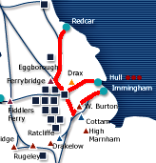
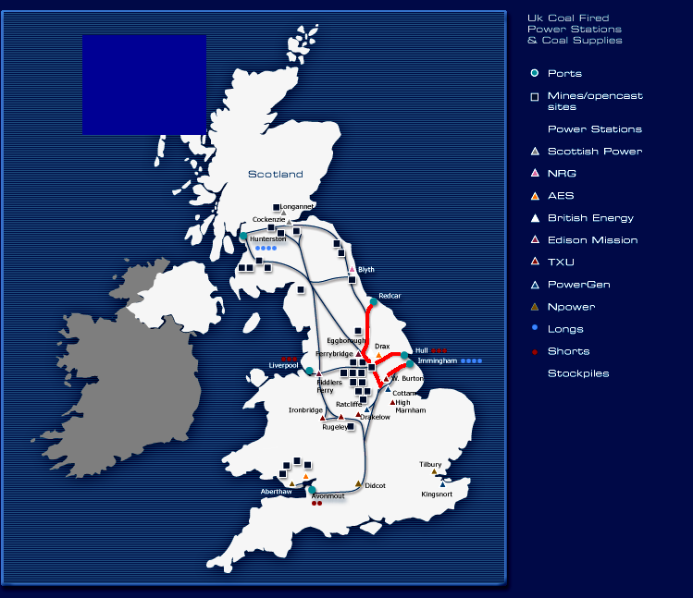
The Coal Pipeline - Enron Coal Transport Ltd.
ECTL
COAL PIPELINE

