Slide 1
2001 Generation Shift Factor Analysis
Presentation to ERCOT TAC
by Ron McNamara, Enron
3/9/2001

Slide 2
Three mutually agreed upon CSCs
West to East: GRAHAM to PARKER, 345kV, ckt 1 (bus 1430 - bus 1436)
South to North: LIMESTONE to WATERMILL, 345 kV, ckt1 (bus 46020 - bus 2428)
Out of Houston: SO TEX 5 to DOW 5, 345kV 18, (bus 5915 - 42500)

Slide 3
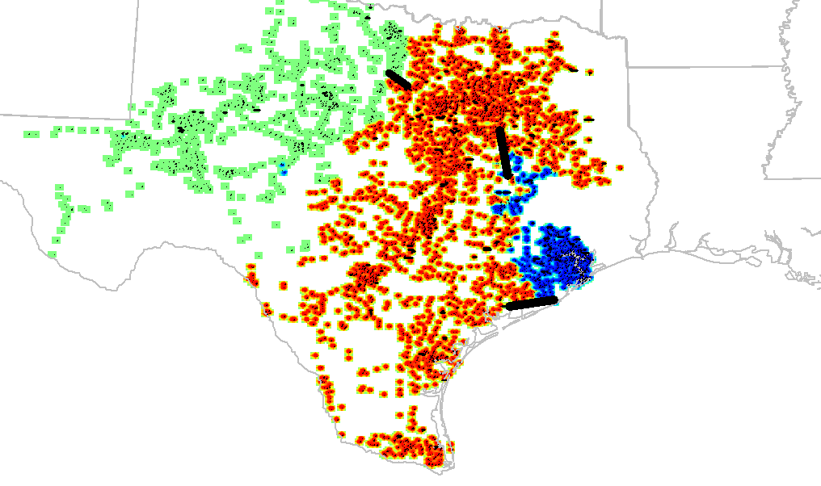
3 CSCs with 3 zones

Slide 4
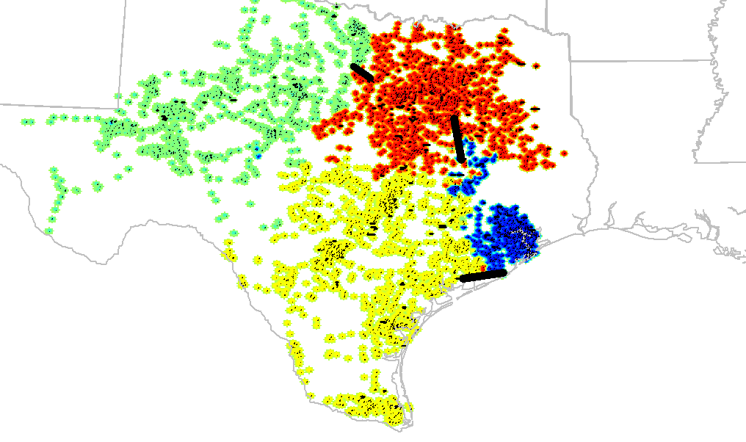
3 CSCs with 4 zones

Slide 5
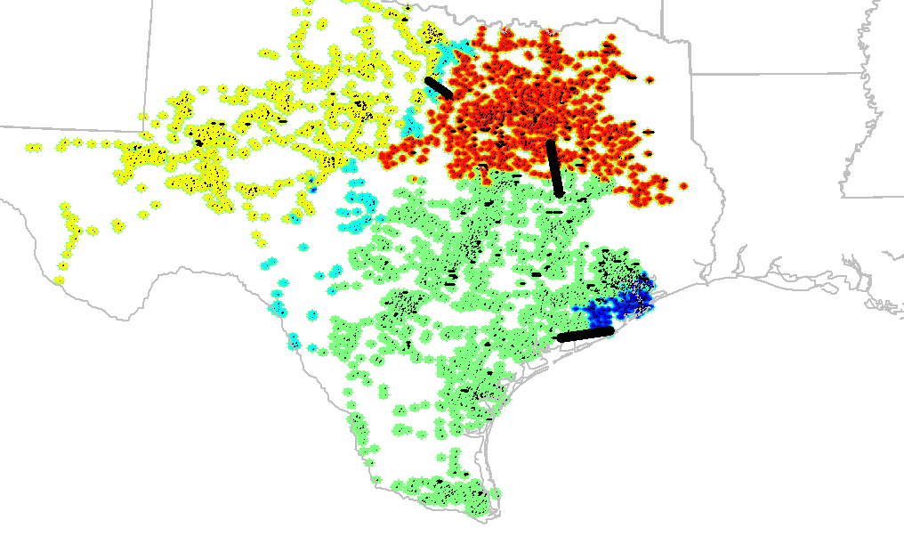
3 CSCs with 5 zones

Slide 6
Reliant requested CSCs
West to East: GRAHAM to PARKER, 345kV, ckt 1 (bus 1430 - bus 1436)
South to North: LIMESTONE to WATERMILL, 345 kV, ckt1 (bus 46020 - bus 2428)

Slide 7
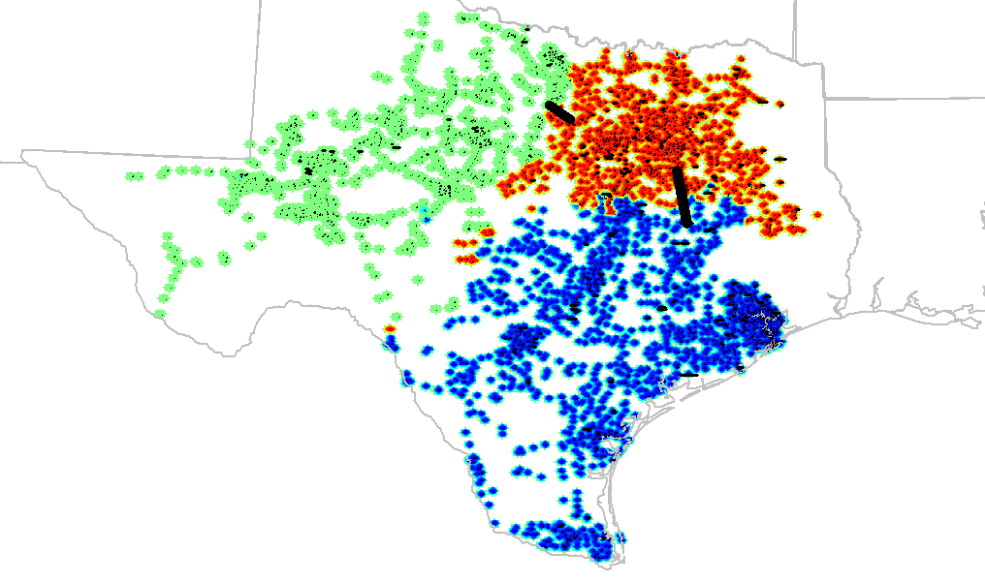
2 CSCs with 3 zones

Slide 8
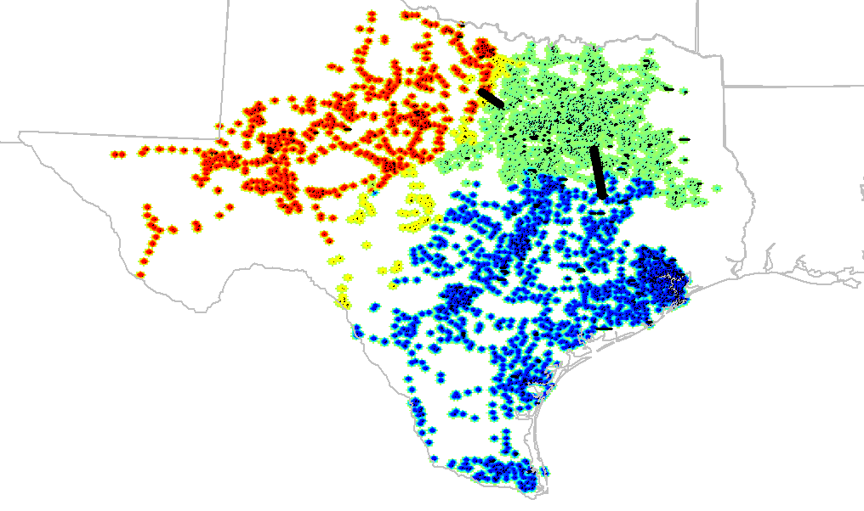
2 CSCs with 4 zones

Slide 9
3 CSCs with 3 zones

