Slide 1

CSC
DETERMINATION PROCESS
KENNETH A. DONOHOO
MANAGER OF SYSTEM PLANNING,TECHNICAL OPERATIONS
kdonohoo@ercot.com
www.ercot.com

Slide 2
PEAK DEMAND
Year | ERCOT Coincident Hourly Peak Demand MW | Annual Growth
1994 | 43,588 | --
1995 | 46,668 | 7.07%
1996 | 47,683 | 2.17%
1997 | 50,150 | 5.17%
1998 | 53,689 | 7.06%
1999 | 54,849* | 2.16%
2000 | 57,606 | 5.03%
 | Average Six Year Compound Growth | 4.85%
*This value would have been greater if there had been no interruptible load curtailments at the time.

Slide 3
SUMMER 2001
PROJECTIONS
 | LSE MOR* HISTORIC
Peak Demand (NCP) | 56,759 MW 59,565 MW 60,198 MW
Interruptible Load | 3,008 MW
Firm Peak Demand (NCP) | 53,751 MW 56,648 MW 57,190 MW
Generation Capacity | 69,947 MW
Summer Reserve w/o IL | 13,188 MW 10,382 MW 9,749 MW
Responsive Reserve | 2,300 MW
Remaining Reserve w/o IL | 10,888 MW 8,082 MW 7,449 MW
* Middle Of Road

Slide 4
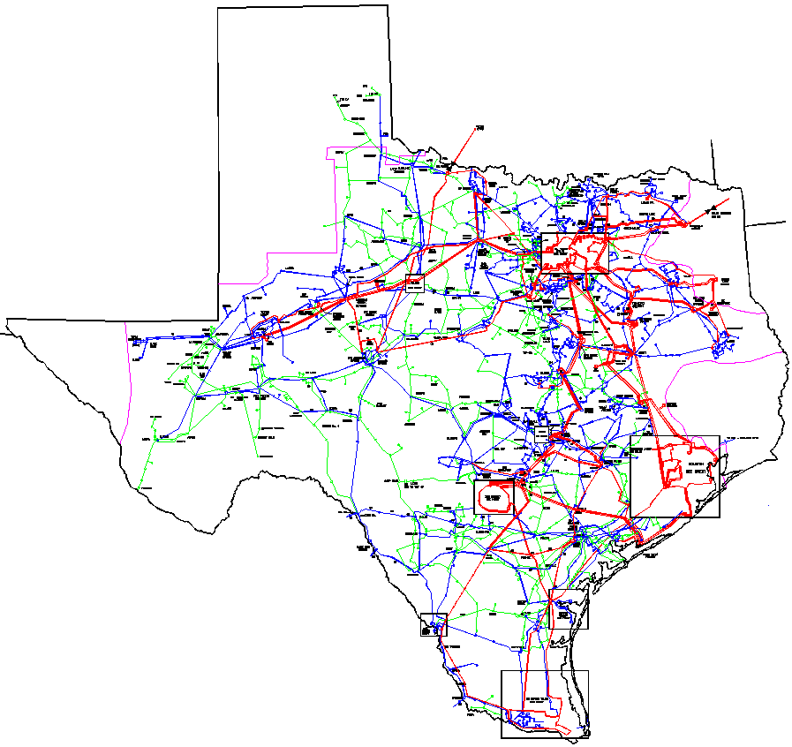
MONTICELLO-FARMERSVILLE 345 kV CIRCUIT
LIMESTONE-WATERMILL 345 kV DCKT
AUSTROP-LOST PINES-FPP 345 kV CIRCUIT
LYTTON-HOLMAN-FPP 345 kV CIRCUIT
NEW MAJOR TRANSMISSION
FOR 2001 SUMMER
MILITARY HIGHWAY STATCOM +/- 150 MVAR

Slide 5
MAJOR TRANSMISSION
PROJECTS UNDERWAY
FARMERSVILLE-ANNA 345 kV
CCN JANUARY 2001
IN SERVICE DEC 2002
GRAHAM – JACKSBORO 345 kV LINE
CCN FILED BY JUNE 2001
IN SERVICE DEC 2002
MORGAN CREEK–SAN ANGELO–COMANCHE SWITCH 345 kV LINE
CCN JUNE 2001
IN SERVICE DEC 2002
SAN MIGUEL–PAWNEE 345 kV LINE
CCN NOVEMBER 2000
IN SERVICE MAY 2002
HOUSTON AREA UPGRADES
COLETO CREEK–PAWNEE 345 kV LINE
CCN DECEMBER 2000
IN SERVICE MARCH 2002
RIO GRANDE VALLEY SERIES CAPACITOR COMPENSATION
IN SERVICE SEPTEMBER 2001

Slide 6
CSC STEPS
SUMMER ON PEAK LOAD FLOW BASE CASE
PERFORM EXTENSIVE EVALUATIONS TO IDENTIFY POTENTIAL CONSTRAINTS
FORM WORKING GROUP REPRESENTING BROAD RANGE OF MARKET PARTICIPANTS (CSCWG)
EXPECTED & ACTUAL ANNUAL CONGESTION COSTS
SELECT PROPOSED CSC’S
CALCULATE SHIFT FACTORS
PERFORM CLUSTER ANALYSIS OF SHIFT FACTORS
PREPARE ZONE MAPS BASED UPON CLUSTER ANALYSIS
TAC & BOARD APPROVAL
INSTALL DATA IN NETWORK MODEL & SETTLEMENTS

Slide 7
CSC TOOLS
PTI PSSE & MUST
  POWER FLOW ANALYSIS
POWERWORLD
  INDIVIDUAL SHIFT FACTOR CALCULATIONS
SAS STATISTICAL SOFTWARE
  CLUSTER ANALYSIS
MS EXCEL & MS ACCESS
  AVERAGE WEIGHTED SHIFT FACTORS
  SORTING & MAPPING

Slide 8
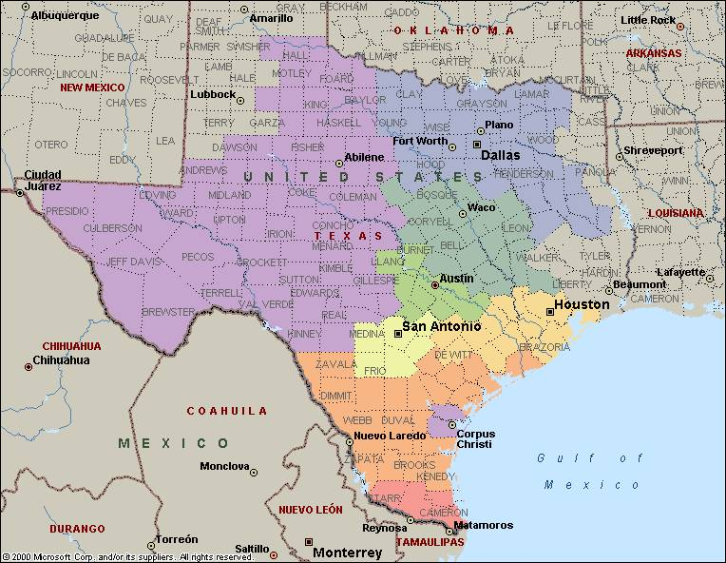
CSC STUDY REGIONS
NOT CSC ZONES

Slide 9
SIGNIFICANT CONSTRAINTS
SUMMER 2001
BASED UPON THERMAL LIMITS ONLY
Will Vary Based Upon System Conditions & Generation Dispatch
WEST to EAST Stability Limit about 1,100 MW
From SOUTH TEXAS Stability Limit about 1,250MW
To SOUTH TEXAS Voltage Stab Limit about 900 MW
Northeast Texas Stability Limits

Slide 10
CSC CONCERNS
ZONES SHOULD HAVE GOOD MARKET BASE
MULTIPLE GENERATION ENTITIES WITHIN ZONE
CSC’S MUST CROSS ZONE BOUNDARIES
SMALL CLUSTERS NOT VALID
INTERATIVE PROCESS

Slide 11
GRAHAM-PARKER 345 kV DOUBLE CIRUIT LINE
LIMESTONE-WATERMILL 345 kV DOUBLE CIRUIT LINE
PROPOSED COMMERCIALLY
SIGNIFICANT CONSTRAINTS
SUMMER 2001
As selected by CSCWG 3/05/01
OPTION
STP-DOW 345 kV DOUBLE CIRUIT LINE

Slide 12
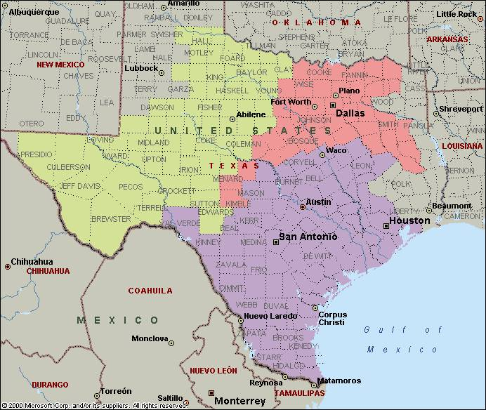
GRAHAM-PARKER 345 kV DOUBLE CIRCUIT LINE
NORTH2001
LIMESTONE-WATERMILL
345 kV DOUBLE CIRCUIT LINE
WEST2001
SOUTH2001
CSC ZONES by County
Actual CSC ZONES will be
BUS by BUS and vary slightly
2 CSC’s & 3 ZONES
OPTION WAS SELECTED
BY TAC MARCH 8, 2001
SELECTED BY ERCOT
BOARD MARCH 21, 2001

Slide 13
CSC EXPERIENCE
COMMERCIAL MODEL DATA AGGREGATION DOES NOT SUPPORT SPLIT OF GENERATION UNITS
  SYSTEM CHANGE REQUIRED
  PHASE II ADDITION
DEVELOP DETAILED PROCEDURES
  INCORPORATE IN PROTOCOLS
  HANDLING OF POSSIBLE EXCEPTIONS
CSC MAY CHANGE EACH YEAR
  BASED GENERATION & TRANSMISSION CHANGES
DEVELOP BETTER MAPPING
  POWER FLOW TO NETWORK MODEL
  GEOGRAPHIC MAPS

Slide 14

QUESTIONS
FOR MORE DETAILS AND ADDITIONAL SYSTEM DATA
VISIT THE SYSTEM PLANNING TECHNICAL OPERATIONS
WEBSITE AT:
ftp://ftp.ercot.com/systemplanning/system_planning_department.htm

Slide 15
NORTH2001
LOAD 20,700 MW
GEN 22,000 MW
1200 MW
WEST2001
LOAD 3,700 MW
GEN 5,300 MW
720 MW
2200 MW
3750 MW
580 MW
310 MW
SOUTH2001
LOAD 33,000 MW
GEN 45,200 MW
LOAD & GENERATION
WITHIN CM/CSC ZONES
TTC BETWEEN
CM/CSC ZONES
ON PEAK SUMMER 2001

