Slide 1

Grid/Utility Computing
Pilot
Frank Karbarz
Enron Broadband Services
Global Wholesale Markets
August 13, 2001

Slide 2
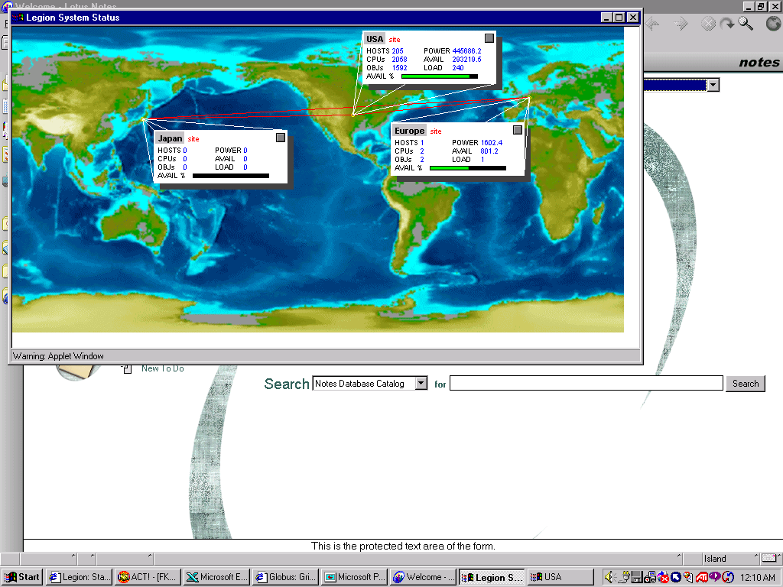
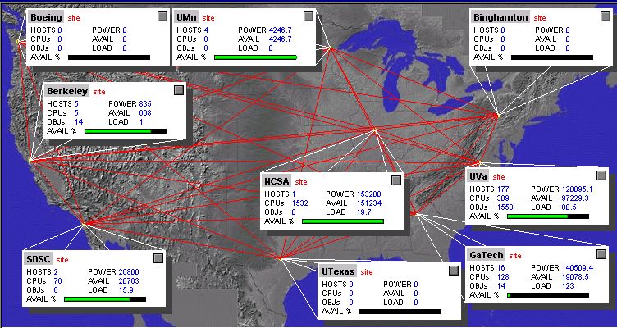
What is Grid Computing?
Combines standard Bandwidth and Computing capacities.
Analogous to an electric power grid.
EBS’ broadband network functions as a compute grid.
Definition: Utility, or Grid Computing is a set of heterogeneous computing resources interconnected by a common network, distributed over a geographically wide area.
Source: University of Virginia

Slide 3
Product Description
Dedicated Capacity
Single user of assigned resources
95% Availability guarantee
Product sold in single 1GHZ processor increments (CPU/HR).
Initial transactions in monthly increments
Type/quality differentiated by operation system and precision (32/64 bit).
Separate IPNetConnect or IP Transport contract may be necessary
Shared Capacity
Multiple users of assigned resources
95% Availability guarantee
Product sold in million instructions per second rate (MIPS)
Initial transactions in monthly increments
Uniform type/quality
Separate IPNetConnect or IP Transit contract may be necessary
Notes:
Three models: distributed PC cycles, cluster cycles, mainframe cycles.

Slide 4
Addressable Market
$100B Market by 2003 (Enron internal). Many verticals
$5B addressable today
Start with high-performance computing needs
Manufacturing
Financial
Services
Electronic Design
Process Simulation
Finite Element Analysis
Failure Analysis
Bioinformatics
Other
Energy
Derivatives Analysis
Statistical Analysis
Portfolio Risk Analysis
Cancer Research
Protein Folding
Protein Sequencing
Entertainment
Web Applications
Weather Analysis
Code Breaking
Academic
Seismic Analysis
Reservoir Analysis
Digital
Rendering
Payroll
CRM
Database Applications
Transaction
Processing
ERP
Financial Settlement

Slide 5
Initial Customers
$1.4 MM Notional
Houston-based, Energy sector
Atlanta-based, IBM customer
Strategy: Break bulk
Counterparty
Product
Type
Type
Term (days)
Start
Notional
Probability
Status
Graphics Co. X
Dedicated
Forward
Sell
90
Q3
$
210,000
75%
Reviewing MSA
Seismic Guy A
Dedicated
Forward
Sell
90
Q3
$
160,000
50%
Initial proposal submitted
Oil Co Y
Dedicated
Forward
Sell
365
Q3
$
400,000
50%
Initial proposal submitted
Oil Co Z
Dedicated
Forward
Sell
180
Q3
$
300,000
50%
Initial proposal submitted
IBM Client
Shared
Forward
Sell
365
Q3
$
350,000
90%
Initial proposal submitted
Follow-on Opportunities
Targets: Energy, Entertainment, Finance sectors
Locations: Los Angeles, Houston, New York

Slide 6
Pilot Requirements
Interim product approval
One commercial resource
One technical resource
IP from Houston to Shaumburg, IL or Austin, TX
Interconnect to Houston metro provider
Potential Short positions $ 1.4 MM
Supply* for Pilot $(1.1)MM
6-mo. Op Expense $ (200)k
*excludes buyback price

Slide 7
Pilot Timeline
IBM committing $1.1MM and resources to Pilot,
and $4B of prior investment
Buyers prepared to sign for delivery within 30 days
SLA’s have been OK’d by EBS legal and IBM
MOU ready to sign

Slide 8
Risks
Start with Linux operating system.
Bandwidth
Price of local loop, long haul, and local
loop for off-net sites and minimums
associated with OC-3 or OC-12 capacity.
Allow off-net transit capacity. Alternatively,
leverage Internet connectivity via VPN

Slide 9
Enron Advantage: Leveraging Complementary Commodities
Data is transported via Bandwidth
“Distributed” Computing requires an IP “Grid”
Value of network enhanced by computing and storage capacity
Enron Service Benefits:
Settlements/Back office
Trading/logistics capability
Standardized Offerings
Flexible Pricing/ Firm Delivery
Liquidity
Bandwidth
Colo
Storage
Capacity
Compute Power
Data is consumed, and generated, by Compute Power
Utility Computing increases storage and IP demand
Access to utility compute power increases velocity of data transport and stimulates need for additional storage and bandwidth.
Power Management
Data is maintained by Storage Capacity
Larger data sets increase computing load
Data growth drives storage and bandwidth demand

Slide 10
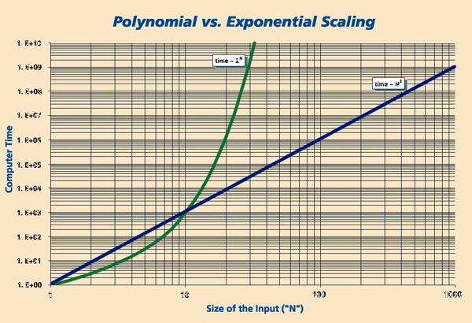
Demand Curve
More data takes more effort to process
Compute-intensive applications require hours, days, or even months to process.
Capacity of local compute resources is constrained by traditional server economics.
Frequency of results is impacted by quality or quantity of input.
Compromises are made:
Size of input
Complexity of algorithms
Scope of calculations
Source: The Scientist 14[23]:1, Nov. 27, 2000
The need for quicker, better results creates a natural short-position.

Slide 11
Appendix: Today’s Economic Problem
Constraints
Utility: $180 + convenience yield - bandwidth
Peak capacity is constrained by cost of in-house strategy
Utility computing lowers cost to achieve peak capacity
Source: University of Virginia

