Slide 1
CPUC Natural Gas Infrastructure Workshop
Pipelines and Power Generation
Scott Tomashefsky
California Energy Commission
April 17, 2001

Slide 2
Topics
The Power Generation Picture and Impact on Natural Gas Demand
Infrastructure Responses
Outlook for 2001 and Beyond

Slide 3
Power Generation in Perspective...
Power generation can account for as much as 40% of natural gas consumed in California.
Forecasted CA Natural Gas Demand in MMCF/D
Power generation in surrounding states impacts gas available to California.
Notes:
Preliminary data indicates about 6,700 MMcfd was consumed in 2000
CEC estimate of 6,400 was made last spring
Gas utilities in the 2000 CGR estimated it would be 5,600 mmcfd
Overall escalation rate equals 1.7% per year
Res 0.7 Comm 2.0 Ind 1.0 EG 2.5
Our outlook on EG demand
Electricity demand will continue to grow at 2.0% per year
New generation after about 2005 is needed to meet increasing demand
(After all 2% per year equates to 20% growth in electricity needs)
Early in the forecast period = Excess Demand; then efficient units replace older; then gas demand grows.

Slide 4
Proposed Generation Within the Western Systems Coordinating Council - MW
http://www.energy.ca.gov/electricity/wscc_proposed_generation.html
Notes:
California is not the only state looking to build new power plants.
Each of the areas have comparable new power plant capacity proposals.
It would appear the per capita of proposed capacity is greater for the regions outside the California /Mexico.
If the proposals indicate present need, you can see why there has not been a lot in surplus capacity for imports to California this year.
Over 276MW peakers approved this year; 960 expected by Sept.

Slide 5
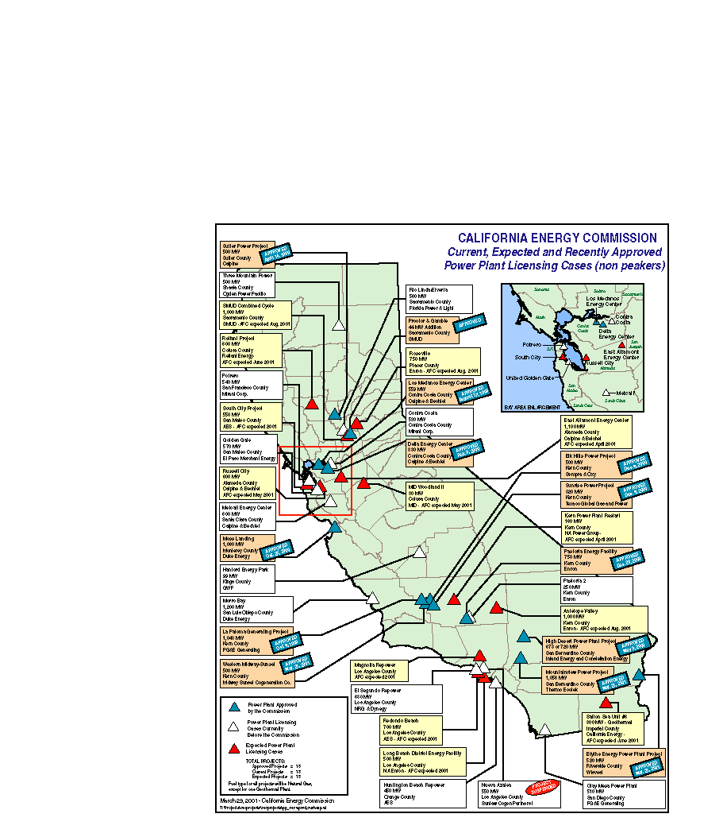
Power Plants in California
Notes:
Jim talked about these numbers.
These plants will demand more natural gas.
Also, with increased generation within the state, gas requirements for power generation will be needed throughout the year, and not seasonal.

Slide 6
Potential Power Generation Along Kern River
1
Pastoria - Enron (750 MW)
High Desert - Constellation (720 MW)
La Paloma - PG&E (1050 MW)
Elk Hills - Oxy/Sempra (500 MW)
Sunrise - Mission Energy (320 MW)
Midway Sunset - Midway Cogen (500 MW)
Antelope Valley - Enron (1000 MW)
Apex - Mirant (1150 MW)
Moapa - Duke (1200 MW)
Meadow Valley - PG&E (1000 MW)
Arrow Canyon - Reliant (500 MW)
Crystal - Calpine (760 MW)
El Dorado - Reliant/Sempra (480 MW)
2
3
PG&E
4
5
6
Kern River
Transmission
7
8
9
12
4
10
9
6
3
8
13
10
3
11
5
7
11
1
Mojave
2
12
13
SoCal
Under Development
CEC Approved
Under Construction
Operational
Source: Kern River

Slide 7
Notes:
Bundled service includes utility purchase and distribution.
After 1992, utility services were unbundled and firm includes the core residential, commercial and small industrial customers.
The core have been shielded from much of the high prices that have occurred this past year
Dec 2000 example: PG&E and SoCalGas had commodity prices in the $6 to $7 per range while spot prices rose as high as $60 per mmbtu. SDG&E had slightly higher prices than the other two utilities.
The customer classes represented by the blue and red are now responsible for purchasing their own gas supplies.
This includes arranging for transportation
Many use one of the 50 or more marketers that are operating in California.
Depending on how they purchased price, i.e., was indexed or length of contract, they were impacted by the high prices.

Slide 8
Current Interstate Delivery Capacity
MMcfd
PG&E-GTN@Malin: 1,930
Kern River: 700
Transwestern@ Needles: 1,090
El Paso@Topock: 2,080
El Paso@Ehrenburg: 1,240
Total Delivery Capacity: 7,000
Total = 7,000 MMCF/D
Notes:
The pipeline capacities listed here may vary from other estimates due to various conditions that are being addressed.
GTN (Gas Transmission Northwest, nee Pacific Gas Transmission) deliveries at Malin (from N’W) are affected by deliveries to Tuscarora and Medford as well as other upstream deliveries.
Kern River has been running full but has been dropping up to 350 MMcfd in Nevada.
Transwestern delivers 50 MMcfd to EOC which has been included in the capacity numbers.
There is 200 MMcfd in interruptible capacity at Ehrenburg

Slide 9
Current California Receipt Capacity
MMcfd
PG&E
Redwood-Malin 1,905
Baja Path 1,140
Kern River/Mojave (400)
Needles (400)
Topock (1,140)
SoCalGas
Needles 750
Hector Road 50
Topock 540
Ehrenburg 1,210
Mojave 400
Needles (300)
Topock (400)
Kern River 700
Winter receipts at Malin drop to 1500 to 1750 MMcfd due to increased demand in the Pacific NW.
In addition, there is about 1,000 MMcfd in California production
Total = 6,675 MMCF/D

Slide 10
California Storage Facilities
Pleasant Creek
S
Wild Goose
S
Los
S
S
McDonald Island
S
Lodi Gas Storage
Medanos
Honor Rancho
Goleta
S
S
S
Aliso Canyon
S
Playa Del Rey
Map not to scale
Notes:
Storage fields are depleted oil or natural gas fields
Storage pressure drops as gas is withdrawn so withdrawal rates will also decline
Storage pressure increases as gas is injected so injection rates will decline.
Wild Goose and Lodi are merchant operations (not regulated)
Lodi plans to be operational Winter 2001-02
Construction has started by laying pipe
Remaining storage is available for lease by others
This includes noncore customers as electricity generators and marketers
The natural gas utilities indicate that all the storage inventory space has been leased to Marketers/Generators.

Slide 11
Interstate Pipeline Expansions
Kern River
    135 MMcfd by July 1, 2001
    2001: 900 MMcfd expansion for operation in 2003
PG&E - GTN Expansion
    200 MMcfd partially available this winter, rest by summer 2002
    April 2001 - Open season for 2003 service
    Within the next 10 years, 1,000 MMcfd expansion expected
Questar Southern Trails Pipeline
    90 MMcfd to California border
    126 MMcfd to Los Angeles Basin
    By spring 2002
Notes:
Interstate pipelines are actively moving to have the capacity additions available when needed.
Capacity expansions would serve both California and other states.
Questar Southern Trails now has FERC certificate
Southern Trails implementation may be held up for two reasons.
1) The SoCalGas Residual Load Service Tariff levees a surcharge on customers using both SoCalGas pipelines and other pipelines. The RLS effectively limits competitiveness of new pipelines coming into Southern California.
2) The current posted rates for Southern Trails maybe higher than the corresponding rates for similar service on SoCalGas.
“Southern Trails” ordered compressors this month (takes 8 months to get, 3 to install)

Slide 12
Interstate Pipeline Expansions
(Cont.)
El Paso Natural Gas Company
  Plains All American Pipeline
    By late August would have 230 MMcfd in capacity added from the conversion to a gas line from a crude line.
    Pipeline capacity could be increased to 500 MMcfd
  Recent open season produced 76 responses for 4.5 BCF/D of requested capacity to California.
Transwestern Pipeline Company
  Presently holding open season for 150 MMcfd - Operational in June 2002
North Baja Pipeline
  500 MMcfd in capacity
  Operational by September 2002
  Will require El Paso and possibly Transwestern expansion
Notes:
The Plains All American pipeline [=“Project 2000”] would be used as “backup” capacity this summer for pipeline segments that El Paso will temporarily take out of service for testing. It would also add longer term backup capacity for sections of pipe which are found needing repair.
El Paso Open Season
El Paso received 127 responses for 9.7 Bcf/d
of this, 76 responses for 4.5 Bcf/d were received for deliveries to the border or inside California

Slide 13
Instate Capacity Expansions
SoCalGas
Utility currently planning to expand system by 175 MMCF/D.
  85 MMcfd at Wheeler Ridge
  50 MMcfd at North Needles
  40 MMcfd on Line 85
Increase storage availability by 24 billion cubic feet.
  10-12 BCF from Montebello (one time availability)
  14 BCF from Aliso Canyon and La Goleta (Increases storage capacity in long term).
PG&E
PG&E presently holding open season to determine interest in adding new pipeline and storage capacity to its system.
Redwood Path (Line 400/401)
200 MMcfd by adding more pipeline capacity
200 MMcfd by adding more compression
Baja Path (Line 300 A&B)
200 MMcfd via combination of new pipeline and
compression

Slide 14
So What Does This All Mean?????
If all power plants are approved and constructed…
  More than 3 BCF/D of new capacity needed.
  System cannot handle it.
If approved plants are constructed….
  More than 2 BCF/D of new capacity needed.
  Major expansions needed.
Need realistic view of future generation needs.
Key question: How much generation and how much gas infrastructure is needed?

Slide 15
Scenario Analysis Assumptions
Base case
  Anticipated hydro conditions
  SONGS out until mid-June
  No plant retrofits this year.
Alternative Scenarios
  1) High unscheduled maintenance, SONGS outage extended to 10/1/01
  2) CA Hydro reduced by 10%, SONGS outage extended to 10/1/01
  3) CA Hydro reduced by 10%, 1,400 MW of QFs out for year
  4) Worst hydro conditions, ISO retrofit maintenance schedule, QFs out for the year.
Notes:
Hydro conditions - Base Case
Pac NW- BPA springs flows are at 60% to 70% of normal then step up to 90% in the summer to meet peak demand
BC at 86 % of normal
Calif. at 80% of normal
Worst Case Scenario
PacNW at _____% of normal
Calif at 75% of normal
April and May: 3000 MW of QFS out
Rest of the year: 1400 MW of QFS out
.

Slide 16
2001 Electric Generation Scenarios-
PG&E

Slide 17
2001 Electric Generation Scenarios-
SoCalGas

Slide 18
2001 PG&E Supply and Demand
- Base Case
Notes:
The demand levels here are stacked with the Red EG line representing the total monthly demand.
Supply capacity includes 200 MMcfd from California production.
The drop off in supply in November and December is due to reduction in GTN delivery at Malin due to increased cold weather demand in the Pacific NW.
The figure indicates there will be plenty of pipeline capacity available for transporting natural gas for storage. (The area between the blue supply curve and the red curve.)

Slide 19
2001 PG&E Supply and Demand
-Worst Case

Slide 20
2001 PG&E Monthly Storage Levels
PG&E has physical ability to place natural gas into storage for core and noncore demand under main adverse scenarios
CPUC lets PG&E bill storage
Bankruptcy judge says gas part of company not at issue, so PG&E should have the ability to purchase natural gas for storage
PG&E’s problem will be the price
Noncore should “decide” to put natural gas into storage
Notes:
Noncore wants great prices before storing, unless maybe required to!
Core 200 is the injection rate allocated to PG&E’s core customers
Noncore 250 is the a higher injection rate which would include 50 MMcfd for noncore customers. This would be a most likely sustainable injection rate.
Core may use injection levels above 200 MMcfd if no one else is.
Core storage level of 33 Bcf. PG&E potentially could reach this level by mid to late July.
Injection capacity will be available for the noncore customers.
PG&E potentially could fill storage this year for core and noncore in base case but during the worst case it may not.
2 CA Marketers (in No. Cal. = Lodi and Wild Goose)

Slide 21
2001 SoCalGas Supply and Demand
-Base Case
Notes:
Spare pipeline capacity that is normally available in April and May for transporting natural gas for storage injection potentially will be needed for power generation this year.
EG natural gas demand will remain high this spring. ISO maintenance schedules for the AQ retrofit for many power plant have been postponed until the fall or next year. Therefore those units will be on line and generating, rather than the area drawing electricity from other areas outside the Southern California area.
The demand includes SDG&E and Rosarito.

Slide 22
2001 SoCalGas Supply and Demand
-Worst Case

Slide 23
2001 SoCalGas Monthly Storage Levels
Assumptions
  June 2001: 12 Bcf of storage at Montebello
  July 2001: 100 mmcfd additional receipt capacity from current locations
  Dec 2001
    Goleta/Aliso Canyon storage: 14 Bcf cushion gas to working and 14 Bcf additional capacity
    Pipeline expansion (Wheeler Ridge, Line 85 & N. Needles) totaling 125 mmcfd

Slide 24
Futures Prices - Generators and Storage
Electric Generators face these price signals
  Low incentive to put gas in storage
  Without gas in storage, more demand strains pipeline capacity for all customers
With storage- increases supply options
Without storage - increases price pressure for all customers
Notes:
Increased drilling, with the expectation of adding more gas to producible supply is causing the overall down turn in prices.
The only incentive for noncore and marketers to place gas into storage is the anticipated price differential between now and when the gas would be used.
The difference in price between now and this summer is only 14 cents.
(May ‘01 = $5.48/MMBtu and August ‘01 = $5.62)
The few cents saved by electric utilities injecting now rather than using flowing gas later would be potentially reduced by injection, withdrawal and interest costs.
But having gas in storage provides supply options when demand is at or over the utilities’ receiving capacity. This is a benefit to all customers on the system because it helps keep natural gas prices down (with options there is competition).
If the electric generators guess wrong by not placing gas into storage and do need supply, it will go to the flowing market. It is willing to pay higher costs that result, because these can be passed through with the price of the electricity it sells.
This will cause the natural gas prices to raise for all California customers.

Slide 25
Conclusions
Gas availability will be tight this summer at best.
Natural gas demand continues to grow.
Pipeline capacity and storage are critical to meeting needs.
Some capacity relief expected by this winter.
Interstate pipeline companies are taking steps to augment capacity.
Current Focus….
  Address issues concerning intra-state infrastructure expansion
  Concerns with electric generators placing gas in storage

Slide 26
What to Watch for
Status of QFs is most important
  3,000 - 10,000 MW could be out
Weather: Pray for a cool summer
  About 4,500 MW swing from an average to hot temperature year
Injections into So. California storage
  Is storage below 20 Bcf after April?
  Is storage above 70 Bcf by Nov. 1?
Are pipe additions proceeding at their expected pace?
Notes:
To watch PG&E Storage -Go to PG&E web site - to business - to Pipe Ranger for daily rate in and out of storage
http://www.pge.com/pipeline/index.html
For SCG: On web site, go to “Gas Select” [but it is password protected]

