Slide 1

Argentine Power Market
Fuel Oil Use
&
Opportunities for the Future
Central Puerto S.A.
Fuel Oil / Energy Buyer’s Conference
Miami, September 2000

Slide 2
Fuel Oil Use & Opportunities for the Future
Argentine Power Market
Central Puerto S.A.
Fuel Oil Market in Argentina
Fuel Oil Use in Power Generation
Opportunities for the Future

Slide 3
Fuel Oil Use & Opportunities for the Future
Argentine Power Market
Central Puerto S.A.
Fuel Oil Market in Argentina
Fuel Oil Use in Power Generation
Opportunities for the Future

Slide 4
Argentine Power Market
NOA
InstCap: 1237 MW
Demand:882 MW
NEA
InstCap: 1877 MW
Demand:500MW
CUYO
InstCap: 1280 MW
Demand:782 MW
GBA-LIT-BAS
InstCap: 6720 MW
Demand:8490 MW
CENTRO
InstCap: 2148 MW
Demand:1053 MW
MEM-SP
InstCap: 840 MW
Demand: 580 MW
COMAHUE
InstCap: 5246 MW
Demand:562 MW
Figures to July-00
Maximum Demand: 13.180 MW
Installed capacity: 18.500 MW
Anual Consumption: 77.300 MWh
SADI
500 kV: 7000 km
MEM-SP
330 Kv: 1660 km

Slide 5
Argentine Power Market
Generation
1999
Installed
Capacity
Fuel Consumption 1999
NatGas FO6 HO2
Baseload Hydro
Nuclear
Combined Cycles
Peakload Hydro
Open Cycle CT
Steam Turbines
22 %
9 %
23 %
14 %
14 %
17 %
69.840
GWh
12 %
5 %
17 %
33 %
10 %
23 %
19.800
MW
34 %
37 %
29 %
9.500
Bm3
100 %
750
(000)ton
27 %
73 %
36
(000)ton
Notes:
3

Slide 6
Fuel Oil Use & Opportunities for the Future
Argentine Power Market
Central Puerto S.A.
Fuel Oil Market in Argentina
Fuel Oil Use in Power Generation
Opportunities for the Future

Slide 7
Central Puerto S.A.
Installed Capacity
GBA Combined Cycle 786 MW
GBA Steam Turbines 1.009 MW
NQN Open Cycle CT 370 MW
TOTAL 2.165 MW
Generation 1999 6.506 GWh
Market Share 8,9 %
Rank by Generation 2nd
Sales 313 MM$
Net Income 50 MM$

Slide 8
Central Puerto S.A.
Central Puerto Steam Turbines’ Fuel Consumption
Year 1998
Fuel Oil: 703.700 tons
Natural Gas: 381.800 Dm3
Year 1999
Fuel Oil: 389.400 tons
Natural Gas: 786.400 Dm3

Slide 9
Central Puerto S.A.
Central Puerto Fuel Oil Average Seasonality
Peak Monthly Consumption 94.400 tons
Average Winter Consumption 230.000 tons
Maximum Winter Consumption 340.000 tons
Winter 2000 Expected Consumption 160.000 tons

Slide 10
Fuel Oil Use & Opportunities for the Future
Argentine Power Market
Central Puerto S.A.
Fuel Oil Market in Argentina
Fuel Oil Use in Power Generation
Opportunities for the Future

Slide 11
Fuel Oil Market in Argentina

Slide 12
Fuel Oil Market in Argentina
Production and sales of Fuel Oil in Argentina
Production
Sales
Year 1999
TOTAL: 1.838.800 tons
Year 1999
TOTAL: 1.422.300 tons
Central Puerto Fuel Oil Consumption 1999: 389.400 tons

Slide 13
Fuel Oil Market in Argentina
Price Fundamentals from a Utility’s standpoint
Export Parity
Local refiners with low conversion refineries export to the Gulf Coast, except some limited exports to neighbor countries
Platts - costo de transporte USGC-BA
Refiners
Platts - costo de transporte USGC-Brasil + costo de transporte Brasil-BA
BRAZIL
Import Parity
Local and foreign traders arrive with fuel oil from abroad, price will depend on freight optimization (crude trip back) and shipment size. Local refiners will sell industrial fuel oil at this prices.
Traders
Platts + costo de transporte USGC-BA
Processing
Depends on capacity, fuel oil-heating oil spread, and local heating oil demand
A refiner may alter it’s run in order to produce additional fuel oil at a higher than usual cost
Refiners

Slide 14
Fuel Oil Market in Argentina
Price Fundamentals from a Utility’s standpoint
Maximize processing of the cheapest fuel, typically natural gas
Fuel Oil’s price indifference to Natural Gas
Natural Gas Price: 66,00 $/Dm3
Lower Fuel Oil efficiency: 0,97
Fuel Oil LHV : 9850 kcal/kg
Natural Gas LHV: 8400 kcal/m3
Volume Conversion: 6,29 bbl/m3
Typical Fuel Oil Density: 0,96 kg/m3
Precio equivalente FO: 75,07 $/ton
Precio equivalente FO: 11,46 $/bbl
Precio equivalente FO: 64,02 $/Dm3
Fuel Oil Shipments will be taken to replace Natural Gas
at a price lower then 75.07 $/ton or 11,46 $/bbl
on a delivered basis.

Slide 15
Fuel Oil Market in Argentina
Fuel Oil in the Winter Season
Keep inventories during the winter season for NG shortages
Natural Gas carries a risk of shortage during the winter season due to transportation capacity limitations.
Fuel Oil delivery lead time is 1 week for local supply (mainly due to tanker availability) and 2-4 weeks for imported material.
Fuel Oil stock capacity: 36.000 tons
Peak Consumption
equivalent: 10 days

Slide 16
Fuel Oil Market in Argentina
Take Stocks to full capacity
Fuel Oil in the Winter Season
tons
Start stock consumption
Fuel Oil consumption dependent on price and natural gas shortages
Start stock purchases in April
April
May
June
July
August
September
October

Slide 17
Fuel Oil Use & Opportunities for the Future
Argentine Power Market
Central Puerto S.A.
Fuel Oil Market in Argentina
Fuel Oil Use in Power Generation
Opportunities for the Future

Slide 18
Fuel Oil Use in Power Generation
Fuel Oil competitive positioning
Fuel Oil based generation is well positioned as an alternative fuel to natural gas.
Fuel Oil consumption is used a as:
peakload generation fuel on years of high hydroelectric generations
baseload and peakload generation fuel on years of low hydroelectric generation or low temperatures.

Slide 19
Fuel Oil Use in Power Generation
Monthly Generation for the Argentine System
Thermal Generation Fuel
Natural Gas
Liquid Fuels
25 $/MWh
35 $/MWh
16 $/MWh
11 $/MWh
35 $/MWh
5 $/MWh
4 $/MWh
Variable Cost

Slide 20
Fuel Oil Use in Power Generation
Average Daily Load Curve for the Argentine System

Slide 21
Fuel Oil Use in Power Generation
Gas supply profile in the Greater Buenos Aires Area

Slide 22
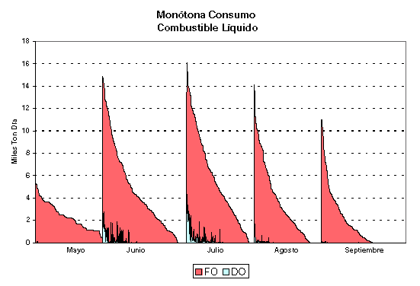
Fuel Oil Use in Power Generation
Liquid Fuel Consumption by Hydrologic Scenario

Slide 23
Fuel Oil Use & Opportunities for the Future
Argentine Power Market
Central Puerto S.A.
Fuel Oil Market in Argentina
Fuel Oil Use in Power Generation
Opportunities for the Future

Slide 24
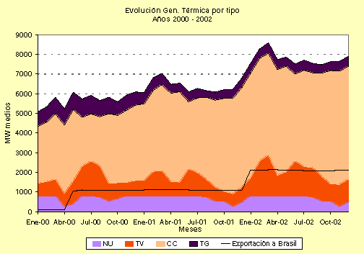
Opportunities for the Future
Medium Term Generation Projections

Slide 25
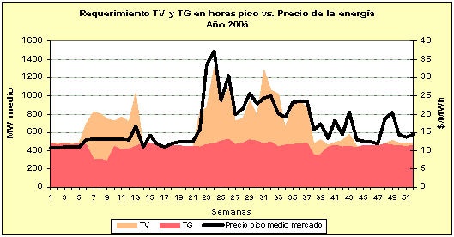
Opportunities for the Future
Long Term Average Generation Projection

Slide 26
Opportunities for the Future
Generating Technologies for PeakLoad Supply
Cost Comparison
Cash Flow
needed for
10 % IRR
Peak Price
Natural Gas
Peak Price
Liquid Fuel
Construction
Cost
Hydroelectric
Open Cycle
Combustion Turbine
Steam Turbine
1500 $/kW
550 $/kW
800 $/kW
55 MM$/year
21 MM$/year
29 MM$/year
72.3 $/MWh
54.52 $/MWh
62.37 $/MWh
72.3 $/MWh
77.05 $/MWh
69.93 $/MWh
Based on a Peaking plant with a load factor of 35 %, the prices represent the average price needed to be“seen” by the plant’s output in order to repay variable and fixed costs and earn a 10 % return on investment.

Slide 27
Opportunities for the Future
Generating Technologies for PeakLoad Supply
Technical Comparison
Reliability on
Alternative Fuel
Availability
Startup Time
Hydroelectric
Open Cycle
Combustion Turbine
Steam Turbine
Dependent
on rains
5-10 minutes
Dual Fuel
1-4 hours
Sensitive to
Liquid Fuel
Dual Fuel
6-10 hours
Same as NG

Slide 28
Opportunities for the Future
Competitive outlook for fuel oil as an alternative fuel
New fuel oil based steam generation plants are not likely to be built in the near future
Existing fuel oil generation plants will most likely continue to be used during the winter season, with a likely increase in annual fuel oil consumption following demand growth and increasing natural gas shortage periods
In the long term a window of 60 days natural gas interruption will most likely remain a market for fuel oil, as new generation combined cycles have increasing restrictions on liquid fuel use

Slide 29
Fuel Oil Use & Opportunities for the Future
Argentine Power Market
Central Puerto S.A.
Fuel Oil Market in Argentina
Fuel Oil Use in Power Generation
Opportunities for the Future

Slide 30
Argentine Power Market
Fuel Oil Use
&
Opportunities for the Future
Central Puerto S.A.
Fuel Oil / Energy Buyer’s Conference
Miami, September 2000

