Slide 1
Western Energy Roundtable
April 26, 2001: San Francisco
Chairman: Michael Zenker
Director
Western Energy
CONFIDENTIAL
©2001, Cambridge Energy Research Associates, Inc.
20 University Road, Cambridge, Massachusetts 02138
No portion of this presentation may be reproduced in any form without prior written consent

Slide 2
Gas Market and Infrastructure: When Will Relief Come?
A Look Ahead Through 2005

Slide 3
Change in Gas Demand for Power Generation Relative to 1999 (billion cubic feet per day)
Source: Cambridge Energy Research Associates.
10330-12

Slide 4
Change in Gas Demand Relative to 1999 (billion cubic feet per day)
Source: Cambridge Energy Research Associates.
10330-13

Slide 5
Change in Gas Productive Capacity Relative to 1999
(billion cubic feet per day)
Source: Cambridge Energy Research Associates.
10330-11

Slide 6
Western Regional Pipeline Capacity and Flows, 1999
(billion cubic feet per day)
Source: Cambridge Energy Research Associates.
10310-14

Slide 7
Western Regional Pipeline Capacity and Flows, 2000
(billion cubic feet per day)
Source: Cambridge Energy Research Associates.
10310-11

Slide 8
Western Working Gas Storage Inventories
Source: Cambridge Energy Research Associates.
10330-15

Slide 9
California Working Gas Storage Inventories
Source: Cambridge Energy Research Associates.
10330-14

Slide 10
California Monthly Gas Demand
Source: Cambridge Energy Research Associates.
10330-17

Slide 11
Increasing Utilization on Southwestern Pipes to California Markets
Source: Cambridge Energy Research Associates.
10330-16

Slide 12
Western Regional Pipeline Capacity and Flows, 2001
(billion cubic feet per day)
Source: Cambridge Energy Research Associates.
10310-11

Slide 13
Western Spot Gas Prices
Source: Cambridge Energy Research Associates.
10330-21

Slide 14
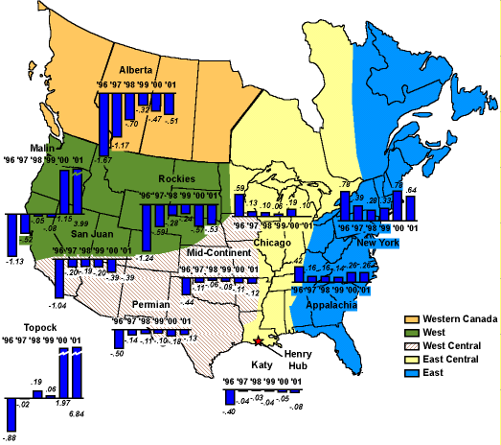
Natural Gas Key Regions of Basis Differentials: Price Differentials to Henry Hub (US dollars per MMBtu)
Source: Cambridge Energy Research Associates.
Note: Supply Realignment case.
90341-1

Slide 15
WCSB Natural Gas Production
Source: Cambridge Energy Research Associates.
01101-10

Slide 16
AECO Spot Gas Price Outlook
Source: Cambridge Energy Research Associates.
90119-4

Slide 17
Sumas Drivers
Source: Cambridge Energy Research Associates.
10210-2a

Slide 18
AECO-Sumas-Rockies Differentials (US$ per MMBtu)
Summer 2001
Winter 2001/02
AECO
AECO
0.20
0.51
0.35
0.10
Sumas
Sumas
0.55
0.41
Rockies
Rockies
Source: Cambridge Energy Research Associates.

Slide 19
Feeding Western Demand Growth: Proposed Infrastructure
(million cubic feet per day)
Source: Cambridge Energy Research Associates.
00105-1

Slide 20
California Gas Demand
Source: Cambridge Energy Research Associates.
10330-20

Slide 21
California Import Pipeline Capacity Utilization Rates
Source: Cambridge Energy Research Associates.
10330-19

Slide 22
Western Canada Pipeline Requirements—2010

