Slide 1
California Energy Solutions Group
Pipelines and Power Generation
William J. Keese, Chairman
California Energy Commission
May 10, 2001

Slide 2
Topics
The Power Generation Picture and Impact on Natural Gas Demand
Infrastructure Responses
Outlook for 2001 and Beyond

Slide 3
Power Generation in Perspective...
Power generation can account for as much as 40% of natural gas consumed in California.
Forecasted CA Natural Gas Demand in MMCF/D
Power generation in surrounding states impacts gas available to California.

Slide 4
Proposed Generation Within the Western Systems Coordinating Council - MW
http://www.energy.ca.gov/electricity/wscc_proposed_generation.html

Slide 5
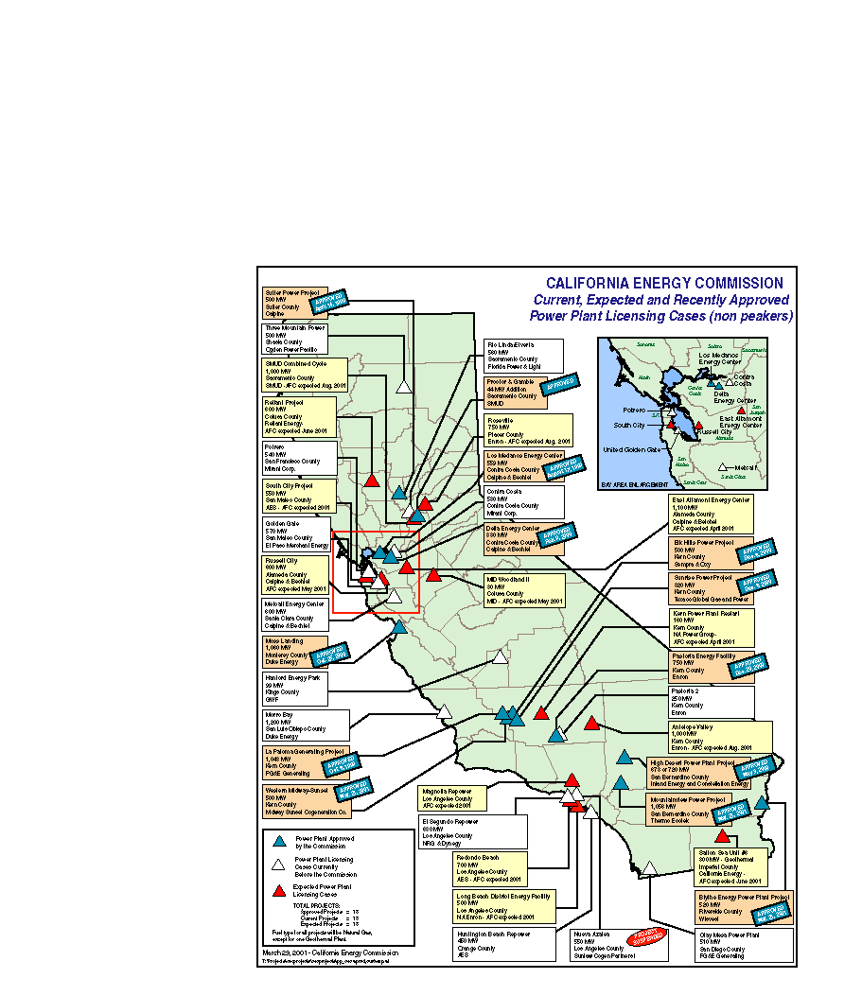
Power Plants in California

Slide 6
Potential Power Generation Along Kern River/Mojave
1
Pastoria - Enron (750 MW)
High Desert - Constellation (720 MW)
La Paloma - PG&E (1050 MW)
Elk Hills - Oxy/Sempra (500 MW)
Sunrise - Mission Energy (320 MW)
Midway Sunset - Midway Cogen (500 MW)
Antelope Valley - Enron (1000 MW)
Apex - Mirant (1150 MW)
Moapa - Duke (1200 MW)
Meadow Valley - PG&E (1000 MW)
Arrow Canyon - Reliant (500 MW)
Crystal - Calpine (760 MW)
El Dorado - Reliant/Sempra (480 MW)
2
3
PG&E
4
5
6
Kern River
Transmission
7
8
9
12
4
10
9
6
3
8
13
10
3
11
5
7
11
1
Mojave
2
12
13
SoCal
Under Development
CEC Approved
Under Construction
Operational
Source: Kern River

Slide 8
Current Interstate Delivery Capacity MMcfd
PG&E-GTN@Malin: 1,930
Kern River: 700
Transwestern@ Needles: 1,090
El Paso@Topock: 2,080
El Paso@Ehrenburg: 1,210
Total Delivery Capacity: 7,010
Total = 7,010 MMCF/D

Slide 9
Current California Receipt Capacity MMcfd
PG&E
Redwood-Malin 1,905
Baja Path 1,140
Kern River/Mojave (400)
Needles (400)
Topock (1,140)
SoCalGas
Needles 750
Hector Road 50
Topock 540
Ehrenburg 1,210
Mojave 400
Needles (300)
Topock (400)
Kern River 700
Winter receipts at Malin drop to 1500 to 1750 MMcfd due to increased demand in the Pacific NW.
In addition, there is about 1,000 MMcfd in California production
Total = 6,700 MMCF/D

Slide 10
California Storage Facilities
Pleasant Creek
S
Wild Goose
S
Los
S
S
McDonald Island
S
Lodi Gas Storage
Medanos
Honor Rancho
Goleta
S
S
S
Aliso Canyon
S
Playa Del Rey
Map not to scale

Slide 11
Interstate Pipeline Expansions
Kern River
135 MMcfd by July 1, 2001
2001: 900 MMcfd expansion for operation in 2003
PG&E - GTN Expansion
200 MMcfd partially available this winter, rest by summer 2002
April 2001 - Open season for 2003 service
Within the next 10 years, 1,000 MMcfd expansion expected
Questar Southern Trails Pipeline
90 MMcfd to California border
126 MMcfd to Los Angeles Basin
By spring 2002

Slide 12
Interstate Pipeline Expansions (Cont.)
El Paso Natural Gas Company
Plains All American Pipeline
By late August would have 230 MMcfd in capacity added from the conversion to a gas line from a crude line.
Pipeline capacity could be increased to 500 MMcfd
Recent open season produced 76 responses for 4.5 BCF/D of requested capacity to California.
Transwestern Pipeline Company
Presently holding open season for 150 MMcfd - Operational in June 2002
North Baja Pipeline
500 MMcfd in capacity
Operational by September 2002
Will require El Paso and possibly Transwestern expansion

Slide 13
Interstate Pipeline Expansions (Cont.)
Sonoran Pipeline - Kinder Morgan and Calpine
Phase one: 750 MMcfd pipeline from San Juan Basin to California border at Needles
Completion summer 2003
Phase two: extends Phase one with 1,000-1,500 MMcfd from Needles to San Francisco Bay Area
Ruby Pipeline
750 MMcfd pipeline from the Rockies to northern California, near Sacramento
Would begin service in late 2003

Slide 14
Instate Capacity Expansions
SoCalGas
Utility currently planning to expand system by 175 MMCF/D.
85 MMcfd at Wheeler Ridge
50 MMcfd at North Needles
40 MMcfd on Line 85
Increase storage availability by 24 billion cubic feet.
10-12 BCF from Montebello (one time availability)
14 BCF from Aliso Canyon and La Goleta (Increases storage capacity in long term).
PG&E
PG&E presently holding open season to determine interest in adding new pipeline and storage capacity to its system.
Redwood Path (Line 400/401)
200 MMcfd by adding more pipeline capacity
200 MMcfd by adding more compression
Baja Path (Line 300 A&B)
200 MMcfd via combination of new pipeline and
compression

Slide 15
What About This Year?
Scenario Analysis Assumptions
Base case
Anticipated hydro conditions
SONGS out until mid-June
No plant retrofits this year.
Alternative Scenarios
1) High unscheduled maintenance, SONGS outage extended to 10/1/01
2) CA Hydro reduced by 10%, SONGS outage extended to 10/1/01
3) CA Hydro reduced by 10%, 1,400 MW of QFs out for year
4) Worst hydro conditions, ISO retrofit maintenance schedule, QFs out for the year.

Slide 16
2001 Electric Generation Scenarios- PG&E

Slide 17
2001 Electric Generation Scenarios- SoCalGas

Slide 18
2001 PG&E Supply and Demand - Base Case

Slide 19
2001 PG&E Monthly Storage Levels
PG&E has physical ability to place natural gas into storage for core and noncore demand under main adverse scenarios
CPUC lets PG&E bill storage
Bankruptcy judge says gas part of company not at issue, so PG&E should have the ability to purchase natural gas for storage
PG&E’s problem will be the price
Noncore should “decide” to put natural gas into storage

Slide 20
2001 SoCalGas Supply and Demand -Base Case

Slide 21
2001 SoCalGas Monthly Storage Levels
Assumptions
June 2001: 12 Bcf of storage at Montebello
July 2001: 100 mmcfd additional receipt capacity from current locations
Dec 2001
Goleta/Aliso Canyon storage: 14 Bcf cushion gas to working and 14 Bcf additional capacity
Pipeline expansion (Wheeler Ridge, Line 85 & N. Needles) totaling 125 mmcfd

Slide 22
Natural Gas Storage for Summer 2001 -Electric Generation
Core customers
PG&E: 33 Bcf
SCG: 70 Bcf
Heat storms
PG&E : 2.1 Bcf
SoCalGas: 13.0 Bcf
SDG&E : 0.3 Bcf

Slide 23
Futures Prices - Generators and Storage
Electric Generators face these price signals
Low incentive to put gas in storage
Without gas in storage, more demand strains pipeline capacity for all customers
With storage- increases supply options
Without storage - increases price pressure for all customers

Slide 24
Conclusions
Gas availability will be tight this summer at best.
Natural gas demand continues to grow.
Pipeline capacity and storage are critical to meeting needs.
Some capacity relief expected by this winter.
Interstate pipeline companies are taking steps to augment capacity.
Current Focus….
Address issues concerning intra-state infrastructure expansion
Concerns with electric generators placing gas in storage

Slide 25
What to Watch for
Status of QFs is most important
3,000 - 10,000 MW could be out
Weather: Pray for a cool summer
About 4,500 MW swing from an average to hot temperature year
Injections into So. California storage
Is storage below 20 Bcf after April?
Is storage above 70 Bcf by Nov. 1?
Are pipe additions proceeding at their expected pace?

