Slide 1
December 2000
Confidential & Proprietary
Management Presentation
Brownsville Overview

Slide 2
Overview
Brownsville Overview
Plant Description: 494 MW (nominal) natural gas-fired, simple-cycle facility
Location: 134-acre tract in Haywood County, Tennessee, in the TVA subregion of SERC
Power Interconnect: TVA 500 kV line
Gas Interconnect: ANR Pipeline Company
Start of Construction: October 1998
Commercial Operation Date: June 1999
Approx. Max. Annual MWh: 674,000 (nominal)
Approx. Run Hours: 1,365
NOx (per unit): <15 ppm (501 D5) and <25 ppm (501 D5A)
CO (per unit): <25 ppm

Slide 3
Facility Strengths
Brownsville Overview
“First-mover advantage” inside TVA
TVA and surrounding areas have historically experienced extreme power price volatility
Ideally suited to capitalize on gas/power arbitrage opportunities
Expansion/conversion potential at existing site
Site has room for additional gas turbines
Technology and layout of turbines allow for conversion to combined cycle
30-minute normal unit ramp up from cold to full load

Slide 4
Plant Picture
Brownsville Overview

Slide 5
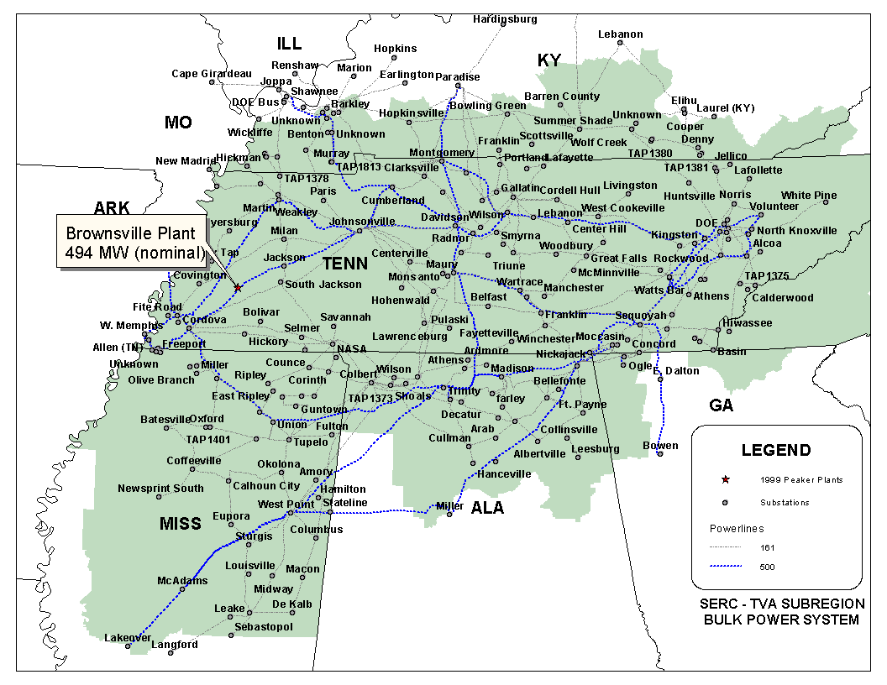
Regional Overview
Brownsville Overview

Slide 6
Power Market Opportunities
Brownsville Overview
Brownsville Power I, L.L.C. is qualified as an Exempt Wholesale Generator and has authority to sell energy and capacity at market-based rates
TVA’s extensive 500 kV system provides system users excellent transmission reliability and reach
Brownsville’s location in TVA and access to eastern U.S. electricity market provide sales opportunities into the wholesale power markets
Brownsville provides access to TVA system with direct connections to 12 surrounding control area markets
Brownsville is within two utility wheels away from over 70 control area markets

Slide 7
Equipment Overview
Brownsville Overview
Turbines: 2 Westinghouse Model 501 D5 and 2 Westinghouse Model 501 D5A, with evaporative cooling
Switchyard Equipment: ABB, 500 kV interconnect breakers
Switchyard Configuration: single ring bus
Transformers: (2) ABB 332 MVA, 3 winding, three-phase, 13.8 kV/500 kV
Control System: WDPF
Generator Circuit Breakers: (4) ABB (11,500 A)
Generator Voltages: 13.8 kV
Plant Distribution Voltages: 4160 V and 480 V
BROWNSVILLE
ENSE
500 kV
G1
B
B
B
GSU T1
B
G2
Cordova
Substation
Bus 2 (500 kV)
Bus 1 (500 kV)
B
G3
B
B
GSU T2
B
G4
Jackson
Substation
Summer
Nominal
Winter
Unit MW Rating:
115
119
124
(D5)
125
128
133
(D5A)
B = Breaker
GSU = Generator Step-up Unit

Slide 8
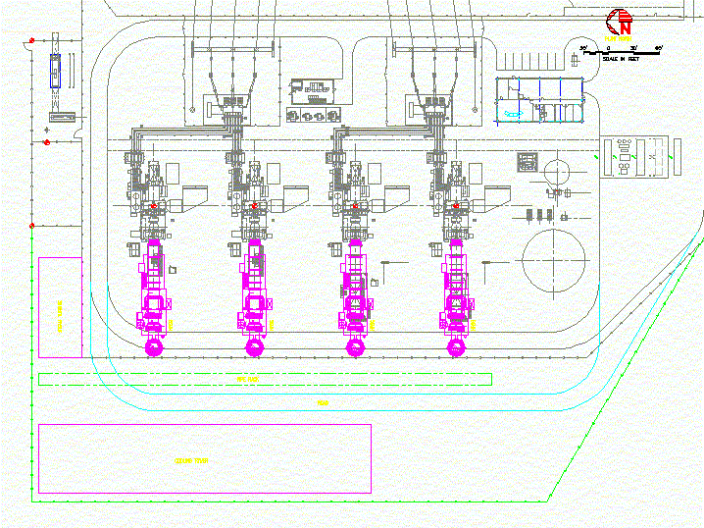
Plant Layout
Brownsville Overview

Slide 9
Performance Results
Brownsville Overview
Performance Data
Unit Type
D5
D5
D5A
D5A
Unit 1
Unit 2
Unit 3
Unit 4
Life-to-Date Run Hours
1,105
922
819
937
Life-to-Date Starts
178
151
174
166
Performance Test Data
Output (MW)
Corrected to 90 F
112
112
119
118
Heat Rate (LHV)
Corrected to 90 F
9,790
9,917
10,451
10,555
Heat Rate (HHV)
Corrected to 90 F
10,867
11,009
11,601
11,716
NOx Emissions (ppm)
Corrected to 15% O₂
11.9
12.6
24.1
24.7

Slide 10
Power Interconnection
Brownsville Overview
Interconnected via a single ring bus switchyard to TVA’s Cordova-Jackson 500 kV transmission line
There is one line connected to TVA’s Cordova switchyard and the other line is connected to TVA’s Jackson switchyard

Slide 11
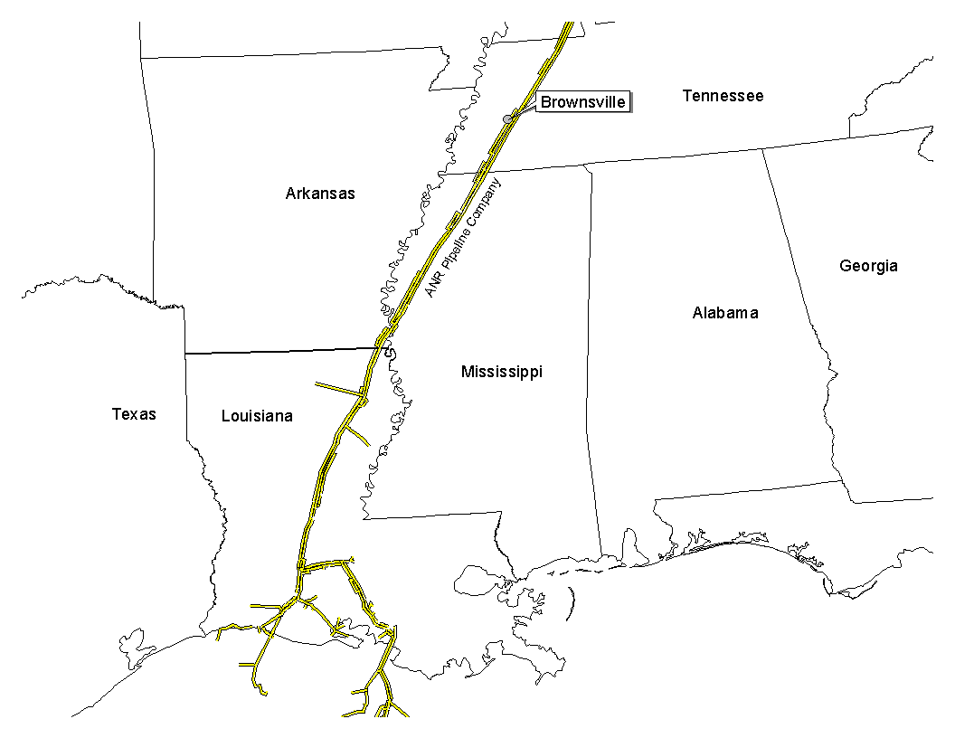
Gas Transportation
Brownsville Overview
Pipeline: ANR Pipeline Company
Delivery Point: ANR ML-2 (Plant Gate)
Base Contract:
Service: IT/IPLS
Term: 10 years (May - Sept), beginning April 1, 1999
Volume: 83,253 Dth/day
Rate: $0.09 plus fuel and ACA
Fuel: 0.0% on backhaul from Chicago; 2.91% on forward haul
Receipt Points: SE Area LA and Joliet, IL.
Balancing: $0.015 per Dth/day for out of balance volumes
Backup Contract: ENA has a one time right to convert to firm transport at any time during the first 5 years of the agreement. Rate is $0.13 plus ACA and fuel.
Balancing: IPLS at plant gate (limited to 84,000 Dth). IPLS service subject to economic dispatching and pipeline operational conditions. Balancing in-kind. Allows for uneven hourly flow at plant delivery point with even 24 hour supply flow

Slide 12
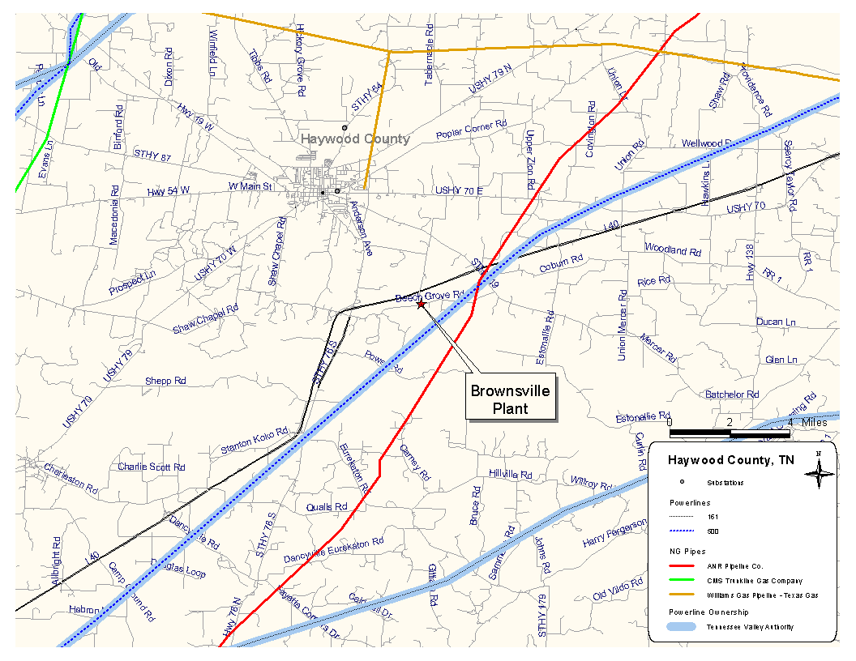
Plant Location
Brownsville Overview

Slide 13
Control Area Status
Brownsville Overview
Brownsville control area, ENSE, has been designated a control area in accordance with NERC policy
Control area designation is valuable for point to point power sales and scheduling of power
Following the sale, control area options for purchaser include:
control area services could be provided by TVA
purchaser could re-establish a control area in accordance with NERC procedures
an Enron affiliate could provide control area and scheduling services, under separate contract

Slide 14
Expansion/Conversion Opportunity
Brownsville Overview
Brownsville has been designed to facilitate a future plant expansion and/or conversion to combined cycle
Net heat rate could go from approximately 11,100 Btu/kWh plant average (HHV) to approximately 7,900 Btu/kWh (HHV), depending on equipment
Net output could go from approximately 494 MW (nominal) currently to approximately 700 MW (nominal), depending on equipment
Conversion of Brownsville should take approximately 18 to 24 months
Installation of an SCR should facilitate getting a PSD permit for combined cycle operation

Slide 15
Environmental Issues
Brownsville Overview
Discharge Permit: Not Required
Air Permit: Non-PSD
NOx Control Method: 2 x Water injection (D5A)
2 x Steam injection (D5)
Compliance Method: CEMS
Limits: 249 T NOx per year
225 T CO per year
Actual Commission NOx: <15 ppm (D5) and < 25 ppm (D5A)
Estimated Run Hours: 1,365

Slide 16
Estimated Operating Costs
Brownsville Overview

Slide 17
Organizational Chart
Brownsville Overview
Brownsville is currently operated by Operational Energy Corp (“OEC”), an Enron Corp. subsidiary
It is anticipated that at closing, O&M contract with OEC will be terminated
Brownsville personnel are currently employees of OEC

Slide 18
Legal Structure
Brownsville Overview
Brownsville Power I L.L.C. (“Brownsville Power”) leases the facility (including real property) from the Industrial Development Board of Haywood County for a term of 15 years beginning on the date of commercial operations (approximately June 1999)
Brownsville Power has the right to buy the facility at any time during the term of the lease or within 90 days after the expiration thereof for $500.00
Brownsville Power is a single member Delaware limited liability company and is 100% owned by Enron North America Corp.
Purchaser will acquire 100% of the member interests in Brownsville Power

