Slide 1
Financial Report November 2000
William I Jacobs
Chief Financial Officer

Slide 2
Quarterly Results - Revenue

Slide 3
Net Income by Quarter

Slide 4
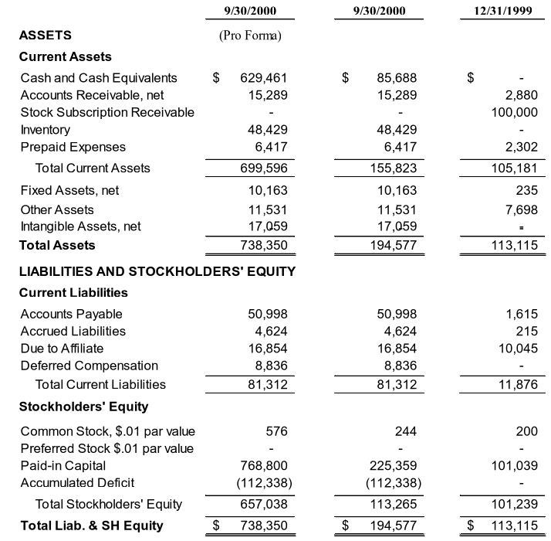
Consolidated Balance Sheet (Unaudited)
$ in thousands

Slide 5
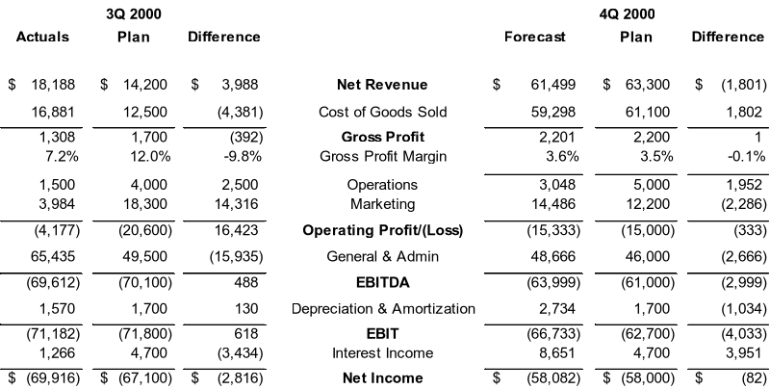
Income Statement - 3Q Actuals and 4Q Forecast
$ in thousands

Slide 6
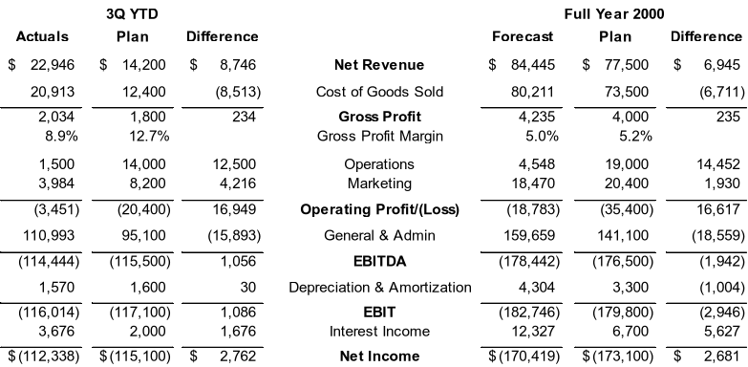
Income Statement - Sept 30, 2000 YTD and Full Year Forecast
$ in thousands

Slide 7
2001 and 2Q 2002 Budget and Planning Timeline

Slide 8
Customer Acquisition Metrics
Weekly Mail Drops & Inbound Response

Slide 9
Customer Acquisition
Weekly Enrollments

