Slide 1
Communications and
E-Commerce
09/27/25 12:54 AM
CONFIDENTIAL
2000 ENRON CORP. LAW CONFERENCE
San Antonio presentation
April 6, 2000
This report is solely for the use of client personnel. No part of it may be circulated, quoted, or reproduced for distribution outside the client organization without prior written approval from McKinsey & Company. This material was used by McKinsey & Company during an oral presentation; it is not a complete record of the discussion.

Slide 2
OVERVIEW
  Telecom basics and network architecture
  Telecom industry overview
  Backbone networks
  The Internet and e-commerce

Slide 3
BASIC TERMINOLOGY
Term
Definition
Example
  RBOC (LEC)
  CLEC
  DLEC
  IXC
  CIXC
  ISP
  MSO
  xDSL
  POP
  POPS
Regional Bell Operating Company or local exchange carrier
Competitive Local Exchange Carrier
Digital Local Exchange Carrier
IntereXchange Carrier
Competitive IntereXchange Carrier
Internet Service Provider
Multiple System Operator
Digital Subscriber Line
Point of presence in a local service area
Potential population served by a wireless service provider in their service area
  SBC
  Birch Telecom
  Rythms
  AT&T
  Qwest
  Mindspring
  Time-Warner
  –
  –
  –

Slide 4
BASIC ACCESS AND TRANSPORT TERMINOLOGY
  Basic analog phone line = 64 kbps connection
  Typical dial-up modem data rate = 28.8 or 56 kbps
  Typical DSL connection data rates = 400 kbps-1.5 Mbps
  SONET = Synchronous Optical Network is an optical interface standard that allows internetworking of transmission products
  OC-n = Optical Carrier Signaling Rate for SONET; OC-1 = 51.84 Mbps or about 672 voice channels
  OC-192 = 10 Gbps or about 130,000 voice channels
  WDM = Wave Division Multiplexing . . . allows multiple windows or frequencies to be run over fiber multiplying capacity by 4-32x

Slide 5
TRANSPORT NETWORK
Analog vs. digital
Transmission media
Multiplexing
Network topology
What you need to know
  Digital is cheaper, easier to multiplex and has less errors, but replacing existing analog networks with digital is usually not economically attractive for “the last mile”
  The physical media: from copper to optical fiber (higher capacity), mobile wireless (cell phones) or fixed wireless (for rural areas)
  Combining several lower capacity channels into a bigger capacity channel (e.g., 32 voice lines over a T1 connection)
  Use of frames and rings to create redundancy
  Transport network creates permanent connections between 2 points at a specified rate
The transport network is the network of pipes that permanently and physical connects switching units and terminals

Slide 6
SWITCHING UNITS
Voice or circuit switching
Data or packet switching
ATM
What you need to know
  There are no dedicated connections. The transport network is shared, and circuits (routes through it) are set up on dialing
  ISDN is the digital network and has household “basic” (2B+D) and business “primary” (30B+D) channels
  The voice network creates minutes of connection between users
  There are no dedicated connections. Data packets are routed individually through the transport network, and may follow different routes, different delays
  IP (Internet Protocol) has developed as a world standard, but X.25 and Frame Relay are still popular
  The data network creates exchange of information (bytes) between users
  Combines voice and data on one network by simulating voice-switched circuits through very reliable data switching
Switching units connect several pipes to form a route

Slide 7
GENERALIZED NETWORK MODEL
Local Area Network (LAN)
Metropolitan Area Network (MAN)
Wide Area Network (WAN)
  Connects multiple devices within a building or campus
  Typically bus or star topology
  Connects set of nodes across a city or region
  Typically ring topology
  Connects nodes across broad geography
  Typically graph topology
Access network
Transport (backbone) network

Slide 8
NETWORK LAYER TECHNOLOGIES
Transport technologies
Max speed
Medium used
T1/DS1
T3/DS3
SONET (OC)
Wireless
1.5 Mbps
44.7 Mbps
0.5-10.0 Gbps**
~50 Mbps
1.5-44.7 Mbps
Twisted pair
Twisted pair*, fiber, coax
Fiber
Wireless
Wireless
Transport (point to point)
Satellite
Microwave
Point to point
Multiaccess
. . .
. . .
Access
* Twisted pair used rarely (where length and other conditions optimal)
Source: Interviews; Team analysis

Slide 9
NETWORK LAYER TECHNOLOGIES (CONTINUED)
Access technologies
Max speed*
Medium used
Analog line
ISDN
xDSL
Cable
T1/T3 carrier
56 kbps
128 kbps
1.5-9.0 Mbps
3.0-10.0 Mbps
1.5-44.7 Mbps
2.4-9.6 kbps
1.5-44.7 Mbps
Twisted pair
Twisted pair
Twisted pair
Coax
Twisted pair, fiber, coax
Wireless
Transport
. . .
Point to
point
(e.g., computer to LAN/WAN, LAN to WAN)
Cellular (AMPS)
Microwave
Wireless
Wireless
Access
10baseT
10 Mbps
100 Mbps
1 Gbps
1.0-16.0 Mbps
44.7 Mbps
100 Mbps
~9.6 kbps
~512 kbps
Coax, twisted pair, fiber
Twisted pair, fiber
Fiber
Coax, twisted pair
Twisted pair, fiber,coax
Fiber
Wireless
Wireless
Ethernet
Token bus/ring
DQDB**
FDDI***
100baseT
Gigabit
Multi-access (e.g., shared LAN)
Cellular
(GSM, CDMA)
Satellite
Wireless
* Only downstream speeds for cable, xDSL, and satellite
** Distributed queue dual bus
*** Fiber distributed data interface

Slide 10
PSTN – LOCAL LOOP
Central office
20mA current loop
Inter-office trunks
Class 5 switch
Twisted pair copper
To other offices and long-haul network
Digital loop carrier
Remote terminal
Private Branch Exchange
(PBX)
5,000-50,000 local loops each up to 20K feet in length
Local Area Network (LAN)

Slide 11
PSTN – OFFICE STRUCTURE
IXC #1
Toll office
IXC #2
Toll office
About 2,000 toll offices
1
2
IXC POP
1
2
1
2
1
2
Tandem office
About 20,000 end offices
To local loops
LATA 1
LATA 2
LATA 3

Slide 12
U.S. NETWORK TRAFFIC VOLUME ESTIMATES
Terabits* per day
Internet/data traffic at 150% growth**
Internet/data traffic at 300% growth***
POTS traffic at 6% growth
Drivers of growth
Growing intercompany interactions
Growing intracompany communications need
Internet revolution
* Terabits = 10¹² bits
** Conservative: includes traditional traffic (e-mail, FTP) and Web traffic
*** Aggressive: includes multimedia telephony and other real-time traffic
Source: Ericsson; Theseus Institute; FCC; Salomon Brothers; Team analysis

Slide 13
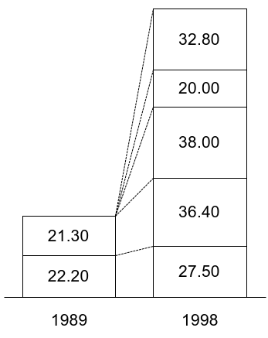
HIGH-END CONSUMER COMMUNICATIONS SPENDING PATTERNS
Average monthly bill
Dollars
154.70
Mobile
Internet access
Cable/satellite
43.50
Local
Long distance
Source: Yankee Group

Slide 14
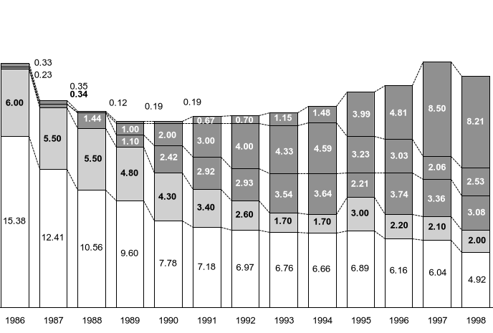
DOMESTIC LONG DISTANCE PRICING
ESTIMATES
Cents per minutes of use
Retail margins
Wholesale margins
21.94
22.06
19.94
20.74
18.60
19.32
17.62
17.48
18.07
16.69
16.69
17.17
17.20
IXC basic tariff¹
Typical
price
points
IXC discounted plan²
Reseller price³
IXC wholesale price⁴
Local exchange access charges⁵
• Equal access
• Multi- location billing plans
• Sprint/
Wiltel support resellers
• Reseller consolidation increases bargaining power
• Access reform
1 Distribution of day, evening, and night rates for residential direct-dialed calls; discounts not applied; small and medium business rates are approximated to be the same as residential rates
2 Excludes IP voice-based offerings – based on AT&T discounted rate
3 Rough estimates from press reports; excludes IP voice-based offerings – based on AT&T discounted rate
4 Includes third-tier, facilities-based carriers carrying at least a portion of traffic on their own networks; calculated as best per-minute price available to heavy users (~$1 million/year long distance billings)
5 Interconnect charge for both originating and terminating access based on common carrier tariffs
Source: Business Communications Review; Network World; Northern Business Information; Furman Selz; Paul MacAvoy; FCC; McKinsey estimates

Slide 15
OVERVIEW
  Network architecture and telecom basics
  Telecom industry overview
  Backbone networks
  The Internet

Slide 16
GLOBAL TELECOM LANDSCAPE
Enterprises
Consumers
Players
Integration, support, and outsourcing services
  Systems/network integrators
  VARs
Network services
  RBOCs, ILECs, PTTs, IXCs
  ISPs
  MSOs
  Resellers
  Satellite networks (e.g., Iridium, Skybridge)
  Focused services providers (e.g., Firefly)
Communication systems
Software and support
End-user devices
  “Big 10” broad-based telecom systems manufactures (e.g., Lucent, Alcatel, Nortel)
  Focused systems/CPE vendors (e.g., Tellabs, Ciena, Nokia)
  Datacom systems vendors (e.g., Cisco, Ascend)
  ISVs (e.g., LHS, Kenan, Metasolv)
  Support services firms (e.g., Bellcore, OSI, MSI)
Communications semiconductors
Other components
  Communication semiconductor manufacturers (e.g., Cirrus)
  Broad-based semiconductor manufacturers (e.g., TI, Intel)
  Component systems/device manufacturers (e.g., Allen Telecom)

Slide 17
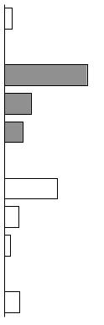
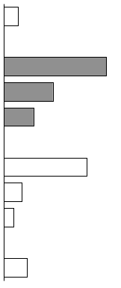
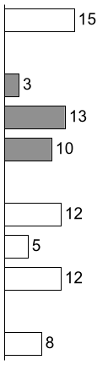
U.S. MARKET REVENUES
$ Billions
Today’s focus
1998
$ Billions
2002
$ Billions
CAGR
Percent
Players
  Integration, support, and outsourcing
15
26
  Network services
    Local and LD voice
    Data/video
    Wireless¹
172
191
56
91
38
56
  Communication systems²
  CPE/end-user services³
  Software and support
110
156
29
33
12
18
  Communication semiconductors/ other components⁴
31
43
1 Includes paging
2 Includes equipment and software
3 Includes consumer telecom and fax equipment and wireless handset
4 Global revenues

Slide 18
EVOLVING NETWORK SERVICES INDUSTRY STRUCTURE
From vertical . . .
. . . to a mixture of vertical and horizontal
Content (AOL, MSN, Yahoo)
Applications (Vocaltec, Firefly)
Services (resellers, ISPs, VANs)
British Telecom
NTT
AT&T
France Telecom
AT&T
British Telecom
Bell Atlantic
France Telecom
Support (CBIS, Teletech)
Backbone (Qwest, IXC)
Access (Winstar, Brooks Fiber)
  Vertically integrated operators
  Sales/relationship marketing focus
  Closed software protocols
  Slow innovation around legacy systems
  Vertical “systems integrators”
  Horizontal product and technology specialists
  Open “innovation based” protocols
  Rapid innovation around new networks
What next . . . Specialist or re-integration?

Slide 19
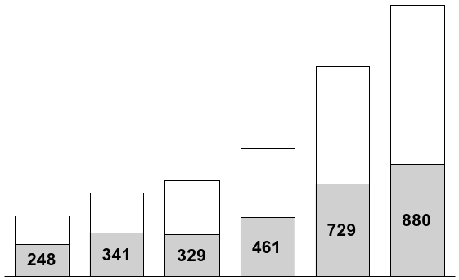
TELECOM INDUSTRY MARKET CAPITALIZATION
$ Billions*
Former AT&T**
CAGR
2,133
40%
The pace
and scale of value creation has steadily increased over the past 4 years, especially for new entrants
1,652
46
1,006
655
755
473
33
1/95
1/96
1/97
1/98
1/99
6/30/99
* Values as of opening price for each calendar year
** Includes AT&T, Lucent, and the RBOCs

Slide 20
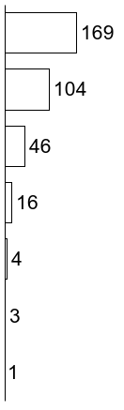
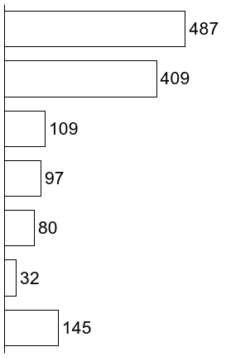
MARKET CAPITALIZATION BY SERVICE SEGMENT
ESTIMATES
$ Billions
Total entity value
1/1/95
6/30/99
CAGR
Local incumbents (RBOCs)
27%
Long distance incumbents (IXCs)
36
Wireless
21
Cable
49
Long distance attackers (CIXCs)
95
Local attackers (CLECs and DLECs)
69
ISP
202

Slide 21
GROWTH IN DEMAND FOR LOCAL SERVICE
ESTIMATES
$ Billions
CAGR
Percent
170
152
75
137
35
115
125
Business Internet
107
41
Residential Internet
Data services*
6
Private line
Voice toll
2
* Total of ATM, Frame Relay, X.25, xDSL, and ISDN
Source: Dataquest; Forrester

Slide 22
TOTAL VALUE OF ANNOUNCED M&A TRANSACTIONS*
$ Billions
?
The pace of MA&A activity has rapidly increased since the passage of the 1996 Telecom Act
* Limited to transactions of greater than $250 million and U.S. acquirers

Slide 23
MERGER ACTIVITY FALLS WITHIN SEVERAL MAJOR CATEGORIES
New companies exploiting new technologies/regulatory arbitrage
  Equant
  Level 3
  Rhythms
  Covad
  Northpoint
  RCN
  Qwest
  @Home
Horizontal telephony consolidation
  Telebras auction
  GTE/Bell Atlantic
  SBC/Ameritech
  Ameritech/Bell Canada
US Cable/xDSL/ Satellite consolidation
  AT&T/TCI
  AT&T/Media One
  Paul Allen/Charter/several MSOs
  AOL/DirecTV
  DirecTV/USSB/Primestar
  Chrome/Roadrunner?
  @Home
Telecom industry
consolidation
Wireless consolidation
  Videophone/ airtouch
  GTE/Ameritech wireless
  Nascent US GSM roll-up
Vertical telephony consolidation
  Worldcom/MCI
  Global Crossing/Frontier
  Qwest/US West
  SBC/Williams
Cross industry applications/ development deals
  AT&T/IBM
  Qwest/Microsoft
Microsoft buying
its way into
multiple platforms
in multiple markets

Slide 24
VENTURE CAPITAL DISBURSEMENT – FIRST VS. FOLLOW-ON 1979-98
$ Millions
Follow-on
First round
Both traditional and corporate VC funds are aggressively pursuing opportunities in the telecom space
Source: 1999 National Venture Capital Association Yearbook; trade press; fund websites

Slide 25
OVERVIEW
  Network architecture and telecom basics
  Telecom industry overview
  Backbone networks
  The Internet

Slide 26
BACKBONE NETWORK DESCRIPTION
Backbone
The backbone is the part of a communications network that provides high-capacity long distance transport of data and voice information
Backbones consist of fiber optic links between points of presence (POP) usually located in major cities. There are ~125 POPs in U.S. backbone networks. Traffic is carried to and from these POPs by the local access networks
Using the latest technology*, each fiber can carry upward of 160 Gbps – the equivalent of 2 million voice calls
* OC-192 16xWDM

Slide 27
BACKBONE FACILITIES AND SERVICES SCHEMATIC
IP
Router
WDM*
WDM
Router
IP
Voice
Voice switch
Fiber
Voice switch
Voice
Data
ATM switch
ATM switch
Data
* Wave division multiplexing

Slide 28
DEMAND FOR BACKBONE-RELATED SERVICES
$ Billions
CAGR
Percent
170
152
75
Wholesale
137
35
125
Business Internet
107
115
41
Residential Internet
Data services*
6
Private line
Voice toll
2
* Total of ATM, Frame Relay, X.25, xDSL, and ISDN
Source: Dataquest; Forrester

Slide 29
BACKBONE CAPACITY DEMAND GROWTH SCENARIOS
Demand – U.S. voice and data traffic
Terabits per day, log scale
Capacity
Number of DS-3s required
4,000,000
400,000
300% CAGR
  “Data traffic in the public network is outpacing the familiar Moore’s Law by doubling about every
  12 months.”
– Telephony, 6/98
40,000
150% CAGR
Data
6% CAGR
4,000
Voice
400
40
Source: FCC; Salomon Brothers; McKinsey analysis

Slide 30
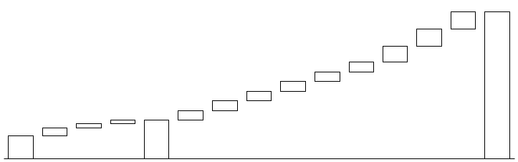
POTENTIAL BANDWIDTH SUPPLY IN 2002
Theoretical number of DS-3S* of national networks**
Thousands
3,338
664
700X
1997 capacity
664
571
111
111
111
442
442
0.2
2.0-5.0
221
1.2
0.4
0.2
Company
AT&T
MCI/
World Com
Sprint
Others
Total 1997 fiber capacity
Qwest
Williams
Level 3
Frontier
IXC
GTE
Enron
Touch America
PF.Net
Maximum fiber capacity*** in 2002
Route miles of fiber network
Thousands
39
32
23
12
106
18
21
15
13
13
17
20
18
11
186
* Assumes fibers are fully lit and operational
** DS-3s = number of fibers X backbone speed X number of windows ÷ 4 (4 fiber BLSR topology); OC-192 = 10Gbps fully lit, assuming today’s state-of-the-art Sonet technology – 96 Windows OC 192
*** Does not include regional providers' capacity.
Note: Qwest, Williams, and Level 3 have laid spare conduits through which they could pull additional fiber at a fraction of new build cost
Source: Salomon Brothers; Standard & Poor’s; interviews; company reports

Slide 31
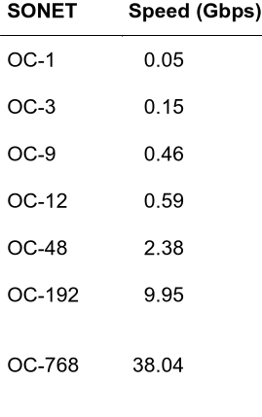
TECHNOLOGY RAPIDLY INCREASING BACKBONE CAPACITY
New technologies
WDM* technology
WDM allows for multiplexing 16 OC-192 channels on 1 fiber, e.g.
  OC-192 with 16-channel WDM allows for 160 Gbps on 1 fiber
?
Pure optical signaling and computing components (e.g., no electrical signaling)
?
Improvements to existing technologies
?
?
?
?
?
?
?
?
Increased bandwidth per fiber
* Wave division multiplexing

Slide 32
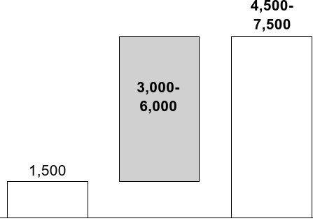
TYPICAL CAPITAL COSTS OF A NEW NATIONAL COVERAGE FIBER OPTIC NETWORK
Attacker network costs
ESTIMATES
$ Millions
Cost to build
Cost to light entire network**,***
Total network costs
* Assumes 16,000 route miles with 96 fibers (48 fiber pairs)
** Assumes 125 POPs with $250,000 OC-192 terminal and $250,000 gigabit router
*** Assumes 125 POPs with $500,000 16-32 window DWDM equipment
Source: Salomon Brothers; press clippings; McKinsey analysis

Slide 33
COST TO CONSTRUCT AND LIGHT A U.S. BACKBONE NETWORK
ESTIMATES
$ Millions
  The construction costs are roughly 1/5 of the total cost to build a fully lit backbone network and so represents an option to add new capacity
  Capacity can be added one fiber pair at a time and so the network can be brought on as existing capacity is filled
  Switching technology price performance improvements will drive down lighting costs in the future; the last fiber pair is likely to be less expensive to light (or provide more capacity than the first pair)
Cost in build network*
Cost to light first fiber pair**
Cost to light second fiber pair
. . .
Cost to light 24th fiber pair
Total network costs
* Assumes 16,000 route miles with 48 fiber pairs, redundancy
** Assumes 125 POPs at $1 million per POP for opto-electronics
Source: Salomon Brothers; Qwest 10K; press clippings; McKinsey analysis

Slide 34
TRANSATLANTIC CABLE CAPACITY ADDITIONS
Voice paths
All commercial submarine cables built, used, and paid for by large incumbent/
monopoly carriers until late 1980s
750 Gbps
WorldCom, Cable & Wireless
Gemini
30 Gbps
AT&T, BT, DT et al TAT 12/13
10 Gbps upgraded to 155 1999
Incumbent consortium
TAT 9, 10, and 11
1.68 Gbps
Global Crossing
AC-1
40 Gbps
AT&T, BT, DT et al
TAT 14
640 Gbps
Sprint and Cable & Wireless PTAT
1.68 Gbps
100 Gbps
Source: TeleGeography; www.globalcrossing.com

Slide 35
OVERVIEW
  Network architecture and telecom basics
  Telecom industry overview
  Backbone networks
  The Internet

Slide 36
THE INTERNET – DEFINITIONS
The Internet
  The Internet consists of networks joined together by high-speed backbone data links ranging from 56 bps to 160 Gbps . . . the Internet effectively is a network of networks
  The web embodies all of the information universally available on the Internet through web access software (e.g., NETSCAPE)
  Computer servers that handle the web pages, information, and databases that are accessible through the Internet with web access software; this service is provided by content hosts or by Internet service providers agreeing to host data for others
  Providers of dial-up or direct access to the Internet from a computer or a local area network (MindSpring, AOL, MSN)
  The network software protocol that allows multiple hardware technologies and software to connect and exchange data
  Core network protocol that underlies interconnection of multiple networks (Transmission Control Protocol/Internet Protocol)
World Wide Web
Web hosts
Internet access/ service providers
TCP/IP
Source: Newton’s Telecom Dictionary

Slide 37
DESCRIPTION OF TCP/IP TECHNOLOGY
TCP/IP network layers
Description
Applications
HTTP, FTP, SMTP – higher order protocols that allow retrieval
Transport
TCP – Transmission Control Protocol breaks data into packets and reassembles the packets
Network
IP-Internet Protocol addresses the packets of information so they can be routed throughout the network
Physical/data link (host to network connection)
LAN, WAN, Internet – the physical connection between the host computer/server and the network
Characteristics of the TCP/IP
  The protocol allows universal connections between various types of hardware architectures and software which allows the interconnection of networks
  IP packets addressed and sent independent of one another

Slide 38
CHARACTERISTICS OF TCP/IP ARCHITECTURE
Pros
Cons
  Flexible and extensible networks based on agreement over modest set of packet protocols
  Robust architecture that can suffer multiple failure points and can dynamically adjust based on local conditions
  Enables much faster growth of services and applications by migrating control and intelligence to end-user devices (computers)
  Routers and hardware able to take advantage of PC price-power performance trajectory
  Generally unsuited to synchronous traffic (voice and data)
  No way to guarantee end-to-end quality of service
  Distributed information makes network management, operations, billings, etc. very complex
  Public Internet structures are less secure – difficult to know which machines have looked at your data
  Fundamental upgrades or changes to network architecture (e.g., IPv6) very hard to coordinate

Slide 39
INTERNET TRANSPORT ARCHITECTURE
Internet Transport Network A
NAP
ISP A
Internet Transport Network D
ISP B
Servers
Dedicated access
T-1, T-3
Private peering point
NAP
Internet Transport E
NAP
Internet Transport F
Public peering point
Dial-up
56 K
Dial-up
56 K
Servers
DS-3
T-1
DS-3
T-1
Home
Home
Corporate
NAP
Home
Corporate
Dedicated access
T-1, T-3
ISP-C
Servers
  The Internet is the network of networks (A, B, C), all of whom connect with each other at private peering points or public network peering points (NAP)
  ISPs (ISP-AB) connect to the Internet (meaning Internet transport providers) at NAPS or private points (with Internet Transport D), or the ISP could be the Internet Transport Provider (ISP/Internet Transport – Provider A)

Slide 40
THE HISTORY OF THE INTERNET
Evolutions of the early network
The new Internet
1969
1970s
1985-87
1990-93
1994-95
1996-99
  DARPA creates ARPANET to connect military bases
  ARPANET includes research universities
  TCP/IP software released with UNIX
  NSF funds super computers and connects with ARPANET
  NSF opens access to other universities
  NSF contracts MCI and IBM to operate links between 5 sites and 170 LANS
  MCI, IBM, and Merit create spin-off – ANS to manage backbone
  NSFNet size and reach attracts commercial user
  Wiltel creates commercial Internet exchange (CIX), as the first commercial peering point
  NSF awards
  4 contracts to create 4 access points for backbone interconnection
  NSFNet shuts down
  (April 30, 1996)
  NAP infrastructure becomes the Internet
  Additional NAPs are added for federal exchange (fix) points
  The commerciali-zation of the web drives private backbone providers to create hundreds of private peering points

Slide 41
NETWORK INTERNET ACCESS POINTS
New York NAP
SprintLink
Pennsauken, NJ
CIX
Santa Clara
Chicago NAP
Ameritech/Bellcorp
San Francisco
NAP
PacBell
MAE-West
San Jose
MAE-Chicago
MAE-East
MAE-East+
Washington DC
FIX-East
College Park MD
FIX-West
Ames Research Center
Mountain View
MAE-Dallas
MAE-LA
Los Angeles
MAE-Houston
Definitions
Official NAPs
  4 NAPs created by the NSFnet through outsourcing to PacBell, Sprint, Ameritech, and MFS (MAE, D.C.)
  6 Metropolitan Area Ethernets were designed to handle interconnect traffic around major metro areas; these have become de facto NAPs
  2 Federal Internet Exchange points and 1 Commercial Internet Exchange points created to provide exclusively government and commercial NAPS
MAE
FIX, CIX
Source: Telegeography; Chicago/Ameritech NAP Web site; press articles

Slide 42
THE INTERNET VALUE DELIVERY SYSTEM
Internet connectivity
Services and content
End user
Internet transport
Local access provider
End customer support
Applications
Description
Examples
Sample players
  The backbone that connects the multiple networks to form the Internet
  High-Speed Transport Backbone between MAE-Dallas and MAE-LA (network access points)
  Dial-up or direct connect service to the local network
  ADSL, modem, cable modem or T1/T3 connections to local networks that tie-back to transport providers
  Services such as customer support or information management
  Web-hosting services for e-commerce companies
  Consumer or enterprise services
  Web-auction services, IP-telephony, video conferencing
MCI WorldCom (UUNet, ANS, CNS)
GTE (BBN)
PSINet
MindSpring
RBOCs
MSN
AOL
Exodus
E-BAY

Slide 43
U.S. INTERNET ACCESS REVENUE FLOWS 1997
Backbone providers
300-400
Dial-up market
Total dial-up market
$4.3 billion-$4.9 billion
800-1,000
OSPs
2,400
500-600
1,100-
1,500
150-200
Large ISPs
250-350
Dedicated access market
250-400
Small ISPs
250-350
Total dedicated access market
$1.0 billion-
$1.5 billion
500-800
Wholesale access market $0.8 billion-$1.2 billion

Slide 44
THE RESIDENTIAL MARKET FOR INTERNET ACCESS IS HIGHLY CONCENTRATED
Residential Internet access market, U.S. 1998
100% = 27,173,000
AT&T
GTE
Prodigy
RCN
SBC
Excite @ Home
Mindspring and Earthlink merged in October 1999 in an attempt to achieve scale in an increasingly concentrated market
BellSouth
1
1
1
Mindspring/Earthlink
MSN
AOL
  Total ISPs
  ISPs serving “other”
  category
  Average customer
  base for other category
= 5,028
= 5,018
= 1,018 subscribers/ISP
Other

Slide 45
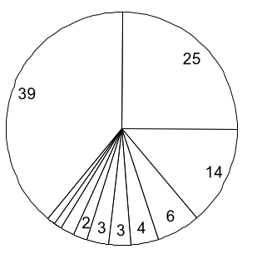
THE BUSINESS ISP MARKET IS JUST AS CONCENTRATED AS THE RESIDENTIAL MARKET
Business ISP market share, U.S. 1999 revenues*
100% = $5,268 million
UUNet
Other
AT&T/CERFnet/
IBM Global Network
1
1
2
Frontier Global Center
QWEST
Concentric
Verio
GTE
PSInet
Sprint
Cable & wireless
* Excludes wholesale
Source: IDC

Slide 46
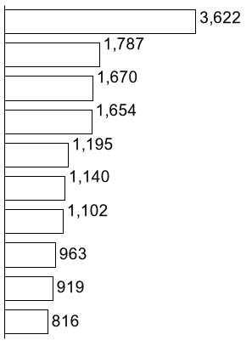
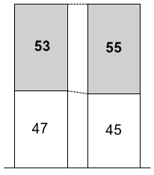
RESIDENTIAL INTERNET USERS ARE CONCENTRATED IN CERTAIN LARGE STATES
U.S. residential Internet penetration, December 1998
Percent
Number of Internet households
Thousands
Top 10 states
California
100% =
103.7 million
27.2 million
Texas
Florida
Top 10
states
New York
Illinois
Pennsylvania
Other
states
Ohio
Michigan
House-
holds
House-
holds
with Internet
New Jersey
Washington
Source: National Telecommunications and Information Administration (NTIA); U.S. Census Bureau (based on Dec. 1998 data)

Slide 47
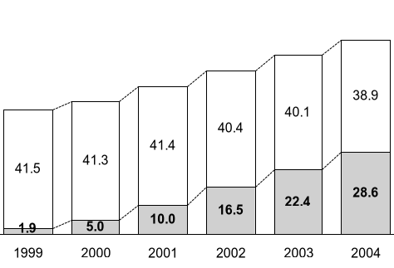
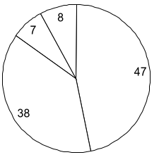
BROADBAND USERS WILL MOST LIKELY BE SPLIT BETWEEN CABLE AND DSL ACCESS PROVIDERS
Broadband subscribers
Residential broadband market share, U.S.
2004 projections
100% = 28.6 million households
Residential Internet subscribers, U.S.
Millions of households
CAGR = 9%
67.5
CAGR
62.5
Fixed
wireless
MMDS
56.9
51.4
43.5
47.3
-1%
Cable
modem
+72
DSL
Source: Sanford-Bernstein/McKinsey analysis

Slide 48
THE SHIFTING NATURE OF THE INTERNET HAS PLACED NEW DEMANDS ON THE WEB OR COMPANIES THAT SUPPORT “THE PUBLIC INTERNET”
The old Internet
The new Internet
“The populist age”
  Highest usage came from universities, research institutions, and government agencies
  All bits of information given the same priority over the Internet
  Coordination to ensure free flow of traffic across the Internet regardless of traffic flow between networks
  Infrastructure development coordinated by the government as a “public good”
  U.S. as the center of the Internet universe
“The commercial age”
  Demand growth and usage from commerce, communications, and data traffic
  Increasing demand for priority traffic in exchange for premium pricing
  Fewer players bearing inordinate amount of the burden for insuring the ubiquity of the Internet
  Internet infrastructure development handled by multiple private companies in response to current and expected demand
  Increasing globalization of the Internet but continued U.S.-centric role

Slide 49
PUBLIC INTERNET “INTERNETWORKING”
EXAMPLES
GTE/Internet backbone
VERIO network
Chicago NAP Ameritech peering point
Web host handling Amazon website
Seattle
Minneapolis
Boston
New York
Philadelphia
Palo Alto
Chicago
D.C.
Maryland
Denver
Richmond
Los Angeles
Durham
Orange
Mindspring ISP provides local dial-up local access
Atlanta
Dallas
Jacksonville
Houston
Interconnect with GTE to provide backbone
  For a mindspring user to access the Amazon website, it traverses
  3 different private networks, 2 interconnect points, and a web hosting site
  The “public Internet” works because private companies have developed ways of managing complex ways of interconnecting
  This collaboration has helped fuel Internet growth, but private companies find it difficult to capture the network externalities of the public Internet

Slide 50
LIMITATIONS OF THE CURRENT INTERNET STRUCTURE
Issue
Limitation
Usage or “bit” measurement
  The measurement of bits of traffic does not necessarily account for the relative value of the particular data
  Legacy of the “old Internet” is the lack of an agreed on standard among all networks to give bits of data priority
  Interconnection (free peering) no longer reflects the actual flow of traffic across the different sized networks
“Bit” priority
Interconnection arrangements

Slide 51
QUALITY OF SERVICE ON THE INTERNET
Many conflicting and confusing ideas about what QoS is . . .
. . . but, in general
Mechanism to provide maximum throughput
Over-engineering/ undersubscribing
Service-level guarantees
  QoS is the ability to differentiate and preferentially treat network traffic
  QoS is characterized by
    Latency (ms)
    Jitter (ms)
    Packet loss (%)
    Availability (% up time)
QoS?
ATM virtual circuits
RSVP
Class of service
Policy to allocate scarce resource to high-priority traffic

Slide 52
PERFORMANCE OF RESIDENTIAL ACCESS TECHNOLOGIES
Acceptable consumer access time
Access method
Dial-up
28.8 KBPS
ISDN
128 KBPS
ADSL
1.5 Mbps
Data over cable
4 Mbps
Content
Standard Web page¹
Standard Web page with 60-second sound file²
Graphics-intensive Web page³
Standard Web page with 60-second video clip⁴
11.1
41.1
61.1
20 minutes
2.4
9.3
13.8
5 minutes
0.2
0.8
1.2
24.0
0.1
0.3
0.4
9.0
1 10% of graphics, 80% text; 40 KB
2 AM-quality Real audio; total 148 KB
3 75% of screen detailed graphics; total 200 KB
4 2” X 2” image; quality similar to video over quad-speed CD-ROM; 4,500 KB
Source: Morgan Stanley; McKinsey analysis

Slide 53
INTERNET SERVICES AND APPLICATIONS
THAT DRIVE E-COMMERCE
EXAMPLES
Service/ applications
Description
Examples
Search engines/ portals (browsing)
E-commerce (shopping)
E-mail
Virtual communities
Streaming video
Chat
Real-time gaming
Allows one to search or link with content on the web through simple, direct commands
Internet application that allow one to purchase goods or services, typically at discount to bricks and mortar channel
  Business to consumer (B to C)
  Business to business (B to B)
Most popular web application which allows people to communicate via text
Web sites with content developed for specific segments or Internet groups; web sites attract focused marketers
Low grade video, either real time or stored. Typically used for short clips for entertainment or conferencing. Expected to converge with TV
Allows users to converse by text in real-time. Can be public or private
Online casinos which allow users to play various casino games
  Yahoo, Excite, Ask Jeeves
  Amazon, Buy.com, E-Loan
  E-Steel.com
  Hotmail
  I-Village, GeoCities
  Broadcast.com, Real Networks
  AOL, CompuServe
  go to casino.com
  thesands.com

Slide 54
THE UBIQUITOUS CONNECTIVITY MODEL
Broadband to the home
  Voice, data, and video over 1 pipe to the home
  Pervasive but competing providers
Networked home
  Many devices sharing one network
  Smart appliances that increase efficiencies, reduce costs, or facilitate lifestyles
2005 – ubiquitous connectivity
  Always on
  High speed
  Internet everywhere
  One set of personal information/preferences
  Intelligent devices
Ubiquitous connectivity
Wireless Internet
  Access to information anytime/anywhere
  Networks supporting rich media content
  Many networks servicing different needs
Personal area network
  Many devices sharing
  1 personal network
  1 common set of per-sonal info/preferences
  Diverged devices for different needs

