Slide 1
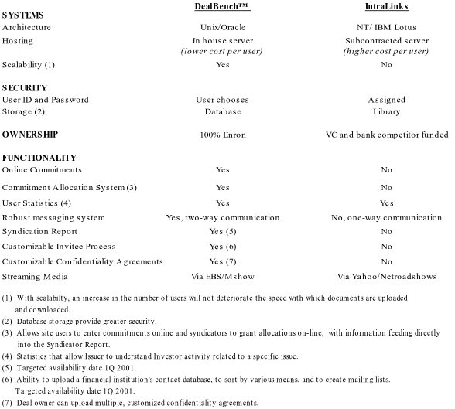
DealBench™ vs. IntraLinks

Slide 2

DealBench™ Technology Summary
Robust platforms
Strong security measures
Redundant systems in place
Change control procedures established
Contingency planning in place
Vibrant technology team

