Slide 1

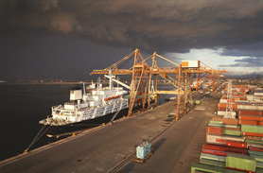
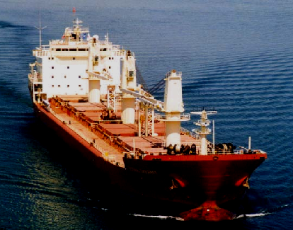
Freight Online
January 2001

Slide 2

Table of Contents
Enron Overview
Enron Freight Online

Slide 3
Enron Overview

Slide 4
Enron’s Network Businesses
Energy
Communications
Transportation
&
Distribution
Wholesale
Energy
Retail
Energy
Broadband
Services
Natural Gas Transportation
Electric Distribution
Marketing and Delivery of Energy Products Worldwide
Energy Outsourcing to Commercial and Industrial Customers
Bandwidth Management and Broadband Delivery Services
IT Commercial Synergies
Traditional
New

Slide 5
Enron’s Network Businesses
Wholesale Energy Services
Enron Europe
Limited
Enron Global
Markets
Enron
Net Works
Enron Industrial
Markets
Enron Global
Assets
Enron
Americas
Power & Gas Trading
Origination
Credit.com
Australia
Japan
LNG
Coal/Emissions
Shipping
I/R, F/X Trading
Weather
Insurance
Petrochemicals and Plastics
Transportation
Agriculture
EnronOnline
Pulp & Paper
Steel
Power & Gas Trading
Origination

Slide 6
Enron Global Markets
New business unit focusing on global markets and commodities outside Enron’s traditional gas and power markets
Global Crude, Products, Petchems, and LPGs
Coal and Emissions
Transportation
Shipping
LNG, Middle East, Puerto Rico, and Venezuela
Currency, Equities and Interest Rate Trading
Agricultural Trading
Insurance
Weather
EGM provides a true network for market making opportunities related to commodities that are highly liquid in physical or financial terms and are enormous in market size
EGM leverages the value of Enron’s existing trading network and international asset positions
EGM’s operations will coordinate and leverage with our North American, European, Australian, and Japanese businesses

Slide 7
EGM’s Wholesale Business
Crude &
Products
Coal
LNG
Emissions
Weather
EGM
Transportation
Insurance
Shipping
FX/Rates/
Equities
Agribusiness

Slide 8
Enron Global Markets
Creating New Markets in Global Commodities
Offices
Coal Activities
Crude and Product Activities
Weather
LNG
LNG Ships
Houston
London
Oslo
Singapore
Seoul
Puerto Rico
Tokyo
Sydney
Panama
Dubai
Johannesburg
Frankfurt
Europe
China
Australia
USA
Korea
South Africa
Japan
India
Colombia
Venezuela
Indonesia
Poland
Russia
USA
UK (Europe)
Singapore
Australia
Panama
Korea
Japan
Argentina
USA Europe
Japan
Australia
India
Puerto Rico
Venezuela
Georgia
Louisiana
LNG Under
Development

Slide 9
LNG
Key Active
Areas &
Contracts
Under
Development
Creating an Enron network of LNG supplies, transportation, terminals and markets to maximize optionality
Gaining access to a broader network of terminals
Market and optimize the use of Dabhol, Hoegh Galleon and Exmar LNG vessels
Developing online trading network and creating an Asian hub

Slide 10
Shipping
Leading market maker of vessel freight
Providing transparency, liquidity and long-dated market making to the international freight market
Actively trading products through EnronOnline
Creating markets in long-dated shipping capacity up to 10 years

Slide 11
Transportation
Developing intermodal and truck-load risk management products to create value for railroad and trucking companies
Technology allows for dramatic increases in efficiency and cost reduction for emerging trading markets with high transaction volume and large numbers of trading partners
Developing new credit and financing alternatives for thinly capitalized trucking companies

Slide 12
Freight Online

Slide 13
Overview
Enron Shipping Origins
The Shipping Market
Current Enron Online Activities
Potential Enron/Bank Partnerships

Slide 14
Enron’s International Coal Group
1999: International Coal Group established to:
“Apply Enron’s commodity and risk management
expertise to the global coal markets”
Just 1 year later: major player in international coal trade
Capture 4 percent of total global coal trade, 60 percent of imports into the UK, and over 10 percent of imports in Germany
Transactions in 20 countries
International coal being commoditised and actively traded in OTC markets
E-commerce initiatives (Enron Online, Coal Tracker) strengthen customer base and improve logistics management

Slide 15
Advantages of an OTC Market in Coal
Standardised contracts allow:
all physical and financial risks to be eliminated with back-to-back trades
reduced transaction costs
transparent pricing in support of pricing indices
explicit valuation of embedded options
Shipping risks are inherent in delivered coal contracts
Coal market development has created demand for new products to manage shipping risks

Slide 16
Shipping is a large market ...
Figures in Billion $US
The Shipping Market is a 500 billion $US market

Slide 17
… and a growing one
Million Tonnes

Slide 18
… and coal is only the beginning
Worldwide shipped volumes
Figures in million tonnes
60,000 ships carrying 5.455 billion tons a year

Slide 19
Volatility in Freight Rates
Typical Volatility: 20 - 25 percent per annum

Slide 20
Market Characteristics
Well established market (Baltic Exchange, Indices, etc.)
But still not fully ready for the new economy:
Contracts still not standardised
Processes are old-fashioned and labour intensive (TELEX still used!)
Brokers still used in most transactions
Derivatives use on the upswing, but credit and compliance issues with many counterparties (e.g. privately held, Gibraltar-incorporated companies)
However, more and more market participants are recognising and looking to manage their exposure to freight volatility and
The Market is Ripe for a Change

Slide 21
The Goals: Commoditisation and Liquidity
Commoditise freight
Standardise physical and financial contracts
Increase liquidity
Increase transparency

Slide 22
The Enron Approach: Portfolio Management
The role of risk intermediaries :
Charterers need short-term flexibility
Ship-Owners require long-term certainty
Utilities
Owners
Steel Mills
Operators
Operators
Traders
Traders
The risk intermediary can aggregate flows into a portfolio to offer counter parties :
- Greater short-term flexibility to address operational uncertainties
- Structures that hedge price risk

Slide 23
Enron’s Skills Come into Play
Value Recognition
Optionality = Value
Different vessel sizes
Voyage vs. Time Charter
Flexibility in load/discharge ports
Optional quantities
Optional delivery periods

Slide 24
Derivatives use in freight markets
Baltic International Freight Futures Exchange (BIFFEX) commenced trading May 15th 1985 on the LIFFE
First acknowledged FFA was executed in Oct 1992
Today futures and swaps available for both dry cargo and tanker freight

Slide 25
Derivatives use in freight markets
More sophisticated markets require more sophisticated instruments
Financial transactions
Options
Swaptions
EnronOnline

Slide 26
The Enron Advantage
Enron is well placed to lead and benefit from the changing market -- after 1.5 years,
already recognised as a market maker
ENRONONLINE OFFERINGS
Voyage contracts:
BCI route 4( Richards Bay/Rotterdam )
BCI route 7( Puerto Bolivar/Rotterdam)
BPI route 2( US Gulf/Japan )
Time Charter contracts:
Average of Time Charter Routes on Panamax

Slide 27
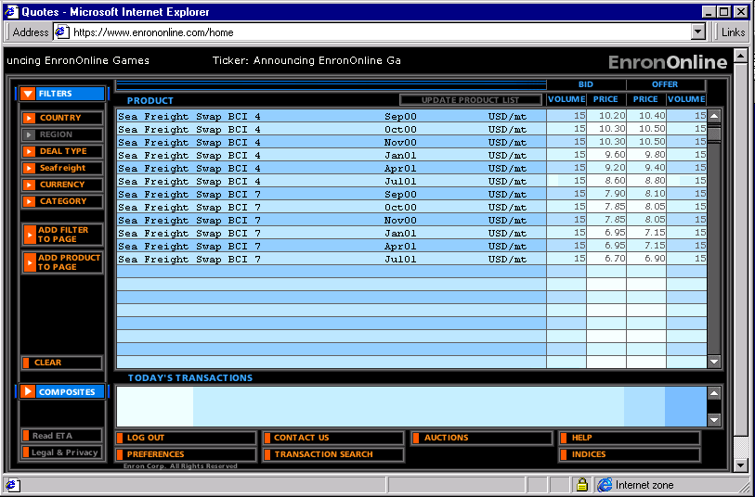
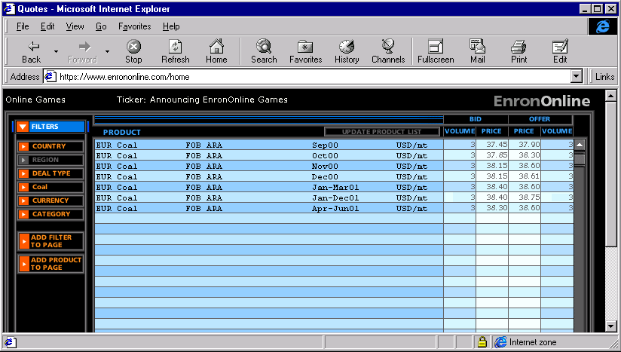
EnronOnline

Slide 28
Deal Example
First structured long-term cape-sized time charter
Deal 1:
Four-year deal with option to extend for 1 year (call)
First 2 years let back, option to call vessel in year 2
Deal 2:
Two-year deal with option to extend for 1 year
Put option available in year 2

Slide 29
Potential Enron/Bank Partnerships
Intermediary/Proprietary Trading
Put Structures (Insurance of Portfolio)
Commodity trading as a freight hedge
e.g. steel or coal trades
Hedges for the secondary debt market
Potential trade guarantor
Credit trading? (enroncredit.com)
Exchange of information on market and counterparties
Publication of market reports on EnronOnline

Slide 30
Where to next?
Growth in financial and derivative products
Increase number of products on EnronOnline
Continue to work for EnronOnline liquidity
Expand freight trading to new markets

