Slide 1
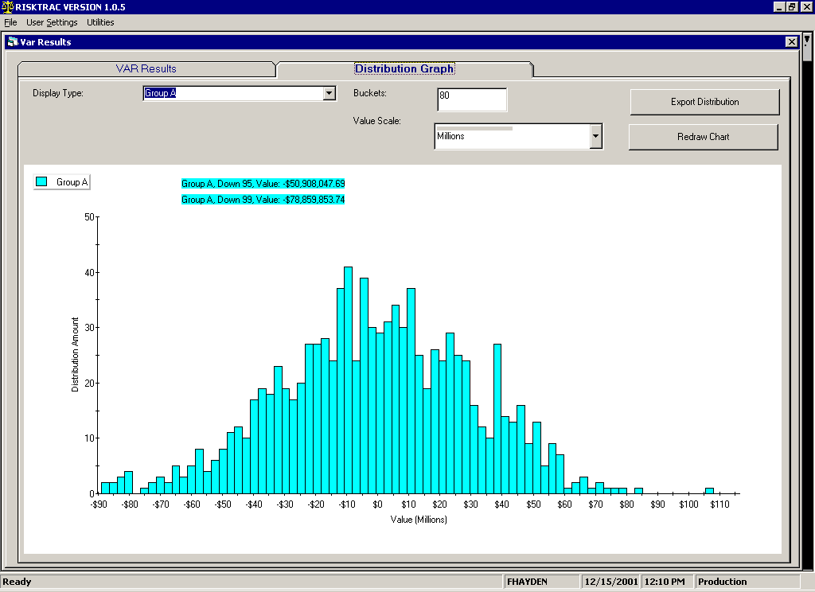
Entire Portfolio

Slide 2
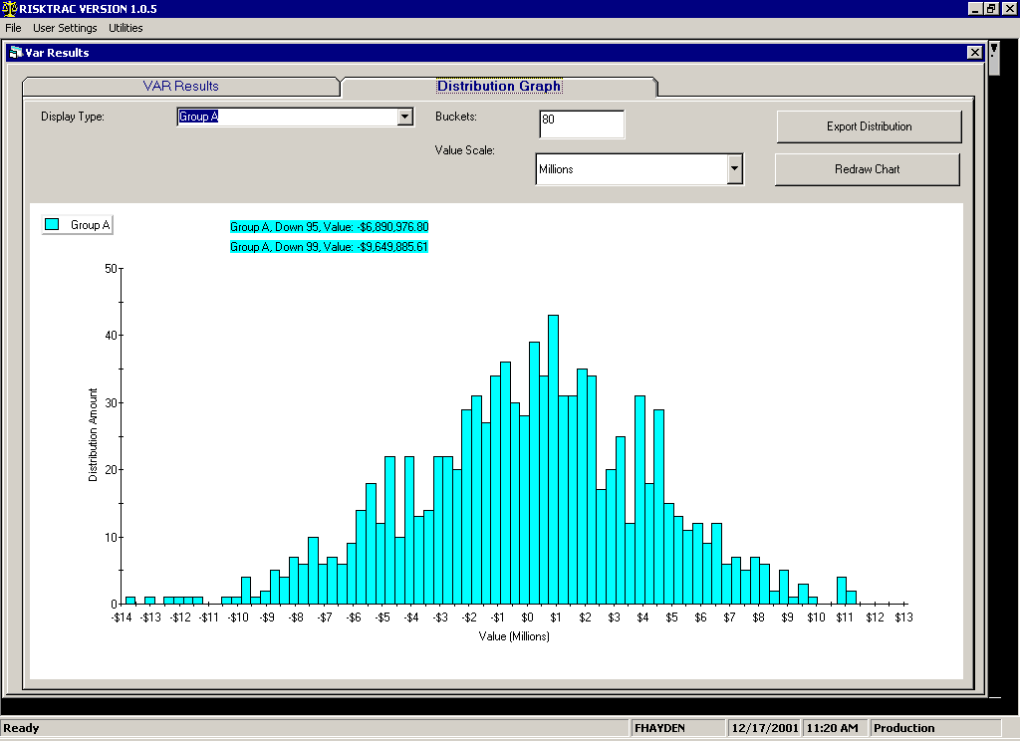
BPA position per credit file

Slide 3
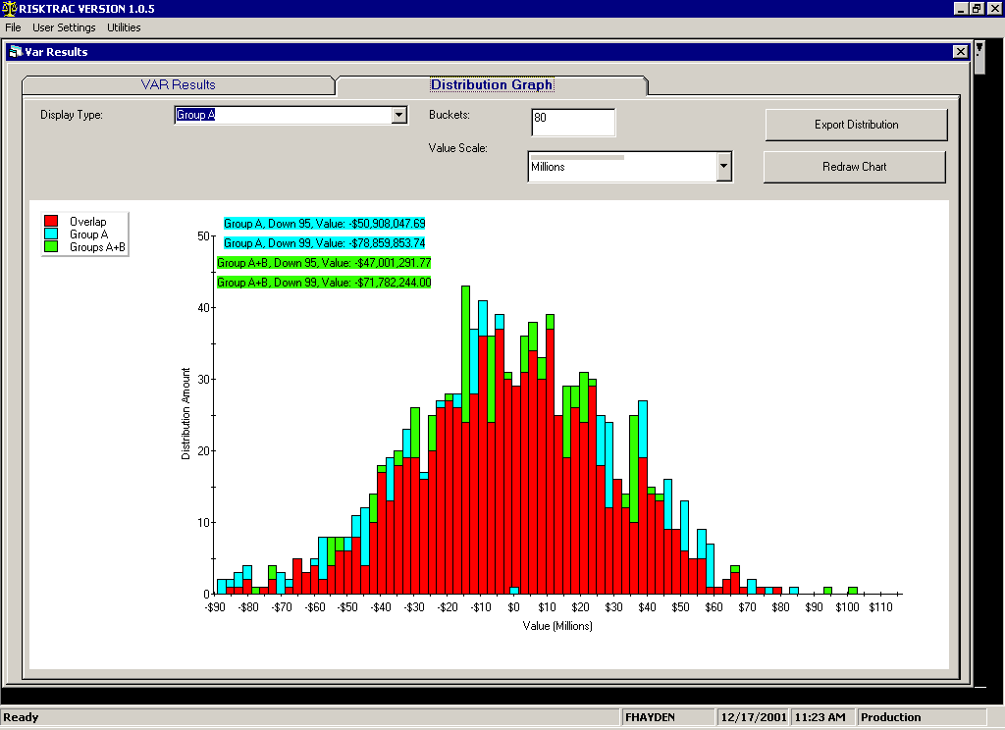
Power VAR w/BPA removed per credit file

Slide 4
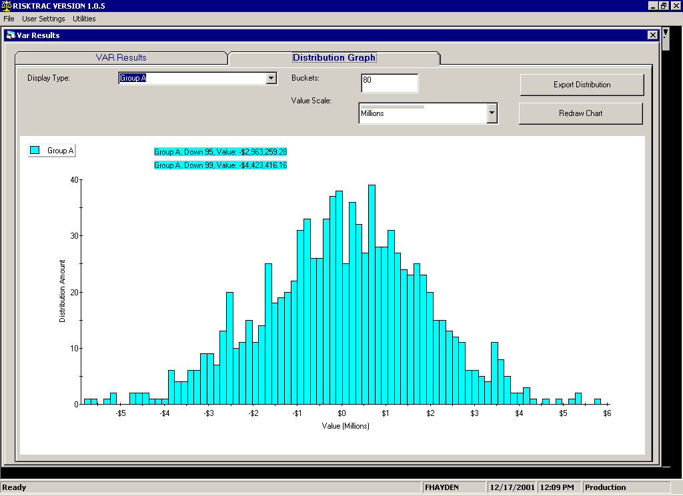
BPA VAR per Mid Office file

Slide 5
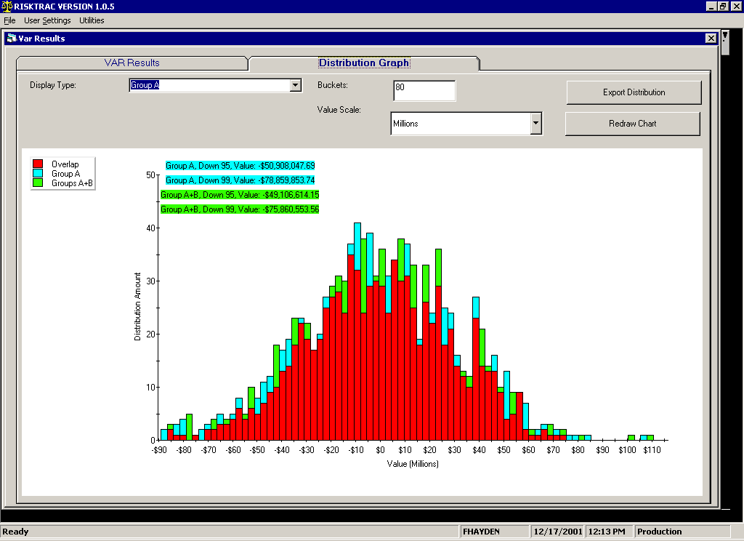
Power VAR with BPA removed, per mid-office file

