Slide 1
Enron North America
Notes:
<number>
<footer>
<header>
<date/time>

Slide 2
Board Presentation
Financial Review
2000 Accomplishments
Market Snapshot
Regulatory Challenges

Slide 3
Board Presentation
Financial Review
Third Quarter/Year to Date Snapshot

Slide 4
Growth Continues, Driven by Commodity Services
EBIT
$ millions
123%
24%
276%
50%
Fourth Quarter
Full Year
Notes:
2000 Progress points are Board Objectives:
1. Achieve 20% growth in total energy volumes
2. Establish industrial business w/$100M GM
3. Complete 3 significant utility outsourcing xactions.
4. Execute more commodity intermediation via EOL.

Slide 5
Capital Deployed ($ millions)
Projected 12/31/99 12/31/00
$2,443
$2,371
Strategic Assets $2,443 $2,371
Merchant Assets 1,053 710
Subtotal $3,496 $3,081
Off Balance Sheet Assets 830 998
Total $4,326 $4,079
65 Net PRM
431
Net PRM
477
Other Assets
63 Working Capital
217
Working Capital
366
Other Assets
701
Gas Assets
500
Gas Assets
$1,053
$998
$830
$710
1,065
Power Plants
929
Power Plants
Strategic
Assets
Merchant
Assets
Off Balance Sheet Assets

Slide 6
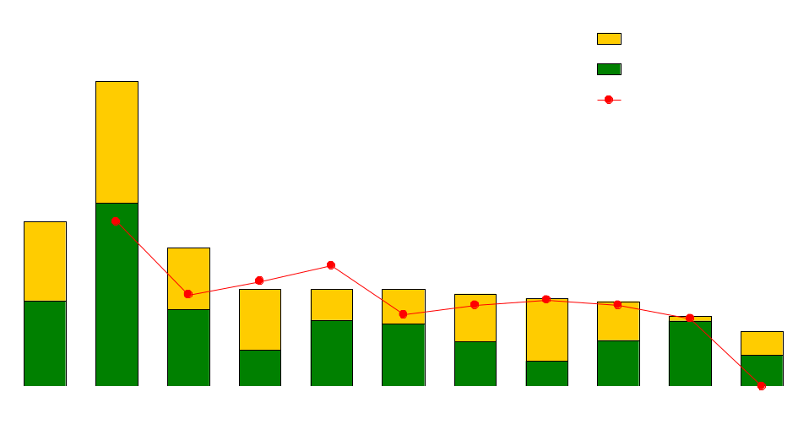
Enron’s Leading Market Position
Third Quarter 2000
(TBtue/d)
47.8
25.9
21.7
15.2
15.2
15.2
14.5
13.8
13.3
11.0
8.6
Source: Gas Daily, Power Markets Week
Notes:
<number>
<footer>
<header>
<date/time>

Slide 7
Physical Electricity Sales Volumes
(Million MWh)
+34%
+46%

Slide 8
Natural Gas Physical Volumes
(Bcf/d)
25.2
23.1
13.3
13.9
+74%
+82%

Slide 9
Rapidly Increasing Utilization of EnronOnline
(North America Gas and Power Transactions)
100% 100% 100% 100%
44% 60% 66% 74%
Notes:
<number>
<footer>
<header>
<date/time>

Slide 10
EnronOnline Average Transactions/day
(North America Gas & Power)
4,613
3,707
3,564
3,057
3,085
3,183
2,773
2,182
2,289
1,913
1,603
983
672
1999
2000

Slide 11
Board Presentation
Financial Review
2000 Accomplishments

Slide 12
2000 Accomplishments
Utility outsourcing is a key proposition in our strategy to augment the network with flexible resources
2000 Progress:
Power Transactions
NSTAR (BECO)
Closed six month all requirements transaction
Oglethorpe
“Virtual Utility” deal
ENA manages:
Assets
PPA’s
Gas Supply Agreements
Load Requirements
Transaction discussions in progress
Gas Transactions
AGL/VNG
Full requirements load
Two year term commencing December 1, 2000
30 BCF/year sales
PSEG
Full requirements load
ENA manages 20%of contractual assets
ENA supplies 20%of native load
60 BCF/year sales
MOU in progress

Slide 13
2000 Accomplishments
Significant success achieved in our generation strategy
Strategy
Control large bank of sites that provide optionality
Profit opportunities
Provide liquidity to network
CANADA
Enron MWs
In Operation 3,340
Development Project 1,638
Site Secured/Prospects
MEXICO
Sales Pending
Type
MW
$ millions
2000 Peakers
SC
1,700
$
1,028
Pastoria
CC
750
580
Caledonia & Brownsville
CC
950
500
Total
3,400
$
2,108

Slide 14
2000 Accomplishments
Significant expansion of our Mexican business
Risk Management
1999
8 Counterparties
$13 MM Notional Value
11.7 Bcf Gas
2000
63 Counterparties
$203 MM Notional Value
58.2 Bcf Gas
% Increase
687%
1,485%
397%
Cross-Border (Tex Mex) Industrial Generation (Vitro)
245 MW facility
3 PPA’s with Mexican Industrials
COD 2002
TEXAS
ERCOT
Brownsville Public Utilities Board
MEXICO
CFE
Backend 1-5 miles to CFE substation
VITRO
Wheeling to Industrials
MEXICO
300 MW HVDC tie between ERCOT & Mexico
15 Year - 112 MW PPA with DeAcero Industrial
COD 2002

Slide 15
2000 Accomplishments
Significant expansion in our Canadian power business
Transactions:
British Energy
3 year PPA upon Ontario Market Opening (by Q4 2001)
500 MW Firm RTC
U.S. $25/MWh
NUG Contract Management
Awarded RFP to assume role of Contract Manager for the Ontario NUG’s on behalf of OEFC (Ontario Electricity Financial Corp.)
1,700 MW’s, 64 IPP’s
3 year term commencing with Ontario market opening
ENERconnect ESA (Electricity Services Agreement)
Exclusive provider of back office services/portfolio management to 54 MEU’s
Represents over 1MM customers & 3,000 MW load
3 years upon Ontario market opening, C$12MM gross revenue
Alberta PPA’s
700 MW Acquisition
Coal fired PPA, 20 year term
70% of full build in May ($37/MWh vs $47/MWh at 16% RoR)

Slide 16
2000 Accomplishments
Completed the monetization of Wind River/Powder River assets
ENA acquired interest in 3 strategic gathering systems in Wyoming from 1998 - 1999
Northern Border recognized potential strategic value to their operations in 1999 and discussions ensued
Montana
Q3 2000 Sale of Wind River/Powder River Assets to Northern Border
$204 MM sales price
$76 MM gain on sale
ENA captures future value in both basins with:
Risk Management
Commodity services
Outsourcing services
Bighorn LLC
EMS Gathering
Idaho
Powder River
Basin
Wind River Basin
South Dakota
Fort Union LLC
Nebraska
Lost Creek LLC
Utah
Wyoming
Colorado

Slide 17
Board Presentation
Financial Review
2000 Accomplishments
Market Snapshot
Power market
Key Fundamentals
Pricing
Gas market
Key Fundamentals
Storage situation
Pricing

Slide 18
Key Fundamental Events Power Market
Significant year on year core demand growth (5%)
Economic expansion
Internet/technology explosion
Warmer than normal summer in the west - cooler than normal summer in the east
Significant decrease in hydro generation in the West
Minimal capacity additions in the West
Significant increase in new gas fired capacity in the East
Resulting price volatility

Slide 19
U.S. Power Price Volatility
Mid-Columbia Prices California Prices (average daily peak) (average daily peak)
Jan Mar May Jul Sep Nov Jan Mar May Jul Sep Nov
Jan Mar May Jul Sep Nov Jan Mar May Jul Sep Nov
1999
2000
1999
2000
($/MWh)
($/MWh)

Slide 20
U.S. Power Price Volatility
Cinergy Prices
(average daily peak)
Nepool Prices
(average daily peak)
Peaked at $1,720
Peaked at $1,781
Jan Mar May Jul Sep Nov Jan Mar May Jul Sep Nov
Jan Mar May Jul Sep Nov Jan Mar May Jul Sep Nov
1999
2000
1999
2000
($/MWh)
($/MWh)

Slide 21
Key Fundamental Events Gas Market
US natural gas supply has been relatively flat over past 24 months
Canadian natural gas supply growth has stalled recently despite significant pipeline expansions
Virtually all power demand growth has been met with natural gas
Summer 2000 was very warm in California leading to storage falling below historical levels
Overall storage levels in the US are currently 23% behind last year
Early cold weather brings concerns over late winter deliverability (particularly in California)

Slide 22
Current U.S. Gas Inventory Levels
(Bcf)

Slide 23
California Storage Levels

Slide 24
Gas Price Volatility
SoCal Prices vs HH Prices
$35
SoCal
$10 HH
Dec 7, 2000

Slide 25
Board Presentation
Financial Review
2000 Accomplishments
Market Snapshot
Regulatory Challenges

Slide 26
Regulatory Challenges
California Power Market Crisis
Price cap for parties selling into Cal ISO and Cal PX
FERC Order on Market Reforms
Class Action Lawsuit
FERC Order 2000 RTO Implementation
Scheduled completion Dec. 2001
Delays in Market Openings
Ontario Market still not committed to “date certain”
Significant Public Policy questions related to continued opening

Slide 27
Enron North America
Notes:
<number>
<footer>
<header>
<date/time>

Slide 28
Return on Capital Deployed ($ millions)
Forecast
2000
EBIT 1,145
Average Capital Deployed 4,779
ROCE 24%
Average Capital Deployed EBIT

Slide 29
2000 Accomplishments
Significant expansion in our QF Restructuring business
Colstrip (37)
CANADA
Michigan Power (65)
Panther Creek (42)
Ada (14)
Gilberton (8)
Inter Power (31)
LV Cogen (41)
Linden (182)
Camden (37)
Bayonne (45)
ACE Cogen (42)
Saguaro (10)
MT Poso (8)
Tenaska (263)

