Slide 1
Enron North America
Notes:
<number>
<footer>
<header>
<date/time>

Slide 2
Board Presentation
Financial Review
Market Position
2000 Accomplishments
Market Snapshot

Slide 3
Board Presentation
Financial Review
Third Quarter Year to Date Snapshot

Slide 4
Growth Continues, Driven by Commodity Services
EBIT
$ millions
123%
24%
276%
50%
Fourth Quarter
Full Year
Notes:
2000 Progress points are Board Objectives:
1. Achieve 20% growth in total energy volumes
2. Establish industrial business w/$100M GM
3. Complete 3 significant utility outsourcing xactions.
4. Execute more commodity intermediation via EOL.

Slide 5
Capital Deployed ($ millions)
Projected 12/31/99 12/31/00
$2,443
Strategic Assets $2,443 $1,783
Merchant Assets 1,053 583
Subtotal $3,496 $2,366
Off Balance Sheet Assets 830 1,027
Total $4,326 $3,393
431
Net PRM
$1,783
217
Working Capital
65 Net PRM
366
Other Assets
63 Working Capital
477
Other Assets
500
Gas Assets
$1,053
$1,027**
701
Gas Assets
$830
$583**
929
Power Plants
477 *
Power Plants
Strategic
Assets
Merchant
Assets
Off Balance Sheet Assets
*Excludes 2000 Peakers Net PP&E of $588
**Assumes Velocity, Mariner, ECP and Catalytica off balance sheet $587

Slide 6
Return on Capital Deployed ($ millions)
Forecast Plan
2000 2001
EBIT 1,145 900
Average Capital Deployed 4,156 3,590 ROCE 28% 25%
Average Capital Deployed
EBIT

Slide 7
Board Presentation
Financial Review
Market Position

Slide 8
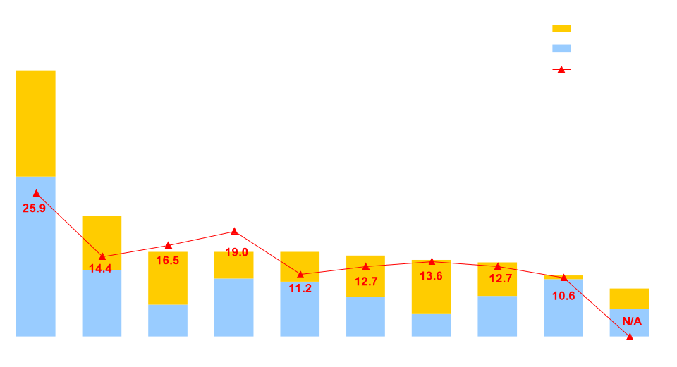
Enron’s Leading Market Position
Third Quarter 2000
(TBtue/d)
47.8
21.7
15.2
15.2
15.2
14.5
13.8
13.3
11.0
8.6
Source: Gas Daily, Power Markets Week
Notes:
<number>
<footer>
<header>
<date/time>

Slide 9
Physical Electricity Sales Volumes
(Million MWh)
+34%
+46%

Slide 10
Natural Gas Physical Volumes
(Bcf/d)
25.2
23.1
13.3
13.9
+74%
+82%

Slide 11
Rapidly Increasing Utilization of EnronOnline
(NA gas and power transactions)
100% 100% 100% 100%
44% 60% 66% 74%
Notes:
<number>
<footer>
<header>
<date/time>

Slide 12
Board Presentation
Financial Review
Market Position
Goals & Objectives

Slide 13
2000 Performance Goals Update
>20% Growth in Energy Volumes
Power volume increase of 42% ytd 3Q99 to 3Q00
Natural Gas volume increase of 74% ytd 3Q99 to 3Q00
EOL growth continues double digit growth
Complete 3 significant utility outsourcing transactions
6 month, highly complex transaction with NSTAR
MOU in progress with PSEG
Discussions in progress with Oglethorpe
Execute more commodity intermediation business via EOL than through traditional means
EOL Nov. 2000 average # Natural Gas transactions 83% of total
EOL Nov. 2000 Natural gas volumes 54% of total traded
EOL Nov. 2000 average # Power transactions 49% of total
EOL Nov. 2000 Power volumes 46% of total traded
Generation of $273 billion of 2000 notional dollar volume

Slide 14
2000 Performance Goals Update
Other Significant Accomplishments
Continuation of Generation Strategy
30 sites in 16 states
Doyle - 350 MWs
Austin Energy - 178 MWs
Pastoria - 750 MWs
Vitro - 245 MWs
Developed, Constructed & Completed 2000 Peaker
On time, on budget
Monetized 2000 Peakers
Significant progress in Mexican Strategy
Explosive growth in risk management counterparties and volumes
Project Tex Mex cross border power opportunity
PPA signed with DeAcero
Major strides in Canadian Power Strategy
Alberta PPA’s
NUGS
British Energy
Interconnect capacity (1300 MW’s)

Slide 15
2000 Performance Goals Update
Other Significant Accomplishments
Additional value creation in QF restructuring, strategy expected to deliver $61MM in gross margin
Motown - acquisition
Cornhusker - acquisition
INGA - acquisition in progress
ECP - sale pending
LV Cogen - sale pending
Completed the monetization of Wind River/ Powder River Assets

Slide 16
Board Presentation
Financial Review
Market Position
Goal and Objectives
Market Snapshot

Slide 17
Power Demand
Increasing Demand
Market underestimates demand growth and overestimates capacity additions as indicated by contango curve for 2001 and 2002
Internet explosion has created unprecedented demand
Internet and related IT equipment may consume more than 13% of US supply an increase of approximately 85,000 MW
Eroding reserve margins
GDP and Peak Demand expected to grow commensurately at 3-3.5 % annually
GDP growth running above normal largely attributable to the Internet revolution
Natural gas supply may constrain plant construction

Slide 18
U.S. Commodity Price Volatility
Cinergy Price
California Prices

Slide 19
Generation Growth Projections
Projected Incremental
Generation Additions (MW) Gas Demand (Tcf)
Estimate 90% of additions will be gas fired
70,055
64,781
29.2
27.1
7.7%
12%
2.1
24.1
3.0
27.1
21.9
10%
2.2
.9
24.1
21.9
21.0
30,424
3,031
5,181
1,581

Slide 20
Electric Generation Issues in the Near-Term
Industrial Gas demand grew 3% in the first half of 2000 compared to the first half of 1999
In 2000, gas-fired generation accounted for 5.1 Bcf/d of natural gas demand
In 2001, new generation is expected to increase to 7.1 Bcf/d
150,000 MWh of Gas Fired Generation is expected to come online by 2005
Source: PIRA; CIBC World Markets; Jefferies, September 2000, Natural Gas Supply Association

Slide 21
Pressure on Gas Supply & Infrastructure
Storage
Demand
Heating Demand
Summer/Winter Spreads
Gas volatility
E&P/Pipeline
El Paso Blowout

Slide 22
Storage
** Forecast, if we begin this winter with 2635 Bcf in storage and withdraw 2265 Bcf during the season (from WEFA forecast assuming 3% warmer-than-normal winter)

Slide 23
Current U.S. Inventory Levels
January 1st
December 31

Slide 24
Beginning Winter Inventory (Nov. 1)

Slide 25
US Gas Demand vs. Domestic Supply
Source: PIRA
2001: PIRA Projection

Slide 26
U.S. Natural Gas Demand
Projected Annual Growth Rate (2000 - 2020)
Residential: 0.6%
Commercial: 0.7%
Industrial: 0.9%
Generation: 4.5%
Source: EIA, 2000 Annual Energy Outlook

Slide 27
The U.S. Domestic Demand/Supply Picture
Growing Dependence on Imports
Source: PIRA, updated 9/26/00

Slide 28
Heating Demand
During three of the warmest winters, residential and commercial demand remained steady
Winter of 2000-2001 could see increase demand of 1.5 to 4 Bcf/D compared to last year
Source: ESAI in Gas Daily, October 11, 2000
Source: EIA

Slide 29
Summer/Winter Spreads (NYMEX)

Slide 30
Gas Price Volatility

Slide 31
More Rigs, but Less Production
Bcf/d
Rig Count
Source: Baker Hughes, EIA

Slide 32
Gas Highlights
Economic Growth
GDP increased 5.6% during Q2, 2000 compared to 2.5% for Q2 of 1999
Gas Fired generation, will account for 90% of all new generation
High prices of competing fuels
General move towards environmentally friendly fuels
Future Technology
Fuel Cell
Gas to Liquid
Sources: Bureau of Economic Analysis

Slide 33
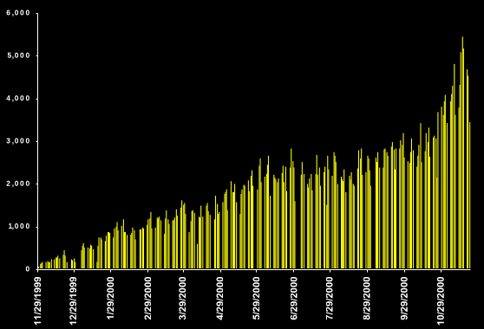
EnronOnline Transactions Per Day

Slide 34
Board Presentation
Financial Review
Market Position
Goal and Objectives
Market Snapshot
Regulatory Challenges

Slide 35
Regulatory Challenges
California Power Market Crisis
Price cap for parties selling into Cal ISO and Cal PX
FERC Order on Market Reforms
Class Action Lawsuit
FERC Order 2000 RTO Implementation
Scheduled completion Dec. 2001
Delays in Market Openings
Ontario Market still not committed to “date certain”
Significant Public Policy questions related to continued opening

Slide 36
Enron North America
Notes:
<number>
<footer>
<header>
<date/time>

