Slide 1
Account Implementation
Planning

Slide 2
Transition Timeline
Phases
Planning Transition Implementation
Timeline
Contract Signed
Services Commencement Date
Pre-Contract Schedule
Develop & Manage
Transition Support Schedule
Coordinate and Plan
Full Scope of Work
Execute Transition Plan
Designate Account
Manager
Manage Transition Schedule
Coordinate and Plan
Post Service
Commencement Date
Activities
Account Manager Handoff Completed
Execute Implementation Plan
Lessons Learned
Activities
Commodity
Bill Mgmt
Projects
O&M
Baseline
Other
Deliverables
Transition Plan
Implementation of Plan
Contract Execution & Compliance
1. Customer Presentation
2. District Designations
3. AM Costs
4. Internal Kick-off (Implementation Team)
5. Contract Signing
6. ATP Complete
7. AM “On Boarding”
8. Hand Off (Deal team to Transition Team)
9. Customer Kick-off
10. Service Commencement Date
11. Handover to AM
12. Business Plan
13. Continual Improvement Process
Key
Milestones

Slide 3
Transition Plan
Transition Plan agreed upon following the Effective Date
Ensure services are initiated by the Services Commencement date
The Plan details major tasks required by both Parties to initiate services according to the Transition Schedule
Goals of the Transition Plan are to:
Generate mutual understanding of priorities and processes for the implementation of services
Define the schedule and milestone dates required to accomplish them within a mutually agreeable time frame
Define and designate the appropriate resources to accomplish timely and cost effective execution of the agreement

Slide 4
Account Management
EES account management team is:
Responsible for execution
Responsible for delivery - consistent, effective, effective, efficient global platform
Responsible for total customer management and satisfaction
The single point of contact for our customer
Manages the relationship with the customer
Oversees all account & delivery activity to ensure contract compliance & performance

Slide 5
Metrics / Measurements

Slide 6
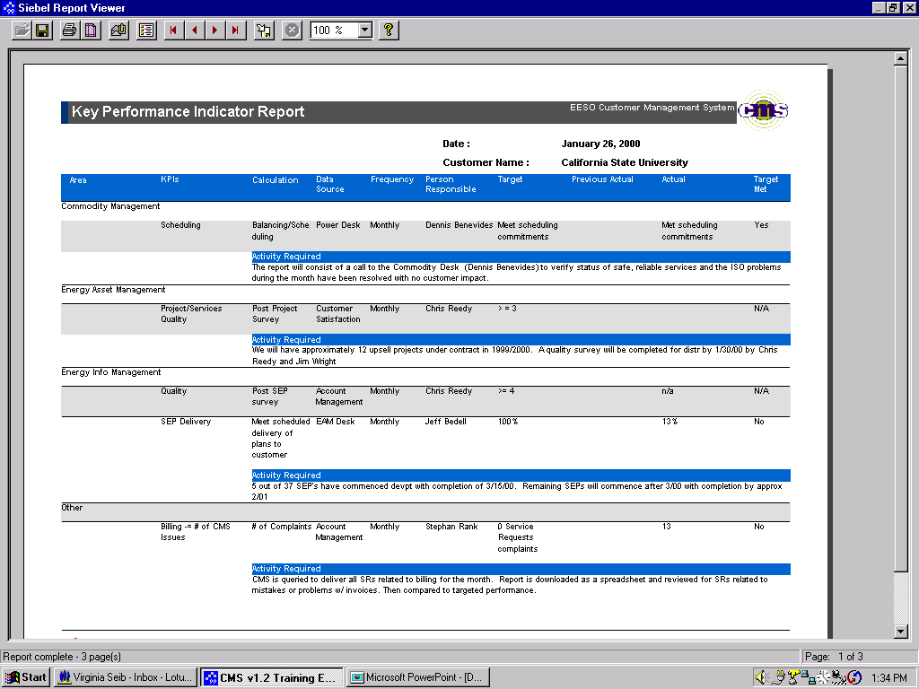
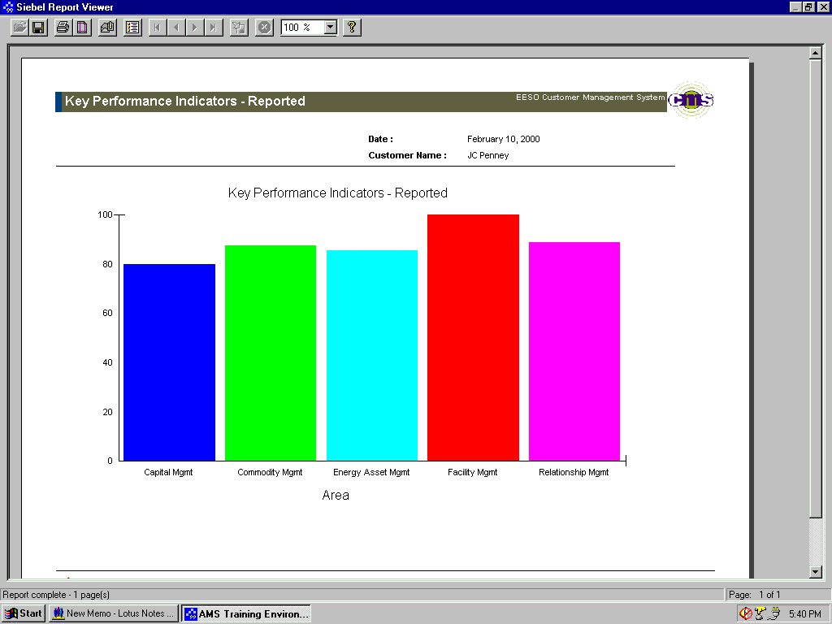
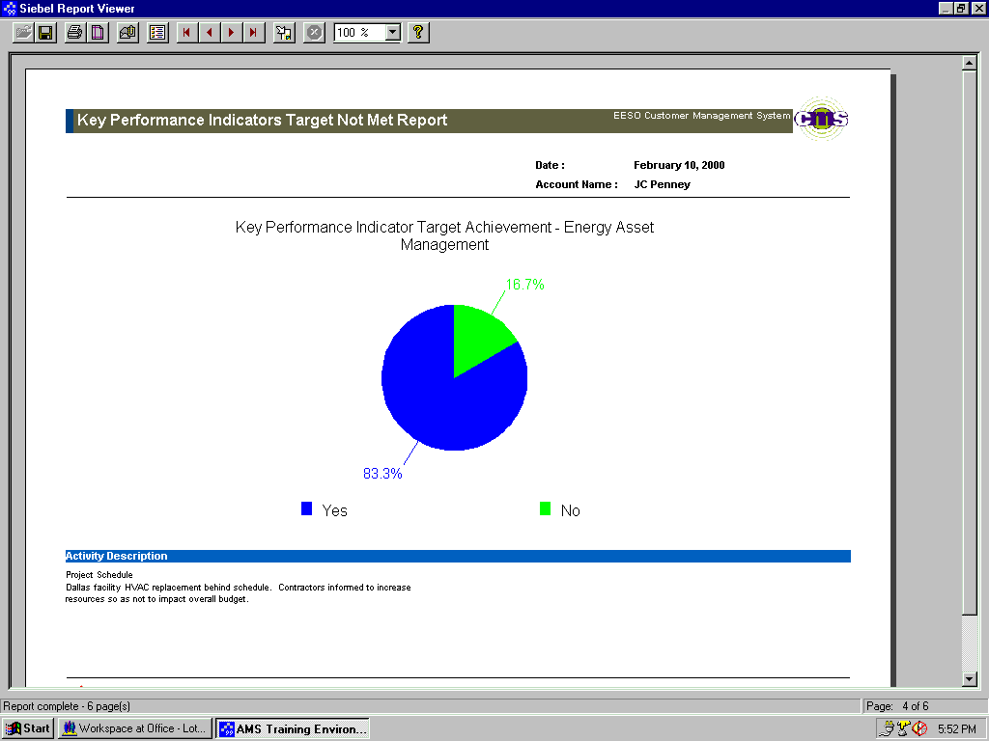

Performance Management Key Performance Indicators
To ensure internal performance, our Customer Management System provides an assessment of our delivery commitments and pre-established Key Performance Indicators by department.
<number>
<number>
Confidential and Proprietary Data

Slide 7
Customer Satisfaction Approach
Our Customer Satisfaction approach focuses on three areas: Performance, Relationship and Value.
Delivery Performance Measurement - KPIs
Ongoing customer assessment - Surveys, “Voice of the Customer”
Performance
Satisfaction
Value
Relationship
Pro-active Account Management - External Performance Management

