Slide 1
Introduction to Options: Pricing
P.V. Krishnarao
Enron Research Group
Bombay, India
15 Dec. 1998

Slide 2
Outline
What is an option premium?
Basic concepts in option valuation
The problem of risk preferences
Replicating portfolio and risk neutral valuation
Assumptions underlying Black - Scholes Equation
Black - Scholes - Merton formula
Yield/drift rate for futures
Black’s formula
Volatility: Historical, implied and some extensions

Slide 3
Terms
Option premium
Probability distribution
Risk neutrality
Black - Scholes equation
Black’s equation
Historical and implied volatility

Slide 4
What is an Option Premium?
It is money that the seller receives in payment for option
It is equal to the money the seller expects to have to pay
to the option buyer in a probabilistic sense
(Actually, the premium is more than that because the seller
wants to make a profit)

Slide 5
What is an Option Premium?
(An Alternative Interpretation)
Option premium should equal (or exceed) cost of hedging
incurred by seller
Hedging involves periodically buying and selling a fraction
of the underlying according to the option's “delta” (described
in section IV)
N.B. Hedging costs in this context does not mean transaction
costs

Slide 6
Calculating an Option Premium
To calculate a European option premium requires
two ingredients:
- Option pay-off structure
- Probability distribution of asset price at expiration date

Slide 7
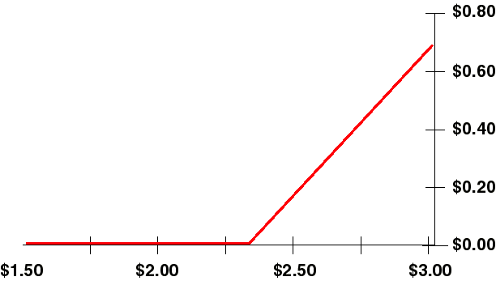
Calculating an Option Premium
(Continued)
Long Call option pay-off structure
Pay-off
(MMBtu)
Gas Price (/MMBtu)
Tells us what the option will pay to the holder at option expiration

Slide 8
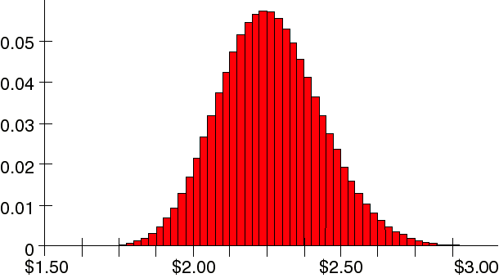
Calculating an Option Premium
(Continued)
Natural gas futures contract price probability distribution
Probability
Gas Price (/MMBtu)
Tells us how likely it is that the asset has a particular price at option expiration

Slide 9
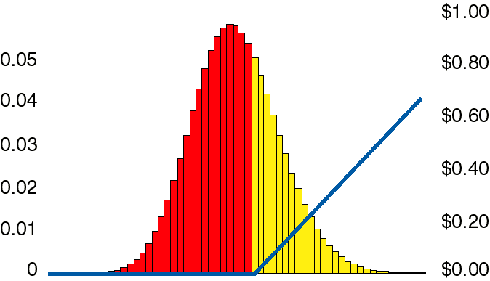
Calculating an Option Premium
(Continued)
Combining the two...
Probability
Pay-Off
Gas Price (/MMBtu)
Option Premium = ∑(Option Pay-off X Probability)

Slide 10
Calculating an Option Premium: Continued
In more formal terms:
- Option premium is expectation of option pay-off
Option premium = PV { E[ƒ(S,K)] }
where ƒ(S,K) = Max[S-K,0] for calls
and ƒ(S,K) = Max[K-S,0] for puts
Option Premium = PV {/0ƒ(S,K)•P(S)dS}
where P(S) is the probability density function

Slide 11
The Problem of Risk Preferences
Option premium is usually paid up-front, so it is the present
value of the expected pay-off at expiration
How is an option (or any other investment) Present Valued?
- Risk adjusted rate of return is normally used
- What is the risk of holding an option?
- This perplexed all of mankind until 1973, when Black
and Scholes published their famous paper

Slide 12
Risk Preferences
(Continued)
Black and Scholes (1973) showed:
- That there existed a riskless hedge between stock
option
and the underlying stock
- i.e. the option is riskless relative to stock
Cox and Ross (1976) showed:
- If everyone agrees on the shape of probability distribution
(i.e. the volatility), then everyone will calculate the same
option value regardless of their view of risk

Slide 13
Risk Preferences
(Continued)
Riskless hedge example
- Suppose a stock starts today at $20 and three months
from now will be either $25 or $15
- Note that we make no assumptions about probabilities
(i.e. rate of return)
$25
$20
$15

Slide 14
Risk Preferences
(Continued)
Consider also a call option with $20 strike and expiration
in three months
$5
$C
$0

Slide 15
Risk Preferences
(Continued)
Construct a portfolio by buying one share of stock and selling
two call options
What is the value of this portfolio in three months?
Terminal Stock Price: $15 $25
Value from Share: $15 $25
Value from Two Options: $0 -$10
Total Value of Portfolio $15 $15
Portfolio yields $15 regardless of terminal stock price
That is to say, the portfolio is riskless

Slide 16
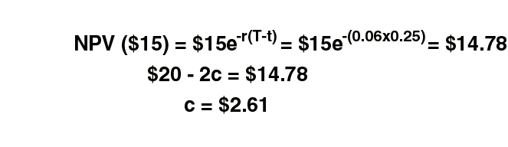
Risk Preferences
(Continued)
The portfolio will be worth $15 in three months
The portfolio costs today: $20 - 2c
Since the portfolio is riskless, expect to earn the risk free
rate on portfolio, so (assuming risk free rate is 6%):

Slide 17

Black - Scholes (-Merton) Equation
Assumptions
- Price movements can be described by Geometrical
Brownian motion
- What does this equation mean, and why do we assume
prices follow this equation?

Slide 18


Geometric Brownian Motion
an aside
First term
μ is the drift or rate of return
Prices can drift in a certain direction over time
The percentage return is independent of price level
Price
Time

Slide 19
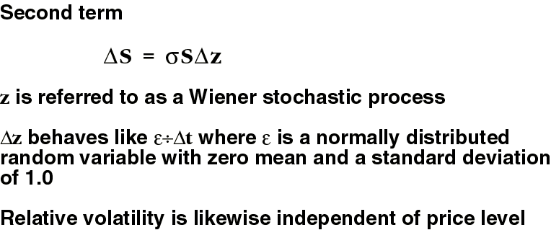
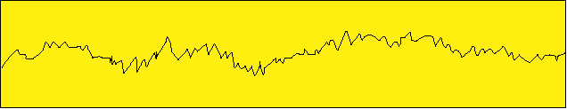
Geometric Brownian Motion
an aside
Price
Time

Slide 20
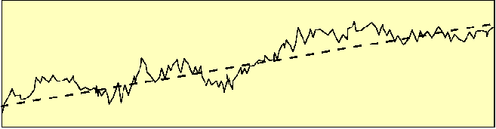
Geometric Brownian Motion
an aside
Combining the two terms:
Time

Slide 21
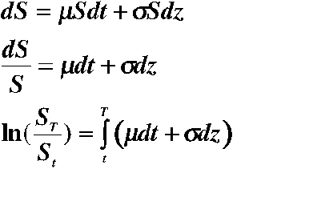
Geometric Brownian Motion
an aside
This equation implies that prices are log-normally distributed
N.B.! This is a stochastic integral, so don’t think you can integrate it like you learned in Math 101. For more info, I sugguest sections 9.2-9.4, 10.1, 10.2, of Hull’s book

Slide 22
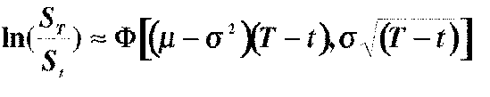

Geometric Brownian Motion
an aside
In fact,
Where denotes a normal distribution with mean m and
standard deviation s.

Slide 23
Assumptions
(Continued)
Assume that volatility is time independent
Assume risk neutrality (stock’s rate of return is equal
to risk free rate).
- This makes problem mathematically tractable
- If you believe Cox and Ross, it makes no difference
Frictionless, continuous markets
Ignore transaction costs
With all these assumptions, the integral for the option
premium can be solved analytically

Slide 24
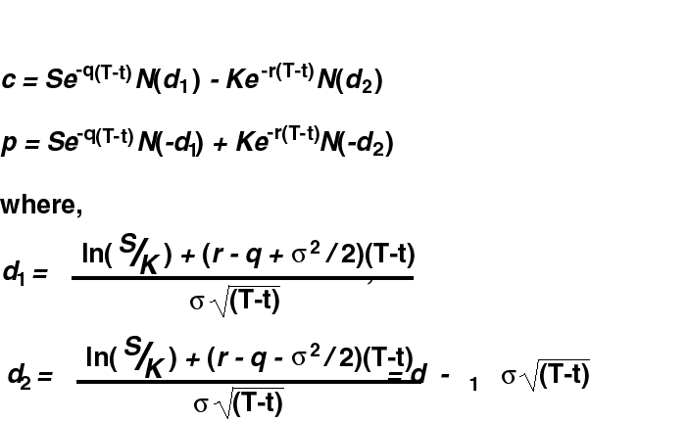
The Equation
European Calls and Puts on Stocks, Stock Indices,
Currencies, and Futures

Slide 25
The Equation
(Continued)
S is the asset price today at time t
K is the strike price of option
r is the annualized risk free interest rate
q is the annualized yield of asset
σ is the annualized volatility
(T - t) is the time to expiration in years. T is the date of
the option, and t is today’s date
N(.) is the cumulative normal distribution

Slide 26
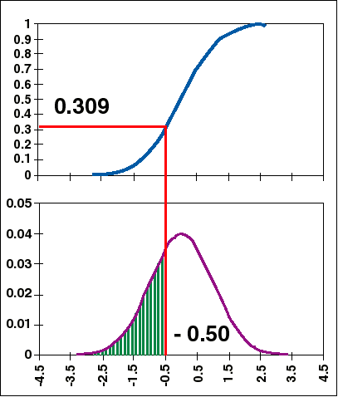
An Aside
The Cumulative Normal Distribution
The cumulative normal
distribution, N(x), measures
the probability that a
normally distributed
variable (mean=0, standard
deviation=1) will be less than
a given number x
e.g. N(-0.50) = 0.309

Slide 27
Some Comments
r - q corresponds to the drift or risk neutral rate of return
for the asset
- For an asset with no yield, the rate of return is simply
the risk free rate
- For an asset with a yield (e.g. a stock that pays dividends), we expect the asset price to appreciate at less than the risk free rate: r - q
- An asset with q = r does not appreciate; the asset price does not, on average, drift up or down over time

Slide 28
Comments
(Continued)
Options on Futures/Forwards
Recall that a forward contract is an agreement today to buy
a commodity in the future. The price is what you agree today
to pay for a commodity in the future
Therefore all time effects should already be reflected in the
price; we should not expect the price to drift either up or
down on average
Therefore a forward contract is an asset with r - q = 0

Slide 29
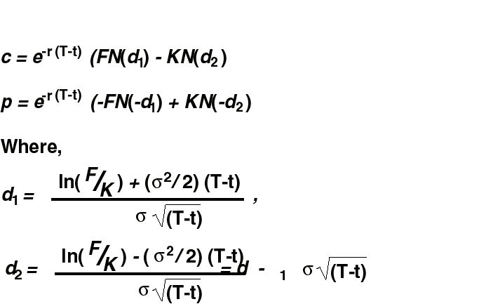
Black’s Equation
European Calls/Put Option on a Future/Forward
Contract

Slide 30
Volatility
Volatility is a measure of the uncertainty of future prices
Volatility is usually expressed as the annualized
standard deviation of the natural log of price returns
There are two classes of volatility estimates:
historical and implied

Slide 31
Historical Volatility
Historical volatility is price volatility observed over
some time period in the past
Historical volatility has dangers
- Past results are no guarantee of future performance
- Volatility may depend on which historical time
period you use
- Results may depend on time step between
observations (daily, weekly, monthly…).
This is the case because volatility is not
really a constant over time

Slide 32
Calculating Historical Volatility for Futures
Assume daily price stream
- Generate stream of natural log of daily returns
i.e. ln(P_{t}/P_{t}-1) for every day
- Take standard deviation
- Multiply by square root of number of days in year
(typically take 250 trading days per year)

Slide 33



Calculating Volatility
(Continued)
Why is this number the volatility?
- Recall that
where denotes a normal distribution with
mean m and standard deviation s

Slide 34

Calculating Volatility
(Continued)
It is usual to quote the annual volatility in the same way that it is usual to quote annual interest rates
If prices are weekly or monthly or whatever, then the
standard deviation must be normalized by the
appropriate factor:

Slide 35
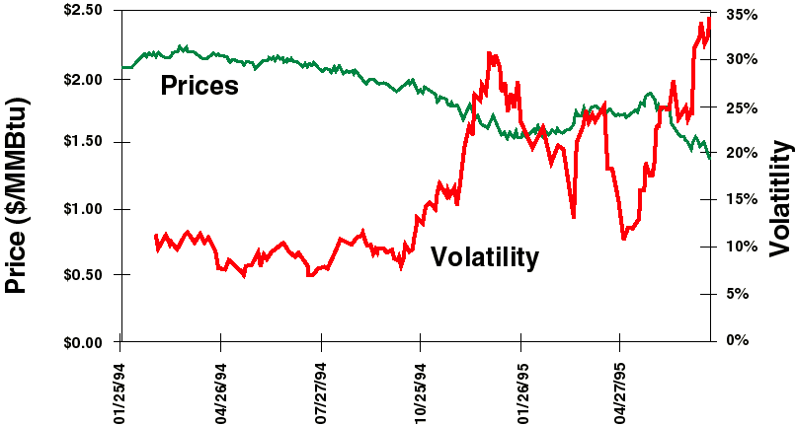
Aug. 95 NYMEX Gas Contract
Price and 21-Day Trailing Historical Volatility

Slide 36
Implied Volatility
Use Black-Scholes in reverse to get volatility
- Go to market to find the price of a
particular option.
- Because every input (price, strike, interest
rate, time to expiration) except volatility is
known, we can solve Black-Scholes using
different volatilities to determine which one
gives the observed price. This is the volatility
implied by the market price.

Slide 37
Risk Parameter Names
Names derived from Greek Alphabet
Symbol
Name
Delta
Gamma
Theta
Rho
Vega
Eta
Charm
Delta Vega
Sensitivity of
Premium
Delta
Premium
Premium
Premium
Premium
Delta
Delta
Sensitivity of
Underlying Price
Underlying Price
Time to Expiration
Interest Rate
Volatility
Correlation
Time to Expriation
Volatility

Slide 38
Delta Hedging
Delta is the option’s hedge ratio for constructing an
instantaneously riskless portfolio
Taking an option position and a “delta” position in the
underlying is called “delta hedging” or creating a “delta
neutral portfolio”
Delta hedging can be used for “synthetic replication” of
an option

Slide 39
Swaption Definition
Swap: Contract to exchange a floating price for a fixed price
for a specified period of time
Eg. Enron agrees to supply 10,000 MMBtu of natural gas per
day in 1996 at a fixed price of $1.50/MMBtu
A customer wants to lock in this price but is unsure if he
really needs the gas until Dec. 1995
Solution is to buy a swaption = the right to enter into a swap
Unlike a regular option, payoff is received not at expiration
but over the life of the swap

