Slide 1
Enron Wholesale Services

Slide 2
Enron Wholesale Services
Strong Execution in North America and Europe
  Leading Market Position in Every Commodity
  Most Valuable, Flexible Networks
  Sustainable Competitive Advantages
Actively Extending into New Markets and Industries
  Japan
  Crude and Products, Coal, Weather
  Metals, Pulp, Paper and Lumber, Steel and Credit
Leveraging New Technology Platforms to Accelerate Growth
  Regional Networks and New Commodities
Best Positioned Company for Long-Term Growth
  Sustainable Growth Opportunities in Every Market
Global Leader in Merchant Energy Services

Slide 3
Enron Wholesale Services
Regional Energy Networks
North America
Europe
Offices 11
Employees 2,730
Offices 18
Employees 1,520
Australia
Offices
Marketing Activity
Japan
Gas
Power
Global Markets
Crude & Products, Coal & Emissions, Weather, LNG
Industrial Markets
Pulp, Paper & Lumber, Metals, Steel
Global Assets
Asset Operations Worldwide
Enron Net Works

Slide 4
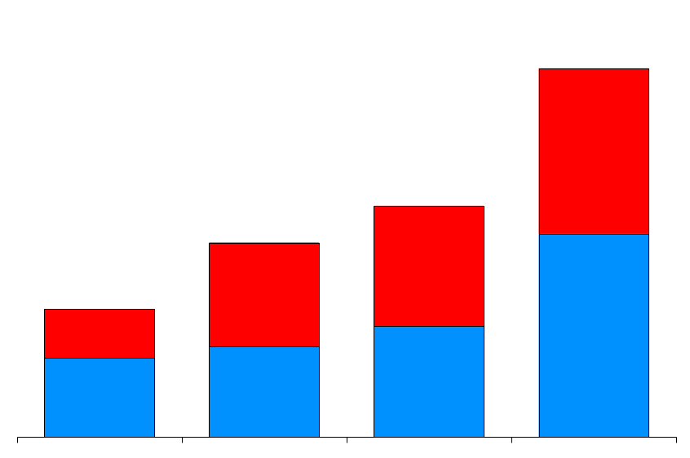
Wholesale Services
Physical Volumes
(BBtue/d)
Financial Settlements
(BBtue/d)
51,715
196,148
Power and Other
Gas
32,429
27,308
99,337
75,266
17,970
49,082
1997 1998 1999 2000
1997 1998 1999 2000

Slide 5
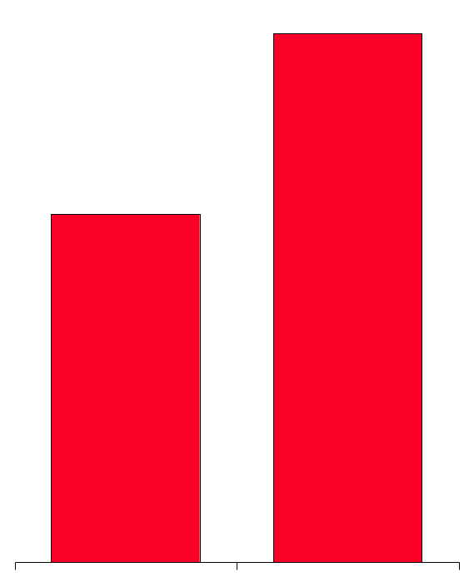
Volume Growth – North America
Natural Gas
(Bcf/d)
Power
(Millions MWh)
24.7
579
381
13.9
+77%
+52%
1999 2000
1999 2000

Slide 6
Volume Growth - Europe
U.K. Gas
(Bcf/d)
U.K. Power*
(Millions MWh)
Nordic Power*
(Millions MWh)
Continental Power
(Millions MWh)
3.1
113
77
46
1.5
53
31
7
107%
113%
148%
557%
1999 2000
1999 2000
1999 2000
1999 2000
*Financial and Physical Settled Volumes

Slide 7
Wholesale Services
Average Daily Transactions
8,000
7,900
EnronOnline
Traditional
6,000
4,000
2,000
650
0
Nov Dec Jan Feb Mar Apr May Jun Jul Aug Sep Oct Nov Dec
1999
2000

Slide 8
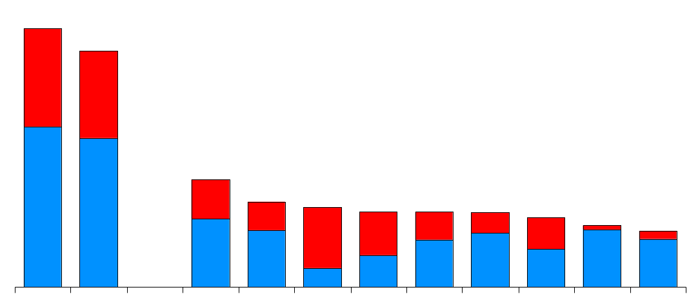
Domestic Energy Marketers
Enron’s Leading Market Position - 2000
(TBtue/d)
45.6
41.7
Power
Gas
19.2
15.0
14.1
13.3
13.2
13.1
12.3
10.9
9.9
Enron
FY00
Enron
Duke
Aquila
AEP
PG&E
Reliant
Dynegy
Southern
Coral
Sempra
3Q YTD
Source: Gas Daily, Power Markets Week, Oil Daily

Slide 9
International Energy Companies
Enron’s Leading Market Position
Natural Gas and Power
(TBtue/d)
45.6
13.0
12.3
11.5
10.6
8.9
8.2
7.5
6.3
Enron
BP Amoco
EdF
France
Exxon Mobil
RWE
Germany
Chevron
Royal
Dutch Shell
Tokyo
Electric
Japan
ENEL
Italy
Source: Company Reports, Enron Analysis

Slide 10
Wholesale Services
Income Before Interest and Taxes
(Millions)
Commodity Sales and Services
Assets and Investments
$2,260
$1,317
$968
$654
48%
36%
72%
1997 1998 1999 2000

Slide 11
Wholesale Market Dynamics
Fundamental Structural Changes in Energy Markets
  Tight Supply/Demand Balance
  High Prices, Increased Volatility
  Increasing Interdependence - Regionally and Across Commodities
Continuing Deregulation and Liberalization
  North America, Europe, Japan
  Customer Driven Demand for Flexible Services and Lower Prices
Old Economy Industries and Market Structures in Transition
Impact of Technology
Strong, Sustainable Growth Opportunities

Slide 12
Wholesale Merchant Opportunities
Enron’s Advantage
High Value Applications
Robust, Flexible Network
Scope and Scale
Liquidity
Market-Making
Risk Management
Technology
Finance
Commodity Risk Management
Benefits of Regional Arbitrage
Cross Commodity Arbitrage
Long-Term Origination
Wholesale Outsourcing
Asset Restructurings
Structured Finance
Enron’s Capabilities Enable Unique Value Creation

Slide 13


