Slide 1
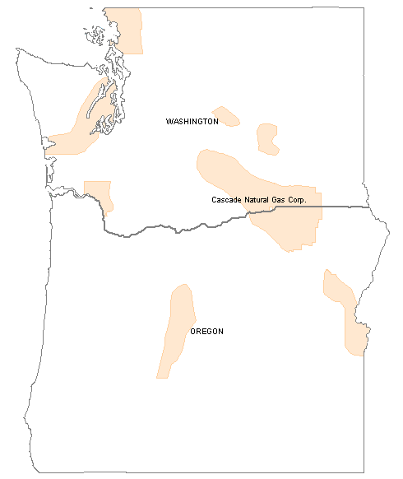
Attachment 1
Cascade Natural Gas
Service Territory
Cascade Service Territory

