Slide 1
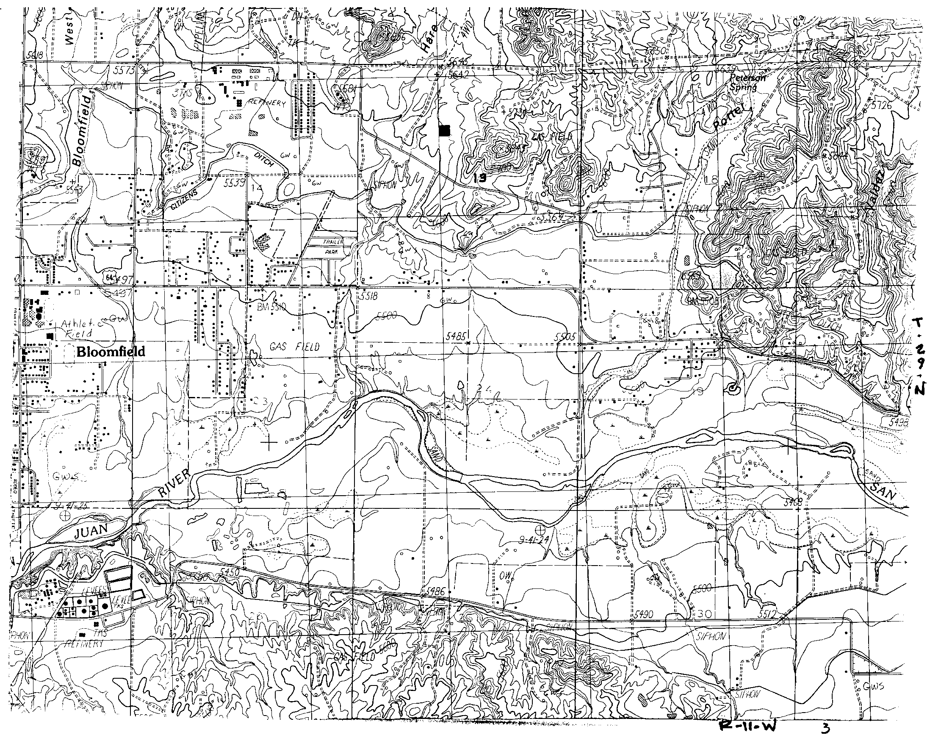
Bloomfield CS
0.75 Mi - 4”
Proposed
Amerimex
Energy Farm
Project
TRANSWESTERN
PIPELINE
COMPANY
HOUSTON, TEXAS
AMERIMEX BLOOMFIELD PROJECT
DETAIL MAP
Revised-06/00
Prepared by: Engineering Records

