Slide 1
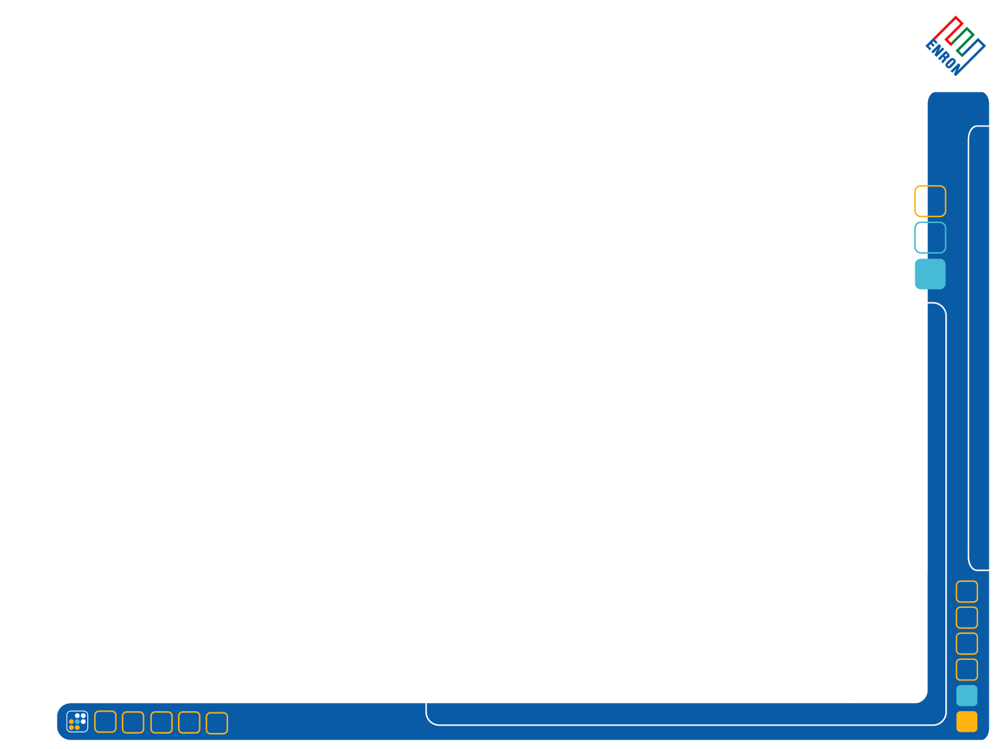





Strategic Alliance
Enron Energy Services
November, 2001

Slide 2
Strategic Alliance – Highlights
Enron at a Glance
The Program
The Rationale & Benefits
The Structure
Cooperative Implementation

Slide 3
Enron at a Glance
®
Enron
Transportation
Services
Enron
Energy
Services
Enron
Wholesale
Services
EES is Enron’s retail energy company and primary growth vehicle.
EES provides Commercial and Industrial customers with energy risk management products and services. National presence results in broad based experience.

Slide 4








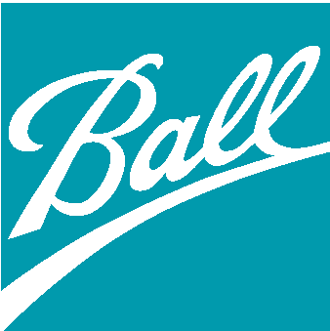

















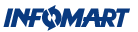









































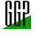









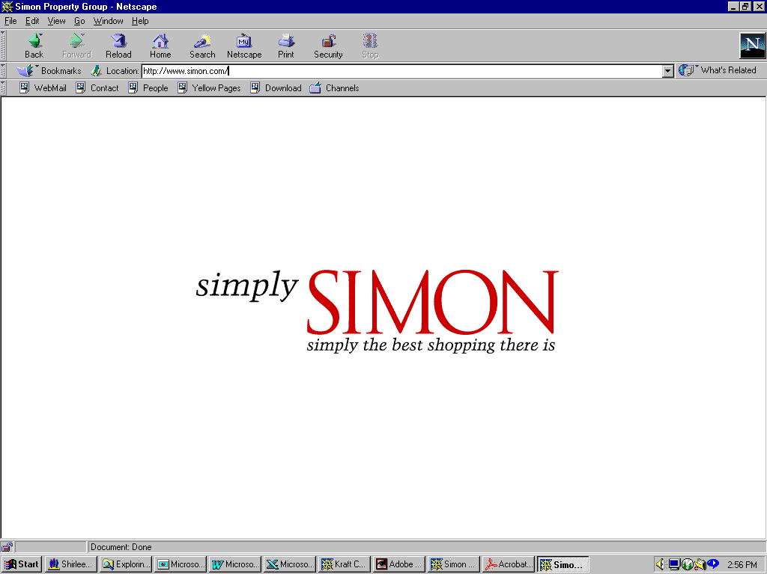


Enron at a Glance
A sample of customers who trust EES to manage their energy needs:
Industrial / Manufacturing
High Technology
Food Processing
REITs / Retail / Hotel
Sports
Financial
Public Sector/Institutions
Structure

Slide 5
The Program
Realize value of strategic alliance to leverage core strengths
Enable Anaheim to offer white branded innovative retail products and services to its customers with minimal effort and investment.
EES manages the price risk.
Risk Management commodity products
Reduce Cost
Demand Side Management Products
Manage Price Exposure
Capital Support
Improve Efficiency
Other products

Slide 6

The Rationale & Benefits
Combination of complimentary strengths permits alliance partner to leverage off of EES expertise and resources.
EES
Alliance Partner
Risk management expertise
Innovative commodity products
Demand side management solutions
National market knowledge
Access to capital
Distributed generation
Performance management systems
Technology
Customer relationship
Innovative customer focus
Marketing force
Local market knowledge
Generation
Brand name recognition
Brand name reputation

Slide 7
The Rationale & Benefits
Enhances value to customers through the delivery of innovative products and services
  Customer satisfaction and loyalty
  Responds effectively to customer demands
  Ensures Anaheim remains supplier through contract term
Provides economic value, risk management, and improved efficiency
Creates additional earnings opportunity if desired
Develops additional flexibility to respond to changing business and market environments
Promotes economic development
Reaffirms value of public power
Improves environment through improved efficiency

Slide 8
The Structure
Alliance
Agreements
Customer
Relationships/
Marketing
EES
e
Alliance
Partner
e
Alliance Partner
Customers
$
$
Physical or
Financial
Confirmations/
Billing & Settlements
Sales Contract/
Billing & Settlements
White Branded in Anaheim name

Slide 9
The Structure
Alliance Partner
EES
Customers
Transmission Distribution
Fixed Price Supply
Indexed Price Supply
Structured Supply
Financial Overlay
Rate Stability
Risk Reduction
Cost Management
Competitiveness
Customer Satisfaction
Customer Loyalty
+
Customer Relationship Management
=
DSM and Add’l Programs
and Services
Ancillaries
Load Following

Slide 10
The Structure
Example: Alliance Partner
Total Customers
Program can be made available to any and all customer classifications that Anaheim desires.
Program enhances current offerings by layering additional product offerings with no additional price risk, or only at the level of risk desired.
Program gives alliance partner the flexibility to adjust customer sales contract as desired:
  Upward price adjustment to enhance revenues
  Decrease price to ensure customer loyalty
  Adjust other terms (i.e. volume flexibility) as desired.
Customers desiring
fixed rate, structured,
Or DSM products
Customers remaining
On existing program

Slide 11
The Structure
Alliance partner and EES partner to enable Anaheim to offer innovative products to customers without price risk
Alliance partner retains customers and maintains customer relationships
EES supplies physical or financial products and services, thus managing price risk
Alliance partner brands the products--customers never see EES
Under alliance, EES is sole supplier for program

Slide 12
Cooperative Implementation
Assessment of market characteristics, interest, and value
Define alliance structure and responsibilities
Develop products and services to be offered
Develop marketing plan
    Markets
      Mass market approach for small and medium businesses
      Customized approach for larger customers
    Timing
    Channels
EES provides support
    Commodity/DSM training to Alliance partner marketing staff
    Pricing/reporting/contract assistance
    Marketing materials
Review and enhance program

