Slide 1
Enron Americas
Notes:
<number>
<footer>
<header>
<date/time>

Slide 2
Agenda
Business Strategy & Financial Results

Slide 3
Business Strategy
GOALS are to expand and enhance our capabilities in:
Accomplishing these goals leads to:
1. TALENT
Recruit and retain the best talent

Slide 4
Enron North America Commercial Headcount
2
54
109
81
111
357
3
48
98
101
120
370
9
56
139
155
113
472
8
41
104
103
174
433
Managing Directors
Vice Presidents
Directors
Managers
Analysts & Associates
TOTAL
1998
1999
2000
2001

Slide 5
Business Strategy
GOALS are to expand and enhance our capabilities in:
Accomplishing these goals leads to:
TALENT
POSITION TAKING
Recruit and retain the best talent
INFORMATION
    Deal Flow and Capture
    Outsourcing Transactions
    Market Maker
STRUCTURED
TRANSACTIONS
LIQUIDITY

Slide 6
Enron North America Gas Transactions Per Day
Non EOL
EOL
1997
1998
1999
2000
2001
Notes:
<number>
<footer>
<header>
<date/time>

Slide 7
Enron North America Power Transactions Per Day
Non EOL
EOL
1997
1998
1999
2000
2001
Notes:
<number>
<footer>
<header>
<date/time>

Slide 8
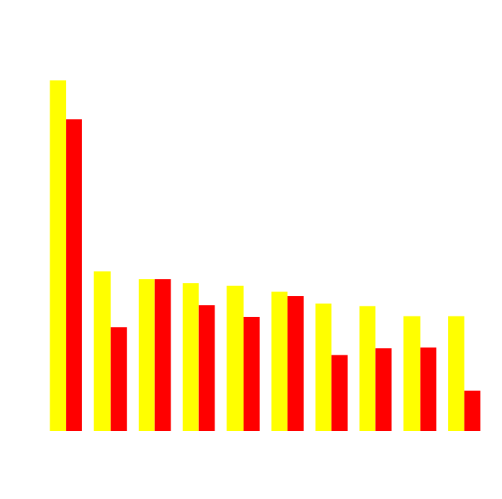
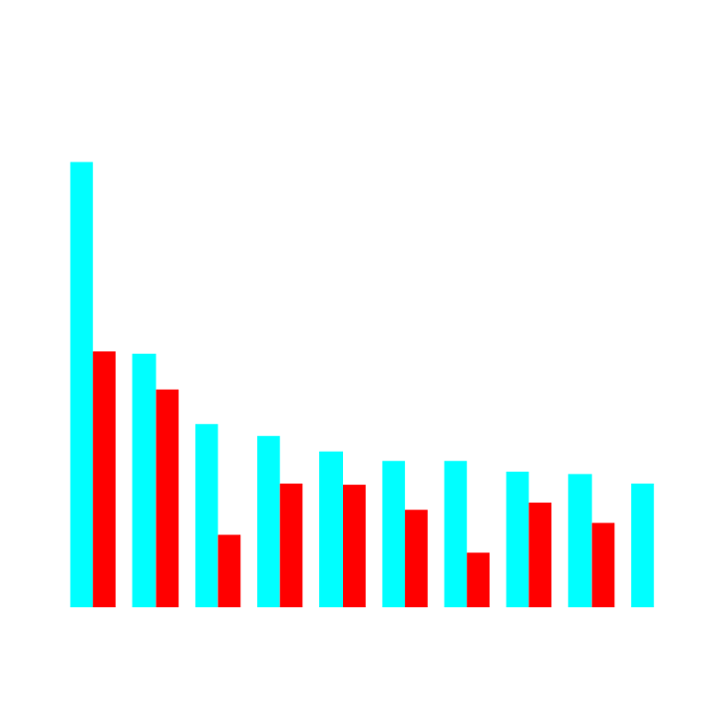
Enron’s Leading Market Position
Second Quarter 2000 vs Second Quarter 2001
(TBtue/d)
Gas Power
2Q01
2Q00
2Q01
2Q00
Notes:
<number>
<footer>
<header>
<date/time>

Slide 9
Enron North America Volumes
(Bbtue/d)
Volumes
in ‘000s
Financial
Physical
Physical Power
Margin
Margin
$ in MM
1995 1996 1997
1998
1999
2000
2001

Slide 10
Enron North America EBIT Without Reductions
($ in millions)
3,843
Reserve
2,220

Slide 11
Enron Americas
Notes:
<number>
<footer>
<header>
<date/time>

Slide 12
Business Principles
Goals are to expand and enhance our capabilities in:
    RECRUIT AND RETAIN THE BEST TALENT
    CONSTANTLY EXPAND LIQUIDITY - PRODUCTS AND LOCATIONS
    BE THE LEADING MARKET MAKER
    COVER ALL THE WHOLESALE CUSTOMERS TO ENSURE SIZEABLE DEAL FLOW
    CONTINUALLY EXPAND OUR OUTSOURCING RELATIONSHIPS
    CREATE A WORLD CLASS INTERNAL RESEARCH CAPABILITY
ACCOMPLISHING THESE GOALS LEADS TO:
    THE ABILITY TO IDENTIFY AND EXECUTE HIGHLY STRUCTURED TRANSACTIONS
    THE ABILITY TO SUCCESSFULLY TAKE POSITIONS ON MARKET DIRECTION

