Slide 1
Enron
CONFIDENTIAL Government and Regulatory Affairs India Country Profile

Slide 2
Contents (1)
1. Country Overview 3
Demographics 4
People 5
Economy 6 - 8
Government 9 - 12
2. Energy Overview 13
Power 14 - 28
Coal 29 - 34
Natural Gas 35 - 39
Refining 40 - 49
3. Environmental Overview 50 - 51
4. Transportation Overview 52 - 53
5. Telecommunication Overview 54 - 65

Slide 3
Country Overview

Slide 4
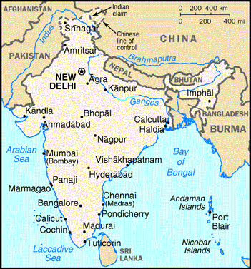
India - Geography
Independence : August 15, 1947 (from UK)
Location: Southern Asia, between Pakistan & Burma
Total Area - 3,287,590 sq. km (90% land & 10% water)
Boundaries - Total 14, 103 km out of which with
Pakistan - 2,912 km; China - 3, 380 km;
Nepal - 1,690 km; Bhutan - 605 km;
Burma - 1,463 km; Bangladesh - 4,053 km.
Coastline - 7,000 kms.
Highest point - Kanchenjunga (8,598m)
Irrigated Land - 480,000 sq..km (1993 estimates)
Defence - Army (980,000); Air Force(110,000); Navy (55,000); Jammu/Kashmir Security Force (185,000)
Climate - Varies from tropical monsoon in South to temperate in North.
Terrain - Upland plain (Deccan Plateau) in South, flat to rolling plain along the Ganges,
deserts in the West and Himalayas in the North.
Major Cities : New Delhi (Capital); Mumbai; Calcutta; Chennai, Hyderabad; Bangalore, Ahmedabad.
Natural resources - coal (4th largest reserves in the world), iron ore, manganese, mica , bauxite,
titanium ore, chromite, natural gas, diamonds, petroleum, limestone.

Slide 5
India - People
Population : 1 Billion plus ( July 1999 est.) with a growth rate of 1.68% (1999 est.)
Age Structure : 0 - 14 yrs is 34%; 15 - 64 years is 61%; 65 years and above is 5%
Birth/Death rate : 25.39 births and 8.5 deaths per 1,000 population (1999 est.)
Infant mortality rate : 60.81 deaths/1,000 live births (1999 est.)
Total fertility rate : 3.18 children born/women (1999 est.)
Ethnic groups : Indo-Aryan 72%, Dravidian 25%, Mongoloid and other 3%
Religions : Hindu 80%, Muslim 14%, Christian 2.4%, Sikh 2%, Buddhist 0.7%, Jains 0.5%, other 0.4%
Languages : English enjoys associate status but is the most important language for national,
political and commercial communication. Hindi is the national language and primary
tongue of 30% of the people. Other official languages are Bengali, Telugu, Marathi,
Tamil, Urdu, Gujarati, Malayalam, Kannada, Oriya, Punjabi, Assamese, Kashmiri,
Sindhi, Sanskrit and Hindustani (a popular variant of Hindi/Urdu spoken widely
throughout northern India). Also, there are numerous other languages and dialects
spoken by millions of other people in India.
Literacy : Defined as persons with age 15 and above who can read and write. Out of the total
population 52% are literate of which male is 65.5% and female 37.7% (1995 est.)

Slide 6
India - Economy Outlook
There were 3 distinct developments that had a bearing on the domestic economic situation in 1999-2000, namely,
The Kargil War with Pakistan in May 1999 which lasted for about 2 months.
Continuation of the Economic sanctions imposed by US, Japan and other western countries, following the Nuclear tests in May 1998.
Increase in International Oil Prices inflated the Oil Import Bill.
The stress in the finances of the Central Government during 1999-2000 was partly due to -
Unanticipated expenditures on account of national defense.
The unprecedented cyclone in Orissa.
The residual impact of the 5th Pay Commission along with the provision of special fiscal assistance to States in the Light of the 11th Finance Commission’s recommendations.
The overall expenditure (revised estimates), as a result, exceeded the budget estimates by 7%.

Slide 7
India - Macroeconomic Indicators (1)
Item 1999-2000
Real GDP (% change) 6.4 %
Rise in Index of Industrial Production 8.1%
Food grains production (million tonnes) 205.9
Foreign Exchange Reserves as on June 2000 36. 37 US $ billion
(out of which, SDRs is $ 8 mn; Gold is $ 2.948 bn & rest is Foreign Currency assets)
Exchange Rate (USD / INR) 43.64/42.44 (as of 10/2000)
Exports (fob) 38.285 US $ bn
Imports (CIF) 55.383 US $ bn
Trade Balance (17.098) US $ bn
Current Account Balance (4.163) US $ bn
Capital Account 10.242 US $ bn
Overall Balance 6.402 US $ bn
(same as monetary movements I.e. IMF net & Reserves and monetary Gold)
Central Government Revenue deficit in Rs. crores 73, 532 crores

Slide 8
India - Macroeconomic Indicators (2)
GDP Composition by sector
Agriculture & Allied activities 25.5 %
Manufacturing & other Industry 22.2 %
Services 52.3 %
Population below poverty line : 35% (1994 est.)
Labor force by occupation: agriculture 67%; services 18%; industry 15% (1995 est.)
Industries - Textiles, chemicals, food processing, steel, transportation equipment, cement, mining, petroleum, machinery
Agriculture products - rice, wheat, oilseed, cotton, jute, tea, sugarcane, potatoes.
Export commodities - textile goods, gems and jewelry, engineering goods, chemicals, leather manufacture
Export Partners - USA 19%; Hong Kong, UK 6%; Japan 5%; Germany 5%(1997)
Import commodities - crude oil, machinery, gems, fertilizer, chemicals
Import Partners - USA 10%; Belgium, UK,Germany 7%; Saudi Arabia, Japan 6% (1997)
External Debt - US $ 93 billion (1998)

Slide 9
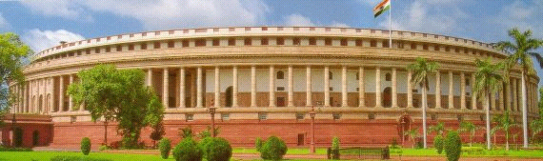
India - Government (1)
Federal Republic Government type with a bicameral Parliament or Sansad consisting of the President and the two Houses - the Council of States and the House of the People.
Independence from UK on August 15, 1947 and Constitution came into force on January 26, 1950 with New Delhi as the Capital of the country.
Suffrage - 18 years of age; universal.
While the two houses continue to be recognized by these names in the Constitution, they are in actual practice known respectively as the Rajya Sabha & Lok Sabha.

Slide 10
India - Government (2)
The Rajya Sabha
Maximum strength of the Rajya Sabha is 250, out of which 238 members are representatives of the States and Union Territories and 12 members are nominated by the President. The members nominated by the President are persons having special knowledge or practical experience in respect of such matters as literature, science, art & social service.
The representatives of State are elected by the elected members of the Legislative assemblies of the respective states in accordance with the system of proportional representation by means of a single transferable vote.
The representatives of the Union Territories (UTs) are chosen in a manner as Parliament may by law prescribe.

Slide 11
India - Government (3)
The Lok Sabha
Members (qualifying age-25) chosen by direct election on the basis of adult suffrage.
Max. strength to be up to 530 from the States; up to 20 from the UTs and not more than 2 members of the Anglo-Indian community to be nominated by the President, if in his opinion, that community is not adequately represented in the House.
Total elective membership is distributed among the States in such a way that the ratio between the number of seats allotted to each State and the population of the State is, so far as practicable, the same for all States.
Lok Sabha, unless sooner dissolved, continues for 5 years from the date appointed for its first meeting and the expiration of the period of 5 years.
In case of Emergency, this period can be extended by 1 year at a time, and not extending beyond 6 months from the cease of Emergency as the Parliament states.
Conduct of Business is the responsibility of the Speaker & Deputy Speaker, who are elected amongst the members of the Lok Sabha.
The 13th Lok Sabha has 27 Cabinet Ministers; 6 Ministers of State with Independent Charge and 38 Ministers of State.

Slide 12
India - Government (4)
Chief of State - President Kicheril Raman Narayanan (since July 25, 1997); Vice-President Krishnan Kant (since August 21, 1997)
Head of Government - Prime Minister Atal Behari Vaipayee
Cabinet - Council of Ministers appointed by the President on the recommendations of the Prime Minister
Elections - President elected by an electoral college consisting of elected members of both houses of Parliament and the Legislatures of the states for a 5 year term; Vice President elected by both houses of the Parliament and the Prime Minister elected by parliamentary members of the majority party following legislative elections
Judicial Branch - Supreme Court, judges are appointed by the President and remain in office until they reach the age of 65.
Legal System - based on English Common law ; limited judicial review of legislative acts; accepts compulsory ICJ jurisdiction, with reservations.
Administrative Divisions - 25 States and 7 Union Territories.
Flag Description - 3 equal horizontal bands of orange(top), white, and green with a blue chakra (24-spoked wheel).

Slide 13
Energy Overview

Slide 14
Energy - Power (1)
Electricity is a concurrent subject at Entry 38 in List III of the Seventh Schedule of the Constitution of India.
Ministry of Power (MOP) started functioning independently with effect from July 2, 1992. Earlier it was known as the Ministry of Energy comprising the Dept. of Power, Coal and non-conventional energy sources.
MOP is primarily responsible for the development of electrical energy in the country and administration of the Indian Electricity Act, 1910; the Electricity Supply Act 1948; and the Electricity Regulatory Commission Act, 1998.
In all technical and economic matters, MOP is assisted by the CEA.
Organizations under MOP are -
Badarpur Management Contract Cell between GOI and NTPC .
NTPC, NHPC, NEEPCO and PGCIL for the construction and operation of generation and transmission projects in the Central Sector.
Naphtha Jhakri Power Corp. (NJPC) & Tehri Hydro Development Corp. (THDC).
Statutory bodies like Damodar Valley Corp(DVC)&Bhakra Beas Mgmt Board(BBMB)
REC for to rural electrification & PFC for term finance to power sector.
Training Institutes like, CPRI, NPTI and Energy Management Center (EMC).

Slide 15
Energy - Power (2)
Organizational set-up of MOP is:
Suresh Prabhu is the Minister for Power & Smt. Jayawanti Mehta is the Minister of State of Power.
A K Basu is the Secretary (Power). He is assisted by a Special Secretary, Additional Secretary and 5 joint Secretaries, including the financial Adviser.
There are 5 wings in the MOP, each headed by a Additional/Joint Secretary. These are
Transmission and Energy Conservation
Hydel, Reforms & Restructuring
Administration; Co-ordination; Operations Monitoring; Thermal
Internal Finance
Investment Promotion Cell, Power Finance Corporation, Power Trading
Corporation & Rural Electrification Corporation
Policy & Planning, External Assist., Training & Research & Vigilance & security
There is a Principal Accounts Office headed by Controller of Accounts who in turn reports to Financial Adviser in MOP.
Total Staff strength of the Ministry is 313.

Slide 16
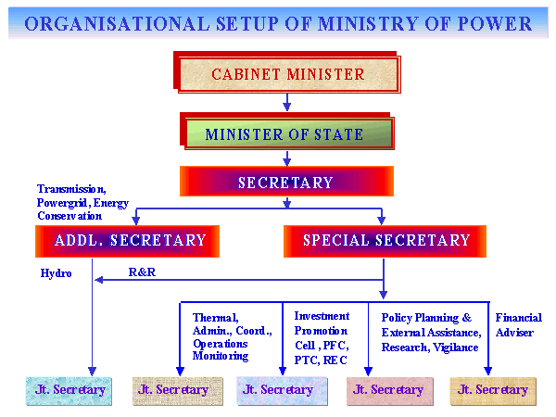
Energy - Power (3)

Slide 17
Energy - Power (4)
Central Electricity Authority (CEA)
Is a statutory body constituted by the Central Government under Sec 3 of the Electricity (Supply) Act, 1948. The CEA is charged with the responsibilities to develop a sound, adequate and uniform National Policy in relation to the control and utilization of national power resources. It conducts the Techno-economic appraisal of the project reports in respect of setting up of generating stations in the country and issues TEC for projects.
State Electricity Boards (SEBs)
The SEBs are constituted by the respective State Governments under the Electricity (Supply) Act, 1948. SEBs generate, transmit and distribute electricity in coordination with the generating company(ies), if any, operating in the State and with the Central Government or any other Board or agency having control over a power system; transmission and distribution of electricity within the State; and exercise control in relation to generation, distribution and utilization of electricity within the State.
Licensee
A Licensee is one who has been granted a license by the State Government, in consultation with the SEB, to supply energy in any specified area, under Section 3 of the Indian Electricity Act, 1910 and governed by the Electricity (Supply) Act, 1948.

Slide 18
Energy - Power (5)
Generating Company
Generating Company, as set up under Section 15A of the Electricity (Supply) Act, 1948 and governed by the relevant sections of the said Act.
Central Electricity Regulatory Commission (CERC)
CERC is a statutory body formed under the Electricity Regulatory Commission Act, 1998. The main functions of the CERC are to regulate the tariff of generating companies by the GOI; to regulate tariffs of generating companies other than those owned by GOI, if such generating companies enter into or otherwise have a composite scheme for generation and sale of electricity in more than one State; to regulate the inter-State transmission of energy including tariff of the transmission utilities; to regulate inter-State bulk sale of power and to aid & advise the GOI in formulation of tariff policy. More details at - www.cercind.org
State Electricity Regulatory Commission (SERC)
As per Section 17(1) of the Electricity Regulatory Commission Act, 1998, the State Government may, if it deems fit, establish an SERC for the State. The main functions of the SERC would be to determine the tariff for electricity, wholesale, bulk, grid or retail; determine tariff payable by transmission facilities; regulate power purchase & procurement process of transmission utilities; to promote competition, efficiency & economy in the electricity industry in the State.

Slide 19
Energy - Power (6)
National Thermal Power Corporation (NTPC)
NTPC was set up in 1975, as a Central sector generating company for the development of the thermal sector. It has to its credit 12 coal based plants and 7 oil/gas based combined cycle projects, totaling 16, 910 MW. NTPC also manages the Badarpur Thermal Power Station in Delhi (705 MW) and Balcos captive power station (270MW) near Korba, Madhya Pradesh, which was also constructed by NTPC. More details at - www.ntpc.co.in
National Hydroelectric Power Corporation (NHPC)
NHPC was set up in 1975, to harness the vast hydro, tidal and wind potential of the country to produce cheap/pollution free power covering all aspects of planning, designs, construction, operation and maintenance of hydroelectric, tidal and wind power projects. More details at - www.nhpcindia.com
North Eastern Electric Power Corporation (NEEPCO)
NEEPCO was set up in 1976 with the objective of developing the large power potential of the North Eastern region of the country through planned development of the region. At present, NEEPCO is contributing 625 MW out of a total installed capacity of 1649 MW in the region. More details at - www.neepco.com

Slide 20
Energy - Power (7)
Rural Electrification Corporation (REC)
REC was set up in 1969 with the primary objective of providing financial assistance for rural electrification in the country. REC programs cover electrification of villages, including tribal villages and Dalit Bastis, energisation of pumpsets, provision of power for small agro based and rural industries, lighting of rural households and street lighting. More details at - www.rec.nic.in
Power Finance Corporation (PFC)
PFC was set up on July 10, 1986 as the prime lender of funds to SEBs, state generation corporations, municipal run utilities besides the central and private sector power projects. The funds provided by PFC are in the nature of the additionality to Plan Allocation (in respect of SEBs etc.) and based on the merits of the individual projects. More details at - www.pfcindia.com
Power Grid Corporation of India (PGCIL)
PGCIL was set up in 1989 with the mandate to establish and operate regional and national power grids to facilitate transfer of power within and across the regions with reliability, security and economy on sound commercial principles. PGCIL operates over 31,000 ckt kms of AC transmission lines comprising 400 kv, 220 kv, 132 kv and 28,000 MVA of HVDC lines distributed over 55 substations and maintained at a persistent level of over 98% availability. More details at - www.powergridindia.com

Slide 21
Energy - Power (8)
Tehri Hydro Development Corporation (THDC)
THDC was set up in 1988 to plan, promote, organize, execute, operate and maintain hydro power projects(HPP) in Bhagirathi-Bhilangan Valley in Uttar Pradesh(UP) as a JV between GOI and GOUP, both sharing the cost of power component (20% of Stage I cost) of the project in the ratio of 3:1. The irrigation component is to be funded entirely by the GOUP. THDC complex comprises of 1000 MW Tehri dam and HPT (Stage -I), the 1000 MW pump storage plant and the 400 MW Koteshwar Dam and HPP.
Nathpa Jhakri Power Corporation (NJPC)
NJPC was set up in 1988 to plan, promote, organize, execute, operate and maintain hydro power projects(HPP) in Satluj river basin in Himachal Pradesh(HP) as a JV between GOI and GOHP, both sharing the equity of the project in the ratio of 1:3. NJPC is executing the project, which will generate 6700 MUs of electrical energy and provide 1500 MW of valuable peaking power to Northern Grid.
Nathpa Jhakri Power Corporation (NJPC)
DVC was set up in 1948 with the objective of - flood control; irrigation and water supply for industrial & domestic use; generation, transmission & distribution of electrical energy; promotion of afforestation and control of soil erosion. DVCs area extends 24, 325 sq. kms & covers 7 districts of Bihar and 5 of W.Bengal. It has constructed 4 multipurpose dams at Tilaya, Konar, Maithon and Panchet and an irrigation system comprising a barrage on river Damodar at Durgapur and a canal system of 2459 km. It has also built 5 thermal plants of capacity 2525 MW.

Slide 22
Energy - Power (9)
Bhakra Beas Management Board (BBMB)
BBMB was constituted under Sec 79 of the Punjab Re-organization Act, 1966 for the administration and operation of Bhakra Nangal Project w.e.f. Oct 1, 1967. The Beas project works, on completion, were transferred by the GOI from Beas Construction Board (BCB) to BMB as per Sec 80 of the Act, 1966 and the BMB was renamed as BBMB w.e.f May 15, 1976. BBMB manages the facilities created for harnessing the waters impounded at Bhakra and Pong in addition to those diverted at Pandoh through the BSL Water Conductor System. It was also assigned the responsibility of delivering water and power to the beneficiary States in accordance with their due/entitled shares. BBMB is responsible for the administration, maintenance and operation works at Bhakra Nangal Project, Beas Project Unit I & II including power houses and a network of transmission lines and grid sub-stations. The total installed capacity of BBMB power houses is 2793.65 MW.
Central Power Research Institute (CPRI)
CPRI was established in Bangalore in 1960 and made autonomous in 1978. Main Objective is to serve as a national laboratory for undertaking applied research in electric power engineering besides functioning as an independent national testing and certification authority for electrical equipment and components to ensure reliability and improve, innovate & develop new products

Slide 23
Energy - Power (10)
National Power Training Institute (NPTI)
NPTI with headquarters at Faridabad, Haryana, has been set up by GOI to function as the national apex body for the Human Resources Development of Power Sector personnel in India. It operates on an all-India basis through its 4 Regional Power Training Institutes located at Neyvelli (Tamil Nadu), Durgapur (West Bengal), Badarpur (New Delhi) and Nagpur (Maharashtra). The training institute at Badarpur is equipped with a computer-based, full scope replica simulator of 210 MW Fossil Fuel thermal power plant.
Energy Management Center (EMC)
EMC was set up in April 1989, as an autonomous organization under MOP and in collaboration with European Community to strengthen the energy management capabilities in the country. It serves as an executive agency of Ministry of Power. EMC also helps in formulation of policy and designing of program on energy conservation and serves as a nodal point at the central level for monitoring and coordinating of energy conservation activities in the country.

Slide 24
Energy - SEB Profile

Slide 25
Energy - SEB Profile

Slide 26
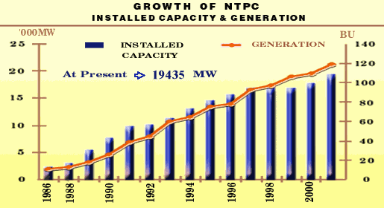
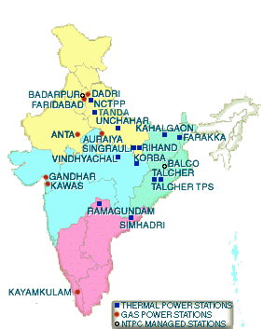
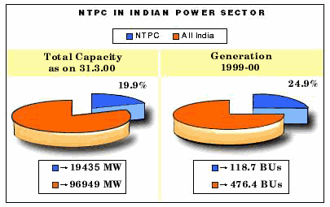
Energy - NTPC

Slide 27
Energy - NTPC Projects

Slide 28
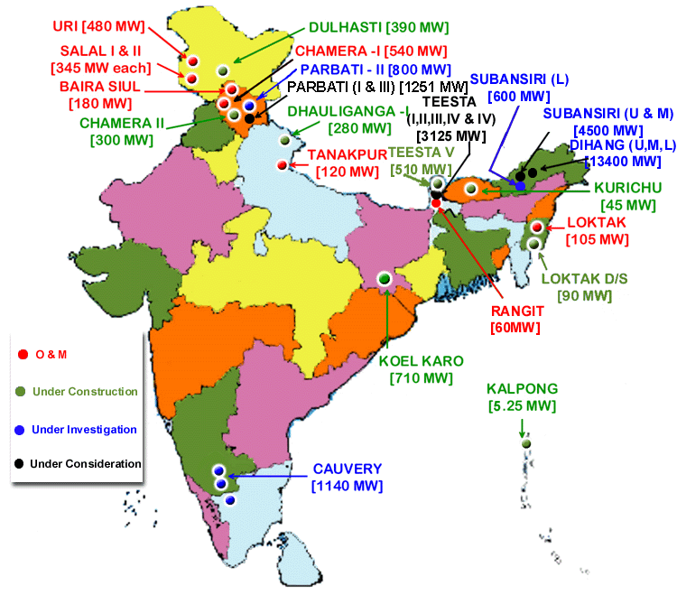
Energy - NHPC Projects

Slide 29
Energy - Coal (1)
The Department of Coal has the overall responsibility of determining policies and strategies in respect of exploration and development of coal & lignite reserves, sanctioning of important projects of high value, and for deciding related issues.
These key functions are exercised through Coal India Ltd. (CIL) and its 8 subsidiaries and the Neyvelli Lignite Corporation Ltd.
The coal reserves of India, upto a depth of 1200m, have been estimated by the Geological Survey of India as 211,593.61 million tonnes as on 1.1.2000.
Lignite reserves have been estimated at 30,300 million tonnes, most of which is in Tamil Nadu and partly in Rajasthan, Gujarat, Kerala, Jammu & Kashmir and Union Territory of Pondicherry.
Coal production achieved during the year 1999-2000 (up to Dec. 1999) has been 208.18 mn tonnes and about 86% of the total coal production of the country comes from the collieries of CIL.
The Coal Mines (Nationalization) Act, 1973 was amended on 9.6.93 to allow coal for captive consumption for generation of power, washing of coal and allow production of cement as an end use for captive mining of coal.
105 captive mining blocks in the CIL areas with a reserve of 27,563 mn tonnes have been identified & offered to nearly 20 parties in the private & public sector.

Slide 30
Energy - Coal (2)
Coal India Limited (CIL)
In Sept, 1975 CIL was formed as a holding company with 8 subsidiaries namely, Bharat Coking Coal Ltd. (BCCL); Central Coalfields Ltd. (CCL); Eastern Coalfields Ltd. (ECL); Western Coalfields LTD (WCL); South Eastern Coalfields Ltd. (SECL); Northern Coalfields Ltd. (NCL); Mahanadi Coalfields Ltd (MCL) and Central Mine Planning and Design Institute Limited (CMPDIL).
CMPDIL is an engineering, design and exploration company set up for preparing perspective plan(s), rendering consultancy services and undertaking exploration and drilling work to establish coal reserves in the country and collection of detailed data for preparation of projects for actual mining. The other 7 subsidiaries are coal producing companies.
CIL & its subsidiaries are incorporated under the The Companies Act, 1956 and are wholly owned by the GOI. The coal mines in Assam and its neighboring areas are controlled directly by CIL under the unit North Eastern Coalfields.
In addition to CIL and its subsidiaries there is a another coal company in Public Sector namely, Singareni Collieries Company Ltd. (SCCL), which is a joint venture of Government of Andhra Pradesh and Government of India sharing SCCL’s equity capital in the ratio of 51:49.

Slide 31
Energy - Coal (3)
Price of Coal
Prior to 1.1.2000, the GOI was empowered under Sec 4 of the Colliery Control Order, under the Essential Commodities Act, 1955, to fix the gradewise and colliery-wise prices of coal. The prices of the administered grades of coal were last revised w.e.f 17.6.94. The price notification had been amended in Dec’95, Jan’96 & Apr’96 to enhance the differential between run of mine, steam and slack coal, to increase the transportation charges and also provide for additional prices for coal produced from Ramagundam OCP of SCCL and Rajmahal OCP of Eastern Coalfields Ltd.
Following the recommendations of Bureau of Industrial Costs and Prices(BICP), in Mar ‘96 a decision was taken by the GOI to deregulate the prices of all grades of coking coal and A, B, & C grades of non-coking coal.
Subsequently in consideration of a recommendation of the Committee on Integrated Coal Policy, the GOI decided to deregulate the prices of soft coke, hard coke & D grade of non-coking coal & this decision was implemented w.e.f. 12.3.97.
GOI also decided to allow CIL and SCCL from Mar ‘97 to fix prices of E, F and G grades of non-coking coal once in every 6 mths by updating the cost indices as per the escalation formula in the 1987 report of BICP.
The latest Avg.. price of CIL coals is Rs. 595.84 per ton (31.5.99) & Avg.. base price of SCCL coal is Rs. 775.62 per ton (19.9.99).
Pricing of Coal has been fully deregulated after the Colliery Control Order, 2000 was notified with effect from Jan 1, 2000 in supersession of the Colliery Control Order, 1945.

Slide 32
Energy - Coal (4)
Bharat Coking Coal Limited (BCCL)
BCCL with headquarters at Dhanbad (Bihar) is the major producer of prime coking coal (raw and washed). Medium coking coal is also produced in its mines in Mohuda and Barakar areas. In addition to production of hard coke and soft coke, BCCL operates a number of sand gathering plants, a network of aerial ropeways for transport of sand and 9 coal washeries, namely - Dugda I & II, Bhojudih, Patherdih, Lodna, Sudamdih, Barora, Moonidih and Rohula.
South Eastern Coalfields Limited (SECL)
SECL with headquarters at Bilaspur (MP) was set up in April 1986 and covers Korba East & West, Baikunthpur, Chirimiri, Hasdeo, Sohagpur, Jamuna-Kotma and Johila areas in MP. Despite seperation of coalfields in Orissa from its jurisdiction, SECL continues to be one of the leading coal producers among the subsidiaries of CIL.
Western Coalfields Limited (WCL)
WCL with headquarters at Nagpur (Maharashtra) covers at present all the coalfields in Maharashtra and 3 coalfields namely, Kanhan, Pench and Patharkheda in Madhya Pradesh. WCL meets to a large extent the requirement of industries and power stations in western region of the country.
Singareni Collieries Company Limited (SCCL)
SCCL with headquarters at Kothagundam (AP) covers the singareni coalfields in AP.

Slide 33
Energy - Coal (5)
Eastern Coalfields Limited (ECL)
ECL with headquarters at Sanctoria (West Bengal) covers the Raniganj coal field in West Bangal and Mugma and Rajmahal coalfields in Bihar. ECL produces high grades of coal to meet requirements of loco and other industries.
Central Coalfields Limited (CCL)
CCL with headquarters at Ranchi (Bihar) covers Bokaro, Ramgarh, Giridih, North and South Karanpura coalfields of Bihar. It produces medium coking coal (raw and washed), non-coking coal, soft coke and hard coke.
Northern Coalfields Limited (NCL)
NCL with headquarters at Singrauli (MP) covers the entire Singrauli coalfields situated in the two states of Uttar Pradesh and Madhya Pradesh.
Mahanadi Coalfields Limited (MCL)
MCL with headquarters at Sambalpur (Orissa) covers Talcher & IB Valley coalfields.
Northern Eastern Coalfields Limited (NECL)
NECL with headquarters at Margherita (Sikkim) is responsible for Assam & Meghalaya. The area has large proven reserves of low ash, high calorific coal but its high sulphur content prevents its coal to be used directly as metallurgical coal.

Slide 34
Energy - Coal (6)

Slide 35
Energy - Petroleum & Natural Gas
The Ministry of Petroleum&Natural Gas(MOP&NG) gets its authority under item no. 53, List 1, Seventh Schedule, article 246 of the Constitution of India. The item reads “Regulation and development of oil fields and mineral oil resources, Petroleum and Petroleum products, other liquid and substances declared by parliament by law to be dangerously inflammable”.
MOP&NG is entrusted with the responsibility of exploration and production of oil and natural gas, their refining, distribution and marketing, import, export, and conservation of petroleum products.
The Ministry is headed by a Cabinet Minister and a Minister of State. The bureaucracy is headed by a Secretary. Under the Secretary there is one Additional Secretary, 4 Jt. Secretaries, 2 Advisers, 4 Deputy Secretaries, 2 Jt. Advisers, 1 Controller of Account, 9 Under Secretaries, 2 Deputy Directors and 1 Senior Analyst.
The Ministry comprises of 5 different wings, namely -
Administration
Exploration
Refinery
Marketing
Finance

Slide 36
Energy - Natural Gas (1)
The production of NG during 1998-99 was around 75 MMSCMD. Assam, AP & Gujarat are the major producers of gas along with the western offshore fields.
Smaller quantities of gas are produced in Tripura, Tamil Nadu & Rajasthan.
60% of the NG is produced along with crude oil as associated gas, while the rest is produced as free gas.
The South Bassein and Tapti fields in the Western offshore and the gas fields in Tripura and AP(K G Basin) are the main producers of free gas.
ONGC & OIL are the main producer of gas. OIL is operating in Assam & Rajasthan while ONGC is operating the western offshore fields and other states.
Gas from western offshore fields is brought to Uran in Maharashtra & Hazira,Gujarat
Gas brought to Uran is utilized in and around Mumbai. The gas brought to Hazira is sour gas which has to be sweetened by removing the sulphur present, after which it is partially used in Hazira and the rest is fed into the Hazira-Bijapur-Jagdishpur (HBJ) pipeline which passes through Gujarat,MP, Rajasthan, UP, Delhi and Haryana.
Gas produced in Gujarat and Assam is utilized within the respective states.
Gas produced by ONGC & the JV consortiums is marketed by GAIL, whereas, OIL markets its gas itself, except in Rajasthan where GAIL is marketing its gas.

Slide 37
Energy - Natural Gas (2)
Gas allocations to consumers is done by the MOP&NG on the recommendations of Gas Linkage Committee (GLC) which is an inter-ministerial committee with representatives from the Planning Commission and the Ministries of Finance, Power, Chemicals, Fertilizers and Steel.
Allocations are based on the Imputed Economic Values (IEVs) of gas in various sectors, subject to preference to fertilizer and gas sectors.
Since crude oil production has to be maintained at the max. possible level, production of associated gas may exceed the demand of the handling capacity, thereby resulting in flaring of gas. ONGC, GAIL & OIL have set up transportation and compression facilities in order to progressively reduce this flaring and currently the flaring is less than 7% and mostly in the North Eastern region.
NG is also the source of 50% of the LPG produced in the country. LPG is now being extracted from gas at Duliajan in Assam, Bijapur in MP, Hazira and Vaghodia in Gujarat, Uran in Maharashtra, Pata in UP and Nagapattinam in Tamil Nadu. New plants are coming at Lakwa in Assam, Ussar in Maharashtra and Gandhar in Gujarat
NG containing C2/C3, which is a feedstock for petrochemicals is currently being produced at Uran for Maharashtra Gas Cracker Complex at Nagothane.
GAIL has also set up a 3 lakh TPA Ethylene gas based petrochemical plant at Auraiya, UP.

Slide 38
Energy - Natural Gas (3)
Price of NG is determined and notified by GAIL with the approval of MOP&NG every quarter depending upon the average price of the basket of fuel oils based on figures obtained from Platts Oil Gram for the previous quarter.
The general price would vary between the floor price of Rs. 2150/MCM and ceiling of Rs. 2850/MCM, but for the North Eastern States it would be between Rs. 1200/MCM and Rs. 1700/MCM respectively.
These prices are exclusive of transportation/service charges, royalty, taxes, duties and other statutory levies on production, transportation & sale of NG.
Sale of NG during 1998-99 was around 60 MMSCMD out of which GAIL sold about 57.4 MMSCMD.
Production of Natural Gas, during -
1999 - 2000 - 76.02 MMSCMD
2000 - 2001 - 79.92 MMSCMD
2001 - 2002 - 84.11 MMSCMD

Slide 39
Energy - Natural Gas (4)

Slide 40
Energy - Refining (1)
As of Oct 1, 1999 there are a total of 17 refineries in the country comprising of 15 in the Public Sector, 1 in the Joint Sector (MRPL) and 1 in the Private Sector(RPL).

Slide 41
Energy - Refining (2)
Guwahati Refinery
Guwahati Refinery, the first in public sector, was set up in collaboration with Romania at a cost of Rs. 17.29 crores and commissioned on Jan 1, 1962 with a design capacity of 0.75 MMTPA. The present capacity is 1.00 MMTPA.
Barauni Refinery
Barauni Refinery was built in collaboration with the USSR at a cost of Rs. 49.4 crores and went on stream in July, 1964. By Nov ‘67, the initial capacity of 2 MMTPA was expanded to 3 MMTPA and currently the capacity of this refinery is 4.2 MMTPA.
Koyali Refinery
Koyali refinery was built with USSR assistance at a cost of Rs. 26 crores in 1965. With an initial capacity of 2 MMTPA, the refinery was designed to process crude from Ankleshwar, kalol and Navagam Oilfields of ONGC in Gujarat. Through various debottlenecking measures and additional processing facilities the capacity was expanded to 3 MMTPA (Sept ‘67) to 7.3 MMTPA (Oct ‘78) to 9.5 MMTPA (1989) and finally to 12.5 MMTPA (Sept ‘99).
Haldia Refinery
Haldia Refinery for processing 2.5 MMTPA of Middle East crude has been set up with two sectors - one for producing fuel products and the other for Lube base stocks. The fuel sector was built with French collaboration and the lube sector with Romanian collaboration. The capacity of the refinery was increased to 2.75 MMTPA (1989) and further to 3.75 MMTPA with the commissioning of new CDU of 1 MMTPA in March 1997.

Slide 42
Energy - Refining (3)
Mathura Refinery
The Mathura Refinery with a capacity of 6 MMTPA has been set up at a cost of Rs. 253.92 crores. The refinery as commissioned in Jan ‘82 excluding FCCU and Suplhur Recovery Units which were commissioned in Jan ‘83 & the refinery was expanded to 7.5 MMTPA in 1989.
Digboi Refinery
The refinery was set up at Digboi in 1901 by Assam Oil Co. Ltd. IOCL took over the refinery and marketing management of Assam Oil Co. Ltd.. in Oct ‘81. The refinery had an installed capacity of 0.5 MMTPA which has been later increased to 0.65 MMTPA by modernization.
HPCL Mumbai, Refinery
The refinery at Mumbai came into stream in 1954 under the ownership of ESSO. However, in Mar ‘74 the GOI acquired the refinery and set up HPCL to own and run it. The capacity was 3.5 MMTPA which got later increased to 5.5 MMTPA in 1986.
HPCL Vizag, Refinery
In 1957, Vizag refinery went on stream under the ownership of M/s Caltex India Ltd.. In May, 1978, M/s Caltex Oil Refinery (India) was amalgamated with HPCL. The installed capacity of 1.5 MMTPA was increased to 4.5 MMTPA (1985) and then to 7.5 MMTPA (Nov ‘99).
BPCL Mumbai, Refinery
The refinery at Mumbai came into stream in Jan ‘55 under the ownership of Burmah - Shell Refineries Ltd.. Following the GOI’s acquisition of Burmah-Shell, the name of the refinery was changed to Bharat Refineries Ltd. (1976) and later to BPCL (1977). The installed capacity of 5.25 MMTPA was increased to 6 MMTPA (1985) and later to 6.9 MMTPA (Apr ‘99).

Slide 43
Energy - Refining (4)
Madras Refinery Limited (MRL)
MRL was incorporated in Dec ‘65 as a JV between GOI, the National Iranian Oil Company and AMOCO and the refinery of 2.8 MMTPA came on stream in Sept ‘69. The installed capacity was increased to 5.6 MMTPA (1985) which has been further increased to 6.5 MMTPA by debottlenecking.
Crude Distillation Unit at Narimanam
GOI had approved in Jan ‘91 setting up of 0.5 MMTPA CDU at Panangudi village near Nagapattinam for processing of Cauvery Basin crude and the project was commissioned in November 1993.
Cochin Refineries Limited (CRL)
CRL is a public sector undertaking set up in pursuance of a formation agreement dated April 27, 1963 between GOI, Phillips Petroleum Co. of USA and Duncan Brothers of Calcutta for an installed capacity of 2.5 MMTPA which has been increased to 3.3 MMTPA (Sept ‘73) and then to 4.5 MMTPA (Nov ‘94) and finally to 7.5 MMTPA (Dec ‘95).
Bongaigaon Refinery & Petrochemicals Limited (BRPL)
BRPL was set up in Jan ‘74 in Assam with the objective of installation of 1 MMTPA refinery and a petrochemicals complex consisting of Xylene, Di-Methyl Terephthalate (DMT) and Polyester Staple Fibre (PSF) units. The capacity of the refinery has been increased to 1.35 MMTPA (Apr ‘87) and then to 2.35 MMTPA (June ‘95). The refinery products are marketed by IOCL and the petrochemical products by BRPL.

Slide 44
Energy - Refining (5)
Panipat Refinery
A 6 MMTPA refinery at Baholi village in Panipat district, Haryana was commissioned in Oct ‘98.
Numaligarh Refinery
Pursuant to the Assam Accord, it was decided to set up a 3 MMTPA grass root refinery at Numaligarh in Golaghat district, Assam. The refinery has been commissioned in Dec ‘99.
Mangalore Refinery & Petrochemicals Ltd. (MRPL)
MRPL is a JV between HPCL and Indian Rayon Industries and the installed capacity of 3 MMTPA commissioned in Mar ‘96 has been further increased to 9.69 MMTPA in Sept ‘99.
Reliance Petroleum Limited (RPL)
The private sector refinery (RPL) was commissioned on July 14, 1999 with an installed capacity of 27 MMTPA at Jamnagar, Gujarat.

Slide 45
Energy - Refining (6)

Slide 46
Energy - Refining (7)
Proven Oil Reserves ( Jan 1, 2000) - 4.8 billion barrels
Oil Production (first 10 months 1999E) - 659,000 barrels per day (bbl/d)
Oil Consumption (1998E) - 1.8 million bbl/d
Net Oil Imports (1998E) - 1.1 million bbl/d
Crude Oil Refining Capacity - 1.9 million bbl/d
Natural Gas Reserves (Jan 1, 2000) - 22.9 trillion cubic feet (Tcf)
Natural Gas Production (1998E) - 761 Bcf
Natural Gas Consumption (1998E) - 761 Bcf
Major Oilfields (1998 Production) - Bombay High (140,000 bbl/d); B-38/Heera & S. Heera (53,835 bbl/d); Neelam (35,085bbl/d); Gandhar (40,700 bbl/d); Ravva (31,425 bbl/d) and Lakwa - Lakhmani (16,700 bbl/d).
Major Oil Terminals - Mumbai, Cochin, Haldia, Kandla, Chennai & Vizag.
Major Pipelines - crude oil (3,005 km); products (2,687 km) & gas (1,700 km)
Oil : Salaya - New Delhi; Barauni - Digboi; Kandla-Bhatinda; Mumbai-Manmad; Vizag - Secundarabad.
Gas : Hazira - Bijapur - Jagdishpur (HBJ)

Slide 47
Energy - Refining (8)
Petronet India Limited (PIL) was set up in May ‘97 as a holding company responsible for developing and owning all new pipelines in the country. PIL has IOCL, BPCL & HPCL at 16% each and IBP at 2% of ownership, with the balance 50% ownership with financial institutions.
Out of the 15 PSU refineries, the ones at Digboi, Guwahati, NRL & BRPL process only indigenous Assam crude oil. Cauvery Basin Refinery also processes crude oil produced from Cauvery Basin & PY -3 fields.
Refineries at BPCL-Mumbai’ HPCL -Mumbai & Vizag, IOCL - Gujarat & Mathura, and MRL process indigenous & imported crude oil.
IOCL - Haldia, Panipat & Barauni process only imported crude oil. However, IOCL Barauni also sometimes processes crude oil from Assam.
Crude Oil & Petroleum products are imported through Term Contracts and Term tenders & monthly tenders from National Oil Cos. of producer countries.
Expected demand for petroleum products in 2001-02 is 110 MT
IOCL is the canalizing agency for import/export of crude oil for PSU refineries and canalized petroleum products
GOI has permitted parallel marketing of LPG, kerosene,LSHS for domestic use

Slide 48
Energy - Refining (9)
Administered Pricing Mechanism (APM) for Petroleum Products
Pricing based on retention concept wherein oil refineries, marketing companies and pipelines are compensated operating cost and are allowed a return of 12% post tax on net worth.
Price of indigenous crude oil is also based on cost plus formula wherein the PSU oil producing cos. are allowed operating cost & 15% post tax return on capital employed.
GOI in 1995 & 1997 appointed a committee called “R” committee which recommended complete disbanding of the APM of all petroleum products (except kerosene) by March 2002.
Currently the APM is operated through the Oil Industry Pool Account mechanism wherein the inflows from collections of surcharges on the sale of petroleum products and outflows for meeting the claims for variation in the elements included in the price built up are adjusted. The difference between the inflows & outflows represents the Surplus/Deficit position of the Account.

Slide 49
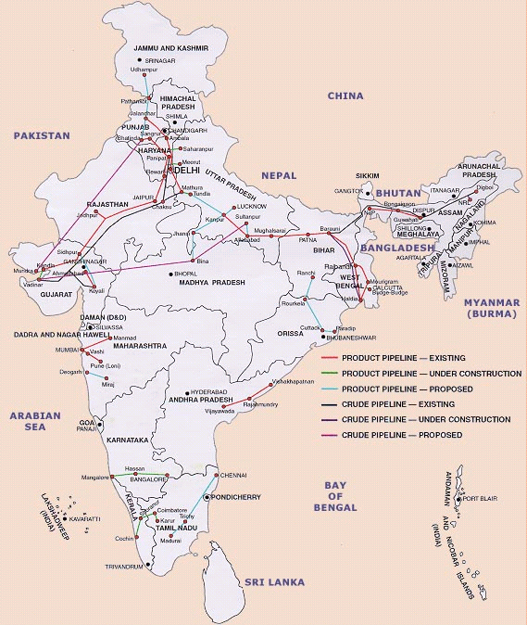
Energy - Refining (10)

Slide 50
Environmental (1)
Total Energy Consumption (1998E) : 12.5 quadrillion Btu (3.3% of world energy consumption) which includes petroleum, dry natural gas, coal, net hydro, nuclear, geothermal, solar and wind electric power.
Energy Related Carbon Emissions (1998E) : 252.6 million metric tons of carbon (4.1% of world carbon emissions).
Per Capita Energy Consumption (1998E) : 12.9 mn Btu (v/s US value of 350.7).
Per Capita Carbon Emissions (1998E) : 0.3 metric tons of carbon (v/s US value of 5.5 metric tons of carbon).
Energy Intensity (1997E) : 27,203 Btu/ $1990 (v/s US value of 13,869 btu/$1990) with the GDP based on EIA Intl’ Energy Annual 1998.
Carbon Intensity (1997E) : 0.57 metric tons of carbon / thousand $1990 (v/s US value of 0.22 metric tons/thousand $1990).
Sectoral Share of Energy Consumption (1997E) : Industrial 68%; Transportation 15.7%; Residential 12.6%; Commercial 3.6%.
Sectoral Share of Carbon Emissions (1997E) : Industrial 67.1%; Transportation 16%; Residential 13.4%; Commercial 3.6%.
Fuel Share of Energy Consumption (1998E) : Coal 55%; Oil 30.5%; Gas 7%.
Fuel Share of Carbon Emissions (1998E) : Coal 67.8%; Oil 26.7%; Gas 5.5%.

Slide 51
Environmental (2)
Renewable Energy Consumption (1997E) : 8,826 trillion Btu (3% increase from 1996)
Number of people per motor vehicle (1997) : 142.9 (v/s US value of 1.3)
Signatory to the Kyoto Protocol (1999)
Major Environmental Issues -
Deforestation
Soil Erosion
Overgrazing
Desertification
Air pollution from industrial effluents and vehicle emissions
Water pollution from raw sewage and runoff of agricultural pesticides
Tap water is not potable throughout the country
Huge and rapidly growing population is overstraining natural resources.

Slide 52
Transportation (1)
Railways
Total : 62,915 km (12,307 km electrified; 12,617 km double track)
Broad Gauge : 40,620 km (1.676 m gauge)
Narrow Gauge : 18,501 km (1 m gauge); 3,794 km (0.762 m & 0.610 m gauge)
Highways
Total : 3,319,644 km
Paved : 1,517,077 km
Unpaved : 1,802,567 km (196 Est.)
Waterways : 16,180 km (3,631 km navigable by large vessels)
Ports & Harbors : Mumbai, JNPT, Mangalore, Kochi, Chennai, Vizag & Calcutta
Merchant Marine
Total : 311 ships (1,000 GRT or over) totaling 6,627,497 GRT/11,038,723 DWT
Ships by type : Bulk 6; Cargo 63; Chemical Tanker 11; Combination bulk 2; Combination ore/oil 3; container 12; Liquefied gas tanker 10; Oil tanker 76; Passenger - Cargo 5; Short sea passenger 1; Specialized tanker 2 (1998 Est.)

Slide 53
Transportation (2)
Airports : 341 (1998 Est.)
With Paved Runways
Total : 230
Over 3,047 m : 11
2,438 to 3,047 m : 48
1,524 to 2,437 m : 82
914 to 1,523 m : 70
under 914 m : 19 (1998 Est.)
With Unpaved Runways
Total : 111
2,438 to 3,047 m : 2
1,524 to 2,437 m : 8
914 to 1,523 m : 50
under 914 m : 51 (1998 Est.)
Heliports : 17 (1998 Est.)

Slide 54
Telecommunications Overview

Slide 55
Telecommunications (1)
SALIENT FEATURES
Telecommunications in India is a subject in the Union list, which means that all powers and functions rest with the Union Government and its representative organizations, as follows:
1. The incumbent operator in the system was the Department of Telecommunications (DoT), which has recently been broken into two parts:
The licensing and policy making authority (DoT), and
The corporatized Bharat Sanchar Nigam Limited (BSNL) - the incumbent.
2. Likewise the incumbent in the long distance sector is the Videsh Sanchar Nigam Limited (VSNL) which owns all the fibre entering into and going out of the country.
3. In addition to these two the government had also set up an organization called the Mahanagar Telephone Nigam Limited (MTNL) to cater to the demand in the two metropolitan cities of Delhi and Mumbai.

Slide 56
Telecommunications (2)
SALIENT FEATURES
Thus, prior to reforms virtually all the areas of telephony, i.e., basic services, domestic long distance (DoT & MTNL) and international long distance (VSNL) were all under the control of the Government.
Telecommunications at the Union level is broadly under the control of three ministries, each having a representation, of the Cabinet level rank, in the Union Ministry. These being:
Ministry of Communications
Ministry of Information and Broadcasting (I&B), and
Ministry of Information Technology (MIT)
Mr. Ram Vilas Paswan is the Union Cabinet Minister for Telecommunications and he is assisted by Mr. Shymal Gosh who is the Secretary.
Ms. Sushma Swaraj is the Union Cabinet Minister for I&B.
Mr. Pramod Mahajan is the Union Cabinet Minister for IT.
1997 saw the formation of the Telecom Regulatory Authority of India (TRAI).

Slide 57
Telecommunications (3)
SALIENT FEATURES
Subsequently TRAI was separated into two components: TRAI and the Telecom Disputes Settlement and Appellate Tribunal (TDSAT), primarily due to the resistance of the DoT to regulation.
Mr. M. S. Verma is the current Chairperson of TRAI and is assisted by four Members, Mr. R.R.N. Prasad, Mr. Ravi Kant, Prof. V.S. Raju and Mr. Rakesh Mohan.
The mandate given to TRAI was to:
(a) Regulate tariffs
(b) Ensure and Monitor Quality of Supply and
(c) Ensure non-discriminatory interconnection
The mandate given to TDSAT was basically to adjudicate in case of disputes between:
(a) Two licensees
(b) Consumer and a licensee and vice versa
(However, if a dispute arose between the licensor (DoT) and a licensee the same was to be governed by the Indian Telegraph Act of 1885.)

Slide 58
Telecommunications (4)
SALIENT FEATURES
The broad intent and the goals/objectives of the Government have been enshrined in a policy document called the New Telecom Policy (NTP), 1999.
Currently the issue that is of immediate concern to the Government is the “Convergence Bill”. After accepting comments on several drafts, a draft final version of the same is currently being reviewed by the Group of Ministers.
With its enactment, the bill will replace all provisions contained in the 1885 Telegraph Act, the 1933 Wireless Telegraph Act and the 1995 Cable Television Networks Regulation Act.
However, in the absence of a consensus among ministers as regards “Which ministry would pilot the bill in the parliament”, delays are expected in its enactment.

Slide 59
Telecommunications (5)
INDUSTRY STRUCTURE
Telecommunications / Information & Broadcasting / Information Technology
Ministry of
Communications
Ministry of
Information & Broadcasting (I&B)
Ministry of
Information Technology (MIT)
Department of
Telecommunications
(DoT)
Videsh Sanchar Nigam
Limited (VSNL)
Press Information
Bureau & others
Directorate of
Film Festivals &
Others
Department
of Electronics
(DoE)
Electronics & Computer
Software Export
Promotion
Council (ESC)
Prasar
Bharati
Mahanagar Telephone Nigam
Limited (MTNL)
Others
National Informatics
Centre (NIC)
Others
DoT
Bharat Sanchar Nigam
Limited (BSNL)
All india
Radio
Doordarshan

Slide 60
Telecommunications (6)
INDUSTRY STRUCTURE
- COMMUNICATIONS
CABINET MINISTER
MINISTER OF STATE
Department of Posts
TRAI
TDSAT
Regulation
Disputes
Department of Telecommunications (DoT)
Administrative Matters
Policy
Licensing
Controls of PSUs
Wireless Spectrum
Equipment Standardization
R&D
Telecom Commission
SECRETARY
(Chairman +
4 Full time Members+
4 External Members)
Other Units
MTNL
VSNL
BSNL
(Delhi &
Mumbai)
(TEC, W.A. etc.)
(21 CGM’s of State Telecom Units)
Private Sector Licences

Slide 61
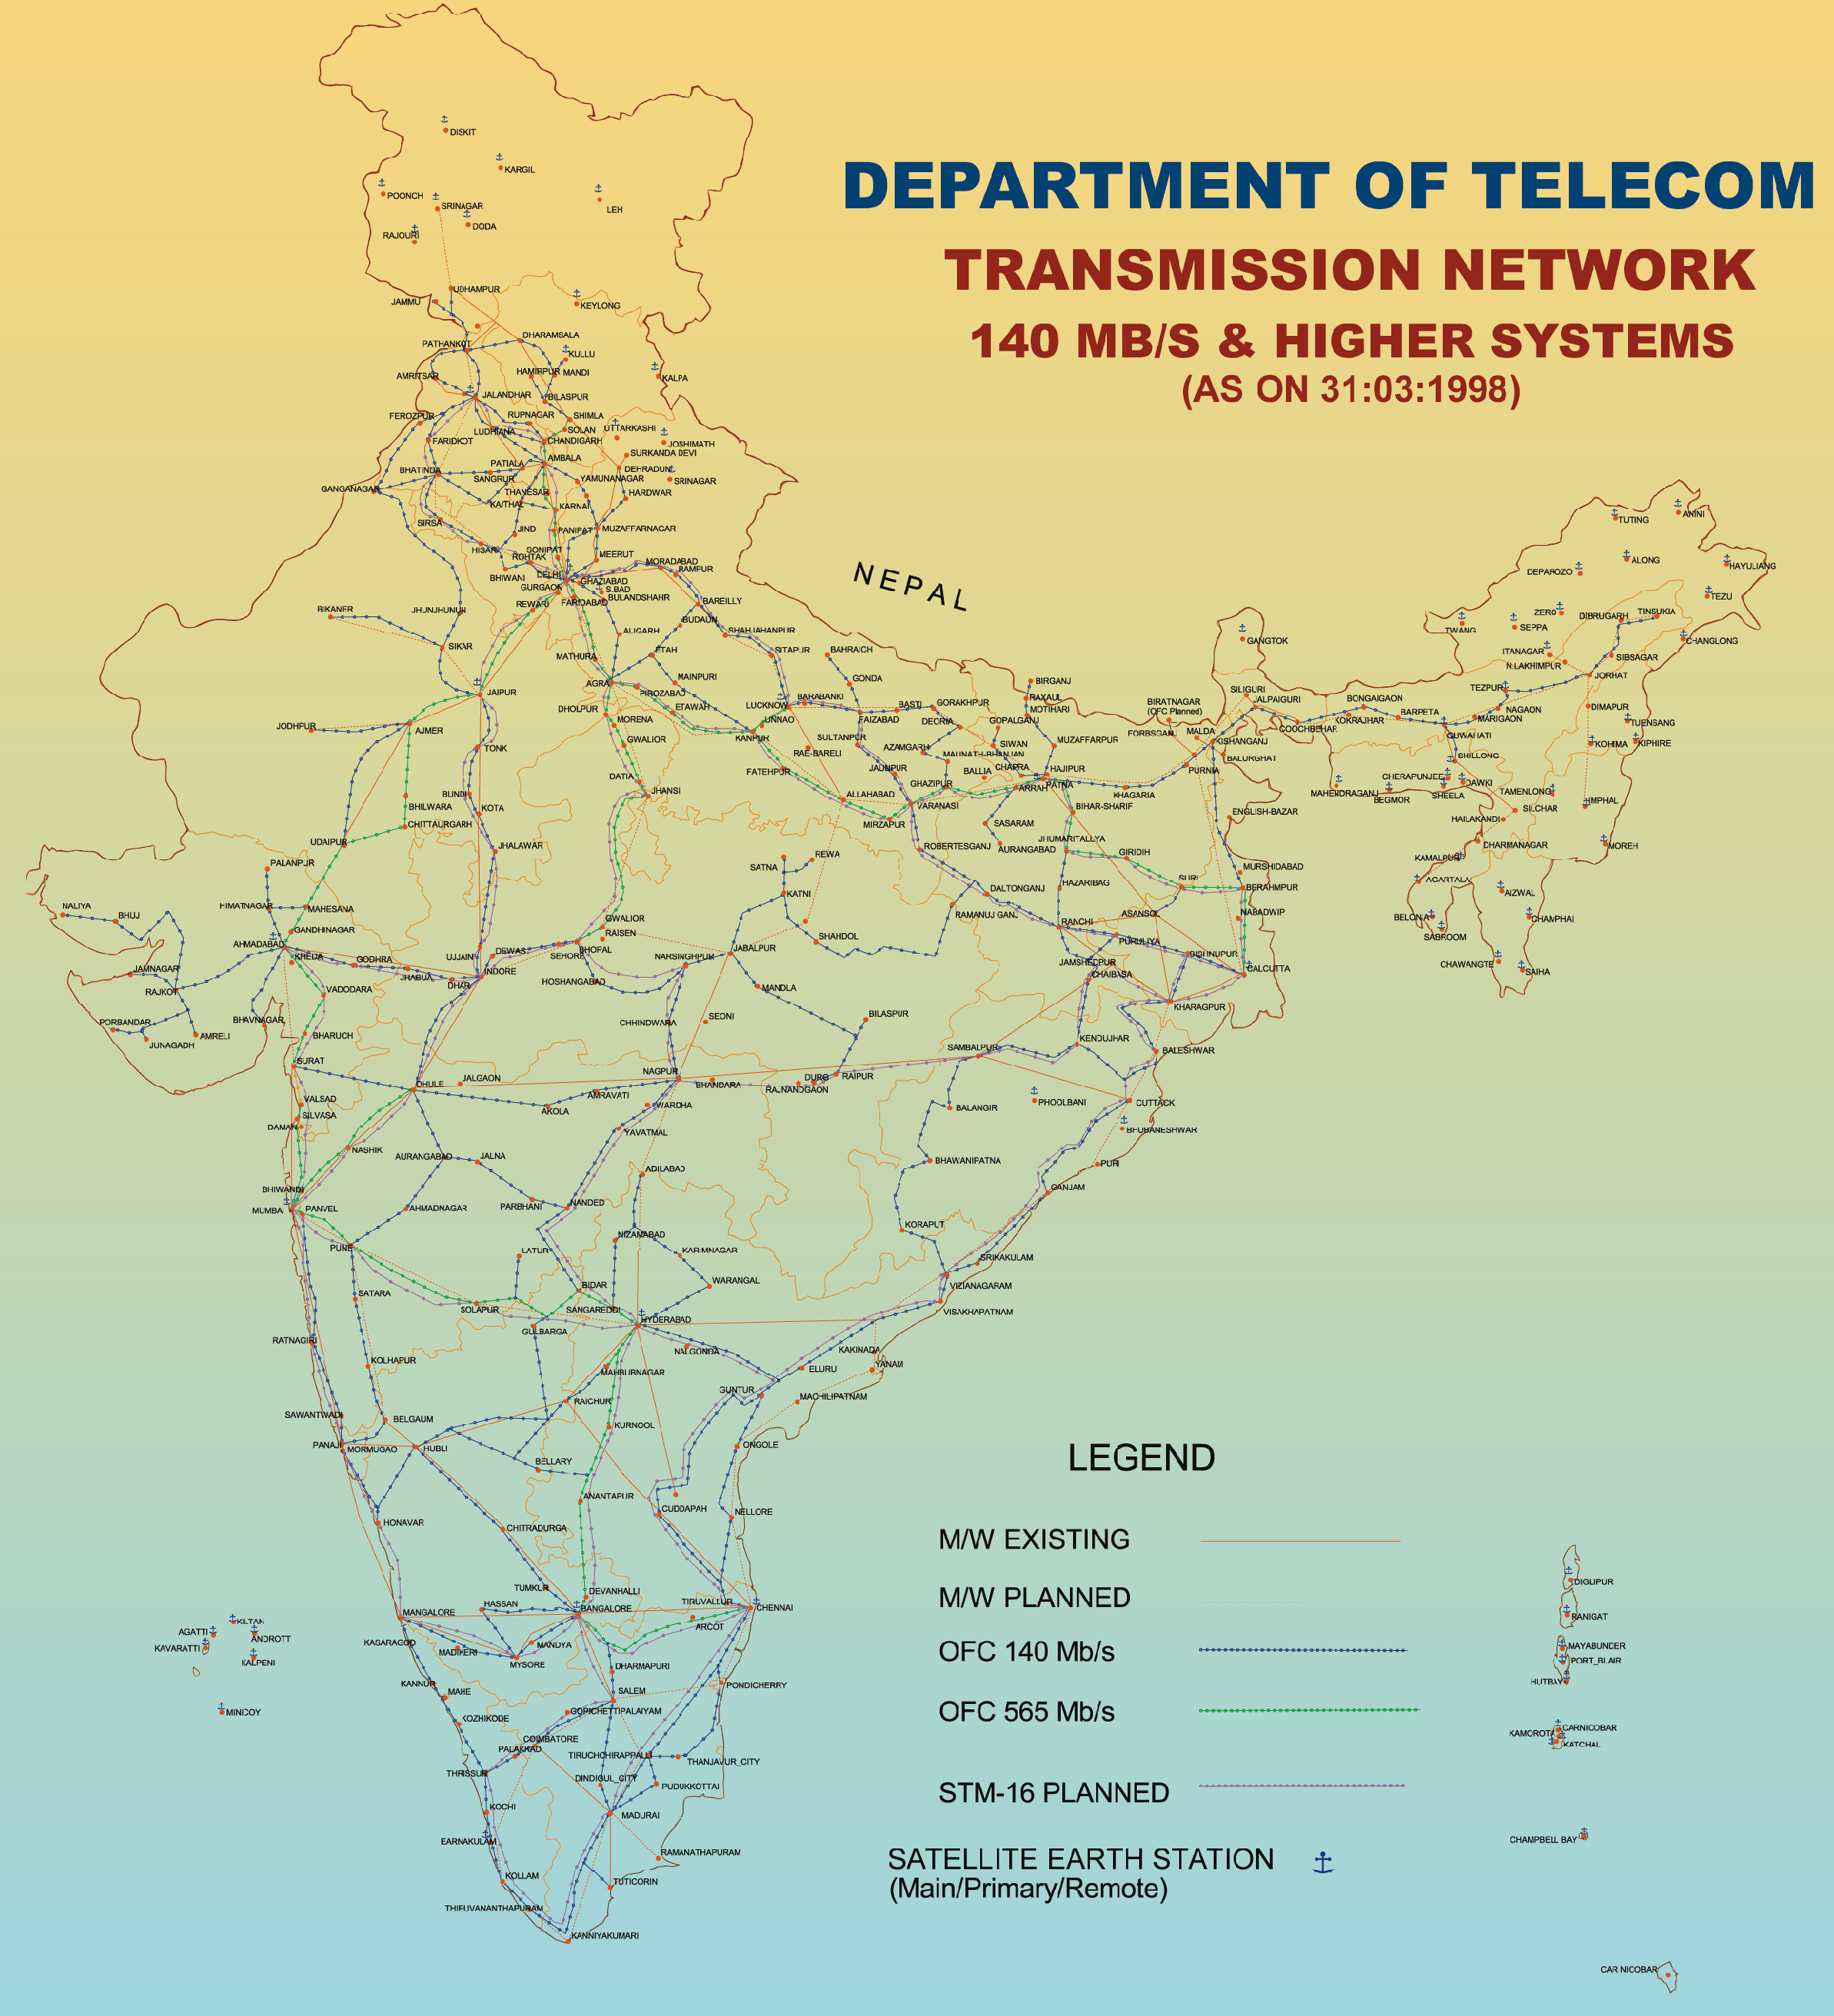
Telecommunications (8)

Slide 62
Telecommunications (9)
POLICIES/LICENSING
First liberalisation policy were initiated in 1992, when bids were invited for (a) Radio Paging Services (in 27 cities), and (b) Cellular Mobile Services (in the four metros).
Subsequently, private Basic/Fixed Service Providers (FSPs) signed licenses and interconnect agreements with the incumbent - DoT.
ISP License
As regards Internet Service Provider (ISP) licenses, as many as 150 private organizations have already obtained this license.
There are three categories of ISP licenses:
Category “A”: Covers the territorial jurisdiction of the Union of India, except specified areas that may be notified from time to time.
Category “B”: Any of the 20 Territorial Telecom Circles, four Metro Telephone districts (Delhi, Mumbai, Chennai, and Calcutta) and the four major telephone districts of Ahmedabad, Bangalore, Hyderabad and Pune.
Category “C”: Any Secondary Switching Area (SSA) of DoT with geographical boundaries as on 1.4.98, with the exception of the four metro telephone districts and the four major telephone districts.

Slide 63
Telecommunications (10)
POLICIES/LICENSING
An ISP license holder can provide “all types of Internet Access/content services except internet telephony on Internet.”
In case of an ISP interested in setting up an International Gateway, there is a restriction on the foreign equity component, to the extent of 49% only.
Infrastructure Licenses
Two categories of infrastructure licenses have been defined:
Infrastructure Category - I (IP-I)
No licensing is required for this category of license, however the company would have to register itself.
IP-Is are basically providers of the dark fibre / duct space / Right of Way / towers etc. which can subsequently sell/lease/rent out to licensees of telecom services.
Further, there is no restriction on foreign equity.

Slide 64
Telecommunications (11)
POLICIES/LICENSING
Infrastructure Category - II (IP-II)
Stringent conditions are required to be met for obtaining this license.
IP-IIs are to establish as well as lease, rent out or sell digital transmission capacity (end-to-end bandwidth) capable to carry a message, to Telecom Service Providers.
There is an explicit restriction of 49% on foreign equity.
National Long Distance (NLD) Licenses
The draft guidelines for the same indicate stringent licensing conditions in the form of
Revocable Performance Bank Guarantees (PBGs) and Financial Bank Guarantees (FBGs).
Requirements in the form of a prescribed Minimum Equity Capital and Combined net worth for the promoters, etc.
NLD License holders are responsible for the carriage of switched bearer telecommunications service over a long distance.
They would have the right to carry inter-circle traffic excluding intra-circle traffic except where carriage is with mutual agreement with fixed service provider.

Slide 65
Telecommunications (12)
ENRON IN COMMUNICATIONS IN INDIA
Broadband Solutions Private Limited (BSPL) a subsidiary of Enron has an Internet Service Provider License (ISP), whereby it can provide all forms of internet services in India.
The i2-EBS deal is being implemented under this license.
Powertel Solutions Private Limited (PSPL) another subsidiary of Enron has been registered as an Infrastructure Provider Category - I (IP-I) whereby it is eligible to set up dark fibre in the entire country.
A National fibre footprint is currently under discussion.
The final Licensing Agreement for an IP-II has been released by the Government. The agreement contains onerous data reporting, monitoring of content, modification of terms and conditions, revenue sharing and bank performance guarantee requirements.
Trading in bandwidth is to be authorized several years hence.

