Slide 1
John Sherriff
President & CEO
Enron Europe
Friday, 8th September

Slide 2
Enron Europe
Europe Overview
Metals
Enron Credit.com

Slide 3
……..Getting Back to Our Plot
What we have built in Europe
Enron’s European Network Strategy
Establish Europe’s Leading Energy Network
Capture Sustainable First Mover Advantage
Extend the Network
Strong, Competitive Position in High Growth Markets
Exploit the Network
Create Significant Value to Enron and its Customers
Natural Gas
Power
Coal
Crude &
Products
Pulp and
Paper
Weather
Metals

Slide 4
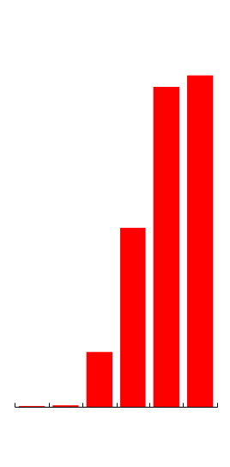
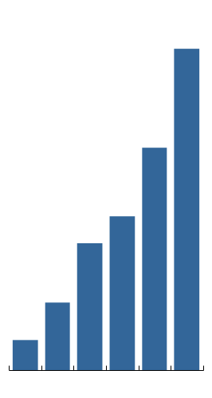
Enron’s U.K. Volume Growth
Power*
(BBtue/d)
Gas*
(BBtue/d)
3,127
2,610
2,702
2,166
1,460
1,497
1,236
660
449
293
9
15
1996
1997
1998
1999
Q1
2000
Q2
2000
1996
1997
1998
1999
Q1
2000
Q2
2000
*Physical and Financial

Slide 5
Enron’s Nordic Energy Network
Leading Player and Market Maker
Increased Liquidity, Price Transparency and Cross-Border Influence
261 Counterparties
World’s Most Deregulated Power Market
Offices
Energy Partnerships
Power
Volume Growth*
(BBtue/d)
1,809
Sweden
1,370
Norway
Finland
Nord
Pool
844
574
Oslo
Stockholm
Helsinki
219
82
1996
1997
1998
1999
Q1 2000
Q2 2000
GEX
Denmark
* Physical and Financial

Slide 6
Continental Wholesale Energy Market
Market Size
Enron’s Customer Mix
$156 Billion Annual Revenues
324 Wholesale Counterparties in 17 Countries
Power – 3,157 TWh
1,695
1,027
Czech Republic
Other
435
Belgium
Western
Central
Eastern
Italy
German
Gas – 29.6 Tcf
18.2
Swiss
Dutch
9.0
(Inception to Date Volumes Traded Per Country)
2.4
Western
Central
Eastern

Slide 7
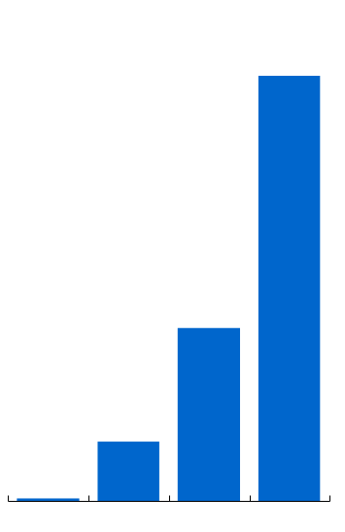
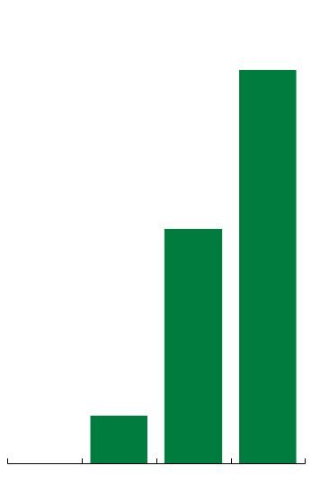
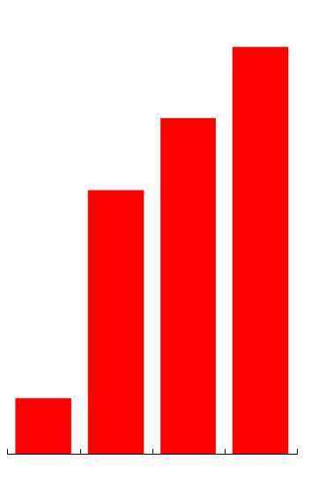
Enron’s Continental Volume Growth
Power Volumes*
(BBtue/d)
Gas Volumes*
(BBtue/d)
Counterparties
1,404
440
324
267
262
210
571
197
53
44
9
0
1998
1999
Q1 2000
Q2 2000
1998
1999
Q1 2000
Q2 2000
1998
1999
Q1 2000
Q2 2000
*Physical and Financial

Slide 8
Enron’s Continental Energy Network - Power
Building Liquidity Across Europe
Transacting in Every Major Market
Contracts Range Up to 5 Years
Strong Catalyst for Liberalization
Negotiating Access and Providing Mutual Benefits to Customers
Favorably Impacting Regulatory Processes
Benefiting from Lead Market Making Role
Early Identification of Bottlenecks
Innovative Products to Manage Price and Term Risk
Exploiting Arbitrage Opportunities
Geographically and Across Commodities
Extending Market Reach Through eCommerce Applications
Major transmission lines
Denmark
Netherlands
Interconnector to UK
Poland
Belgium
Germany
Czech Republic
Luxembourg
Slovakia
France
Austria
Hungary
Switzerland
Slovenia
Croatia
Romania
Croatia
Italy
Spain
Portugal
Notes:
<number>
<footer>
<header>
09/27/25

Slide 9
Enron’s Continental Gas Network
Bacton
Norpipe Europipe
Emden
Building Liquidity at Key Gas Hubs throughout Europe
Perceived to have become the market-maker and main trading participant at Zeebrugge
Actively trading 6 border points across Belgium, Holland, Germany and France
Strong Catalyst for Liberalisation
Short term market previously dominated by 1-2 European counterparties and London traders
Today, major European counterparties such as GdF, Distrigas, Essent, Ruhrgas, Wingaz, Norsk Hydro and Statoil are on one end of 88% of the trades
Zeepipe
Oude/Bunde
UK
Netherlands
Zeebrugge
Zelzate
S’Gravenvoeren
Germany
Belgium
Blaregnies
Aachen
France
Luxembourg
Trading Points
Exploiting Arbitrage Opportunities
Ability to link commodity networks has increased risk management presence with particular reference to Gasoil, Fueloil and FX
Notes:
<number>
<footer>
<header>
09/27/25

Slide 10
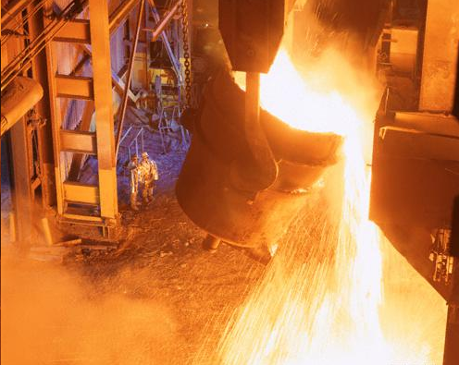
Enron & Metals

Slide 11
MG Worldwide
Stockholm
Humberside
Hamburg
Rotterdam
Liverpool
Cologne
London
Chicago
New York
Frankfurt
Beijing
Los Angeles
Newhaven
Seoul
Tokyo
New Orleans
Shanghai
New Delhi
Hong Kong
Singapore
Lima
Santiago
Melbourne
Merchanting Offices
Broking and Trading Offices
Warehouse Locations
Notes:
<number>
<footer>
<header>
09/27/25

Slide 12
Base Metals vs. Selected Commodities (Relative Size)
Based upon data provided in the Goldman Sachs Commodity Index
Notes:
<number>
<footer>
<header>
09/27/25

Slide 13
Market Sizes
Physical Market ($129 bln)
Derivatives Market ($2.8 trillion)
Physical Market by Metal
Derivatives Market by Metal
Notes:
<number>
<footer>
<header>
09/27/25

Slide 14
Metals Derivative Market
LME
COMEX
OTC
~$2 Trillion
~$0.1 Trillion
~$0.7-2 Trillion
lots
1999
1992
1995
1999
1995
1999
Other metals*
Copper
* Zinc, Nickel, Tin, Lead, Aluminium Alloy
Source: LME 1998 Annual Report; NYMEX SEC S-4 Filing; MG Interviews
Primary Aluminium
Notes:
<number>
<footer>
<header>
09/27/25

Slide 15
Metals Traded
LME

Slide 16
LME Consolidation
MG’s inception in 1970, 32 LME ring members
No. of members
Currently 12 LME ring members

Slide 17
Revenue Streams
Term &
Structured
Products
Risk Management
Outsourcing
Cross Commodity Products
Asset Acquisitions
Trade Financial Products (MG Ltd.)
Trade Physical Product (MG Plc.)

Slide 18

Enron’s Competitive Advantage
Brokers/ Producers
Alcoa
Phelps Dodge
BHP Glencore,etc
Electronic Platform
e-Commerce
Spectron
Metal Site
e-Metra, etc
Physical
$
Financial Institutions
Morgan Stanley
Goldman Sachs, etc

Slide 19
Integration Status
Physical Move
London - Mid September
NY - Done
Tokyo - Late September
Migration of OnLine Systems
Market Maker - Mid September
Complete System Migration - Q1 2001
Mid/Back Office - 75% Complete

Slide 20
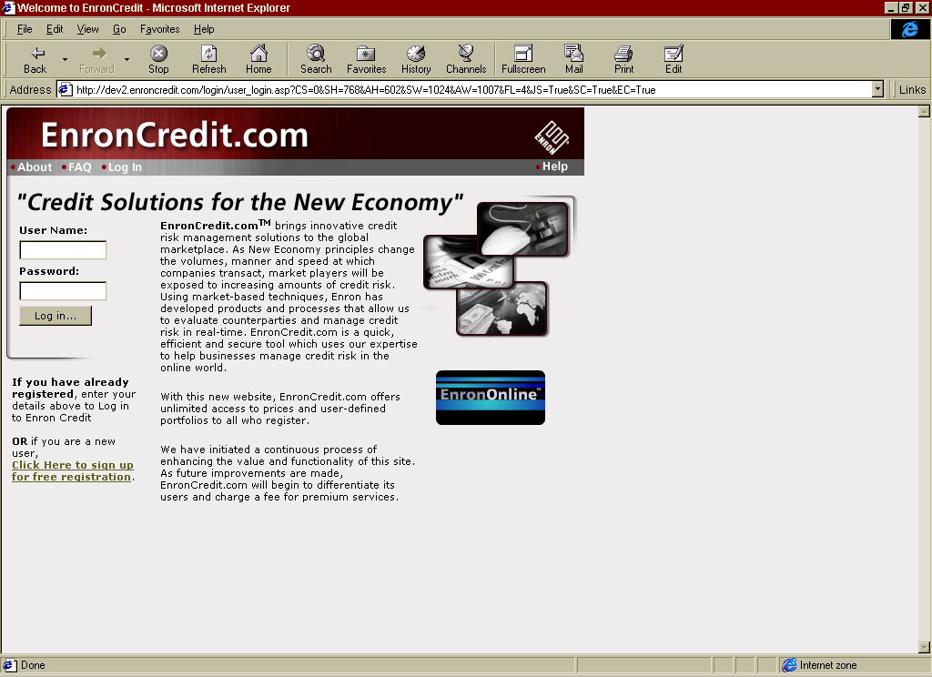
We Are a Newcomer to the Online Credit World With Enroncredit.Com

Slide 21
The Credit Business
Our business used to be 90% commodity and 10% credit
Today a deal is 90% credit wrapped around the 10% commodity portion

Slide 22
Credit Market Opportunities
On average 60,000 US businesses file for bankruptcy each year
90,000
80,000
70,000
60,000
50,000
40,000
30,000
20,000
10,000
0
Number of Bankruptcies
1980 1982 1984 1986 1988 1990 1992 1994 1996 1998
Data Source: American Bankruptcy Institute
Years
Reference - <number>

Slide 23
Credit Market Opportunities
In the credit risk market….
The Opportunity
Our Response
There is lack of transparency
We are providing cost of credit for tens of tens of thousands of companies

Slide 24
Credit Market Opportunities
In the credit risk market….
The Opportunity
Our Response
There is a lack of liquidity
We are offering to transact on more companies than anyone else (by a significant margin)

Slide 25
Credit Market Opportunities
In the credit risk market….
The Opportunity
Our Response
The existing credit processes are sluggish and inefficient
We are providing standardized transactions on-line

Slide 26
Credit Market Opportunities
In the credit risk market….
The Opportunity
Our Response
There are no easy tools for evaluating and managing cost of credit
We are providing simple tools available free over the internet for managing credit risks and will provide customised solutions for adoptors of our technology

Slide 27
Implementation Approach
EnronCredit is taking a different approach in commoditizing Global Trade Credit
Traditionally:
We lead with transactions and
We profit only from market making and structured origination activities
Reference - <number>

Slide 28

Enroncredit Is Taking a Different Approach...
But the capabilities of the internet and speed to market now requires a different approach   

Slide 29
The Phases of Building Enroncredit.Com
LEADING WITH TRANSPARENCY
Creating a massively scalable advantage in pricing credits
Distributing prices for free
BUILDING THE BRAND
Making our Enron Cost of Credit (ECC) and Enron Cost of Hedging Credit (ECHC) the standards in pricing credit
IDENTIFYING EARLY ADOPTORS FOR CUSTOMISED REAL TIME CREDIT SOLUTIONS
Lead with information; follow with active management
Reinforce our scale advantage by further obtaining private credit information (like payment histories)
Sell the solution, then build what we sold
Build once and sell many times
DRAMATICALLY SCALING THE TRANSACTIONS
EnronCredit is the major intermediary for trade credit
‘Just in time’ syndication

Slide 30
Taking a Different Path….
Why this approach?
Scalable Advantage: Our ability to accurately price thousands of names is the foundation for the entire value proposition.
Market Acceptance: We are translating old/slow/cumbersome information into a real time usable format. It will take time for the market to understand the value of our information. Only after companies understand their current credit exposures will they begin to hedge their concentration risk.

Slide 31
Taking a Different Path….
New Product: New trade products take years to gain acceptance. Prior to the internet we had to simply slug it out before transactions followed. This was slow and expensive.
New Customers: We need to develop new techniques to access large numbers of of non-traditional Enron customers.
Leveraging the Net: The internet allows us to change the rules in establishing a new product . It is easier to get market attention using our prices as free advertising. It will be more efficient to find the early adoptors using the internet rather than expensive air travel.

Slide 32
Phases to Build EnronCredit.com
Jan
2000
Jun
2000
Jan
2001
Jun
2001
Jan
2002
150 Names
1000
Names
2500
Names
Critical Mass
10,000
Names
Phase I
Scale Reference Credits
Cost per Reference Name
30,000
Names
100,000
Names
Critical Mass 100,000
eyeballs
Phase II
Build Brand
Total number of people that see our ECC prices per week
Cost per eyeball
1,000,000
eyeballs
10,000,000 eyeballs
Phase III
Provide Customized Solutions
Annualized Contract revenue signed per quarter
Cost per revenue acquisition
$250,000
Critical Mass
$2 million
$1 million
$4 million
Phase IV
Scale Deal Flow & Syndication Capacity
Cost per transaction
Notional value of transactions per month
$200 Million
Critical Mass
$6 Billion
$2.5 Billion
Slippage costs = $2,000,000 per day!

Slide 33
EnronCredit Website Users
Cumulative number of registered users
20,000
20,000
18,000
16,000
14,000
13,000
12,000
10,000
Registered Users
8,000
7,000
6,000
5,000
4,000
2,700
2,344
2,000
933
1,179
1,414
365
693
0
February March April May June July August September October November December
Months

Slide 34
EnronCredit Metrics

Slide 35
Franchise Value Growth
EBIT
Annualized to the end of 2000 2001 2002 2003
Approximate EBITDA ($millions) -$5 $17 $92 $171
10
$8.55
8
6
($Billions)
$4.58
Franchise Value
4
2
$0.86
0
2001
2002
2003
End of Year
Assumptions:
Revenue targets are met
Franchise value multiple = 50
Loss on portfolios is 0.65%
Risk held by Enron is up to VAR = $5,000,000

Slide 36



Potential Early Adopters
Ingram Micro (Europe)
World largest provider of technology products - new economy company
45,000 debtors
Exposure range from $10,000 to multi-millions
Recognizes credit risk, not satisfied with yes/no credit decision making
Potential user of:
Two way information tolling
Credit risk
Integrated business systems
Hewlett Packard
Serious credit issues
Recognize value of information and bankruptcy swap
Potential use the same as Ingram Micro
ABB
Sirius Division is deciding on whether to staff up or utilize our information services

Slide 37
Top Two Challenges
Brand Recognition: Establishing the brand and acceptance of ECC prices as the standard
This is a new Enron skill set
Educate our target market that there is a cost for credit and it is far more profitable to manage it than ignore it
Pricing System: To scale our pricing system from publicly traded companies to non-publicly traded companies requires a new paradigm

