Slide 1
Enron Metals – AS/400 Technology Transfer
Project Initiation February 2001
Steve Whitaker, Change Management Group
Robert Campbell, IT Development
DRAFT FOR DISCUSSION

Slide 2
Background
Core Enron Metals systems run on an AS/400 platform
Platform not mainstream Enron architecture
System is difficult to integrate
System is high maintenance
Small development pool
There are operational issues
It is certain that the current system cannot grow with the business
Our AS/400 system is not a good long-term investment.

Slide 3
Reasons for Change
Undocumented system
Difficult to make enhancements – application and data tightly coupled, changes in one area does have unforeseen impacts on other areas
Difficult to resource – high dependency on “key-man” developers (2 key resources have resigned)
Operational Issues
Resource bottleneck – Huge demand is being built up with serious operational risk considerations
System difficult to integrate with Enron upstream / downstream systems
System not flexible enough to move with the business.

Slide 4
Objectives
Create a more streamlined, maintainable and efficient application architecture for Enron Metals (and Softs?)
Migration of functional components off existing AS/400 Platform in a logical manner that will maximise business benefit whilst mitigating the risk of business interruption
Not necessarily the complete decommissioning of the AS/400 – there may be some components where it is the best alternative
We need to have greater development optionality
Move to an environment that is consistent with Enron’s technical architecture – e.g. Oracle/SQL Server
Develop an application architecture that is consistent with the business model for Enron – e.g. stripe concept for Middle Office

Slide 5
Scope: Products, Markets & Functionality
Products and Markets
Futures
Traded options
Traded average price options
Averaging contracts
London Metal Exchange
Lead
Silver
Tin
Zinc
LME Index available for futures and traded options only.
COMEX
Aluminium
Copper
London Bullion Market
Silver
Gold
LIFFE
Coffee
Cocoa
New York Board of Trade
Coffee
Cocoa
OTC
Physical Metal Contracts
Foreign exchange Contracts
Functionality
Deal Capture
Price Entry
Automated feeds
LME commodity prices, volatilities, interest rates and foreign exchange rates gained via the LCH’s LME External Interface for settlement and COB
NYBOT Softs prices are obtained via an automated text file import from the web.
Manual price entry from dedicated screens
Administrative users enter additional market/commodity prices, FX and interest rates manually from sources such as the FT etc.
Valuation / Risk / Position Management
Intra-day and overnight Mark-to-Market valuations
Futures and averaging cards produced intra-day
Option position “Greek” matrixes showing “what-if” scenarios.
Interfaces
LME External Interface (TCP/IP)
Mercur risk management system
SAP.
EnronOnline Bridge (TIBCO)
Cconstant trade feed from EOL via TIBCO bridge.
Compliance
Overnight regulatory processes to calculate:
Position Risk Requirement (PRR) CAD 2.
Counterparty Risk Requirement (CRR)
CFTC/PERTS Large position report downloads
Softs equity summary report downloads
LME Large position reporting - automatically transferred via the LCH’s gateway to LME compliance.
Client Communication
Automation of telex, fax or email
Aluminium Alloy
Aluminium
Copper
Nickel
Reports / Invoicing
Created and sent to clients during the day and overnight
Trade confirmation
Position evaluation
Settlement
Margin reports
Physical stock invoicing etc.
Enquiry Tools
The user interface provides enquiry screens allows internal customers to run standard and adhoc account, trading and stock queries.
External clients can view a reduced set of reports via the web based application J-Walk.
Gold
Silver
Sugar
Sugar
Accounting
Trade settlement
Ledger balance postings
Invoicing
Commission analysis
Loans
Standing orders etc.
Static Data Management
Prompt date diaries
Stock port listings
Metal brand specs etc.
Physical Business
Stock control and allocation
Weight adjustment
Warrant price fixation
Off balance sheet financing
Physical position analysis.
Credit / SPAN Margining
Overnight process calculates initial and variation margin for LME trades using SPAN margining
Customers’ credit and margin positions assessed against SPAN
Call invoices produced and sent automatically.

Slide 6
Scope: Location, Architecture, Departments and Businesses
Locations
Europe
UK
London
Liverpool
Germany
Essen
Dusseldorf
Hamburg
Frankfurt
Spain
Bilbao
Sweden
USA
New York
Houston
St Louis
Los Angeles
Chicago
Canada
Montreal
Asia/ Pacific
Tokyo
Korea
Architecture/Infrastructure
Data
Reference data
Corporate data
Migration and data conversion.
System interfaces
Upstream
Downstream e.g. SAP/Mercur.
Impacted systems
New systems/components
Enhancements to existing systems.
Architectures
Technical architecture
Application architecture
Business architecture and processes.
Departments
Front Office
Middle Office
Risk Management
Documentation
Trade Accounting
Working Capital
Invoicing/ Settlements
Back Office
RAC
IT
Development
Operations
Businesses
Trading
Physical Trading
Financial Trading
Brokerage
Warehousing
Recycling

Slide 7
Current Risks for Development
The scale and complexity of work is being underestimated
Insufficient IT resources to complete work within timeframes
Poor data quality and processes in existing systems prevent the new business processes from operating effectively
Line responsibilities and other priorities mean that business users are unable to devote enough time to the work
Perceived lack of buy-in from business representatives given the scale of operational risk/ business threats
Lack of cross departmental management framework leads to co-ordination and communication breakdown
Commercial pressure to deliver short term solutions and enhancements diverts focus and resources away from overall goals.

Slide 8
What Do We Need To Do?
Deliver value as early as possible with minimal risk
Incremental change not BIG BANG
Prioritise according to Business needs/musts
Solution should not compromise the existing business - parallel
Business and IT working as one team
Collective achievement of collective goals not individual achievement of individual goals
Create joint incentives for success
Incentivise ALL with appropriate risk/reward trade off.
CEO & Senior Management sponsorship and continuous involvement
Development and adherence to a Framework that will enable structured thinking and informed decision making, without compromising individual entrepreneurship
Efficiency not bureaucracy
Open and frequent status reporting and measuring of performance
Rapid problem resolution
Continually challenge the overall direction
Clear accountability and responsibility
Do not attempt to manage and control everything all at once.
Take care to apply what we have learnt from previous initiatives.

Slide 9
Future Risks for Development
New business acquisitions shift the focus and priority of the work
Lack of required skills for a more structured initiative:
Dependency on key technology resources
Not enough depth of experience at delivering large projects and complex programmes
Insufficient infrastructure/ control to deliver something this complex
Inter and Intra project dependencies are not understood.

Slide 10
Next Steps
What should we plan to do in the short term?
Drive the project through the formal approval process
Determine the business priorities and hence functionality to be delivered as part of release 1
E.g. Inventory Management
Confirm the architecture approach and overall scope
Develop a roadmap and programme plan
Establish roles & responsibilities and make individuals accountable NOW
Set up the project’s framework and establish steering committee
Develop detailed plans for release 1
Communicate the intent
Mobilise the project
Deliverables – 15 March 2001
Business justification
Project justification
Roadmap and programme plan
Detailed Release 1 plan.
Who should do this?

Slide 11
APPENDIX
Approach and Plan

Slide 12
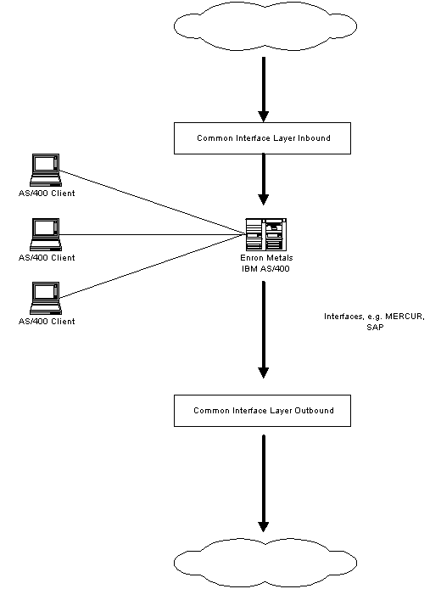
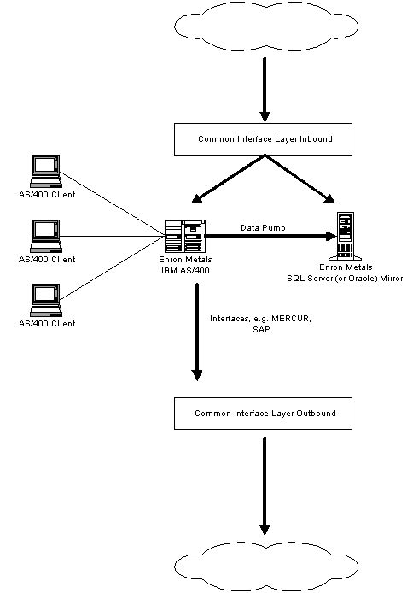
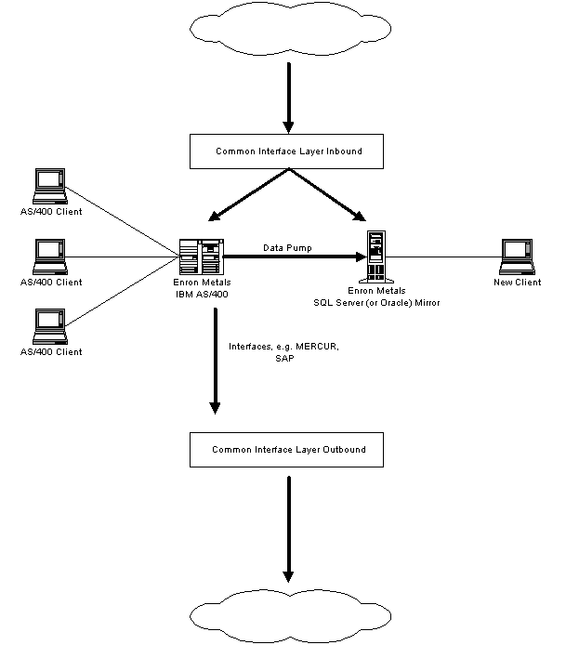
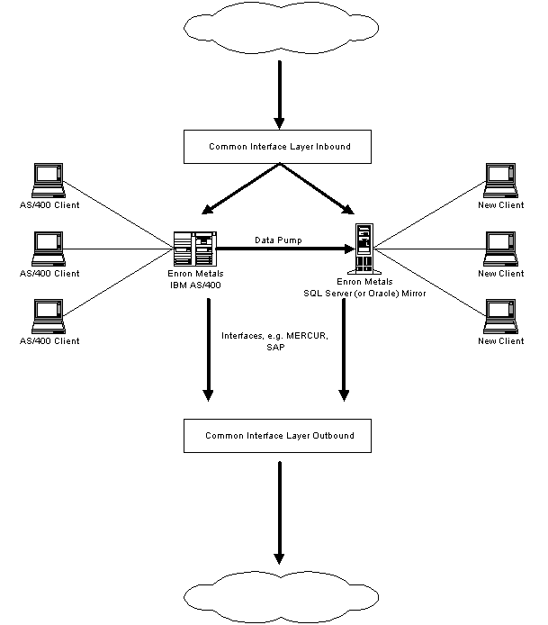
Approach – Architectural Concept
System Boundary
Current architecture
AS/400 – “System Isolation”
System boundaries are too wide – it does “everything”
AS/400 – Shortcomings
Tight coupling of applications and data
System developed by a small development team, suffers from rigid development “style”
Too many operational tasks are handled by developers having to change programs
Parallel execution
Minimise operational risk
Build the new architecture in parallel to the current AS/400
Leverage IT expertise in areas we are good at
Build on a platform currently supported elsewhere in the business
Implement Enron minimum IT control standards
Port data real time to an “Enron” type database through a data pipe
Break project up into releases
Deliver separate functional components
Facilitates managing the project
Demonstrate progress
Lose obsolete functionality
Determine what is essential and what is “nice to have”
Don’t switch off any AS/400 functionality until new functionality is proven
Use components developed for other systems where appropriate
Replace/ improve current functionality
Build up functionality supported off the AS/400 over time
Revisit and confirm priorities before each new proposed release
Decommission AS/400 processes once new functionality is stable
End-game determined as we get a better understanding of the AS/400 components that remain
Could decide to decommission the whole system
May wish to keep some streamlined functionality e.g. Deal Capture
Release 1
Release 2
Release 3
Release n

Slide 13
Approach – Release Based Programme
Indicative Only
2001
2002
Q1
Q2
Q3
Q4
Q1
Q2
Q3
Q4
Existing
Initiatives
Roadmap and Programme Management
SAP Integ
Off Balance Sht
EML Mnemonics
Release 1
PROJECT APPROVAL, PROGRAMME PLANNING
AND MOBILISATION
Release 2
External
Dependencies
Release 3
Legal
Release n
Current Project
Approach Used
Planning &
Mobilisation
Release Based Approach

Slide 14
Approach – Release Based Programme
We are failing by concentrating on independent projects
There are huge interdependencies and priorities which need active management.
Develop a release strategy/ roadmap to show a possible route to the end game
Break it down into manageable pieces
Revisit regularly to ensure its continued validity
Once a release has been agreed plan this in more detail – leave future releases to be planned later
Do not attempt to plan everything all at once – things will change far too quickly.
Organise the work as a series of phases/ releases
Enables us to focus on shorter term objectives
3-6 months
Focused delivery of a new service (or set of business functions) to Metals
Appoint a Release Manager to ensure this delivery takes place according to plan.

Slide 15
Approach – Roles & Responsibilities
Enron Metals
Commercial and Commercial Support
Requirements
Release Acceptance
Business Management
Business Requirements
Business Change
System Tested Application
Service Level Requirements
Business Process Requirements
Tested Service
Integration Tested
Release
Release 1
New Systems
Development
Release 2
Integration Tested Release (Service)
Release 3
Systems
Integration
Service Delivery
Service/Operability
Requirements
Existing Systems
Development
Service Implementation
Release Management
Programme Management

Slide 16
Approach – Roles & Responsibilities: Business
Business Management
Developing the initial function and service definition i.e. what is going to be in a release - in consultation with Commercial and Commercial Support
Developing the detailed business requirements and the business acceptance criteria that reflect these requirements
Developing the communications plan
Marketing and launching the new release
Supporting the business acceptance process
Defining the roll-out approach.
Business Change
Developing the new procedures that need to be operated in conjunction with the new systems
Tested in Business Integration Testing
Managing the training of the business users in the new service
Executing Business Integration Test
Organising the setting up of a customer help desk (if necessary).

Slide 17
Approach – Roles & Responsibilities: IT Development
New Systems Development
Supports the core build of the application and architecture software - through to system test.
Existing Systems Development
Undertakes all development work associated with the existing systems impacted by the new release - again through to the system test of these modifications.
Systems Integration
Looks across all system development projects
Establishes the process by which the various systems - and associated manual procedures - will be integrated within a single release
Development of an integration test environment, and after system test is complete, the execution of the integration test cycles
Support the development of the conversion utilities and interim software that will be needed during the cutover of the production environment to the new release.

Slide 18
Approach – Roles & Responsibilities: IT Operations
Service Implementation
Project-based team responsible for managing the impact of the new release on the production environment.
develop the new service model
define the changes necessary to service delivery
develop the service acceptance criteria
define the service level agreement (SLA) that will formalise the relationship between service delivery and the business for the live service
accept the new release from systems integration
train service delivery personnel
support the Business Integration Test of the new release.
Service Delivery
Supports the production environment
On-going function rather than a project
Accept the Business tested release from Service Implementation and support its live operation.

Slide 19
Release Plans & Deliverables - Indicative
Indicative Only
Release 1 – September 2001
Feb
Mar
Apr
May
Jun
Jul
Aug
Sep
BUSINESS
Elaboration
Construction
Transition
Release Launch
BUSINESS MANAGEMENT
BUSINESS CHANGE
Release
Requirements Definition
Communication plan
User Acceptance Test
Communication
Business Acceptance Criteria
Business Acceptance
New Business Processes
Business Integration Test
Business Processes Converted
IT DEVELOPMENT
NEW SYSTEMS DEVELOPMENT
1. Release Requirements Analysis
2. Project a Development- Data pipe
3. Project b Development – Enron database
4. Project c Development – Inbound interfaces
5. Project d Development – Inventory Management
Confirmed Release Requirements
System Test
Functional Specification
Technical Specification
System Test
Functional Specification
Technical Specification
System Test
Functional Specification
Technical Specification
System Test
Functional Specification
Technical Specification
EXISTING SYSTEMS ENHANCEMENT
1. Release Requirements Analysis
2. Project e Development - AS/400 Pipe Interface
Confirmed Release Requirements
System Test
Functional Specification
Technical Specification
SYSTEMS INTEGRATION
Migration Plan
Integration Test Complete
Integration Test Plan
IT OPERATIONS
Release Operability Requirements
De-commissioning Approach
Business Integration Test
SERVICE IMPLEMENTATION
SERVICE DELIVERY
Business Integration Test
Acceptance
Criteria
Accepted Software Release
De-commissioning Plan
Convert
Production Systems
Release
Acceptance Criteria
Release
Acceptance
Live
Service
RELEASE MANAGEMENT
PROGRAM MANAGEMENT
Today

