Slide 1
Alliance Update
Illinois Commerce Commission
Electric Policy Committee
July 10, 2001

Slide 2
Alliance Update
1. Background on Alliance RTO
2. Transco Business Model
3. Settlement with MISO
4. Transmission Rates
5. Status of Infrastructure Development
6. Market Development Issues
7. Stakeholder Process

Slide 3
Background on Alliance RTO
Company Generation Approximate Miles of Service Area
Capacity Peak Load Transmission (Sq. Miles)
(MW) (MW)
AEP 23,900 24,000 22,000 45,400
Ameren 13,000 11,500 5,120 18,000
ComEd 26,300 21,000 4,779 11,500
Consumers Energy 8,000 7,500 5,300 27,800
DP&L 3,300 3,000 2,154 6,000
DTE (ITC) 10,300 10,700 3,000 7,600
FirstEnergy 12,000 12,000 7,000 13,200
Illinois Power 4,800 4,100 2,800 15,000
NIPSCO 3,400 3,000 2,700 15,000
Virginia Power 17,600 16,300 6,000 30,000
Alliance Total 122,600 113,100 60,853 189,500

Slide 4
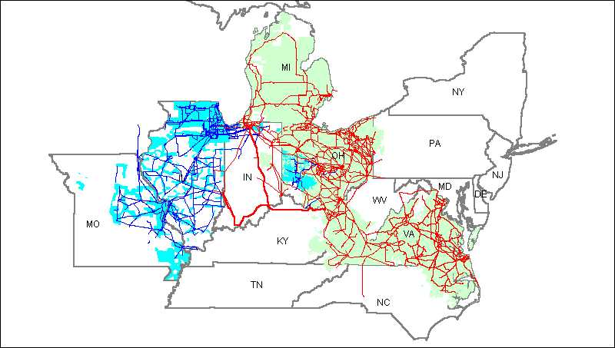
Alliance RTO

Slide 5
Background on Alliance RTO
Initial Discussions in December 1997
Desire of companies to have a for-profit Transco rather than a non-profit ISO operate the transmission system
First FERC filing in June 1999
FERC approved most aspects of Alliance proposal to be an RTO in January 24, 2001 order
RTO filing on January 16, 2001

Slide 6
Transco Business Model
Alliance RTO will operate as a for-profit transco
Transmission Owners can transfer control of their facilities through
  Operating Agreement (Class C shares)
  Divestiture (Class B shares)
Managing Member holds Class A shares

Slide 7
Transco Business Model
Alliance RTO can own transmission - owner operator
Alliance RTO in discussions with National Grid UK about the possibility of National Grid becoming managing member

Slide 8
Settlement with MISO
FERC ordered settlement conference in January 24 Order
Thirteen full days of settlement negotiations
Private meetings between parties and with the Chief Judge held
90 and 135 participants each day and ten or more parties on the speaker phone

Slide 9
Settlement Participants
Alliance Transmission Owners, including ComEd, IP, Ameren
MISO, Inc.
MISO Transmission Owners
Power marketers/IPPs
State regulators
Consumer groups
Others
Chief ALJ Curtis Wagner presiding

Slide 10
Settlement with MISO
Ameren, ComEd and IP allowed to leave MISO, on payment to MISO of $60 million
Payment avoids a MISO bankruptcy and gets them to startup
FERC approved settlement on May 8, 2001 with minor modifications

Slide 11
Settlement with MISO
ARTO will be Transmission Provider
  Calculation of ATC
  Administer OATT
  Administer generator interconnection procedures
  ARTO will be the Security Coordinator
  All load under the ARTO OATT
    TOs will take service for bundled load
Existing control area operators will continue to operate control areas in near-term

Slide 12
Key Settlement Terms:
Joint Rate for MISO, ARTO
Single rate for transactions sourcing and sinking in MISO or ARTO, as constituted on 2/28/01
    ARTO rate design to be used
    Zonal rates to recover revenues lost
    Working on obtaining data for calculation
Effort to be made to develop joint rate for PJM, MISO and ARTO by November 15, 2001
If no agreement, any party free to make unilateral proposal

Slide 13
Key Settlement Terms:
Inter-RTO Cooperation
Inter-RTO Cooperation Agreement
  Provides for coordination of planning, congestion management, security coordination, business practices across region
  Includes timetable for development of protocols and procedures
Joint Independent Market Monitor selected with MISO and SPP

Slide 14
Transmission Rates
Zonal rates for a transition period through December 31, 2004
Elimination of pancaking within Alliance RTO and MISO (super-region)
Zonal rates have three parts
  Zonal Facilities Charge
  Zonal Transition Adjustment - make up for loss of revenues due to elimination of pancaking within Alliance
  Super-Regional Adjustment - make up for loss of revenues due to elimination of pancaking between Alliance and MISO
Out-and-Through Rate - non-pancaked

Slide 15
Alliance Implementation Schedule
FERC Order No. 2000 effectively requires all public utilities to participate in an RTO that will be operational by Dec. 15, 2001
ARTO - MISO Settlement has financial disincentive for not making Dec. 15 date
The ARTO implementation schedule is aggressive
  7/9/01 - System testing begins
  8/27/01 - Operational Trials (formerly called Market Trials) begin
  12/15/01 - ARTO In-Service day one operation

Slide 16
Alliance Implementation
ARTO implementation organization
  Formed temporary organization, sometimes referred to as BridgeCo, to manage implementation
  Hired a Bridgeco CEO - Tony Schuster formerly of NSP
  Seconded five full-time managers from other utilities for Bridgeco, and 20 additional employees seconded on a part-time basis
ARTO implementation approach
  Distributed verses centralized
  Utilize existing infrastructure and systems to the greatest extent

Slide 17
Market Development Issues
Day 1
  Balancing Market - voluntary bid-based
  Congestion Management - similar to today
    Mandatory Redispatch for emergencies
    Voluntary bilateral redispatch between generators and customers if insufficient transmission capacity
Day 2
  LMP in real-time
  Tradeable flowgate rights

Slide 18
Some Market Development Issues
Day 1
  Pay-as-Bid vs. Market Clearing Price
Day 2
  Character of flowgate rights - physical, financial
  How will flowgate rights be distributed - allocation, auction
  Commercial vs. Operational Congestion
Being discussed in Market Development Advisory Group

Slide 19
Customer Advisory Process
March 22 Stakeholder Meeting
Market Development Advisory Group (MDAG) Meeting
  Meetings approximately every two weeks since April 24, 2001
  Next meeting on July 18 in Chicago
Generator Interconnection Agreement
  May 2 - Concourse Hotel, Columbus, OH
  answer to questions posed after March 22 meeting posted
  Joint meeting with MISO - June 7 - 8
Impediments to Performance of other regional transmission entities in the US/Methods of compensation small transmission owners
  June 21
Proposed Interconnection Agreement for Load Serving Entities
  July 11 - Concourse Hotel, Columbus, OH
Customer Education: Began effort in MDAG meetings, continuing with meeting July 19 and monthly thereafter.
Information posted at http://www.alliancerto.com

