Slide 1


Enron Overview
Last Updated
8/00

Slide 2
Fourth Vision
?
(2000- )
Enron’s Visions to Date
Third Vision
To Become the World’s Leading Energy Company
(1995-1999)
Second Vision
Become the World’s
First Natural Gas Major
(1990-1995)
First Vision
Become the Premier Integrated Natural Gas Company in North America
(1986-1989)

Slide 3
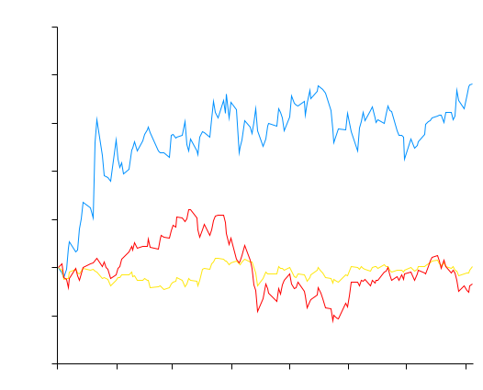
Stock Price Performance
2000 Year-to-Date*
100%
Enron
S&P 500
NASDAQ
80%
60%
40%
20%
0%
20%
40%
January
February
March
April
May
June
July
*Through August 4

Slide 4
Market Capitalization of Energy Majors ($Billion U.S.: Rank as of 8/23/00)
Exxon
Mobil
Royal Dutch
Shell
BP
Totalfina
Elf
Enron
Chevron
Enel
Schlum- berger
ENI
Suez
Lyonnaise
Source: PFC Energy

Slide 5
Price Earnings Ratios Enron vs. Peer Groups (as of 8-18-00)
Enron
Communications
Peer Group
Energy
Peer Group

Slide 6
Energy
Communications
Transportation
&
Distribution
Wholesale
Energy
Retail
Energy
Broadband
Services
Enron
Net Works
Natural Gas Transportation
Electric Distribution
Marketing and Delivery of Energy Products Worldwide
Energy Outsourcing to Commercial and Industrial Customers
Bandwidth Management and Broadband Delivery Services
IT Commercial Synergies
Traditional
New
North America
International
(over 30 countries)

Slide 7
Energy
Communications
Transportation
&
Distribution
Wholesale
Energy
Retail
Energy
Broadband
Services
Enron
Net Works
Natural Gas Transportation
Electric Distribution (sale pending)
Traditional
New
North America

Slide 8
Transportation and Distribution
Operating Highlights
Northern Border
1,214 Miles
Began construction for Florida Gas Transmission’s Phase IV expansion. Conducted Open Season for Mainline expansion.
Transwestern installed new compressor station in Gallup, NM increasing available capacity by 15 percent.
99% Utilization of Northern Border’s Pipeline.
Currently conducting open season for C & D line extensions on Northern Natural Gas’ Pipeline.
Northern Natural Gas
16,463 Miles
Transwestern Pipeline
2,487 Miles
Interstate Throughput
(Bbtu/d)
Florida Gas Transmission
4,795 Miles
9,785
9,151
Throughput for 1999 was 9.2 Bbtu/d
Operates 32,000 Miles of Natural Gas Pipelines
Serves Customers in 21 states
Transports 15% of U.S. Natural Gas Demand

Slide 9
Energy
Communications
Transportation
&
Distribution
Wholesale
Energy
Retail
Energy
Broadband
Services
Enron
Net Works
Marketing and Delivery of Energy Products Worldwide
Traditional
New
International
(over 30 countries)

Slide 10
The Energy Network Model
Applications
Utility Facility
Operations
& Management
Energy
Outsourcing
Fuel
Management
Services
eCommerce
Applications
Physical Delivery
Contracts
Price Risk
Management
Contracts
Settlement
Services
Peaking &
Storage Services
Finance
Market Making
Contract Access
Physical Assets

Slide 11
Energy Customization
Oil and Products
NYMEX
Natural Gas
CBOT/MGE
Coal
IPE
Electricity
Nordpool
BASIS
EAST-BASIS
EAST-OPTION-BASIS
GAS DAILY
KC-EAST-BASIS
East
PRM-EAST-BASIS
East
PRICE
EAST-GD-GDL
EAST-BASIS
POWER
EAST-OPTION-BASIS
NY
KC-EAST-BASIS
PRM-EAST-BASIS
BASIS
EAST-GD-GDL
EAST-OPTION-PRICE
Central
GAS DAILY
EAST-PRICE
KC-EAST-PRICE
Long Term
PRICE
NG-INDEX-ANN-EAST-PRICE
EAST-PWR-PRICE
POWER
EAST-PWRP-PRC
KC-NY-BASIS
Texas
BASIS
NY-BASIS
NY-OPTION-BASIS
GAS DAILY
PRM-NY-BASIS
NY-GD-GDL
PRICE
KC-NY-PRICE
POWER
NY-OPTION-PRICE
West
NY-PRICE
Commodity
BASIS
PRM-NY-PRICE
BASIS
NY-PWR-PRICE
GAS DAILY
NY-PWRP-PRICE
Canada
GAS DAILY
CENTRAL-BASIS
CENTRAL-OPTION-BASIS
PRICE
KC-CENTRAL-BASIS
PRICE
PRM-CENTRAL-BASIS
POWER
CENTRAL-GD-GDL
POWER
INTRA-CAND-EAST-BASIS
CENTRAL-OPTION-PRICE
NE
INTRA-CAND-WEST-BASIS
INTRA-CAND-BC-GD-GDL
INTRA-CAND-EAST-BASIS
INTRA-CAND-WEST-BASIS
BASIS
IN
TRA-CAND-BC-PHYSICAL
INTRA-CAND-BC-GD-GDL
GAS DAILY
IN
TRA-CAND-BC-PHYSICAL
INTRA-CAND-WE-GD-GDL
SE
PRICE
INTRA-CAND-WEST-PHYSICAL
INTRA-CDBC-GDOPT-GD
INTRA-CDEA-GDOPT-GDL
Short Term
POWER
INTRA-CANADA-PRICE
Volume
BASIS
INTRA-CAND-BC-PRICE
INTRA-CAND-EAST-PRICE
Central
INTRA-CAND-WEST-PRICE
PHYSICAL
TP-FINANCIAL-BASIS
TP-FINANCIAL-PRICE
PRICE
HPL
LRC
BASIS
NORTHERN BORDER PIPELINE
PHYSICAL
TRANS CANADA PIPELINE
Texas
PACIFIC GAS TRANSMISSION
PRICE
BAMMEL
NAPOLEONVILLE
BASIS
BISTINEAU
PHYSICAL
UNION GAS
TRANSCO
PRICE
OPTIONS-CE-BASIS
West
OPTIONS-EA-BASIS
BASIS
OPTIONS-NY-BASIS
PHYSICAL
OPTIONS-PRICE-BASIS
BASIS
OPTIONS-TX-BASIS
PRICE
Canada
OPTIONS-WE-BASIS
BASIS
OPTIONS-CE-PRICE
PHYSICAL
OPTIONS-EA-PRICE
OPTIONS-NY-PRICE
OPTIONS-PRICE-PRC
Transport
PRICE
OPTIONS-TX-PRICE
OPTIONS-WE-PRICE
GAS-DAILY-BASIS
GAS-DAILY-OPTION-BASIS
GAS-DAILY-GDL
GAS-DAILY-OPTION
-GDL
GD-OPTION-CENTRAL-GDL
Storage
GD-OPTION-EAST-GDL
GD-OPTION-NY-GDL
GD-OPTION-TEXAS-GDL
GD-OPTION-WEST-GDL
OPTIONS-GDOPT-GDL
GAS-DAILY-OPTION-PRICE
GAS-DAILY-PRICE
OMICRON-PRICE
POWER HEDGE
EXOTIC PRC
INDEX-OP-BAS
HEDGE SPEC
Futures
ERMS-XL
INDEX-OP-PRD
OPTIONS
MAH II - PRC
PRICE
OPTIONS
Price
MAH IV - PRC
PRICE
OPTIONS
ECT STRATEG-PRC
PRICE
ENERGY-AMER-PRC
OPTIONS
PRICE
Central
CANADA
OPTIONS
PRICE
CENTRAL
OPTIONS
NORTHEAST
PRICE
Regions
East
OPTIONS
PRICE
SOUTHEAST
OPTIONS
PRICE
West
OPTIONS
PRICE
EAST TX
OPTIONS
Texas
PRICE
OPTIONS
WAHA
PRICE

Slide 12
Wholesale Energy Operations and Services
Physical Volumes
(BBtue/d)
Income Before Interest and Taxes
(Millions)
32,429
$1,317
27,308
$968
17,970
$654
12,392
$466
8,966
$401
1995
1996
1997
1998
1999
1995
1996
1997
1998
1999
38% CAGR
35% CAGR
37%+ CAGR

Slide 13
COB
COB
Hub
Hub
Cinergy
Cinergy
Hub
Hub
Palo
Palo
Verde
Verde
Hub
Hub
Entergy
Entergy
Hub
Hub
Henry
Henry
Hub
Hub

Slide 14
Enron’s European Wholesale Network
Nordic Region
Market Maker and Largest
Power Marketer
U.K.
Established Market Leader in Power and Gas
Nord
Pool
Helsinki
Total Volumes (BBtue/d)
Oslo
Offices
Energy Exchange
LNG Project Under Development
Energy Services
Energy Partnerships
Leased Capacity
Utility Services
Teesside
1,875 MW
Stockholm
3,243
Power and Other
Wilton
154 MW
Gas
Amsterdam
Oxford
APX
Warsaw
Moscow
EEX
Nowa Sarzyna
116 MW
1,825
London
Brussels
Power Plants
Frankfurt
In Operation
In Construction
Under Development
Energovill
Zurich
Enron/Petrom JV
Budapest
+78%
Milan
Jertovec
Energy Marketing
Activity
240 MW
Bucharest
Gas
Power
Coal
Sarlux
551 MW
Madrid
Marmara
478 MW
1Q99
1Q00
Arcos
1,200 MW
Continental Europe
Only Significant New Entrant in Power and Gas

Slide 15
Enron Today: International Portfolio
In Operation
Power Plant
Pipeline
Other
E&P
LPG Facility
LNG Facility
Water
Gas Distribution
Electricity Distribution
In Construction
Power Plant
Pipeline
Other
LPG Facility
LNG Facility
In Development
Power Plant
Pipeline
Other
E&P
LPG Facility
LNG Facility
LNG Vessel
Barge
Offices
Office Locations
Teesside
1,875 MW
United Kingdom
London
Sutton Bridge
790 MW
Poland Elektrocieplownia
Nowa Sarzyna
116 MW
Wessex
Germany
Bitterfeld
125 MW
Jertovec
240 MW
Italy
Milan
Croatia
Zagreb
China
Beijing
Turkey
Trakya
478 MW
Western-Eastern China
Natural Gas Pipeline
South Korea
Seoul
Dominican Republic
Santo Domingo
Italy
Sarlux
551 MW
Palestine
Gaza
Power Project
EOG
Sichuan
E&P
Wuhan
Loop
Sichuan-Wuhan Natural Gas Pipeline
SK-Enron
Gas Distribution
LPG Import
Puerto Rico
San Juan
United Arab Emirates
Dubai
LNG Vessel
135 Mc³m
Dabhol-
Talasari
Pipeline
EOG - India
3,200 Bbls/d
38 MMcf/d
Wuhan Qingshan
443 MW
Guatemala
Guatemala City
Puerto Plata
185 MW
EcoEléctrica
507 MW
LNG Facility
Chengdu
Logun
284 MW
Wuhan Wuchang
189 MW
Guam
Anigua
Puerto Quetzal
110 MW
124 MW
Jamaica
Kingston
San Juan Gas
LDC
Abu Dhabi
500,000 Tons
LNG Export
Oman
1.6 MM Tons
LNG Export
India
Delhi,
Mumbai
Philippines
Manila
Piti
80 MW
IGL
ProCaribe
Trinidad and
Tobago
EOG
115 MMcfd;
3,500 Bbls/d
Dabhol
LNG
Import
Thailand
Bangkok
Hainan Island
160 MW
Subic Bay
116 MW
Nicaragua
Corinto
70MW
Progasco
Nigeria
Lagos State Power Project 90 MW Barge
560 MW CCGT
Vietnam
Hanoi
Batangas
110 MW
Venezuela
Caracas
India
Dabhol
2,184 MW
Phase I: 740 MW
Phase II: 1,444 MW
Malaysia
2.6 MM Tons
LNG Export
First Gas Power Co
Fuel Supply
30-35,000 Bbls/d
Panama
Bahía Las Minas
355 MW
Phase I: 245 MW
Phase II: 110 MW
Colombia
Bogotá
Ventane
Citadel Venezolana
Benin
Integrated Gas
& Power Project
80 MW
20 Miles
Singapore
Promigas
1,062 Miles
Bachaquero III
Centragas
357 Miles
CALIFE
LDC
Accro III & IV
Gaspart Northeast
5 LDC
Pantanal Energía
480 MW
Phase I: 150 MW
Phase II & III: 330 MW
Indonesia
Jakarta
Bolivia
Santa Cruz
Brazil
Salvador, Sáo Paulo, Rio de Janeiro
Maputo Iron &
Steel Project Integrated Steel Slab Manufacturing Facility 3.5 MTPY
TRANSREDES
3,093 Miles
Cuiabá Pipeline
385 Miles
Riogás/CEG
LDC
Bolivia to Brazil
Pipeline
1,864 Miles
Gaspart South
2 LDC
Pande Gas Project 378 Miles
Elektro Eletricidade e Serviços
South Africa
Johannesburg
Mozambique
Maputo
Obras Sanitarias
de Mendoza
Australia
Sydney
Argentina
Buenos Aires
TGS
4,104 Miles
Enron projects completed or underway
in over 30 countries

Slide 16
Energy
Communications
Transportation
&
Distribution
Wholesale
Energy
Retail
Energy
Broadband
Services
Enron
Net Works
Energy Outsourcing to Commercial and Industrial Customers
Traditional
New
International
(over 30 countries)

Slide 17
Total Energy Outsourcing
Traditional Suppliers
Customer Needs
Enron
Utilities
Commodity
Management
Software Vendors
Light
Control Manufacturers
Architects
Energy Information Management
Engineers
Equipment Manufacturers
Conditioned Air
Mechanical Contractors
Energy Asset
Management
Electrical Contractors
HVAC Svc Companies
Consultants
Facilities
Management
Specialty Contractors
Managed Facilities
Lenders
Capital
Management
Internal Treasury

Slide 18
Enron Energy Services
Annual Contract Value
(Billions)
Profitability
(Millions)
$16.0
$75
($107)
($119)
($68)
$8.5
$3.8
$1.2
1997
1998
1999
2000E
1997
1998
1999
2000E

Slide 19
Enron Energy Services - National Network
Enron Offices
HVAC Service
Facility Management
Energy System Design &
Installation
$16 Billion in contracts expected by YE-2000
16,500 total facilities
1 billion square feet of managed space
Customer Sites

Slide 20








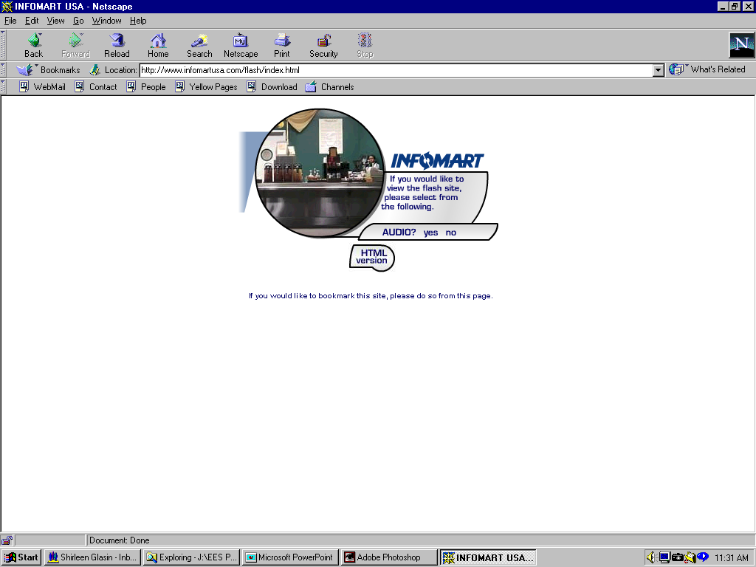






















Enron’s Retail Energy Customers
Manufacturing
High Technology
Hotels / REITs
Lucent Technologies
Bell Labs Industries
Food Processing
Sports Venues
Financial Institutions
Public Sector/Institutions

Slide 21
Enron Retail in Europe
Marketing Offices in London, Frankfurt, Stockholm and Amsterdam
670 Employees
Successfully Expanding U.S. Relationships to Europe
Rolling Out Energy Outsourcing to Large European Customers
Significantly Growing Mid-Market Commodity Business
Customer Segments Include:
Retail Establishments
Transportation
Government

Slide 22
Energy
Communications
Transportation
&
Distribution
Wholesale
Energy
Retail
Energy
Broadband
Services
Enron
Net Works
Bandwidth Management and Broadband Delivery Services
Traditional
New
International
(over 30 countries)

Slide 23
Enron Broadband Services
Enron
Intelligent
Network
Bandwidth Intermediation
Deploy the Most Open, Efficient Network with Broad Connectivity
Content Services
Be the World’s Largest Provider of Premium Broadband Delivery Services
Be the World’s Largest Buyer and Seller of Bandwidth
Fiber
Servers
Pooling Points
Software
Bandwidth Marketing
Comprehensive Bandwidth Management
Delivery of Streaming Content
Data Management Services
Replicating Enron’s Wholesale Energy Experience and Skill Base in a Highly Scalable, Efficient Broadband Strategy

Slide 24
Key EBS Metrics
Total Headcount
Fiber Route Miles
1,100
18,000
15,000
775
12,325
490
5,538
89
1,755
25
1997
1998
1999
2000E
2001E
1997
1998
1999
2000E
2001E
Servers
Pooling Points
3,000
40
1,500
13
0
0
222
0
0
3
1997
1998
1999
2000E
2001E
1997
1998
1999
2000E
2001E

Slide 25


Network Connectivity
_{Europe}
_{Asia}
Fiber
Servers
Markets
Pooling Points
Unlimited, Real-Time Bandwidth Access with
End-to-End Control

Slide 26
Energy
Communications
Transportation
&
Distribution
Wholesale
Energy
Retail
Energy
Broadband
Services
Enron
Net Works
IT Commercial Synergies
Traditional
New
International
(over 30 countries)

Slide 27
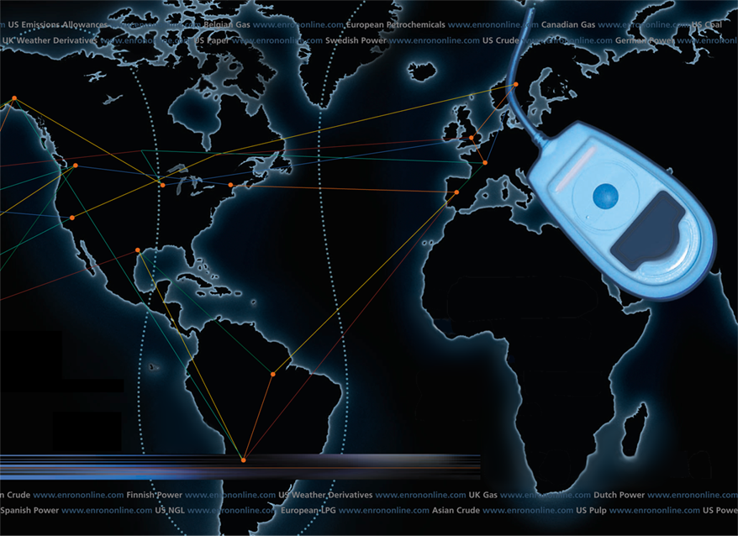
EnronOnline
TM
Putting the Energy into e-commerce
TM

Slide 28
The Internet Fastest Social Change in History
U.S. Users (Millions)
Radio
Television
Cable
Internet

Slide 29
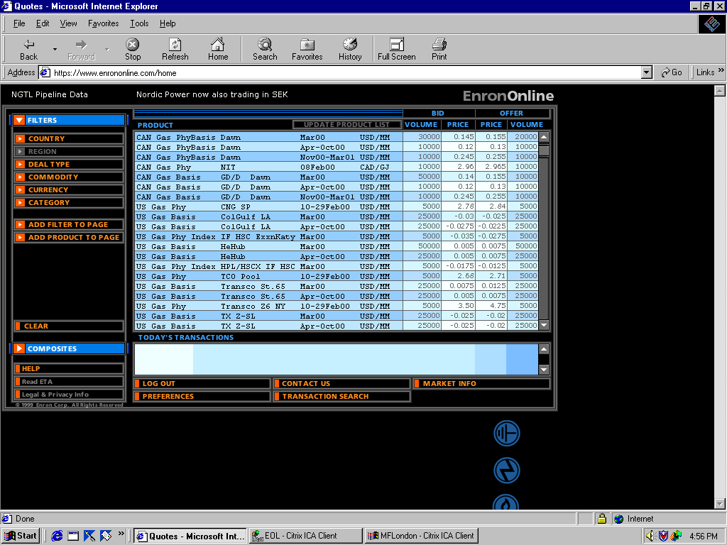
EnronOnline Extending Enron’s Products to the Internet
Free, Reliable Transaction System with Enron as Principal
Fully Integrated into Enron’s Established Risk Management and Logistic Processes
Utilizing Site to Offer Energy-Related Auction Capabilities
Expands Enron’s Information Base and Market Knowledge
“Tried and Tested” Platform for Expanding Enron’s
eCommerce Activity

Slide 30
EnronOnline vs. Traditional Channels (as of June 9th)
Volume
Transactions
EnronOnline
Traditional

Slide 31
Mass Customization Enron Risk Products
EnronOnline: 1000 products
Gas
Electricity
Liquids
Other

Slide 32
Enron’s Evolution

Slide 34
Creating a New Energy Model
Traditional
Energy Major
Hardware intensive
Vertically integrated
Geographically dominant
Commodity-price dependent
Hierarchical
New Energy Major
Intellectual intensive
Network integrator
Online Reach
Differentiation dependent
Entrepreneurial

Slide 35
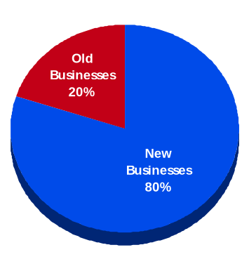
Enron IT Expenditures: New Businesses ($ Millions)
*Exclusive of $96 million budgeted for new-building IT purchases

Slide 36
Intellectual Capital
Enron Employees
Analyst/Associate – New Hires
17,900 Employees Worldwide 3,560 Employees have Advanced Degrees 8 Year Average Enron Experience Over 50 Languages Spoken 7% Growth in New Jobs Expected in 2000

Slide 37
Management Strategy: Tight and Loose
Tight Controls
Enron Values
Financial accounting
Risk management
Performance reviews
Legal obligations
Loose Controls
Organization
Creativity/new business ideas
Work schedules
Working environment
Dress code
Floor design
Providers of equipment/services

Slide 38
What’s New

Slide 39
MG Acquisition
MG, the world’s leading publicly traded metals marketer, was purchased by Enron Metals will be added to EnronOnline Expansion of core competencies
EnronOnline platform for greater liquidity
Segue to energy-intensive producers
Financing opportunities from Enron balance sheet

Slide 40
New Power CompanyTM
First national provider of energy and related services to residences and small businesses in deregulated markets
A partnership of industry leaders: Enron, AOL, IBM
Initial investment of $120 million
First customer sign-up in Pennsylvania and New Jersey later this year

Slide 41

Azurix Stock Price Since Inception
High
23.75
Issuance
19.00
$
Present
4 15/16
© 2000 RB-Economy-0100-<number>

Slide 42
Endless Possibilities
Networks
Energy &
Communications
Energy
®

