Slide 1
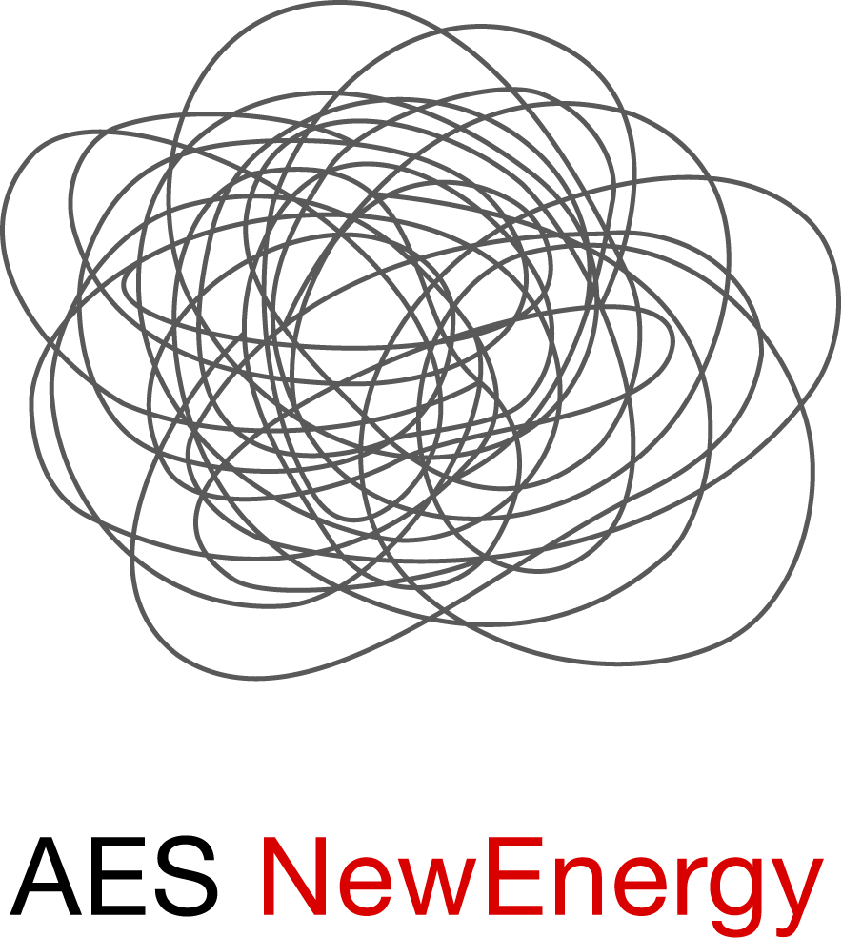
America’s Leading Retail Energy Services Provider
AES NewEnergy’s Initial View on the Proposed Alliance RTO
Illinois Commerce Commission
Energy Policy Committee
July 11, 2001
Prepared by Mario Bohorquez
Chicago (312) 704-9212
mbohorquez@newenergy.com

Slide 2
AES NewEnergy
Retail marketer of energy supply and energy services to C&I and institutional customers
Actively selling power in thirteen open-access states
Currently selling about 3 Million MWh annually in ComEd’s Control Area
Multi-year wholesale and retail supply contracts

Slide 3
AES NewEnergy supports an Independent RTO/ISO
We are generally supportive of an independent transmission organization that forms the basis for a robust, efficient and competitive electricity market.
ICC should actively encourage divestment of transmission assets to the RTO.

Slide 4
We are concerned:
Many important details have not been finalized. There is much risk/uncertainty at this time.
Will the cost of managing risks be so great that ARES will not be able to compete with PPO or bundled rates?
Will there be unmanageable risk on implementation date?
Will ComEd require day-ahead balanced schedules?
Who will forecast ARES’s load day-ahead?
Who will bear load forecast risk?

Slide 5
Major Issues:
Will the price of eliminating pancake rates be higher than ComEd’s current rates? If the answer is yes, then…
Would higher transmission costs translate to lower delivered electricity prices due to greater liquidity and wholesale access?
In the near term, the potential benefits will not be available to hedged retail books or retail customers with fixed price contracts that extend beyond December 15, 2001.

Slide 6
Major Issues (Cont.):
The timing of new transmission rates (December 15, 2001) may endanger the viability of ARES’s retail contracts that run into 2002 and beyond.
The timing gives ComEd an unfair marketing advantage for the PPO since the MVI tariff accounting methodology for transmission costs is not scheduled for revision until 2003; accordingly, established PPO rates may understate transmission charges starting December 15, 2001.

Slide 7
Final Thoughts:
The devil is in the details. The details (yet to be finalized) need to be carefully reviewed and understood by all.
The biggest detail: The new transmission rates
Examples of other unresolved details:
Will the physical attribute of Flow Gate Rights result in inefficient use of resources making electricity more expensive?
Will the final pricing methodology selected by the ARTO send the correct price signal to encourage efficiency and investment where it is needed?

Slide 8
Final Thoughts (cont.)
FERC Tariff filings and proceedings are too opaque.
The ICC should encourage current transmission providers to hold informational seminars with Retail Energy Suppliers (network service customers) to review, explain and seek advice on upcoming changes as they develop, particularly as they relate to network transmission service for retail load.

